Slide 1
JavaScript: project 3
Conway’s Game of Life
Hamel Patel
Joana Ibarra
Joshua King

Slide 2
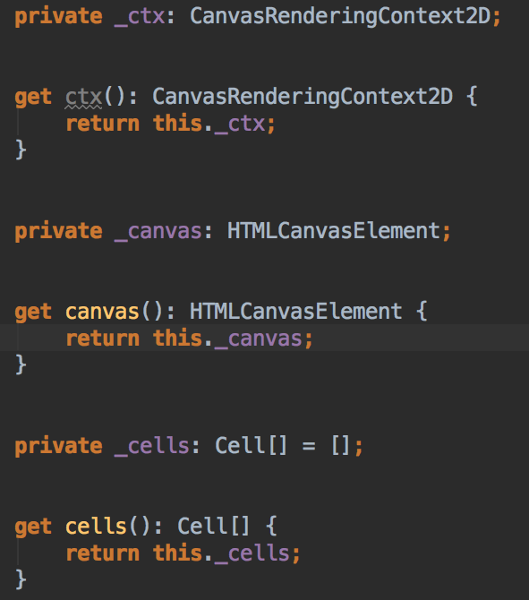
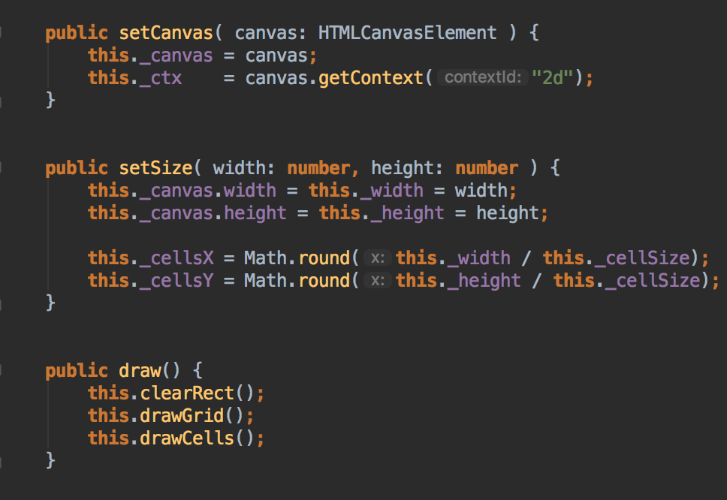
Grid
Index.html
Grid.ts

Slide 3
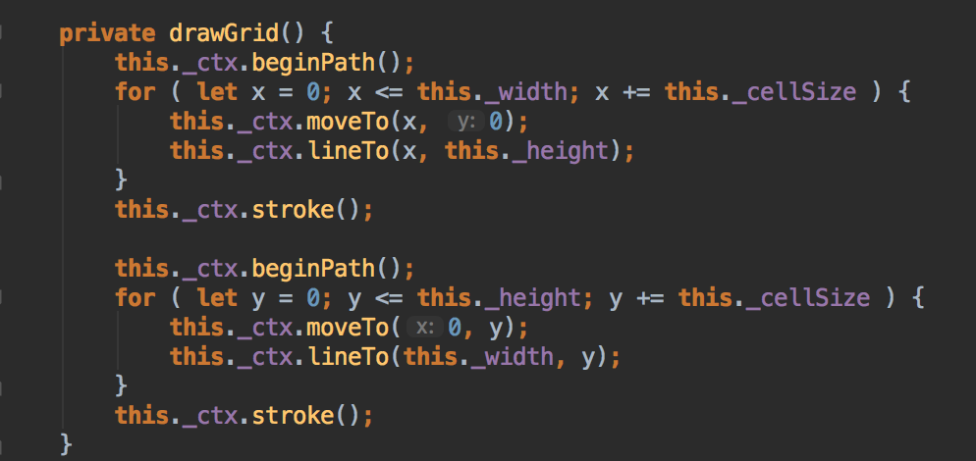

Grid cont’d

Slide 4
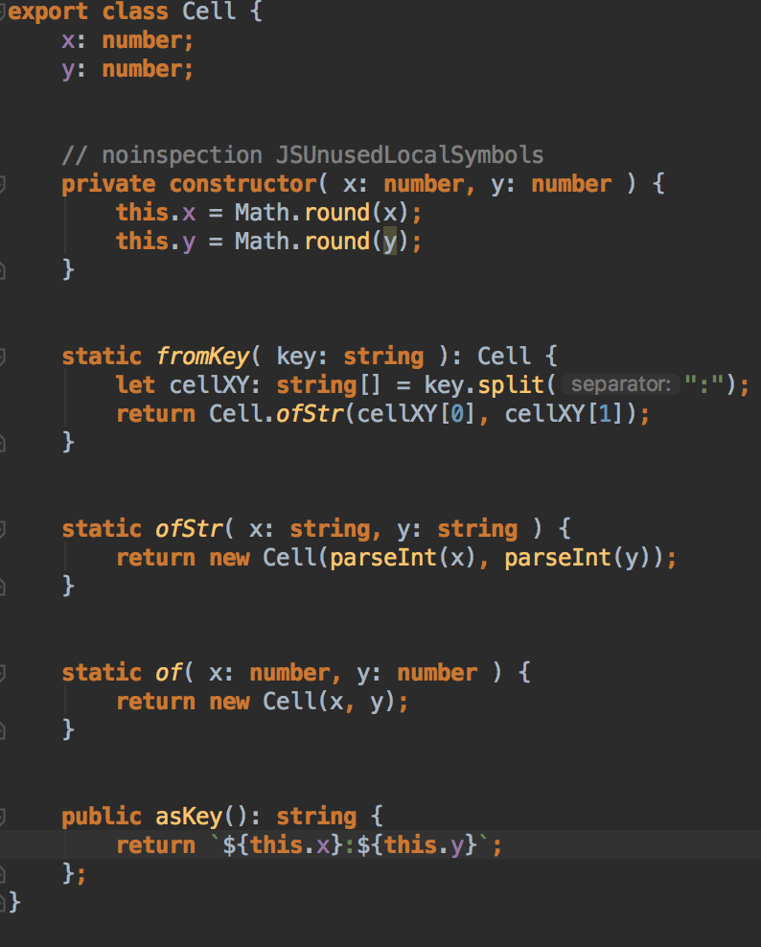
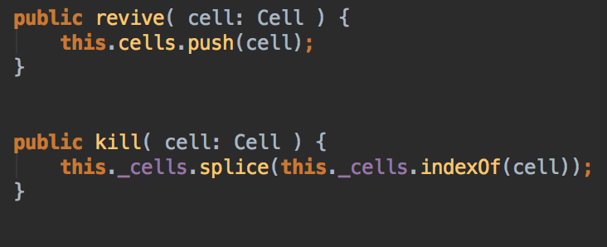
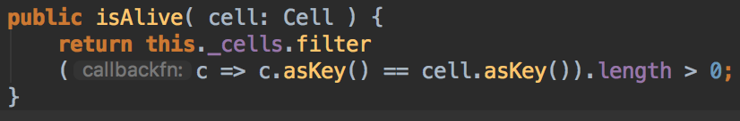
Mouse Events
Cell.ts
Grid.ts

Slide 5

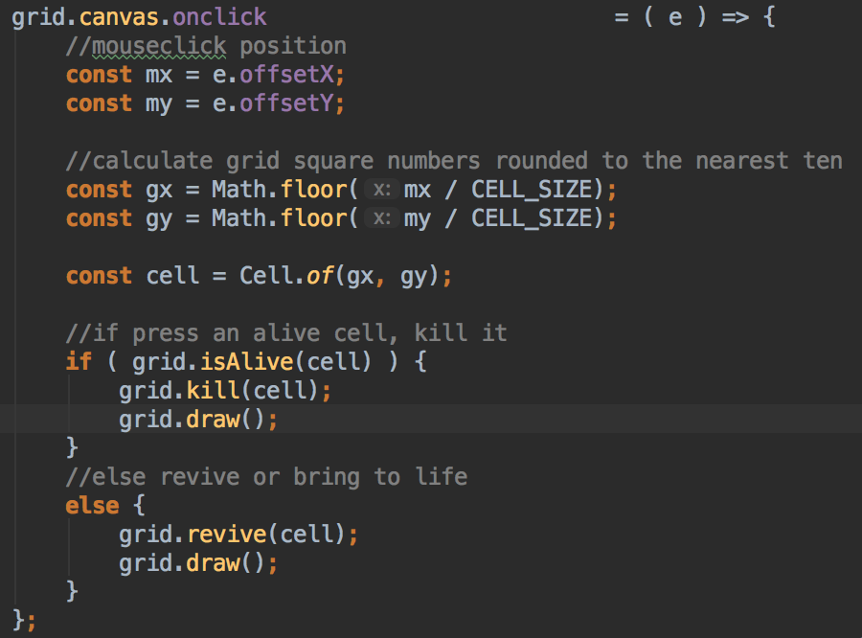
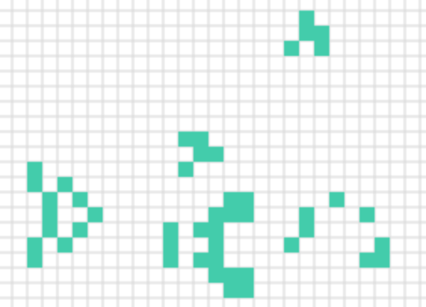
Mouse Events cont’d
main.ts
Dead (or Killed) Cell ➡
Alive (or Revived) Cell ➡

Slide 6
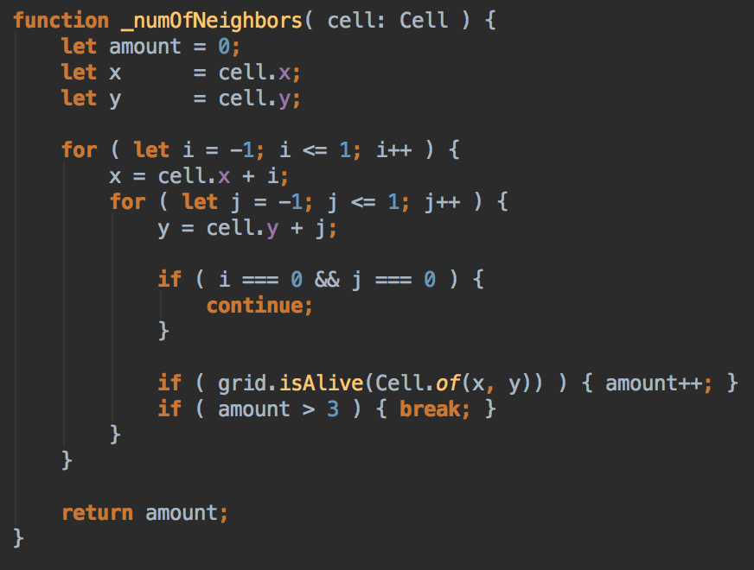
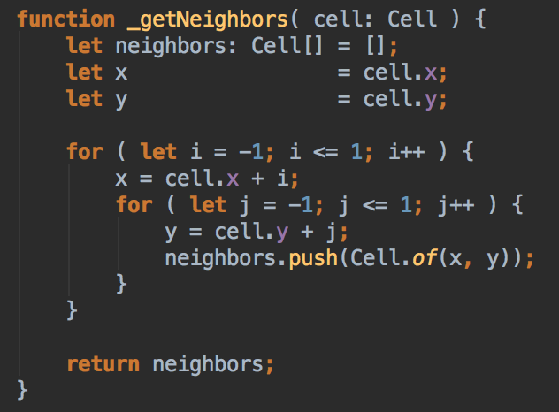
Logic
Grid.ts

Slide 7
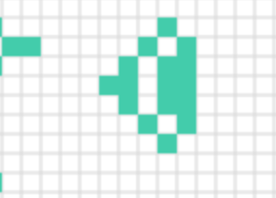


Logic cont’d
Previous 2 functions shown provided within our step() function.
Its functionality allows a user to see step by step what is going to happen next on our grid element.
i.e.

Slide 8
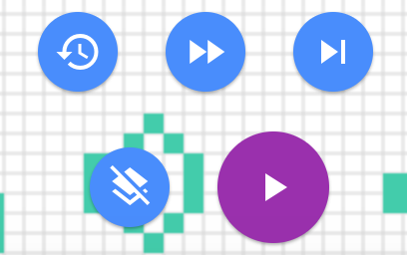
Other Features
Buttons found at the bottom right of our grid.
Play: begins playthrough
Pause: shows after ’Play’ is clicked
Restore all initial life
Clear all life: Every cell is killed
Next step: advance play one step at a time
23rd next step: advance play quicker
A resizable grid (accustomed to your window size).

Slide 9
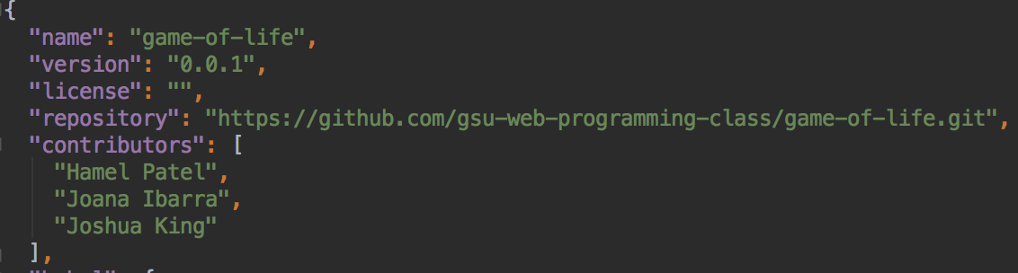
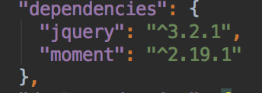
JSON examples within project:

