Slide 1
Virtual Travel Agency Final Project
Hamel Patel
Joana Ibarra
Josh King

Slide 2
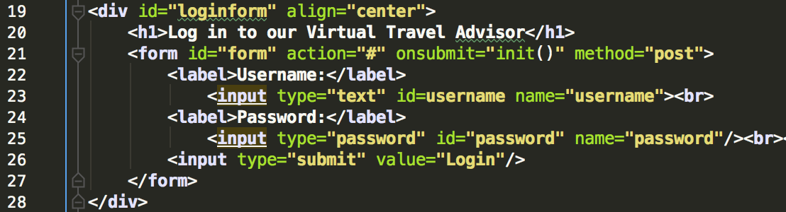
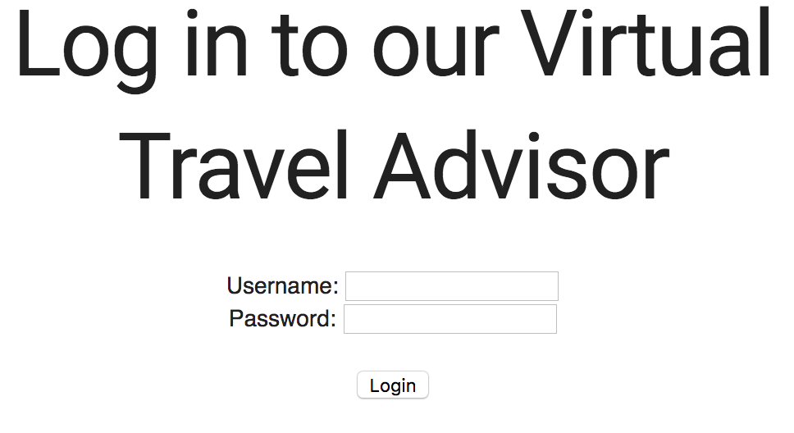
HTML
Used to create are forms for basic views
In example: login form, login.index.html
uses onsubmit for validation in javascript

Slide 3
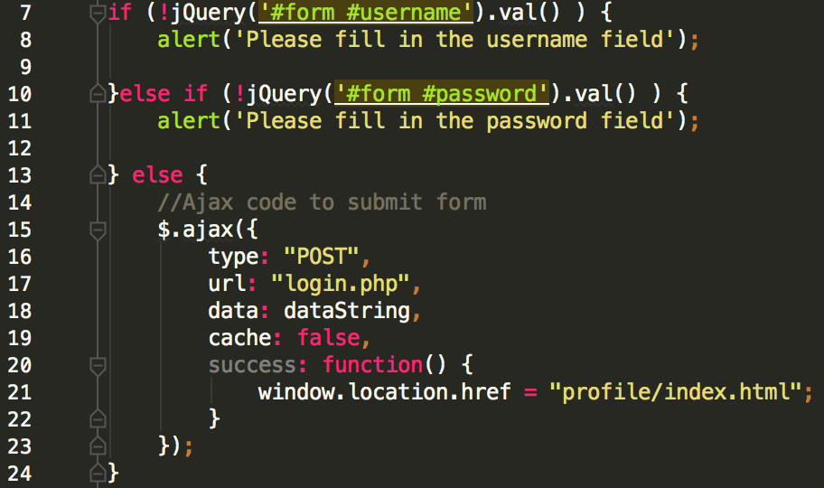
JavaScript, Ajax and jQuery
jQuery used for efficient validation of html form(s)
If all fields are just fine, ajax is used to submit the form and post to out “login.php” file
onsucess, redirect to profile/index.html

Slide 4
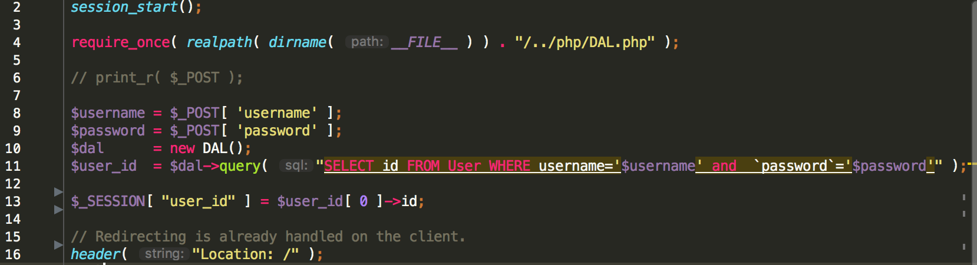
PHP and mysql
PHP files make use of session variables to preserve a sessions valid information while it lasts
Values are queried directly from our database with the help of our DAL.php file and then stored in a session variable to use for whatever the user is currently working on (ie. Login view, cart view, etc.)
Example:

Slide 5
DAL.PHP
Snippets of dal as it relates to our database
ADD screenshots of work on the brower and its specific code snippets (?)

