Slide 1
Virtual Travel Agency Final Project
Hamel Patel
Joana Ibarra
Josh King

Slide 2
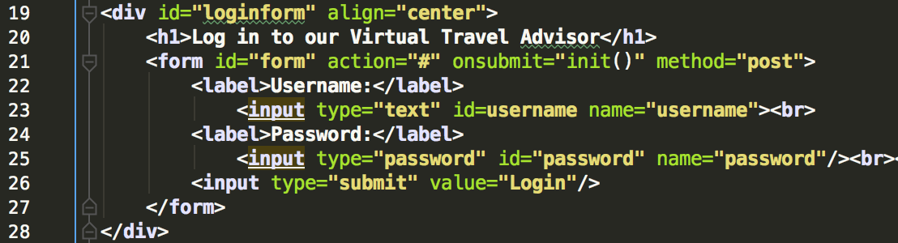
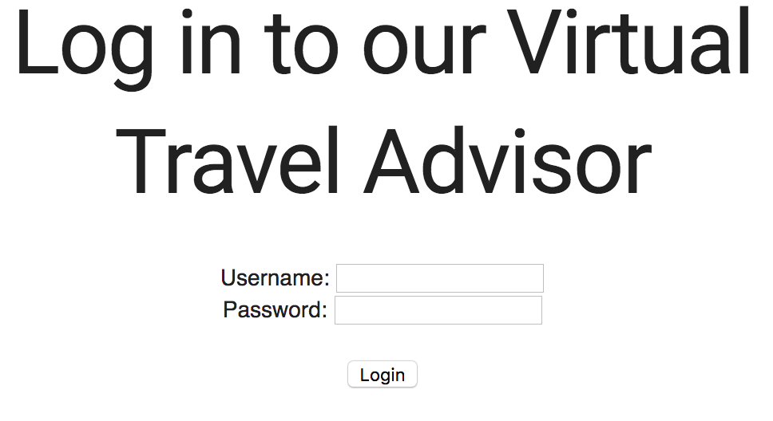
login/index.html
Used to create are forms for basic views
In example: login form, login.index.html
uses onsubmit for validation in javascript

Slide 3
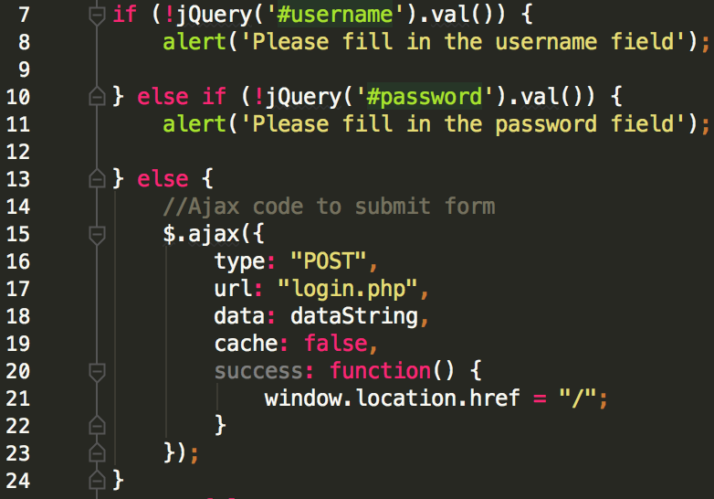
JavaScript, Ajax and jQuery
login.js
jQuery used for efficient validation of html form(s)
If all fields are just fine, ajax is used to submit the form and post to out “login.php” file
onsucess, redirect to profile/index.html

Slide 4
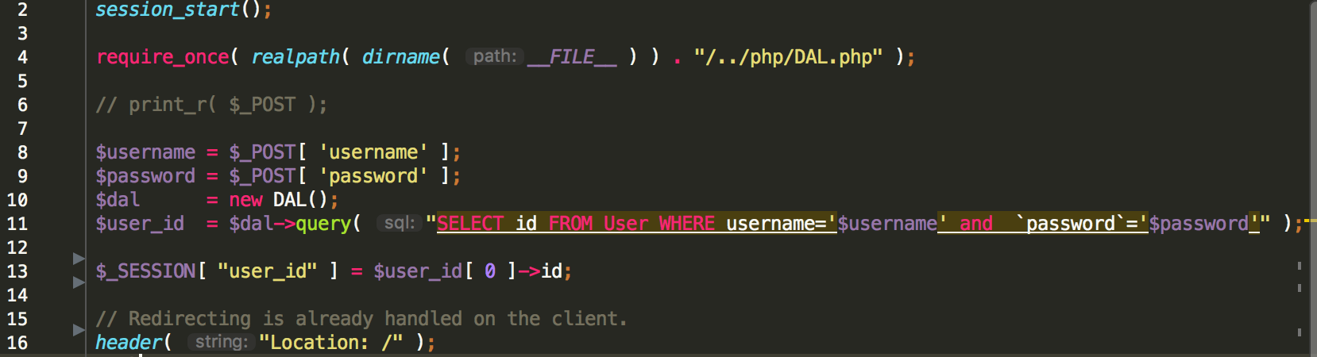
Login.php and mysql work
PHP files make use of session variables to preserve a sessions valid information while it lasts
Values are queried directly from our database with the help of our DAL.php file and then stored in a session variable to use for whatever the user is currently working on (ie. Login view, cart view, etc.)
Example:

Slide 5
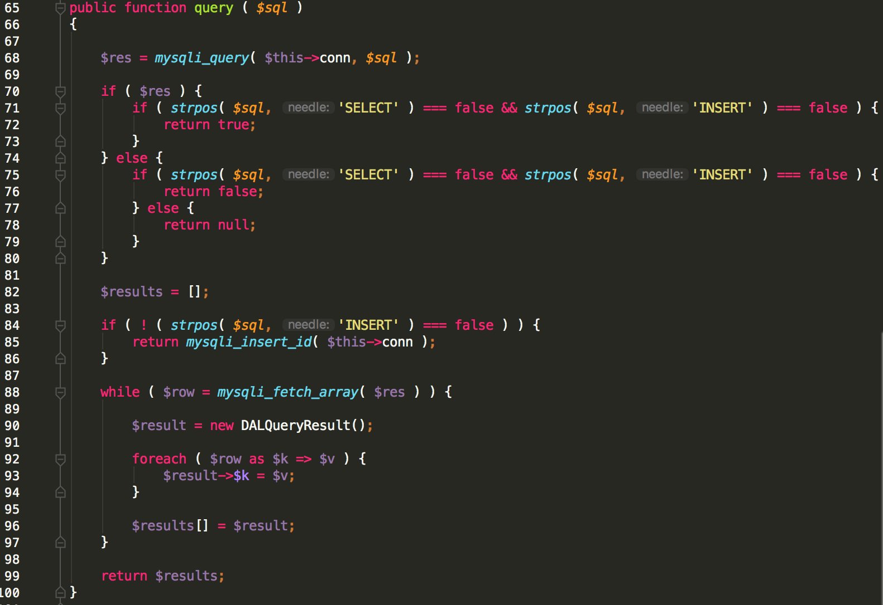
DAL.PHP
This file allows us to easily query our database to assist setting session variables.
Here’s a bit of how it works:
Then a variable $dal = new DAL();

Slide 6
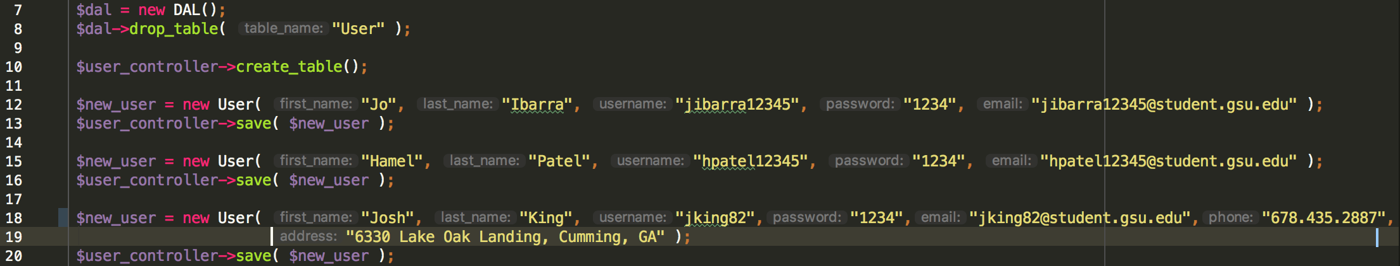
Using DAL to create our user logins

Slide 7
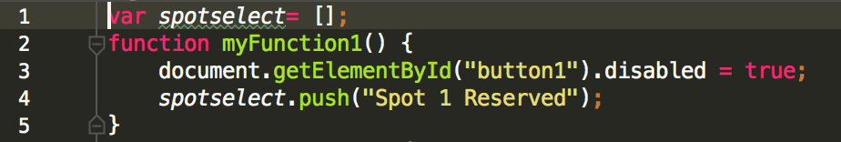
Parking.html
Parking spots are buttons arranged on a table positioned by their class.
Parking.js
JavaScript functions allow user to distinguish selected or reserved spots versus those that are still available.

Slide 8
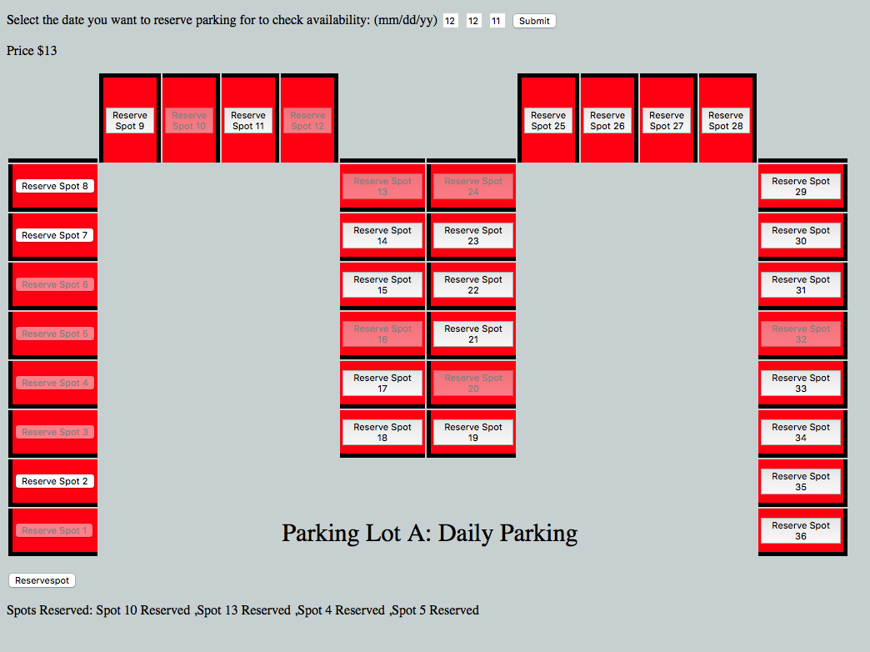
Parking View in browser

Slide 9
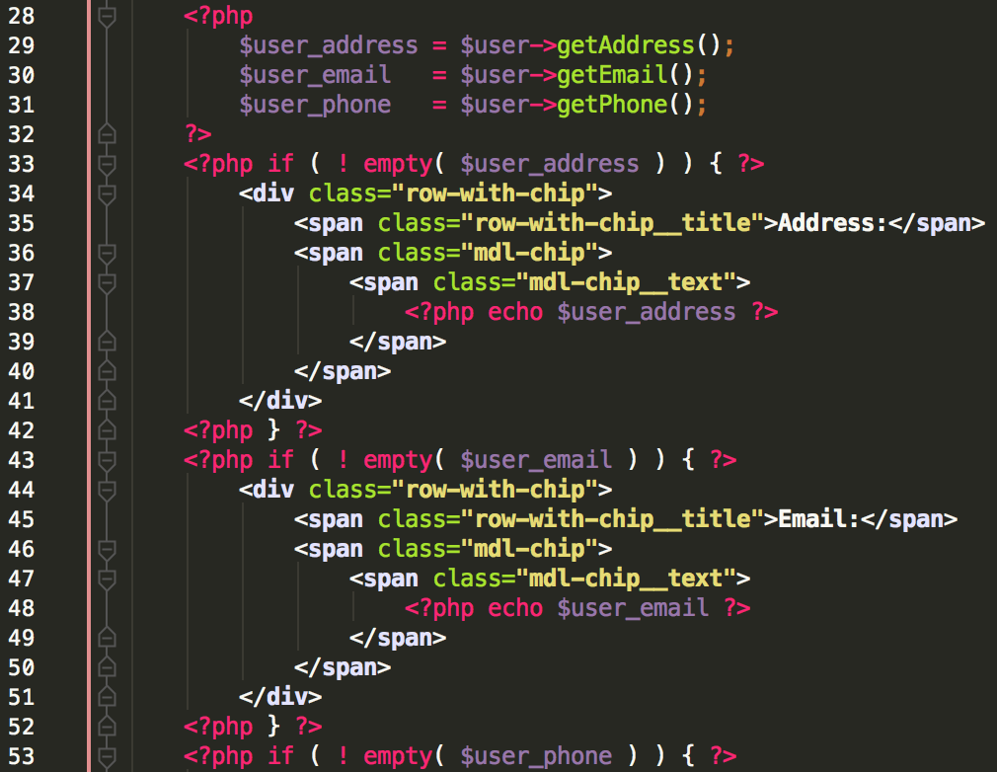
Profile/index.php
On login you are directed to your profile, as shown in the login code snippets.
Index.php makes sure all of our needed values are posted to the user profile and displayed with style.
Example shown to right highlights check for all values and how it is to be laid out on Profile

Slide 10
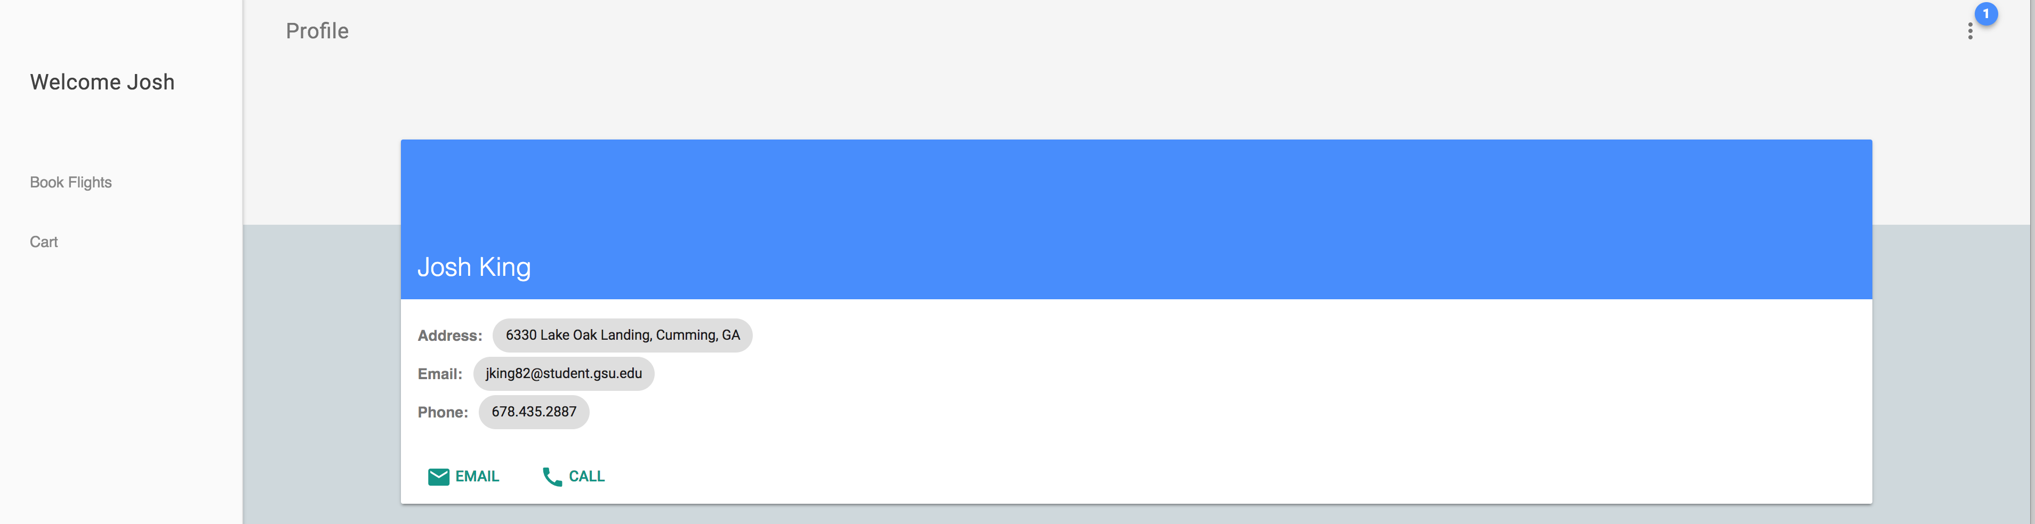
Profile/index.php
So on login this is what you see
A separate .scss file was also used for styling purposes
From this page you can redirect to flight booking, your cart, logout, etc.

