Slide 1

Jenkins
Sudarshan

Slide 2



Agenda
Github
CI\CD\CD Pipeline

Slide 3




Introduction

Slide 4
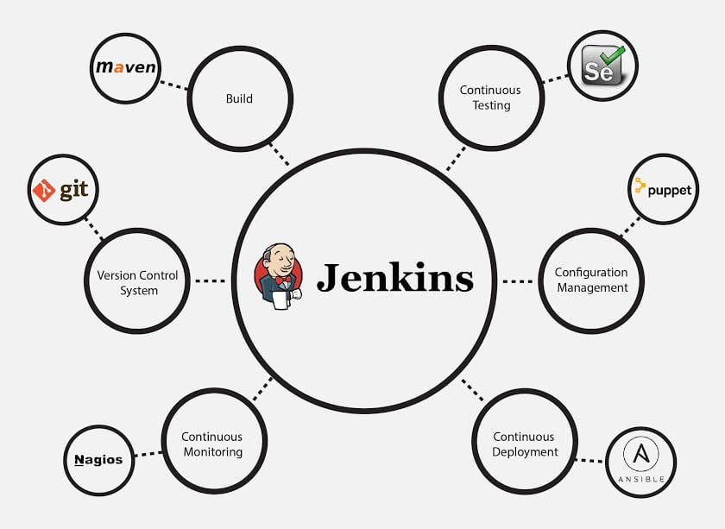

Topic one
Subtitle

Slide 5
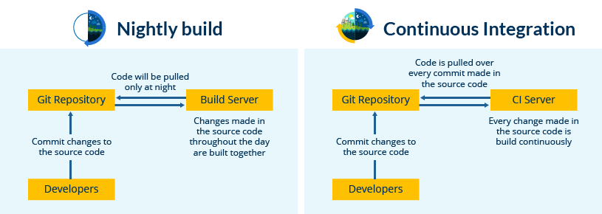

Slide 6
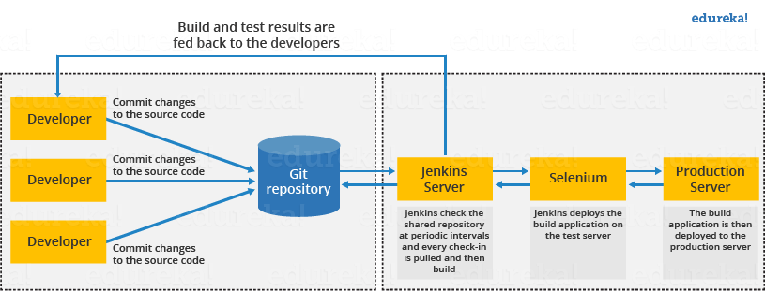
Timeline

Slide 7
Before and After Jenkins
Before Jenkins | After Jenkins
The entire source code was built and then tested. Locating and fixing bugs in the event of build and test failure was difficult and time-consuming, which in turn slows the software delivery process. | Every commit made in the source code is built and tested. So, instead of checking the entire source code developers only need to focus on a particular commit. This leads to frequent new software releases.
Developers have to wait for test results | Developers know the test result of every commit made in the source code on the run.
The whole process is manual | You only need to commit changes to the source code and Jenkins will automate the rest of the process for you.

Slide 8
Videos
https://drive.google.com/file/d/10Qzjbr_WXVN9TisOpie5xibTsCn1TAu7/view
https://drive.google.com/file/d/10Qzjbr_WXVN9TisOpie5xibTsCn1TAu7/view

Slide 9


Thank You
Presenter name
Email address
Website address

