Slide 1


IPL DATA SCRAPER AND ANALYSIS
Social Web Analytics

Slide 2


PROBLEM STATEMENT
ESPNcricinfo is the most detailed source of cricket data — but lacks an open API.
Their live data is protected with token-based authentication.
Standard scraping tools like BeautifulSoup or Selenium struggled with JavaScript-heavy pages.
Real-time scraping was not feasible due to API security blocks.
Our objective: Analyze IPL ball-by-ball data from 2008–2024.
Solution: Use match-by-match scraping and extract commentary + scorecard data
Notes:
Cricket is a huge sport in India, but the lack of access to public cricket data has always meant the analytical side of cricket left a lot unexplored. This is why we decided to scrape our own dataset from the biggest cricket website, ESPNcricinfo.
S

Slide 3

Playwright (Python): Handles dynamic websites, dropdowns, and scrolling
Python: Core programming language for all logic and processing
Pandas: DataFrame manipulation and transformations
ujson: Ultra-fast JSON parsing from scraped data
Plotly & Matplotlib: For interactive and static data visualizations
Excel: Stored and looped through 1000+ match IDs for scraping
TECHNOLOGY STACK

Slide 4

PROJECT WORKFLOW
Goal: Match IDs for all IPL games (2008–2024) collected and stored in Excel for analysis
Step 1: Playwright script scrapes one match at a time: commentary + scorecard.
Each match’s data saved as a structured .json file.
Step 2: A transformation script converts all JSONs into a single master DataFrame.
Step 3: Final DataFrame analyzed using custom plots and visual insights.

Slide 5
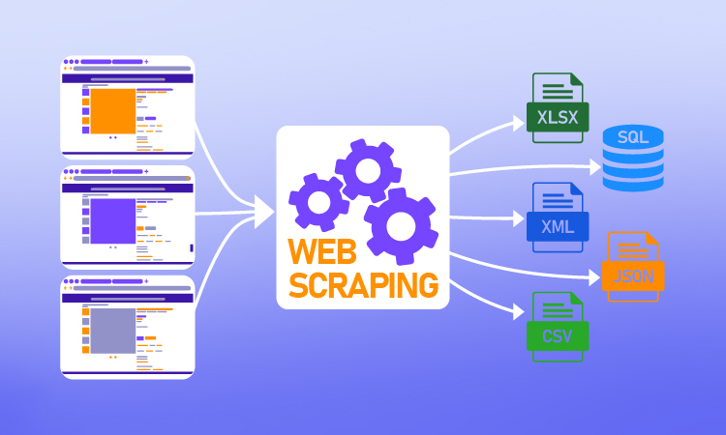
THE SCRAPER
espn_scraper.py
Visits each match page on ESPNcricinfo.
Navigates between tabs: Scorecard and Commentary
Handles:
Dropdown menus for innings
Infinite scrolling to load full commentary
Network sniffing to capture hidden JSON APIs
Saves all extracted info as a .json file per match.

Slide 6

SCRAPER LOOP
espn_scraper_loop.py
Automates scraping for all matches using match IDs from Excel
Calls the main scraper script for each match sequentially
Took ~24 hours to scrape 17 full IPL seasons
Generated over 1000 JSON files containing ball-by-ball data

Slide 7

JSON TO DATAFRAME
json_to_df.py
Each JSON file contains nested structures: innings, players, match info, ball-by-ball info
Script extracts over 60 detailed features per ball
Includes metadata: player names, shot types, pitch zones, dismissal type, batting position, win probability, and more
All files combined into a single Pandas DataFrame

Slide 8

SUMMARY STATISTICS
📦 Matches processed: 1000+
🔢 Total deliveries analyzed: ~3 million
👤 Unique players: Over 800
🏟️ Venues covered: 40+
🧾 Total features/columns in final DataFrame: 60+
Built one of the most granular IPL datasets using public web data

Slide 9
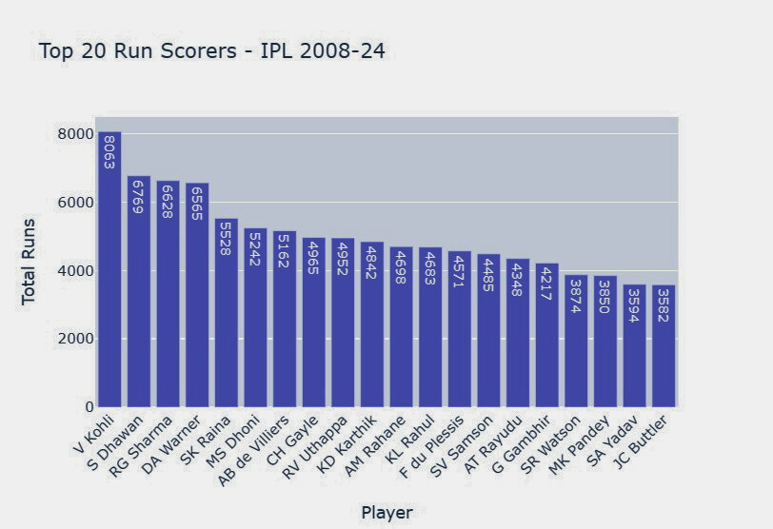
TOP 20 RUN SCORERS (2008–2024)
Aggregated runs scored by each player across all seasons
Top scorers include:
Virat Kohli
Suresh Raina
David Warner
Rohit Sharma
Shows consistency and dominance over time
Displayed via an interactive bar chart with total runs per player
@reallygreatsite

Slide 10
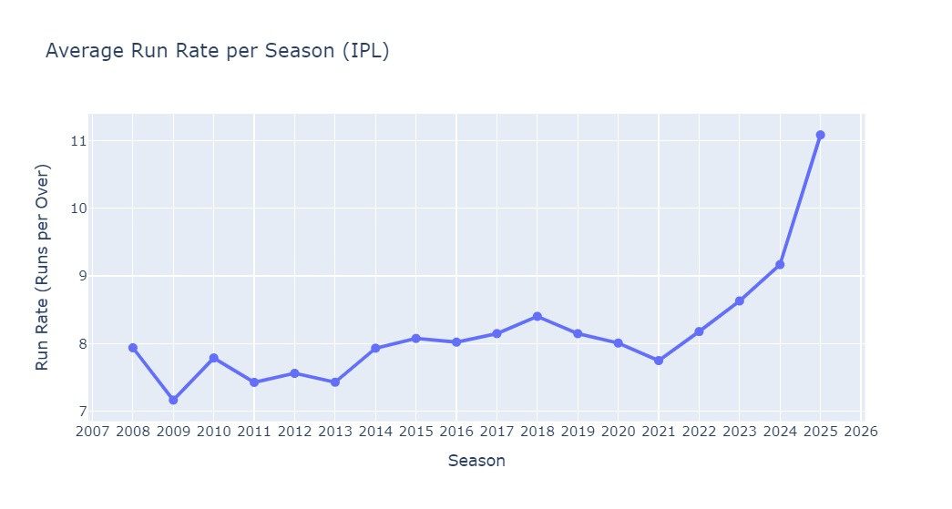
RUN RATE OVER SEASONS
Calculated average run rate = Total runs / Valid overs per season
Clear upward trend: IPL has become more aggressive
2016 and 2024 were particularly high-scoring seasons
Reflects changes in tactics, rules, and batting depth
Displayed using a season-wise line chart
@reallygreatsite

Slide 11
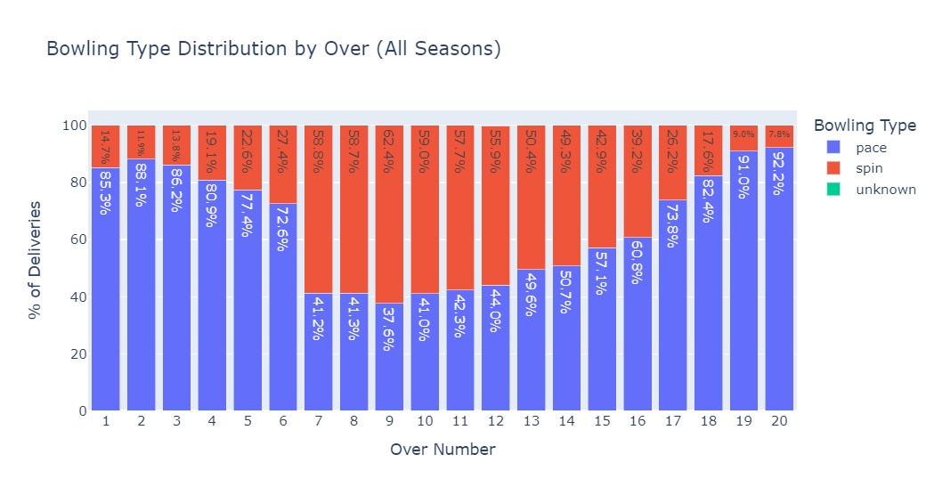
BOWLING TYPE DISTRIBUTION BY OVER
Analyzed % of spin vs pace deliveries across all 20 overs
Findings:
Powerplay: Dominated by pace
Middle overs: Heavy use of spin
Death overs: Pace returns with yorkers and variations
Strategy clearly shifts across phases of the game
Displayed using a stacked bar chart (Over vs Bowling Type %)
@reallygreatsite

Slide 12
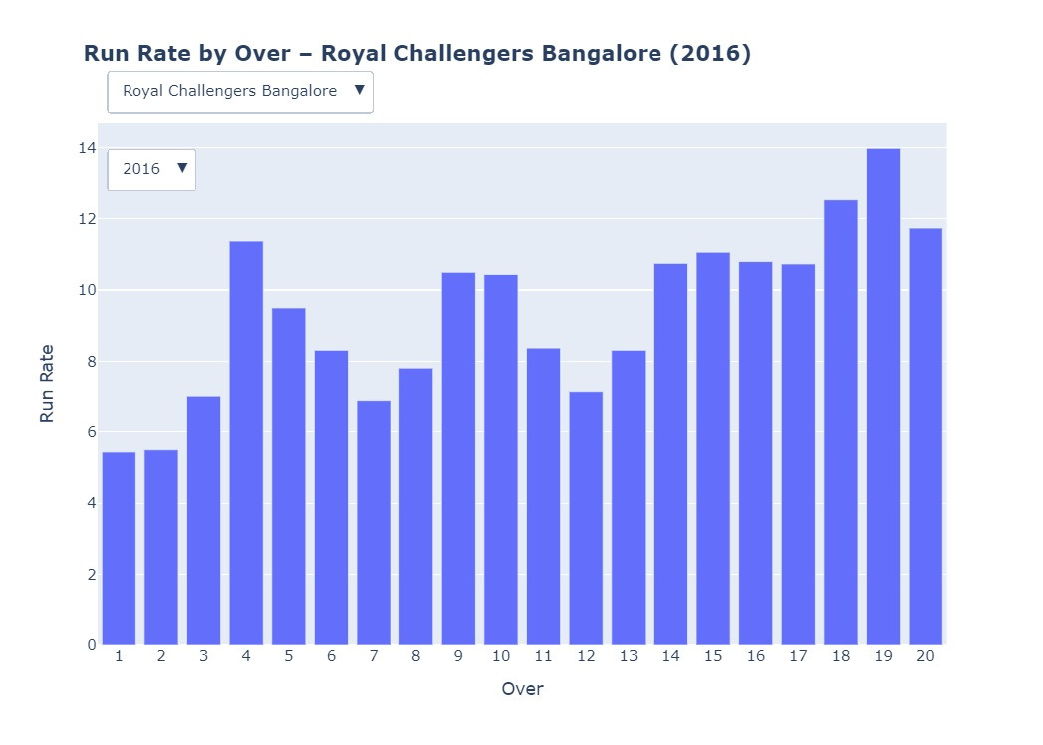
OVER-WISE RUN RATE BY TEAM & SEASON
Built an interactive plot with filters for:
Batting team
Season
Analyzes how teams approach different overs in different years
Example insights:
RCB 2016: High scoring in death overs
CSK: Often conservative early, aggressive late
Dropdowns allow dynamic comparison between seasons and teams
@reallygreatsite

Slide 13
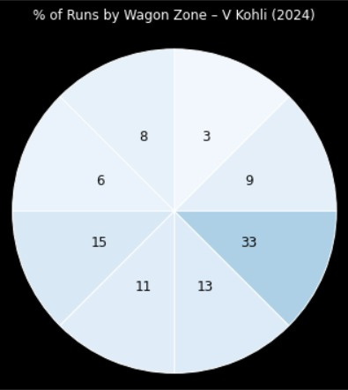
WAGON WHEEL ANALYSIS – KOHLI (2024)
Analyzed where Virat Kohli scored runs using wagon zone data
Divided field into 8 directional zones
Percentage of runs calculated zone-wise
Found strengths in zones 3 and 6 → strong in cover drives and flicks
Displayed using a polar radar-style wagon wheel chart
@reallygreatsite

Slide 14
✅ Built a full scraping + analysis pipeline with no API access
🧠 Extracted and processed ~3 million deliveries
📊 Generated meaningful visual insights using real match data
🔮 Future work:
Enable live scraping (if token obtained)
Apply machine learning for win prediction, player clustering
Build a dashboard for fans, teams, analysts
Collaborate with sports data communities
CONCLUSION & FUTURE SCOPE

Slide 15

THANK
YOU

