Slide 1

Titles
Two rows
Xiulong Yang
Jan 18, 2019
Notes:
Good morning, everyone.
welcome to my qualifier presentation.
My topic is
Now please let me introduce my research briefly.

Slide 2
Papers
Notes:
Do not repeat titles , tell journal and publication year
My talk is based on these two paper. the first one is from ... Using the sparse modeling to do active learning. the other comes from… combine the ensembles and active learning.

Slide 3
Outline
1. Background
2.
2.1
2.2
2.3 Experimental Results
3.
3.1 Methodology
3.2 Experimental Results
4. Conclusion and Discussion
Notes:
The outline mainly has 4 parts.
At the beginning, I will introduce some background like active learning.
Then I’ll dive into the details and results of two papers. The final part is the conclusion and

Slide 4
Reference
[8] Claude Elwood Shannon. A mathematical theory of communication. Bell system technical Journal, 1948.

Slide 5
Thank you!

Slide 6
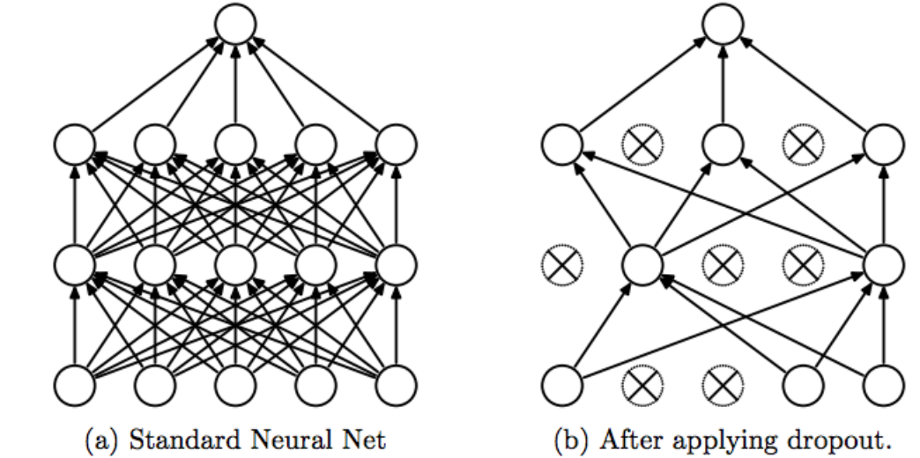
Dropout

