Slide 1
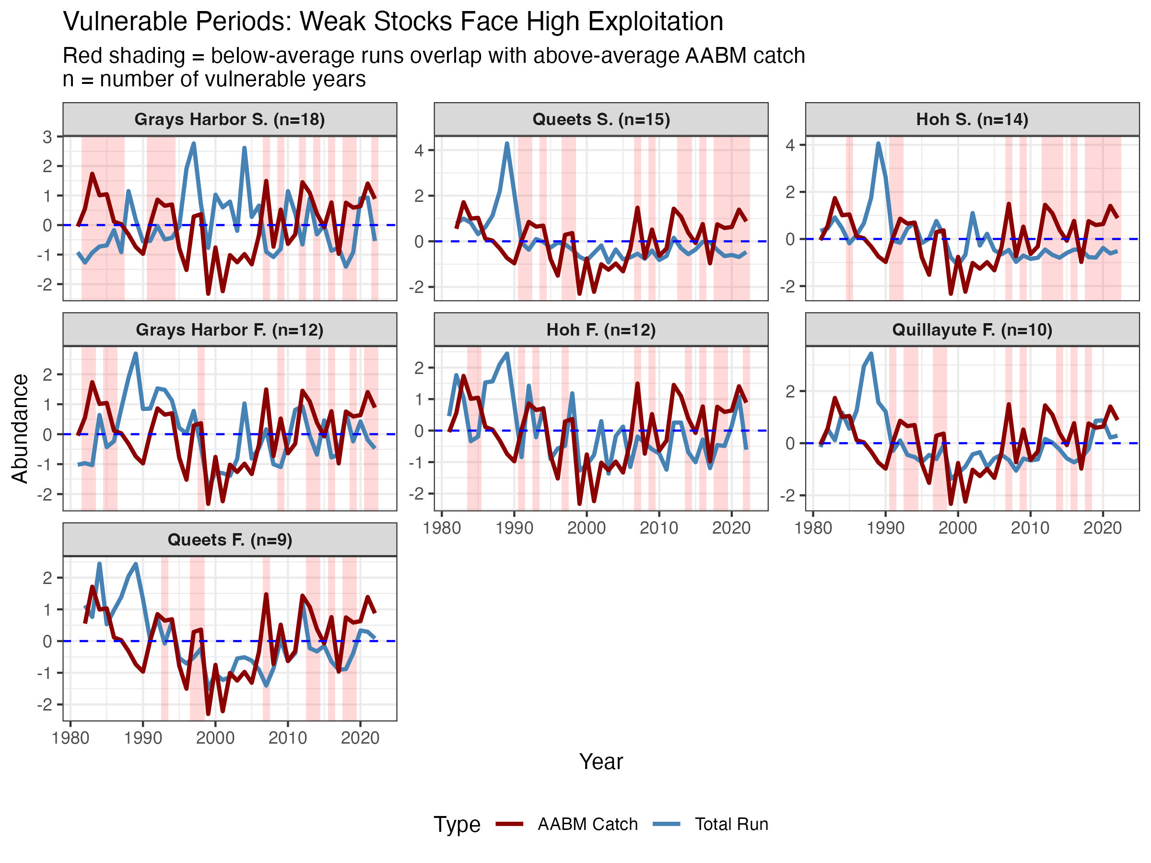
(Mean scaled values))
Data Source: CTC PSC

Slide 2
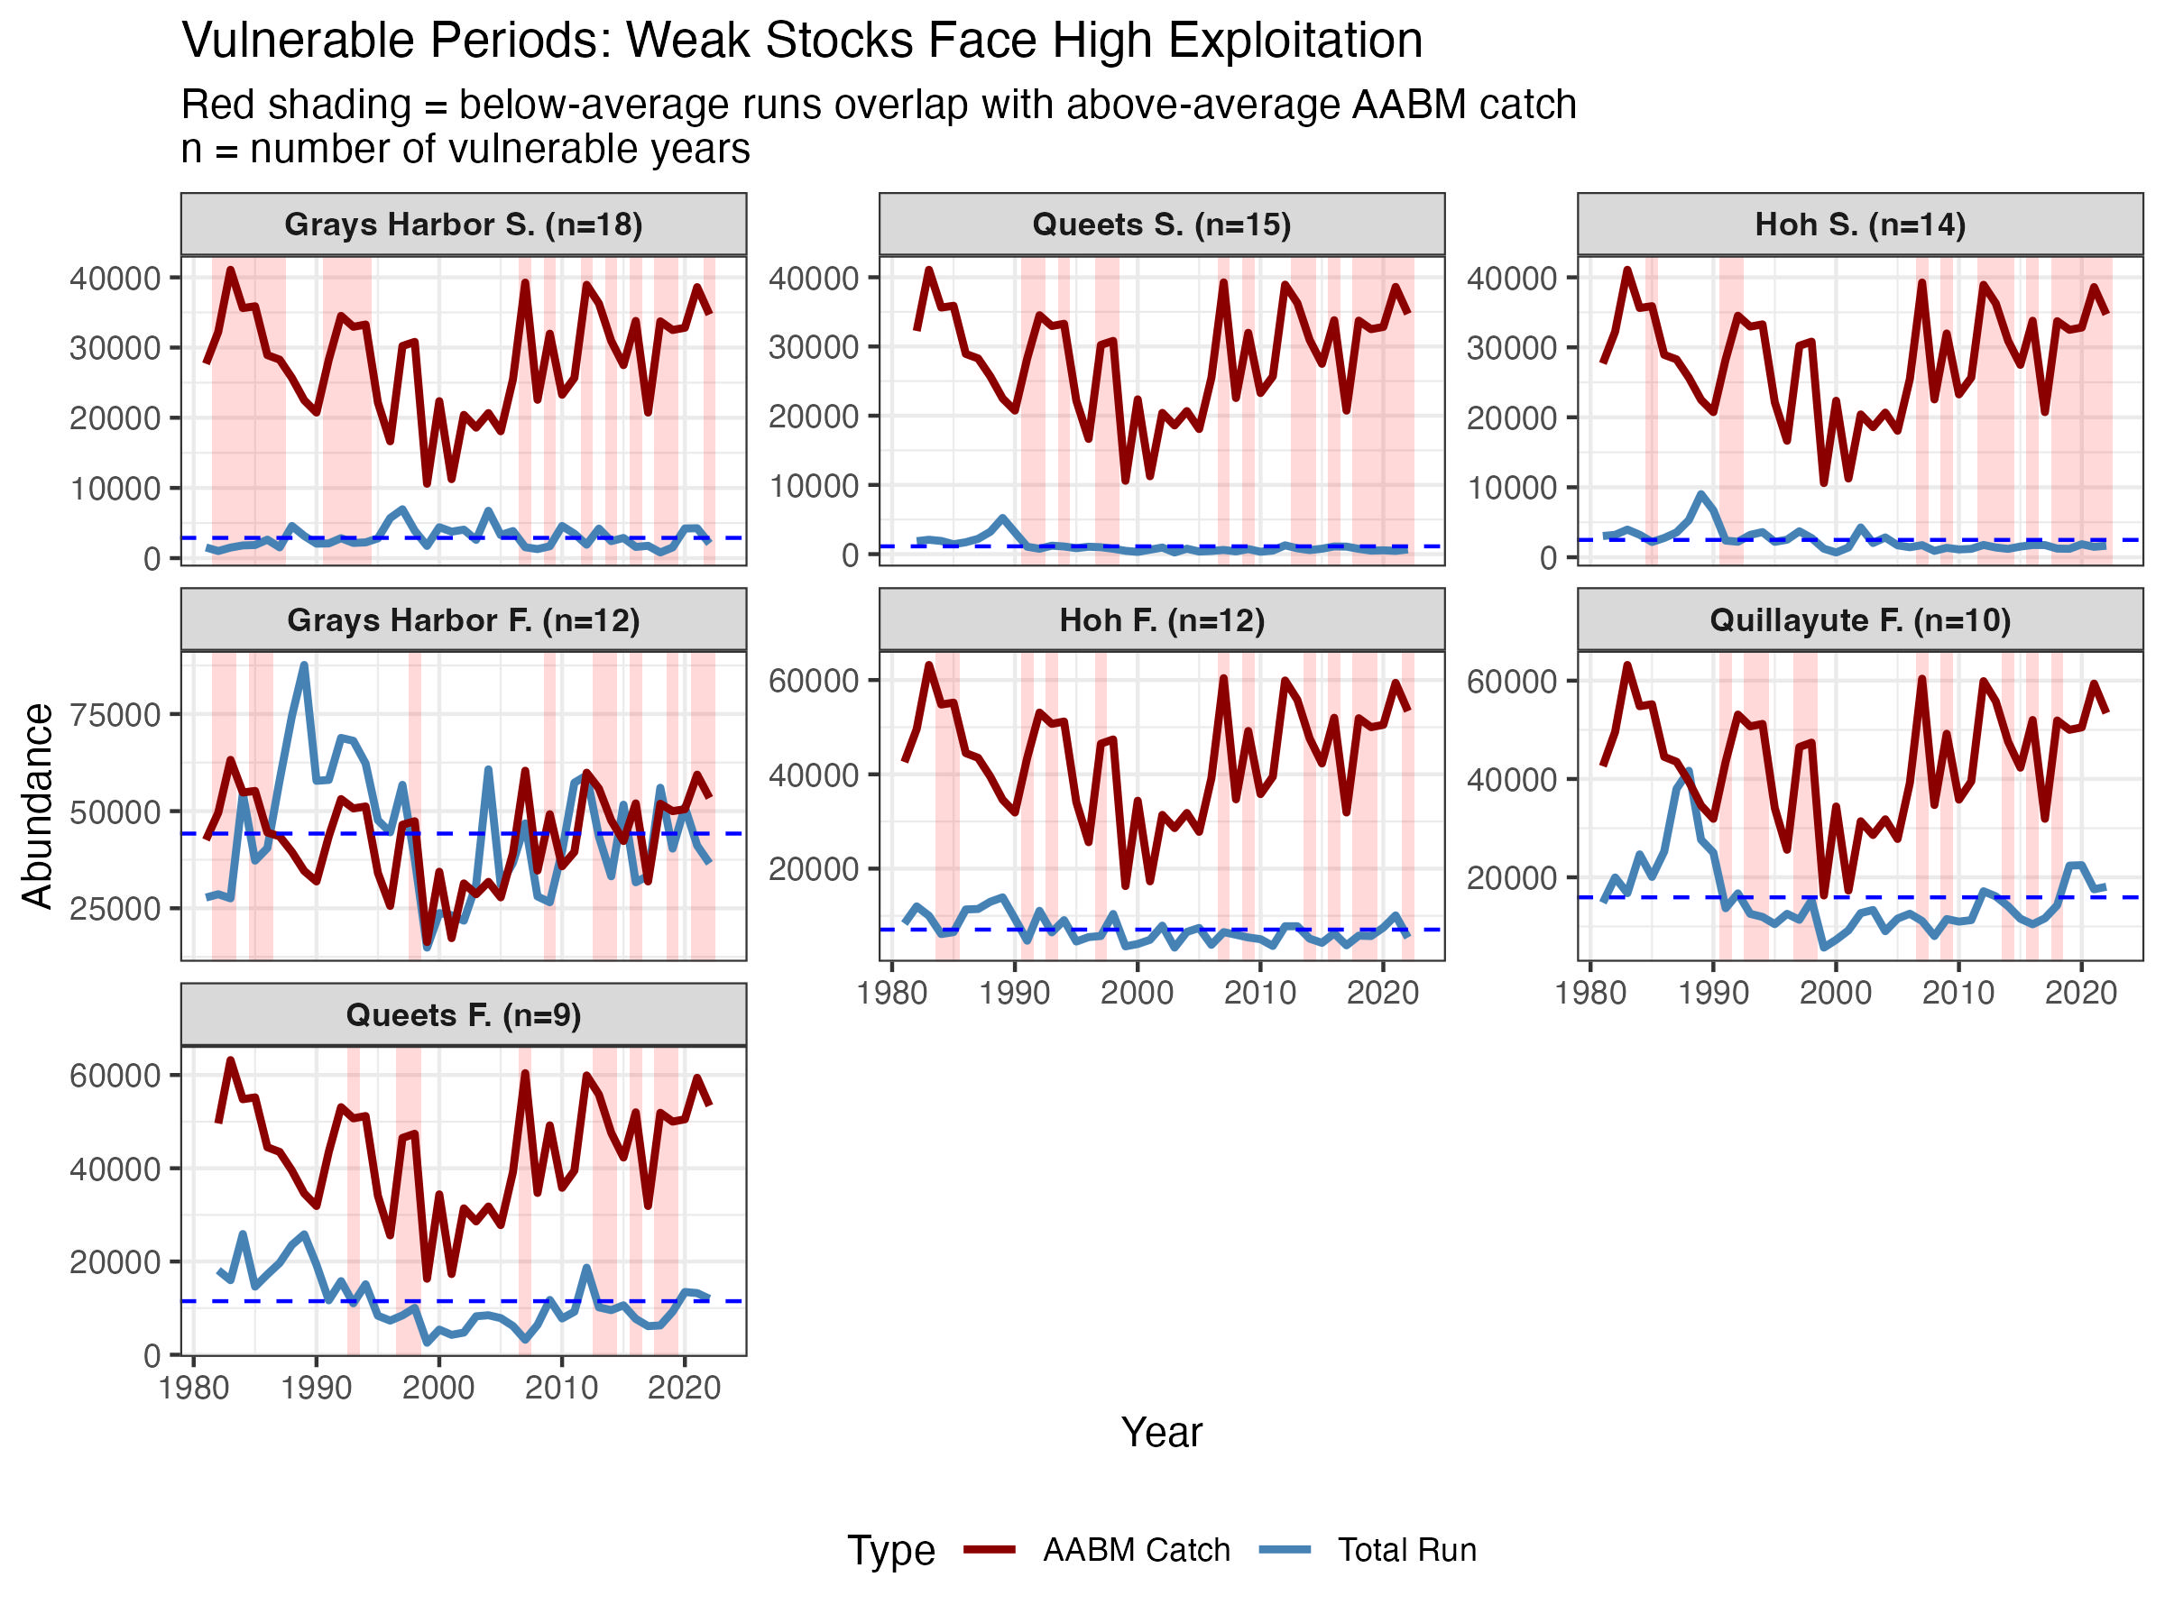
(Raw #s)
Data Source: CTC PSC
Notes:
Theme: Issue with aggregate-abundance: plot total Queets and Hoh runsize v. AABM ERs (SEAK + NBC + WCVI). Show that high harvest rates occur on smaller run sizes (or lack of correlation between OP Chinook run sizes and ERs in AABM).
Data source: CTC/PSC
Script: Plot_AABM_ER, option 3

Slide 3
Size – size declines are happening for many reasons, common trend among stocks across N Pacific. Problem: Management is not accounting for this
Plot 1: Plot size declines
Output from a Linear mixed effects model?
Sensu Ohlberger et al 2018
- Outcome = average mm change in size for each age for the last ~30 years on wa outer coast

Slide 4
Plot 2: Summarize decline impacts on reproduction (using Malick et al)

Slide 5
Plot 3: how would accounting for size declines change escapement goals

