Slide 1

SOAPUI
11/13/2021 Sumit Ghosh

Slide 2
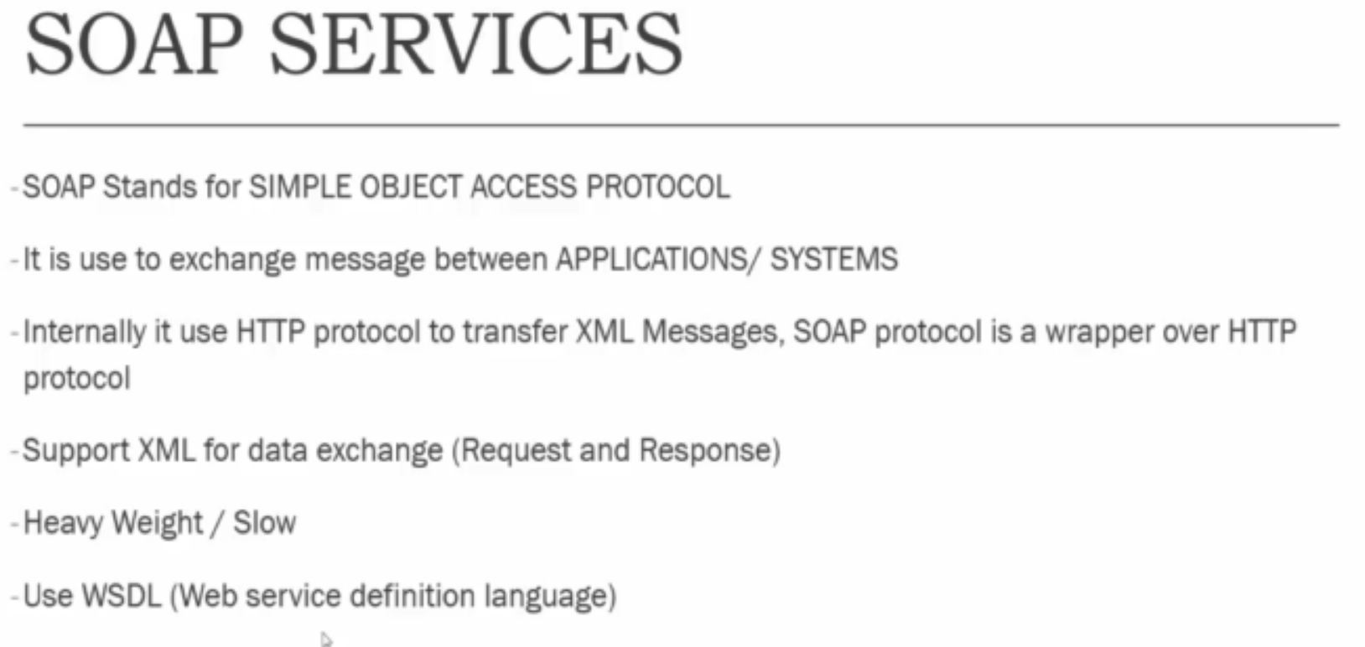
SOAP Services
<soapenv:Envelope xmlns:soapenv="http://schemas.xmlsoap.org/soap/envelope/" xmlns:blz="http://thomas-bayer.com/blz/">
<soapenv:Header/>
<soapenv:Body>
<blz:getBank>
<blz:blz>RBC</blz:blz>
</blz:getBank>
</soapenv:Body>
</soapenv:Envelope>

Slide 3
SOAP Fault
<soapenv:Envelope xmlns:soapenv="http://schemas.xmlsoap.org/soap/envelope/">
<soapenv:Body>
<soapenv:Fault>
<faultcode>soapenv:Server</faultcode>
<faultstring>Keine Bank zur BLZ RBC gefunden!</faultstring>
<detail>
<Exception>org.apache.axis2.AxisFault: Keine Bank zur BLZ RBC gefunden!
at com.thomas_bayer.blz.BLZService.getBank(BLZService.java:41)
at com.thomas_bayer.blz.BLZServiceMessageReceiverInOut.invokeBusinessLogic(BLZServiceMessageReceiverInOut.java:49)
at org.apache.axis2.receivers.AbstractInOutSyncMessageReceiver.invokeBusinessLogic(AbstractInOutSyncMessageReceiver.java:42)
at org.apache.axis2.receivers.AbstractMessageReceiver.receive(AbstractMessageReceiver.java:96)
at org.apache.axis2.engine.AxisEngine.receive(AxisEngine.java:145)
at org.apache.axis2.transport.http.HTTPTransportUtils.processHTTPPostRequest(HTTPTransportUtils.java:275)
at org.apache.axis2.transport.http.AxisServlet.doPost(AxisServlet.java:120)
at java.lang.Thread.run(Thread.java:745)</Exception>
</detail>
</soapenv:Fault>
</soapenv:Body>
</soapenv:Envelope>

Slide 4
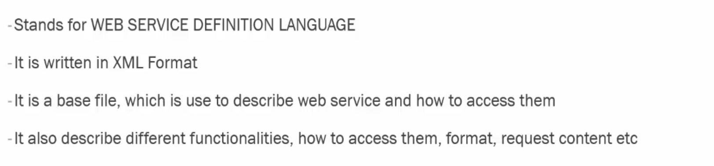
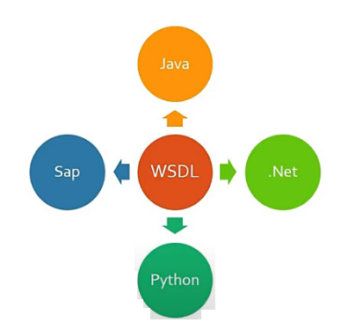
WSDL
http://www.thomas-bayer.com/axis2/services/BLZService?wsdl

Slide 5
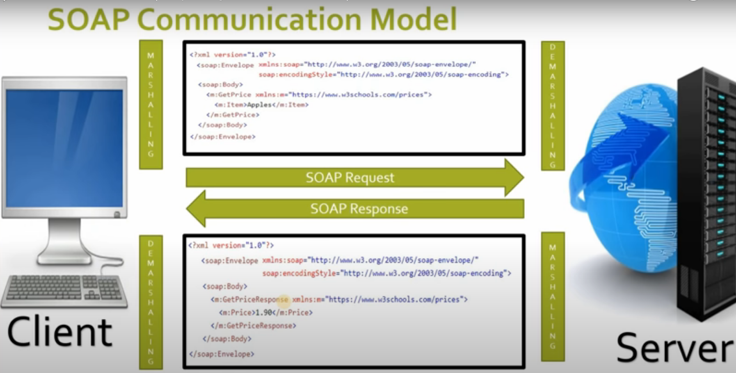
SOAP Communication Model

Slide 6
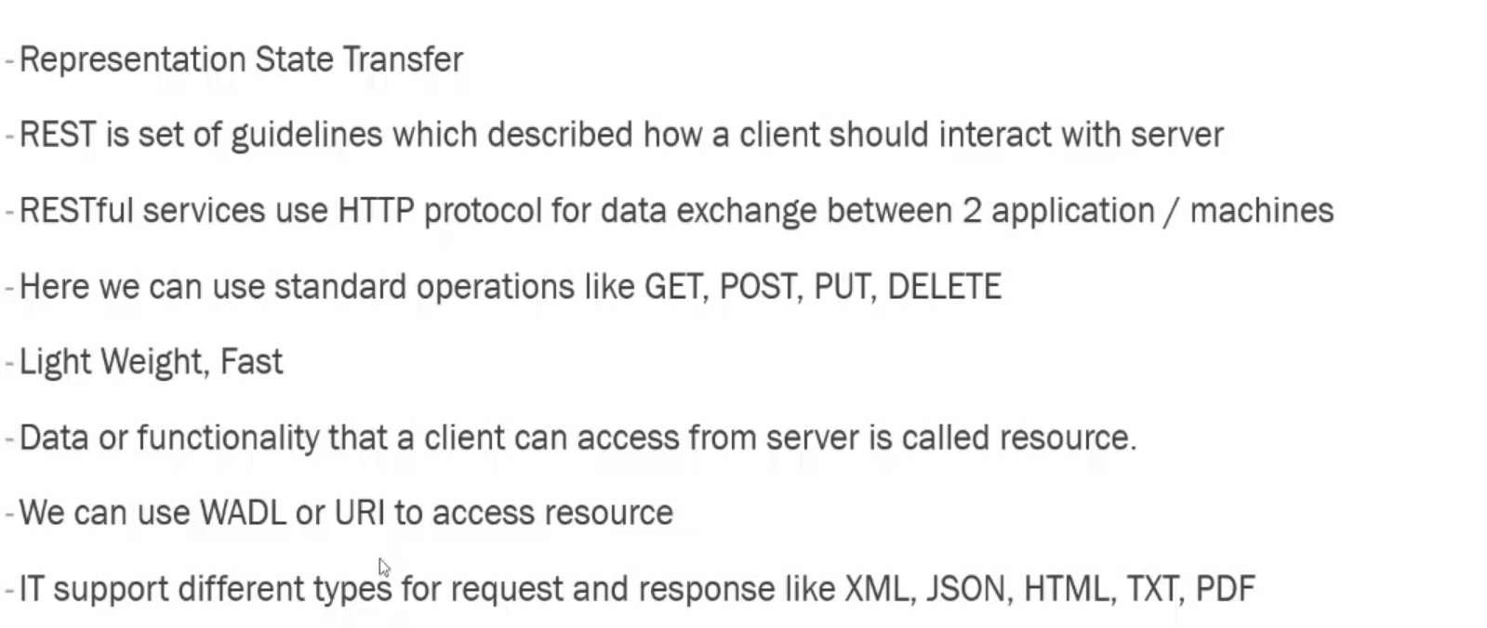
Rest API

Slide 7
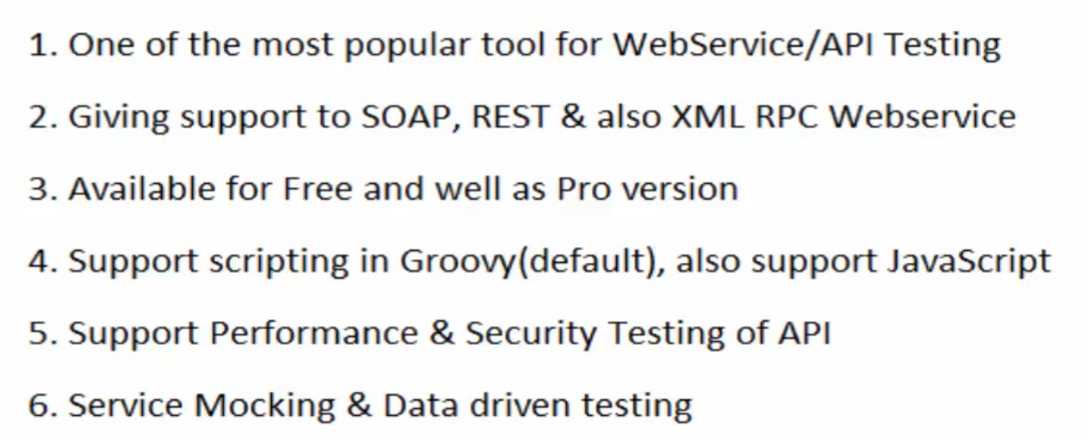
SOAP UI

Slide 8
Installation-SOAP UI
https://www.soapui.org/downloads/soapui/

Slide 9
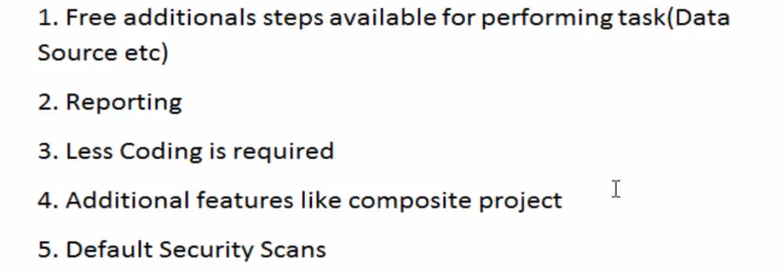
SOAPUI Pro Vs Free

Slide 10
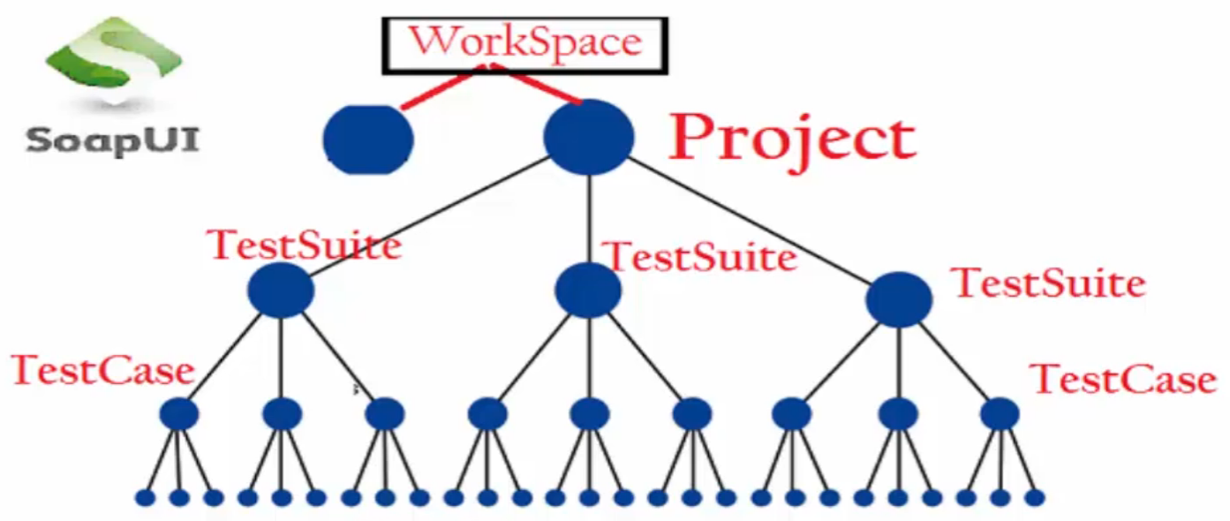
SOAPUI Work Hierarchy

Slide 11
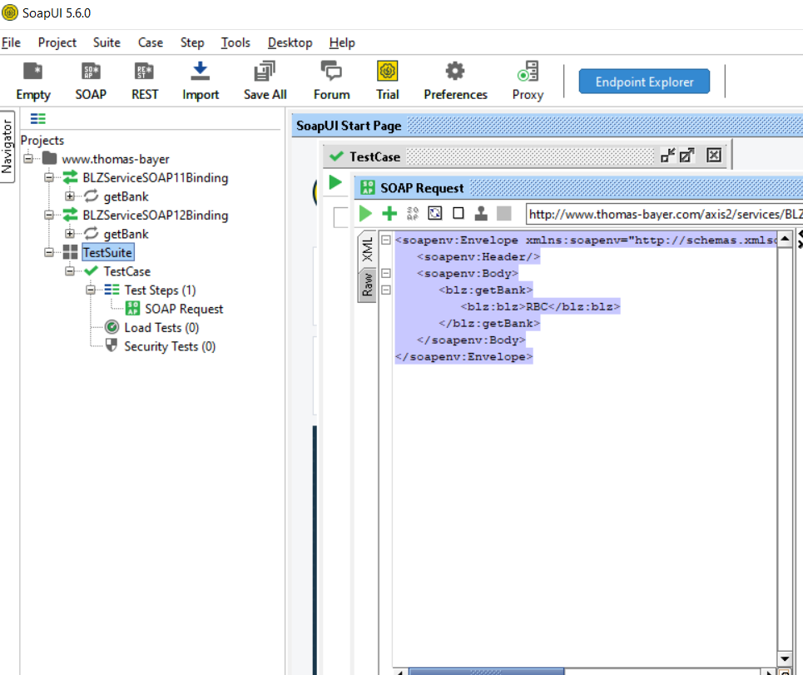
Project, Test Suite & Testcase

Slide 12
Properties
What is properties
Why to Use
Where & How to we can define Property
How to use the Properties
Properties Type
Global File→Preferences→Global Properties
Project Level[apply on project level]
Test Suite Level
Test Case Level
Test Step

Slide 13
Get Properties
Properties can be accessed at following levels: Project - ${#Project#PropertyName} TestSuite - ${#TestSuite#PropertyName} TestCase - ${#TestCase#PropertyName} TestStep - ${TestStepName#PropertyName} System - ${#System#PropertyName} Env - ${#Env#PropertyName} Global - ${#Global#PropertyName}

Slide 14
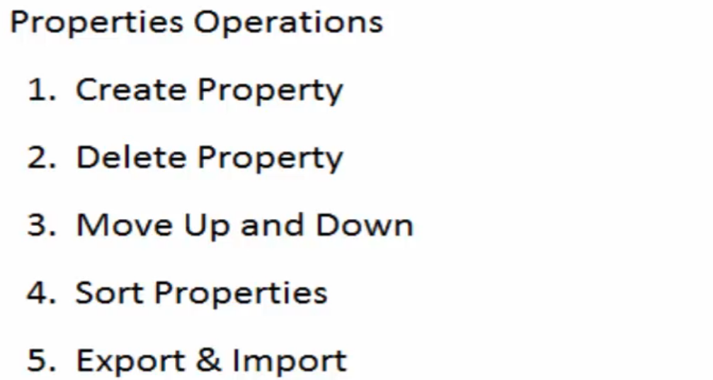
Properties in SOAPUI

Slide 15
Assertion

Slide 16
Xpath

Slide 17
Add Steps to test case

Slide 18
Property Transfer
https://www.soapui.org/docs/functional-testing/properties/transferring-properties/

Slide 19
Groovy
// Get and Set Property //Project
testRunner.testCase.testSuite.project.getPropertyValue("Name")
testRunner.testCase.testSuite.project.setPropertyValue("Name","I am in Project")
//TestSuite
testRunner.testCase.testSuite.getPropertyValue("Name")
testRunner.testCase.testSuite.setPropertyValue("Name","I am in TestSuite")
//TestCase
testRunner.testCase.getPropertyValue("Name")
testRunner.testCase.setPropertyValue("Name","I am in TestCase")
//TestStep
testRunner.testCase.getTestStepByName("CountryCodes").getPropertyValue("Name")
testRunner.testCase.getTestStepByName("CountryCodes").setPropertyValue("Name","I am in Test Step")
//Global
com.eviware.soapui.SoapUI.globalProperties.getPropertyValue( "Name")
com.eviware.soapui.SoapUI.globalProperties.setPropertyValue( "Name","I am in Global Prop" )
// Add Property
testRunner.testCase.testSuite.project.addProperty("DOB")
// Remove property //Project
testRunner.testCase.testSuite.project.removeProperty("Name");
//TestSuite testRunner.testCase.testSuite.removeProperty("Name")
// Loop through properties
testRunner.testCase.properties.each { key,value - log.info (testRunner.testCase.getPropertyValue(key))
//log.info (key+" - "+value) }

Slide 20
Running the tests

Slide 21
Run from cmd

Slide 22
Reports

