Slide 1

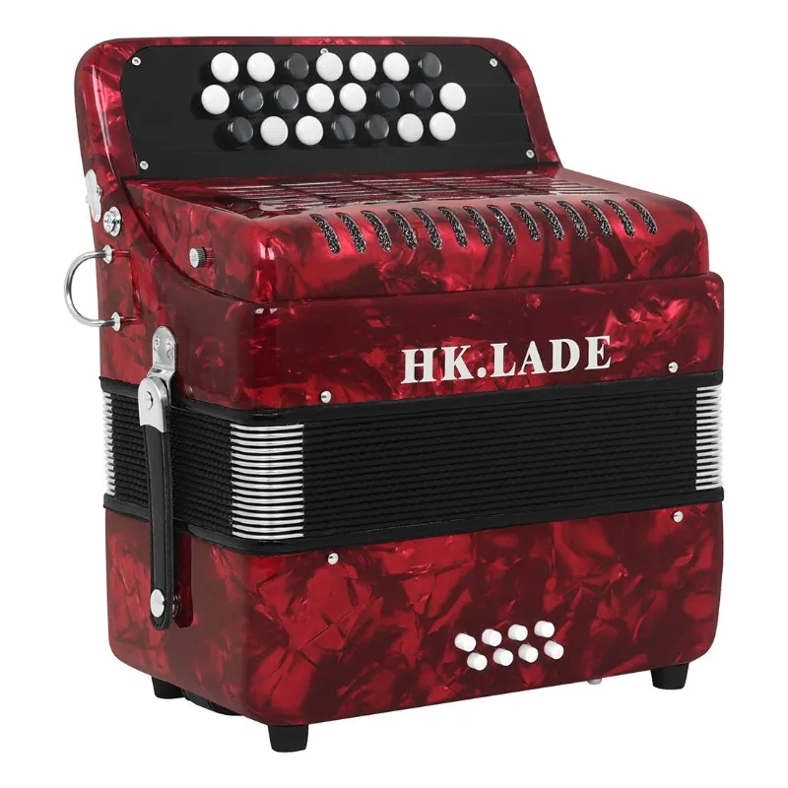
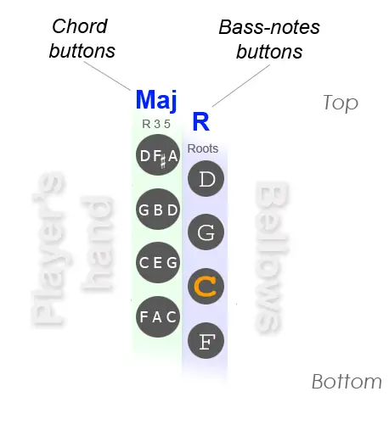
Treble
Key
All of the electronics will be stored in the bellow of the accordion
Bass
Button

