Slide 1
Churn Analysis

Slide 2
Agenda
Problem Statement
Data Analysis
Model Training
Model Interpretability
Predictions
Recommendations
TODO

Slide 3
Problem Statement
Technical Usecase:
Predict whether the customer would churn or not based on the given features
Business Usecase:
Based on the customer churning, Organization should perform follow up’s or lucrative offers will be provided to reduce the churn rate
Machine learning model should be able to identify most of the customers who are going to churn (recall)
Machine Learning model should be able to identify most accuractely whether customers are going to churn or not (precision)

Slide 4
Data Analysis
train.csv and metadata.csv contains the information about all the data features and data targets
Problem statement can be solved via binary classification as there are only two classes, either churned or not churned
cust_id is the identifier and it is unique
All the features are considered and modelling is performed based on the region_id

Slide 5
Data Analysis
Field Name | Data Type
cust_id | category
gender | category
age | numeric
driving_license | category
region_code | category
previously_insured | category
vehicle_age | category
vehicle_damage | category
annual_premium | numeric
policy_sales_channel | category
days_since_insured | numeric
response | category
age, annual_premium and days_since_insured are the numerical features
cust_id is unique
gender, driving_license, region_code, previously_insured, vehicle_age, vehicle_damage, policy_sales_channel are categorical features
region_code and policy_sales_channel are high cardinality features
There is no NaN values

Slide 6
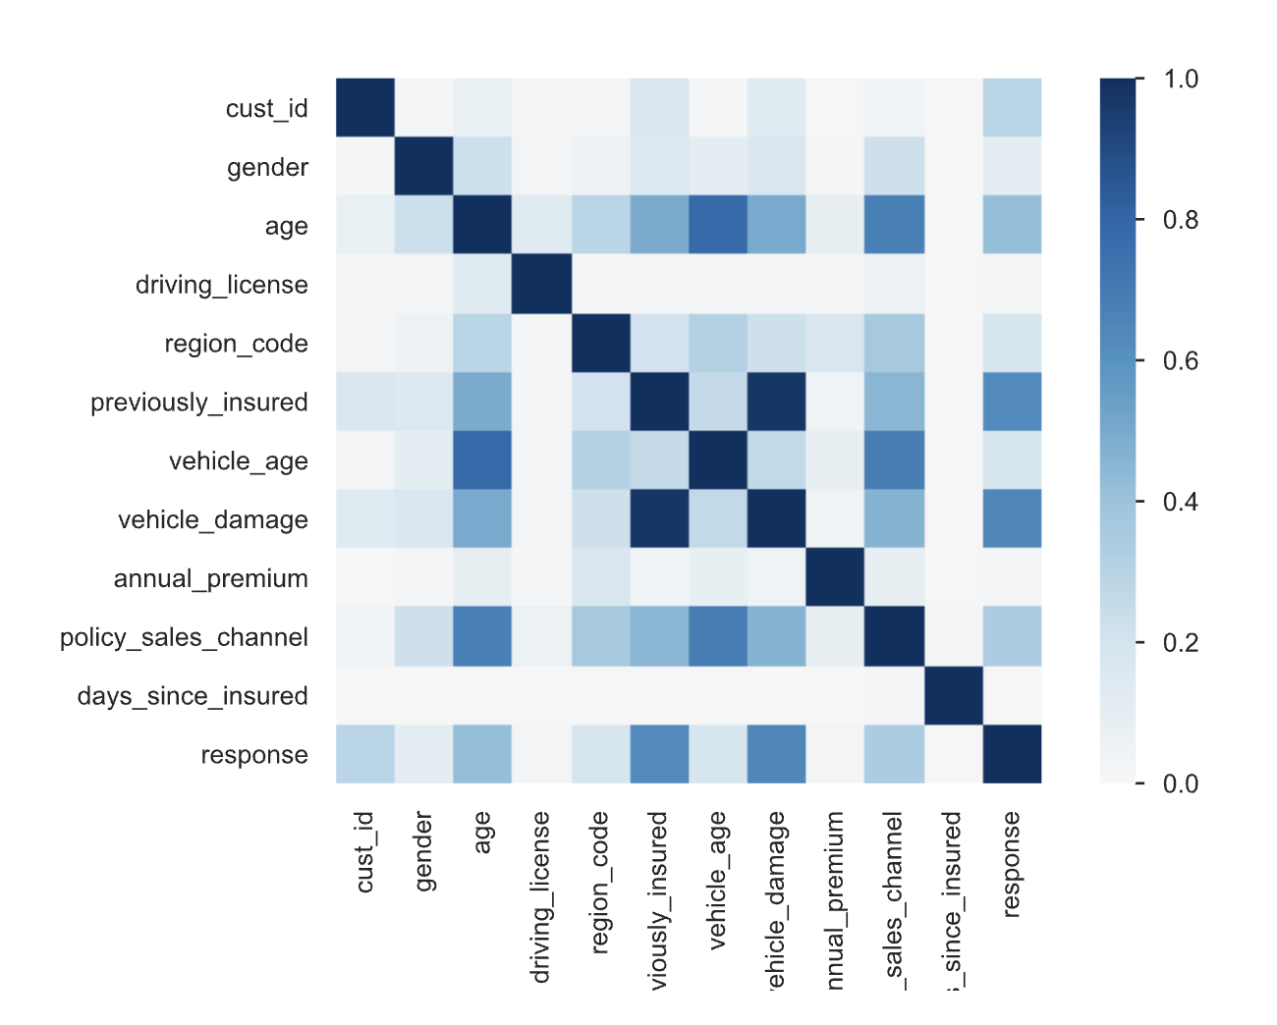
Data Analysis
EDA is performed using the pandas profiling. File location: reports/basic_churn_prediction_report.html
previously_insured and vehicle_damage features have high correlation to churn rate and age, policy_sales_channels also have slight correlation

Slide 7
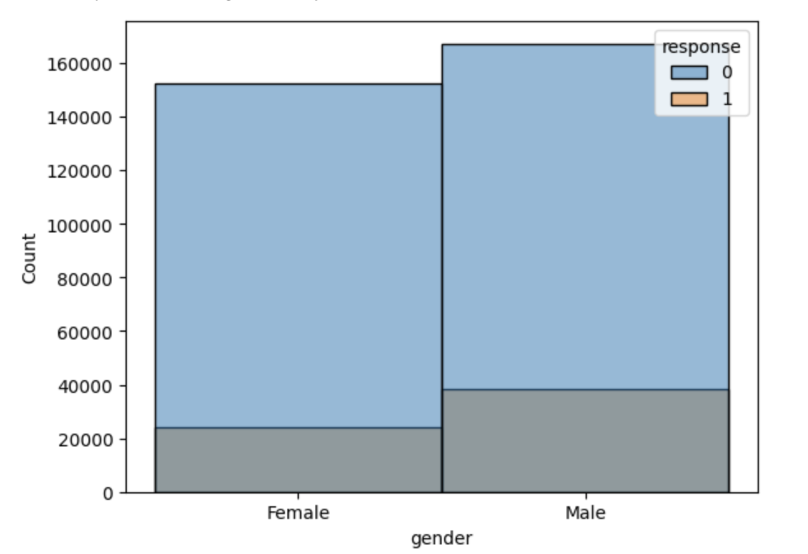
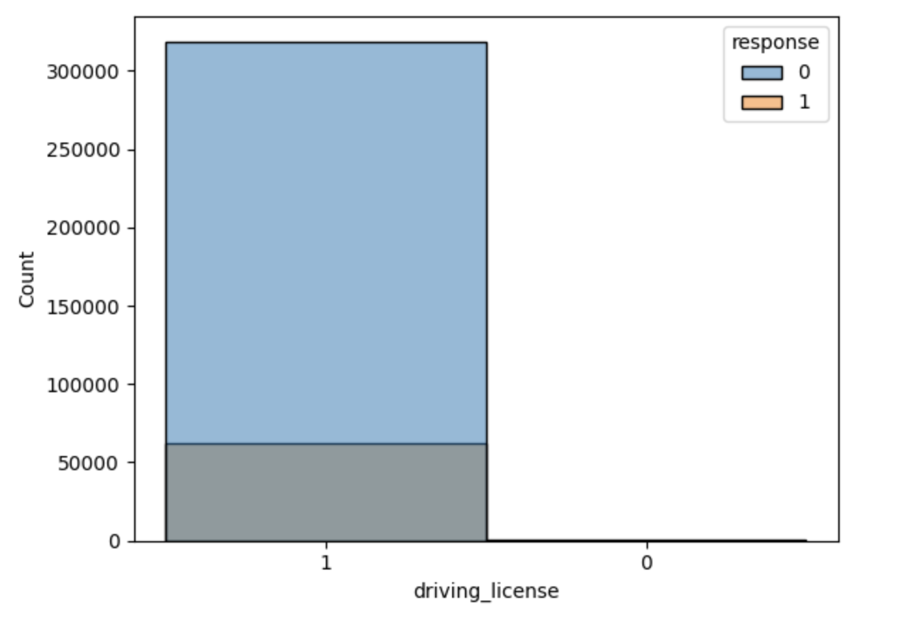
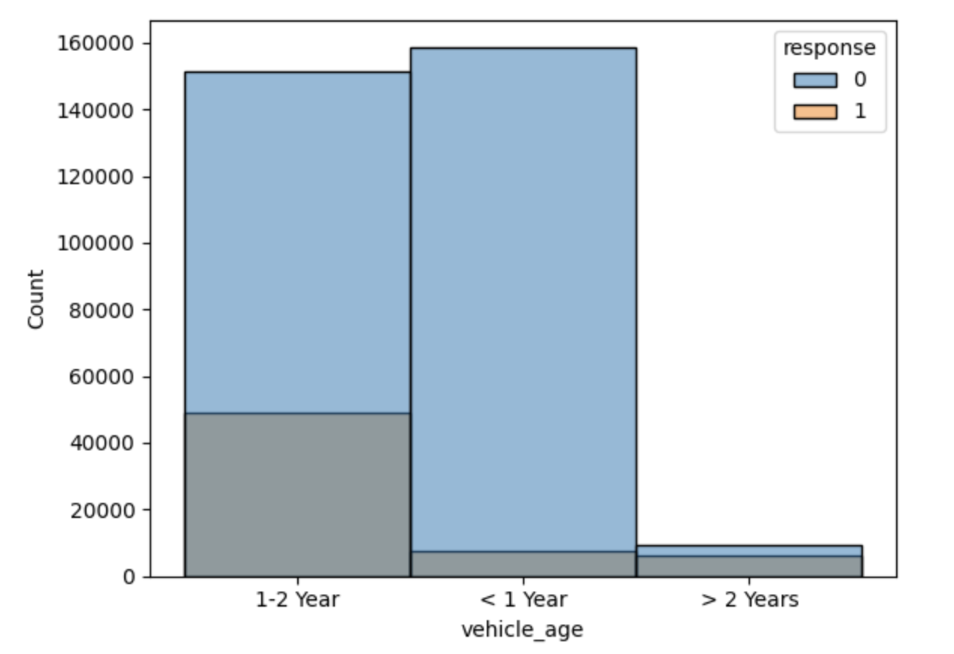
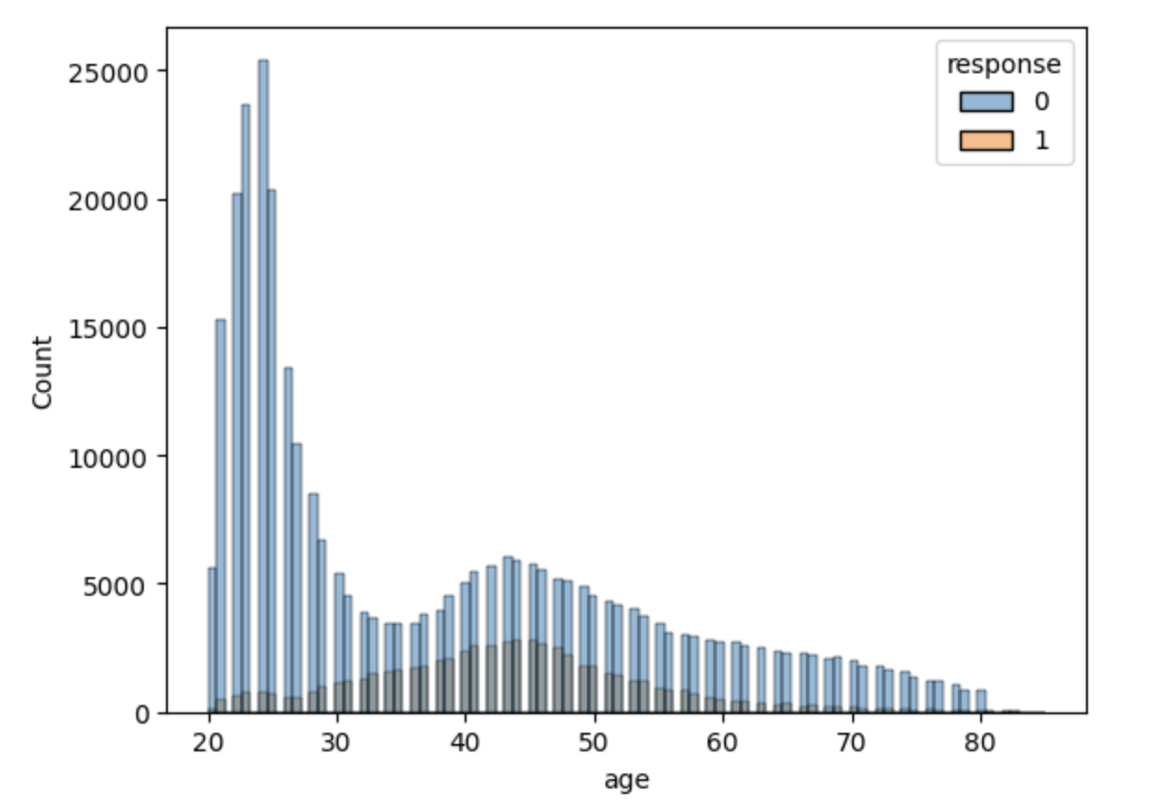
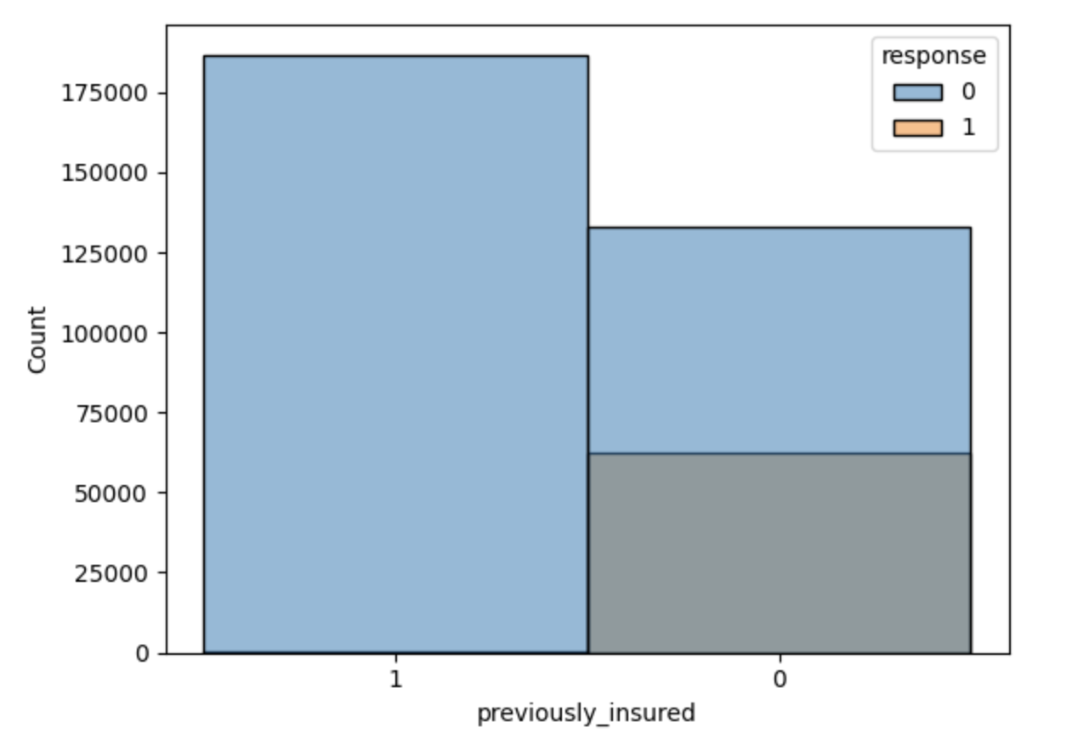
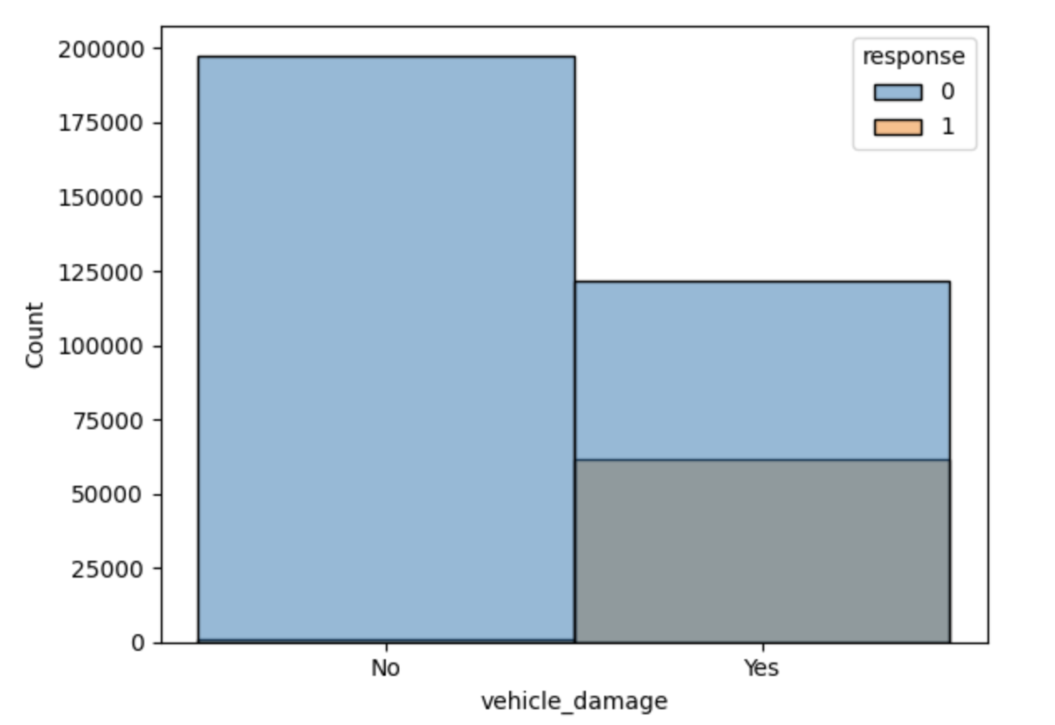
Data Analysis

Slide 8
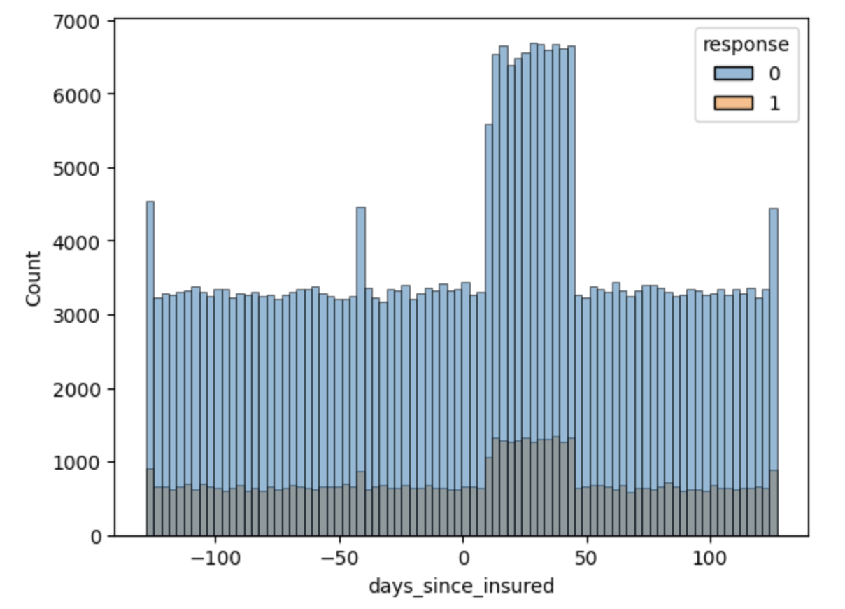
Data Analysis
if the customer is not previously insured then there is a higher chance of churn
If the customer vehicle damage, then there is a good chance of churn
If the vehicle_age is greater than 2 years, then percentage of churning is higher
Most of the customers have the driving license
People with the age between 40-50 years have the slightly higher chance of churn rate
Most of the people are getting insured within 0 to 50 days

Slide 9
Model Training
Experimented the base metrics with different classification models using the pycaret, base model has 0.47 f1 score
Experimented using the region based model using the XGBoostClassifier and we got around 0.55 to 0.59 f1 score for region based models
As the dataset is imbalanced, I have determined the thresholds that would determine the higher precision and higher recall. With these experiments we got 0.59 to 0.61 f1 score
Experimented with the GridSearchCV hyper parameters to reduce the overfitting and improve f1 score. We have got 0.59 to 0.63 f1 score

Slide 10
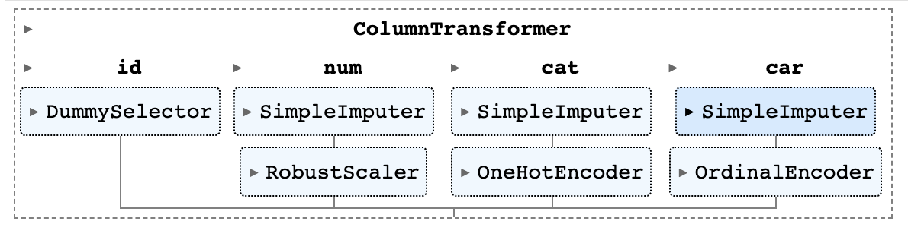
Model Training
Model is built using the Sklearn pipelines. Above is the structure of the pipeline for ChurnClassifier model and used 80:20 split for evaluation
Region based model is considered only for the top regions which has the data count > 15k records and remaining regions are grouped as generic
Experimented by keeping the region and removing the region but there is no much difference in the final f1 score for generic model
Training Results: executions/11072022174134/

Slide 11
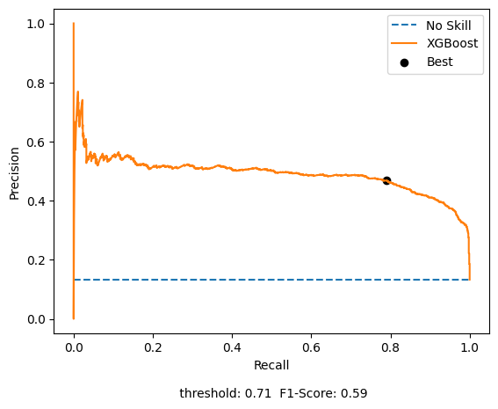
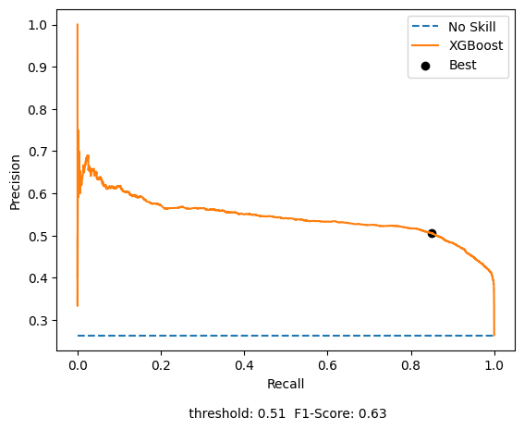
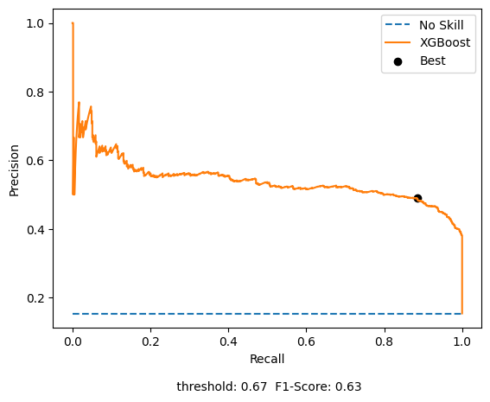
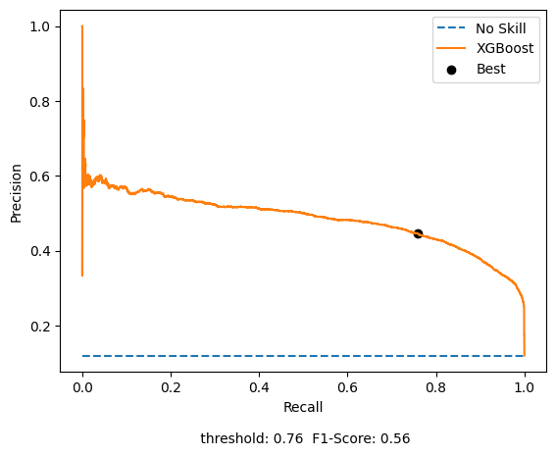
Model Training – Region Based F1 Scores
Region code - 8
Region code - 28
Region code - 46
Region code - generic

Slide 12
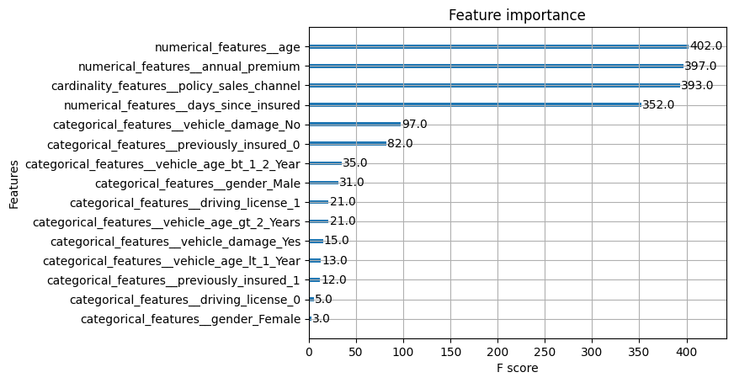
Model Interpretability
Feature Importance for Region Code 28
Used the default feature importance from the XGBoost

Slide 13
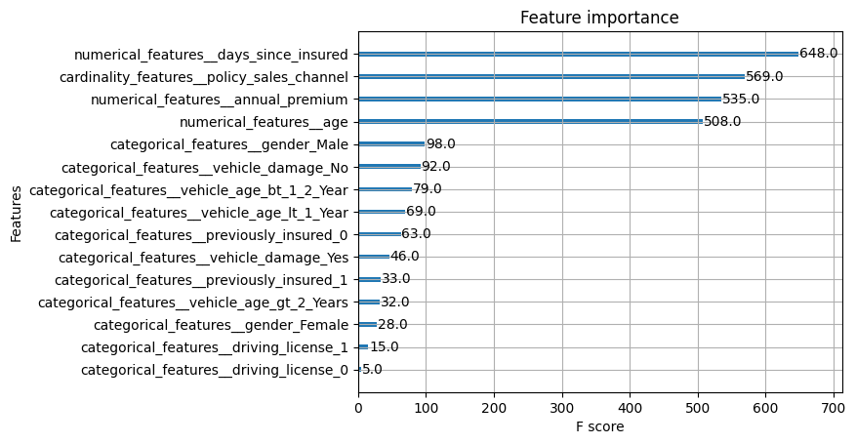
Model Interpretability
Feature Importance for Region Code generic

Slide 14
Prediction
Prediction uses the same pipeline generated during the training and transforms the data
Unknown values are grouped into a new category for all categorical values and for numerical values, NaN and unknown values are replaced by 0
Prediction Result: executions/11072022184627/

Slide 15
Recommendations
Based on the urgency, team can select whether the model to output high precision or high recall
High Recall Example:
Using the high recall we’ll miss only few customers who will be churning,
but we will get a lot of false positives (means a lot of additional customers).
From the business point of view if we don’t want to loose any customer we can use high recall.
Follow up on those many customers can be done via email (cost-effective)
High Precision Example:
Using the high precision we’ll get accurate number of customers who will be churning, only few customers are returned
Only a few false positives, but a lot of false negatives customers would be there when compared to recall
This strategy can be used when there is minimal time and we wanted to really focus on the churned customers, we can use the precision

Slide 16
TODO
Explanability via Shap
Clustering techniques to find the better grouping of regions or some other features
Improving the code quality

