Slide 1
Churn Analysis

Slide 2
Agenda
Problem Statement
Data Analysis
Model Training
Recommendations
TODO

Slide 3
Problem Statement
Technical Usecase:
Predict whether the customer would churn or not based on the given features
Business Usecase:
Based on the customer churning, Organization should perform follow up’s or lucrative offers will be provided to reduce the churn rate
Machine learning model should be able to identify most of the customers who are going to churn (recall)
Machine Learning model should be able to identify most accuractely whether customers are going to churn or not (precision)

Slide 4
Data Analysis
train.csv and metadata.csv contains the information about all the data features and data targets
Problem statement can be solved via binary classification as there are only two classes, either churned or not churned
cust_id is the identifier and it is unique
All the features are considered and modelling is performed based on the region_id

Slide 5
Data Analysis
Field Name | Data Type
cust_id | category
gender | category
age | numeric
driving_license | category
region_code | category
previously_insured | category
vehicle_age | category
vehicle_damage | category
annual_premium | numeric
policy_sales_channel | category
days_since_insured | numeric
response | category
age, annual_premium and days_since_insured are the numerical features
cust_id is unique
gender, driving_license, region_code, previously_insured, vehicle_age, vehicle_damage, policy_sales_channel are categorical features
region_code and policy_sales_channel are high cardinality features
There is no NaN values

Slide 6
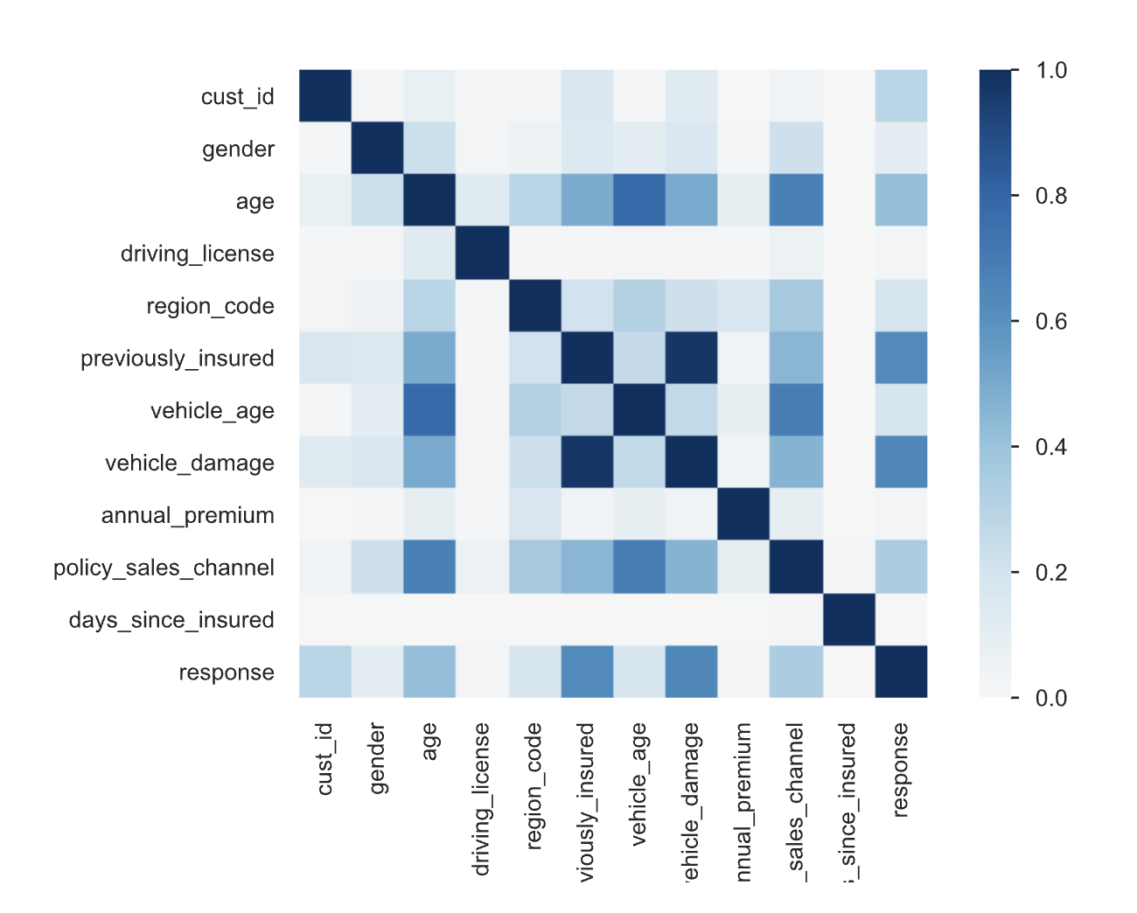
Data Analysis
EDA is performed using the pandas profiling. File location: reports/basic_churn_prediction_report.html
previously_insured and vehicle_damage features have high correlation to churn rate and age, policy_sales_channels also have slight correlation

Slide 7
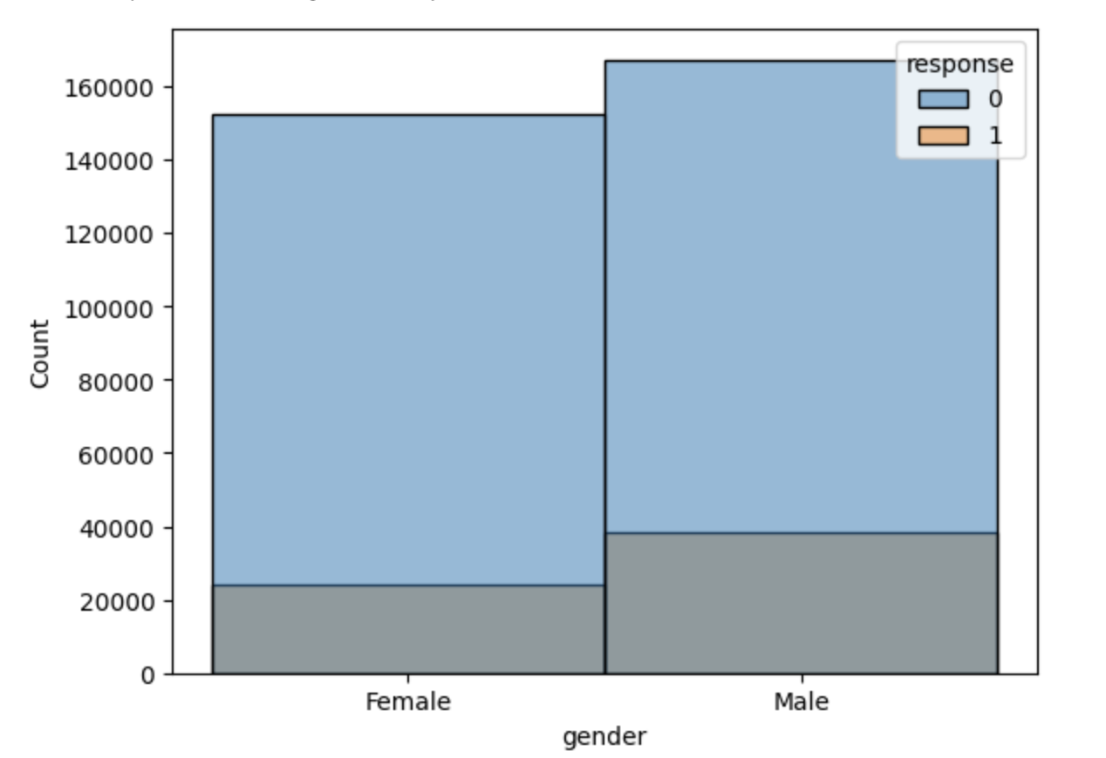
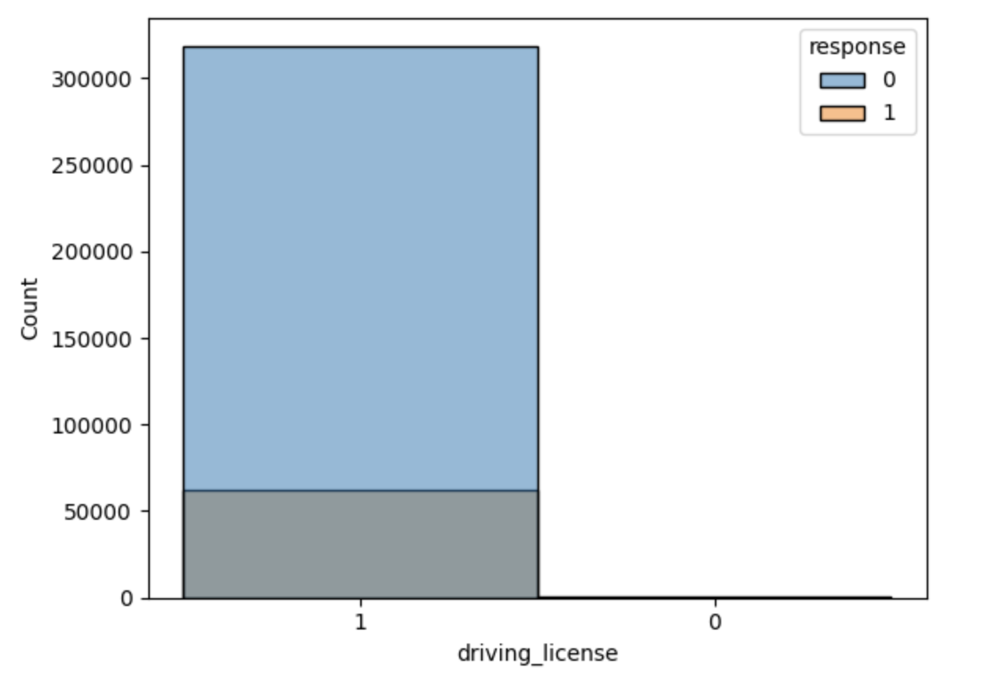
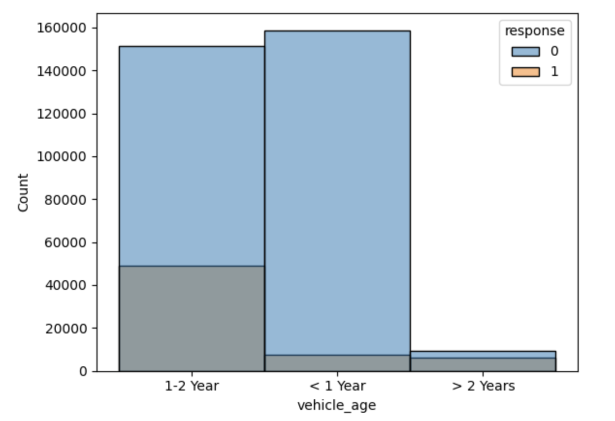
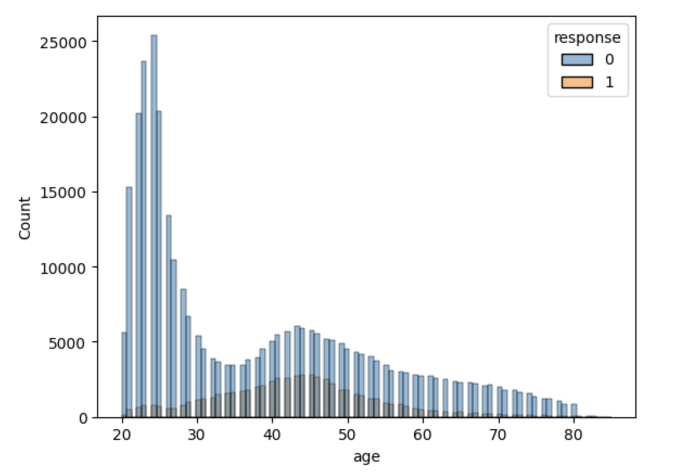
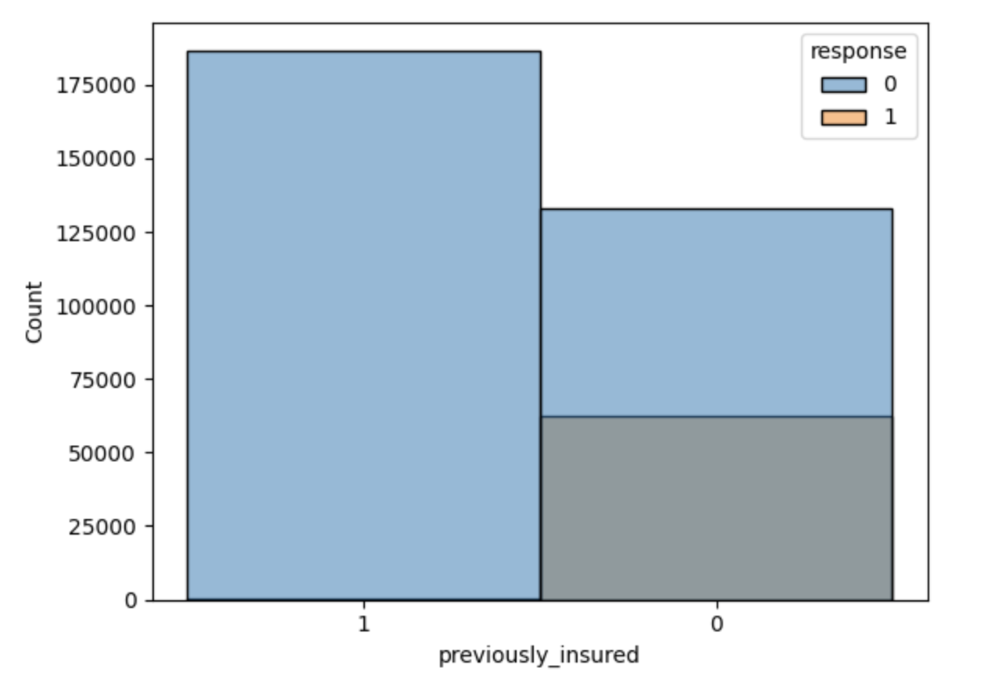
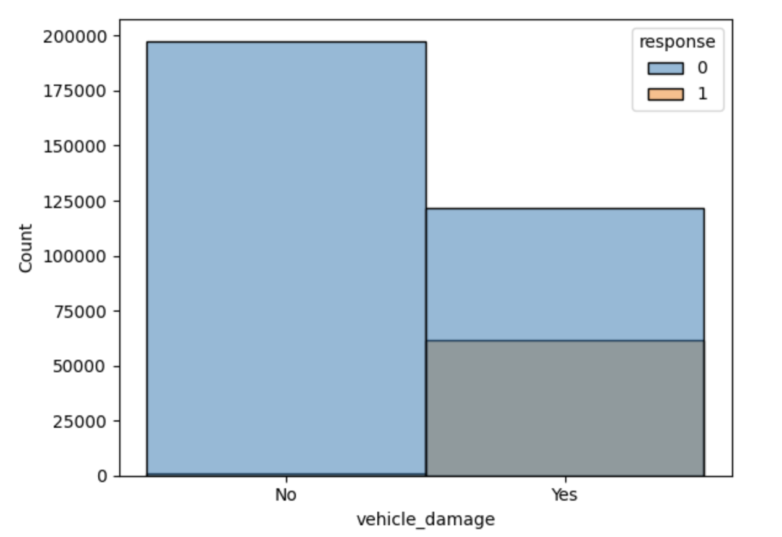
Data Analysis

Slide 8
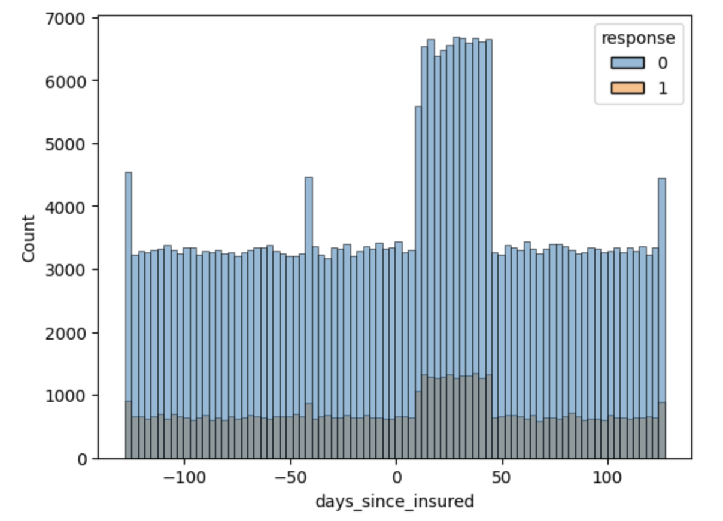
Data Analysis
if the customer is not previously insured then there is a higher chance of churn
If the customer vehicle damage, then there is a good chance of churn
If the vehicle_age is greater than 2 years, then percentage of churning is higher
Most of the customers have the driving license
People with the age between 40-50 years have the slightly higher chance of churn rate
Most of the people are getting insured within 0 to 50 days

Slide 9
Model Training
Experimented the base metrics with different classification models using the pycaret, base model has 0.50 f1 score
Experimented using the region based model using the XGBoostClassifier and we got around 0.55 f1 score for region based models
As the dataset is imbalanced, I have determined the thresholds that would determine the higher precision and higher recall. With these experiments we got 0.59 f1 score
Experimented with the GridSearchCV hyper parameters to reduce the overfitting and improve f1 score. We have got 0.61 to 0.63 f1 score

Slide 10
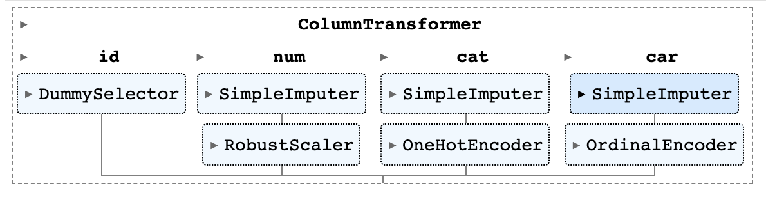
Model Training
Model is built using the Sklearn pipelines. Above is the structure of the pipeline for ChurnClassifier model
Region based model is considered only for the top regions which has the data count > 15k records and remaining regions are grouped as generic
Experimented by keeping the region and removing the region but there is no much difference in the final f1 score for generic model

Slide 11
Model Training
TODO: Add the images of the f1 score and Roc and AUC curves for every region

Slide 12
Model Interpretability
TODO: Add the images of the f1 score and Roc and AUC curves for every region

Slide 13
Model Interpretability
TODO: Add the images of the f1 score and Roc and AUC curves for every region

