Slide 1
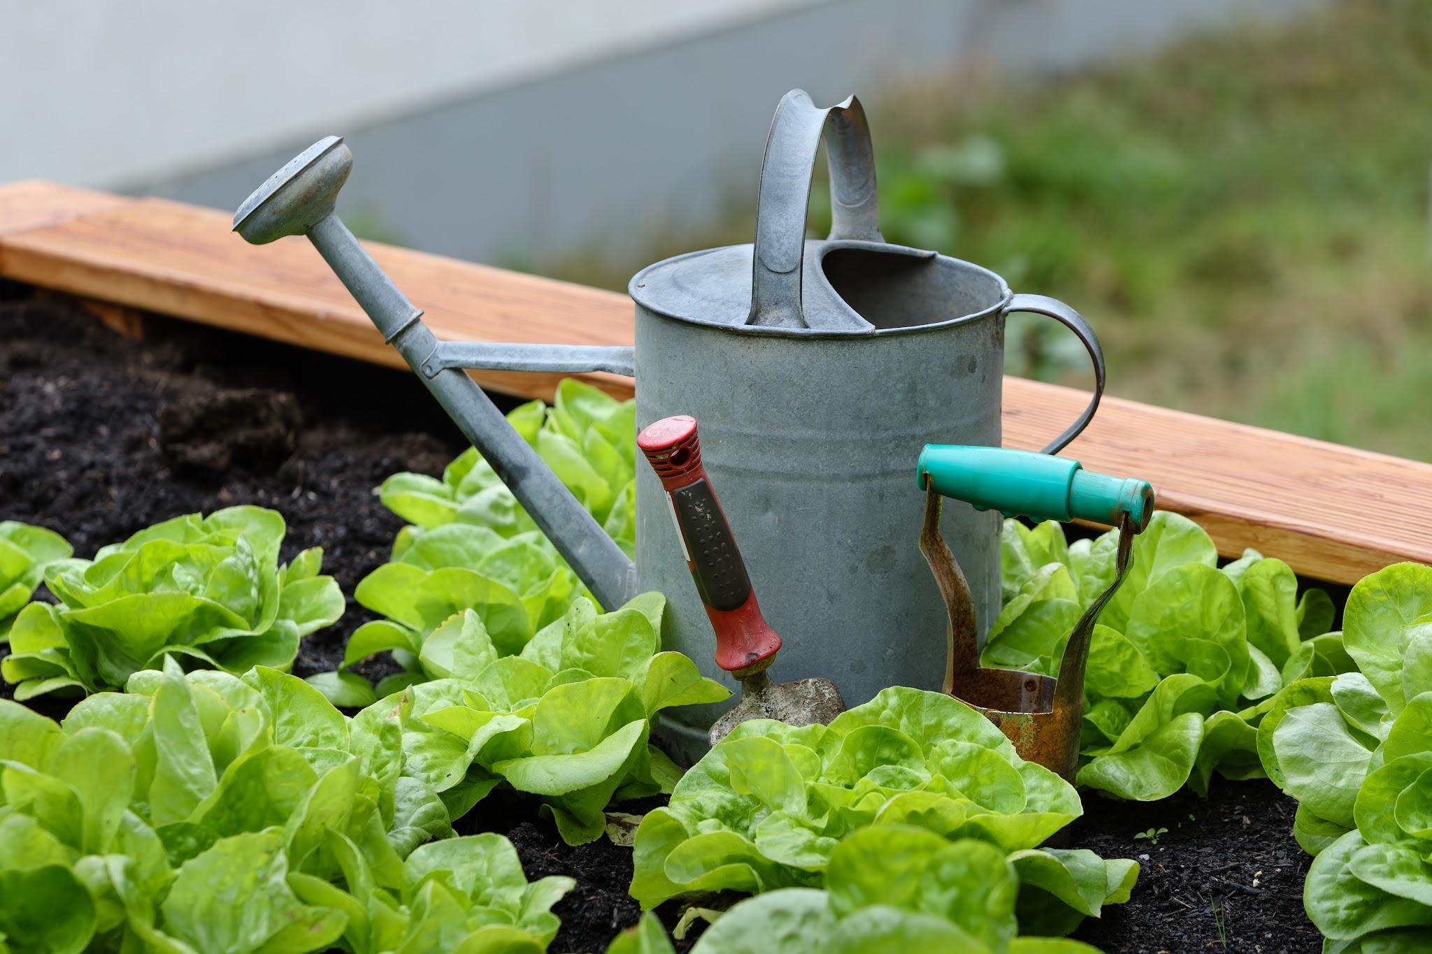
My Hobby Gardening: Cultivating Nature at Home
Notes:
Good afternoon, everyone. My name is [Your Name], and today I'd like to share with you a hobby that has brought me a lot of joy and fulfillment: gardening. Over the next few minutes, I'll take you through my journey into the world of plants, flowers, and all things green.

Slide 2
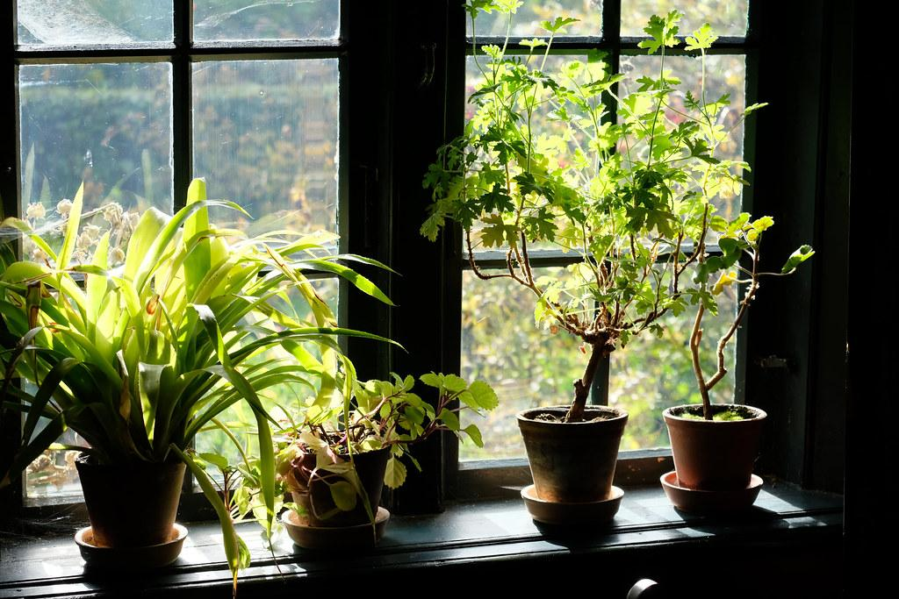
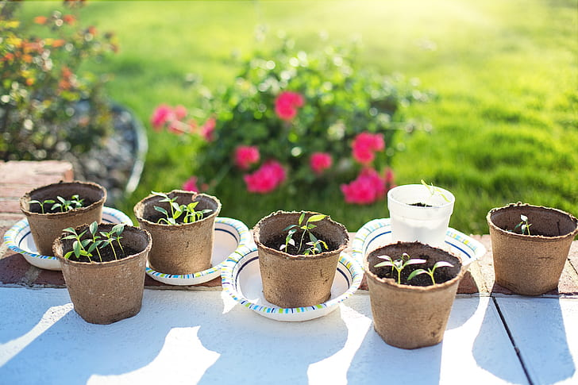
How I Got Started
Inspiration from dad
First experiences with indoor plant
Overwatering and choosing the run soil
Notes:
My gardening journey started a few years ago when I was inspired by dad. My first experience was with a small indoor plant, and from there, my interest grew. Like any new hobby, I faced some challenges, such as overwatering plants and choosing the wrong soil, but these early lessons were crucial in shaping my gardening skills."

Slide 3
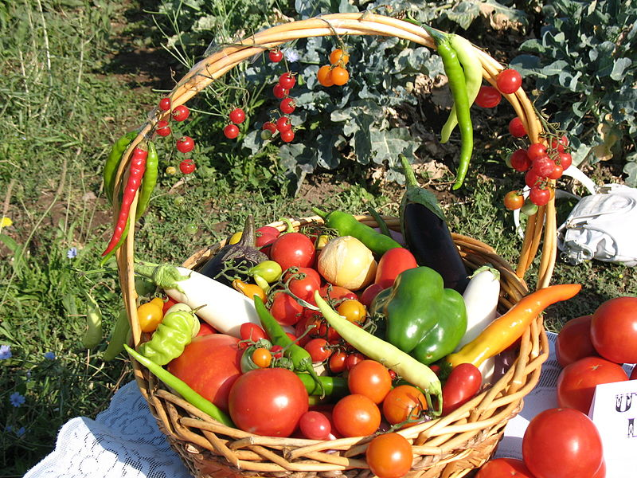
What I Grow
Photos of your childhood home, neighborhood, or places you frequented
Notes:
In my garden, I grow a variety of plants, including vegetables like tomatoes and peppers, herbs such as basil and mint, and flowers like marigolds and roses. I enjoy experimenting with seasonal plants, adjusting my garden to reflect the changes in weather. My favorite plant has to be [favorite plant], because [reason]. It brings a special charm to my garden.

Slide 4
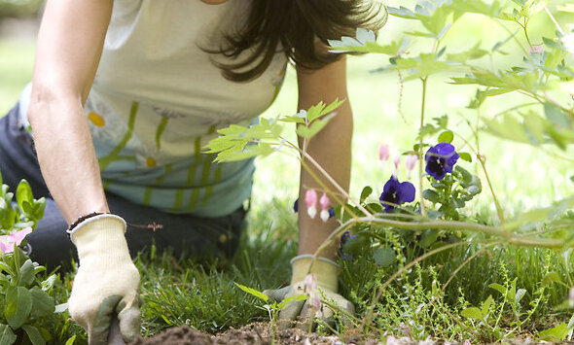
Benefits of Gardening
Keeps me active
Calming therapeutic effect
Deeply rewarding when connecting with nature
Picture of your school, group photo with friends, school events
Notes:
Gardening is more than just a hobby; it offers a range of benefits. Physically, it keeps me active, while mentally, it provides a calming and therapeutic effect. There's something deeply rewarding about connecting with nature, watching your plants grow, and knowing that your garden supports local wildlife like bees and butterflies.

Slide 5
Challenges and How I Overcame Them
Dealing with pests
Natural pest control methods
Unpredictable weather conditions
Time management for watering plants
Learning from mistakes
Notes:
Of course, gardening comes with its challenges. Pests can be a major problem, and unpredictable weather can disrupt even the best-laid plans. I've had to learn how to deal with these issues, whether it's through natural pest control methods or time management to ensure I can water and care for my plants properly. Each challenge has taught me something new and improved my gardening techniques.

Slide 6
My Favorite Gardening Moments Over Time
Notes:
One of the most rewarding aspects of gardening is those memorable moments that make all the hard work worthwhile. Harvesting my first bouquet of flower was an unforgettable experience. Watching flowers bloom, especially those that took months of care, brings a unique sense of accomplishment. I also enjoy sharing my produce with family and friends, which adds a social dimension to this hobby.

Slide 7
Looking Ahead: My Gardening Goals
Plans for expanding or diversifying the garden
More exotic plants
New plants or techniques to try
Start gardening if you haven’t tried it!
Notes:
In conclusion, gardening has become a significant part of my life, offering endless opportunities for growth and learning. Looking ahead, I plan to expand my garden, possibly trying my hand at growing more exotic plants or experimenting with new gardening techniques like vertical gardening. I encourage anyone who hasn't tried it to give gardening a chance—it's a fulfilling hobby that connects you with nature and provides a wonderful sense of achievement. Thank you for listening, and I hope I've inspired you to explore the world of gardening!"

