Slide 1
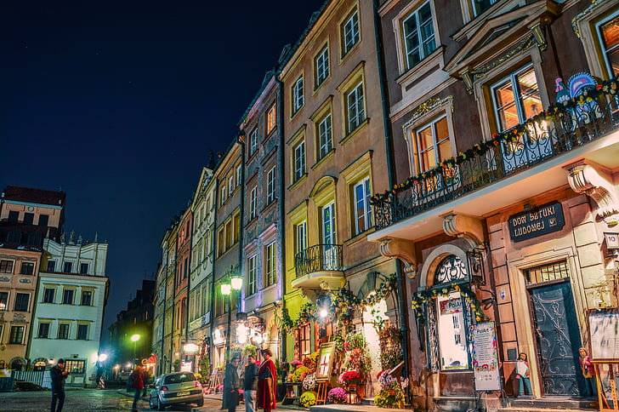
Childhood in My Hometown: A Journey Through Memories
Notes:
"Good [morning/afternoon], everyone. Thank you for being here today. My name is [Your Name], and I’m excited to take you on a journey through my childhood in my hometown. This presentation will explore the places, people, and experiences that shaped my early years and how they have influenced who I am today."

Slide 2
Introduction to My Hometown
Brief description of your hometown (location, size, key features)
The significance of your hometown in your life
A personal connection to the place
Notes:
Slide 2: Introduction to My Hometown "I grew up in Springfield, a small city located in Europe. It's a place that holds a special place in my heart, not just because it’s where I was born and raised, but because of the deep connection I have with its people, its culture, and its landscapes.

Slide 3
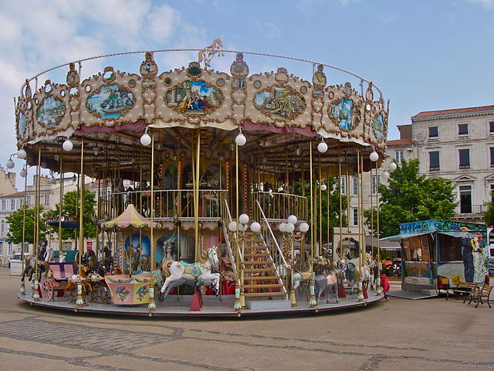
Early Childhood Memories
Fond memories of the park next to my house.
Childhood joys:
Playing in the park
Riding the Carousel
Spending time with family
These places were central to my early adventures and remain vivid in my memory.
Notes:
Some of my earliest memories are of the park next to my house. Growing up, my days were filled with simple joys—playing in the park, riding on the Carousel, and spending time with family in our cozy home. These places were the backdrop to my childhood adventures, and they remain vivid in my memory to this day.

Slide 4
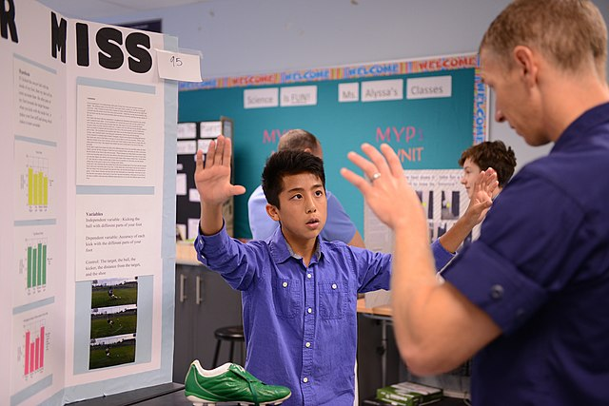
School Days and Friends
Notes:
"My school days were some of the most formative years of my life. I attended Lincoln Primary School, where I made lifelong friends and discovered my love for science, particularly chemistry. I can still remember the excitement of our annual science fair, where I built a volcano model that actually erupted, and how much fun we had during homecoming week and the school’s theater productions. My friends and I would spend hours after school working on projects together and hanging out at the local diner, and those bonds have lasted long after we graduated."

Slide 5
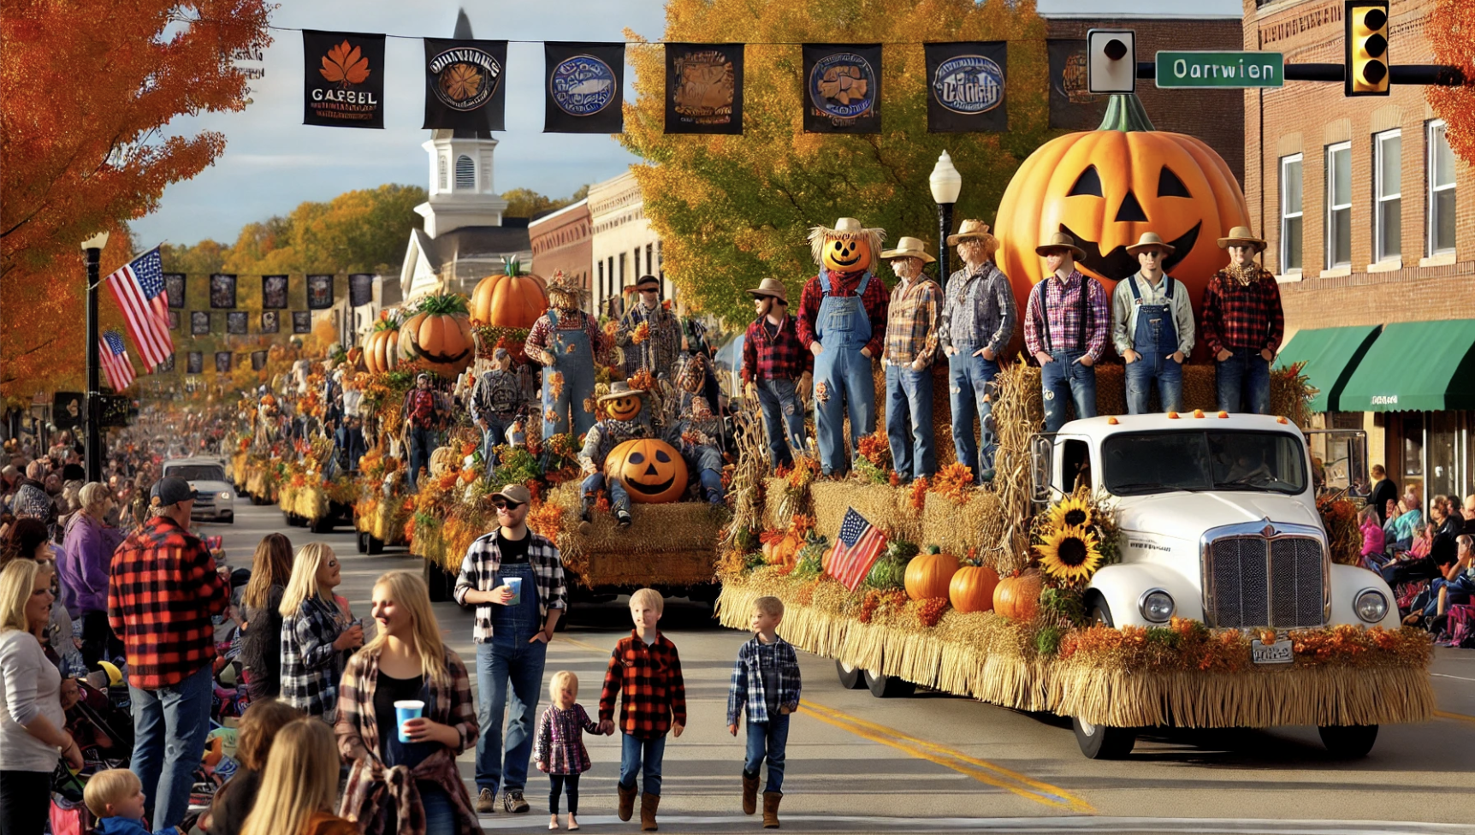
Festivals and Traditions
Cherished local festivals and traditions.
The annual Harvest Festival
Family activities:
Baking pies
Decorating with autumn leaves
Participating in the parade
These events fostered a deep connection to my cultural roots and created lasting memories.
Photos of festivals, family gatherings, traditional attire or activities
Notes:
One of the things I cherish most about my childhood is the local festivals and traditions that were an integral part of our community. Every year, we would celebrate the Harvest Festival with great enthusiasm. My family would spend the day baking pies, decorating our home with autumn leaves, and participating in the community parade, and it was during these times that I felt a deep connection to my cultural roots. These events were more than just celebrations; they were opportunities to come together and create lasting memories.

Slide 6
Community and Values
Strong sense of community in my hometown.
Core values: hospitality, resilience, togetherness.
Influence of these values on the community and personal growth.
Notes:
One of the most defining aspects of my hometown is its strong sense of community. The people here share core values such as hospitality, resilience, and a deep sense of togetherness. These values are more than just words; they are lived every day, shaping the way we interact, support one another, and face challenges together. Growing up in this environment, I have absorbed these values, which have profoundly influenced my personal development and continue to guide me in all aspects of my life.

Slide 7
Reflections and Future Aspirations
My hometown's significant role in shaping my identity and values.
The lessons of community, resilience, and cultural pride that I carry with me.
How these experiences have influenced my personal and professional goals.
The ongoing impact of my hometown on my aspirations, serving as a source of strength and inspiration for the future.
Notes:
As I reflect on my journey, I realize how deeply my hometown has shaped who I am today. The values of community, resilience, and connection that I learned through my experiences there continue to guide me. Looking ahead, I aspire to carry forward these lessons, no matter where life takes me. My hometown will always be a part of me, and its influence will forever be a source of strength and inspiration as I pursue my future endeavors.

