Slide 1
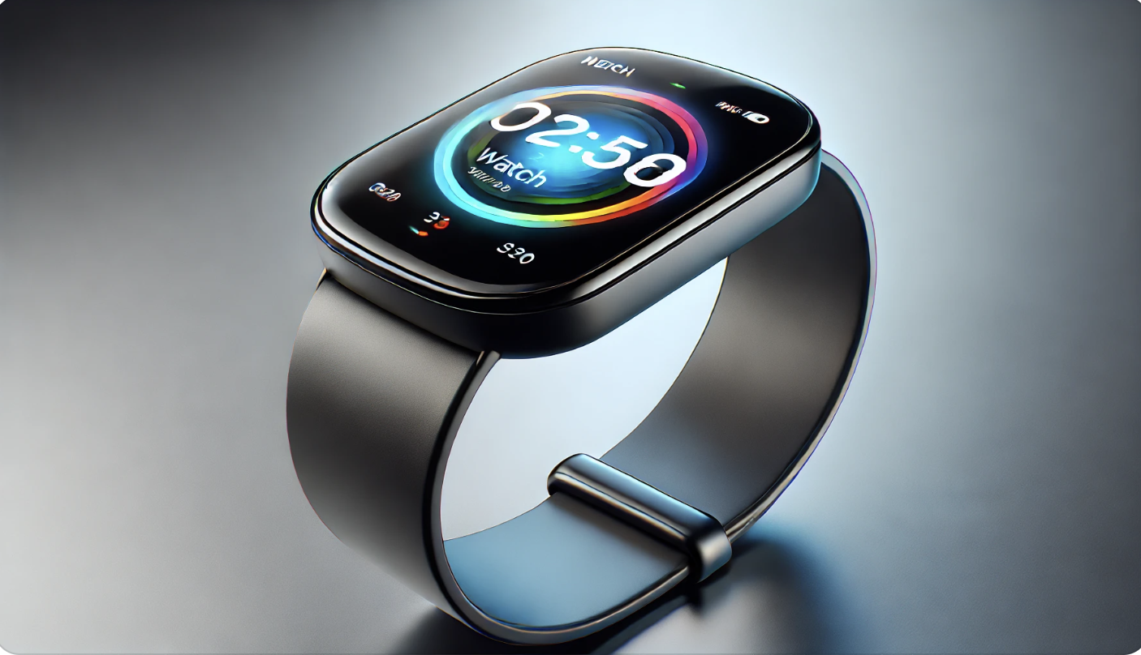
Introducing the Latest aWatch: Innovation on Your Wrist
Your Name, Conference
Notes:
Good [morning/afternoon], everyone. Today, I’m excited to introduce the latest version of the aWatch—the most advanced smartwatch we've ever created. Designed to be the ultimate companion for health, fitness, and connectivity, this watch is not just an accessory; it’s a powerful tool that integrates seamlessly into your daily life."

Slide 2
Design and Display
Larger, edge-to-edge display
More space to interact with apps and notifications
New materials and finishes
A range of styles to match your personal taste
Customizable watch faces
Truly make this watch your own
Notes:
"Let’s start with the design. We introduce a stunning edge-to-edge display that’s larger than ever, providing more space to interact with your favorite apps and notifications. We’ve also introduced new materials and finishes, offering a range of styles to match your personal taste. And with customizable watch faces, you can truly make this watch your own."

Slide 3
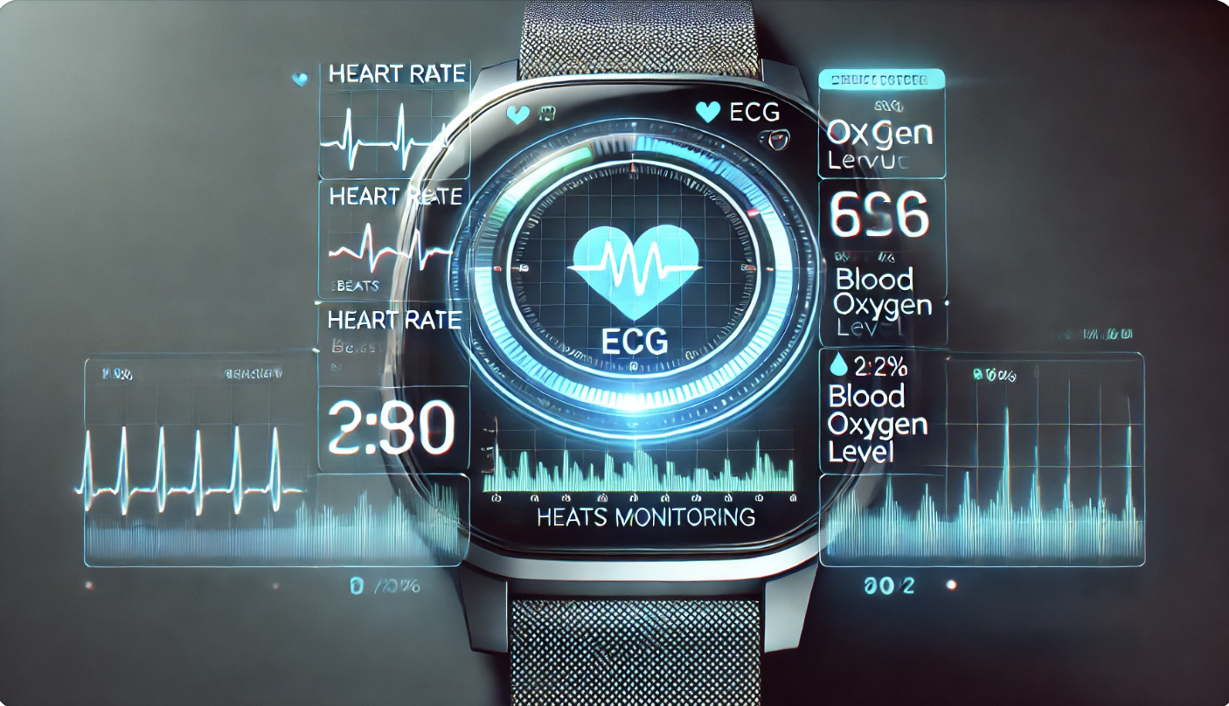
Your Health, Our Priority: Advanced Health Monitoring
Notes:
aWatch has always been at the forefront of health and wellness, and the latest version takes this even further. With enhanced heart rate monitoring, a blood oxygen sensor, and the ECG app, it’s like having a personal health monitor on your wrist. Plus, with irregular heart rhythm notifications, you can stay informed about your heart health and take proactive steps toward wellness."

Slide 4
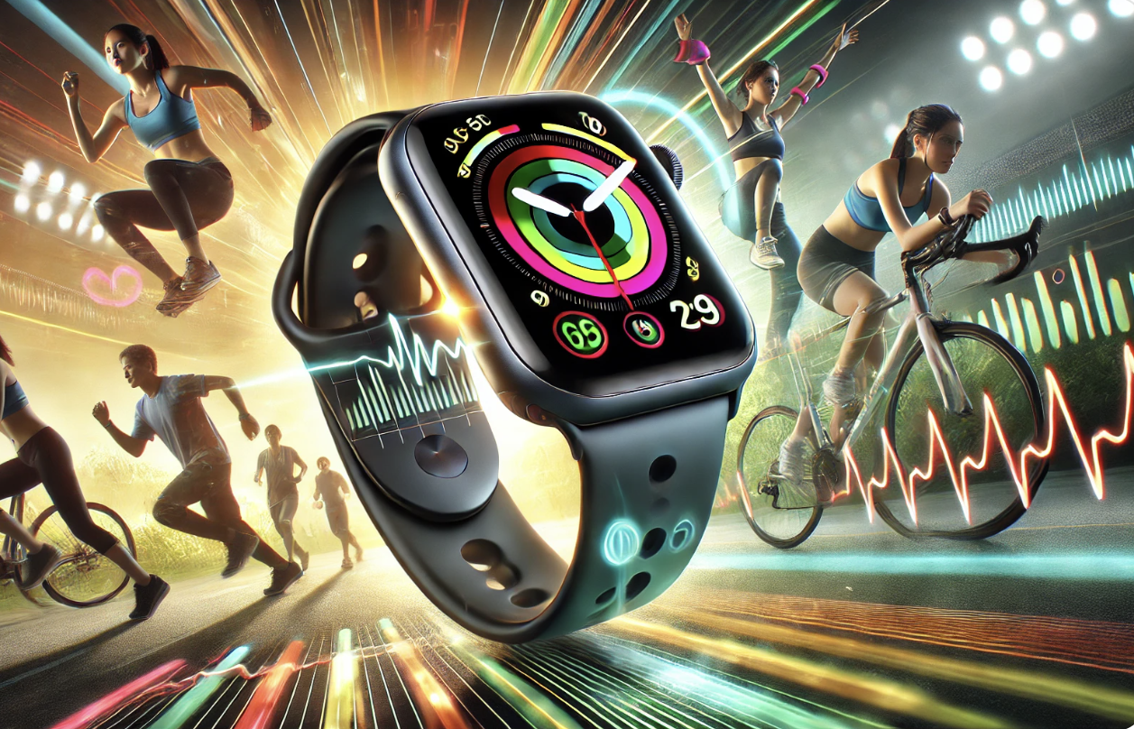
Elevate Your Fitness: Comprehensive Activity Tracking
New workout types and advanced metrics
Built-in GPS and altimeter
Fitness+ integration
Notes:
Whether you’re an athlete or just starting your fitness journey, the aWatch is designed to help you reach your goals. The latest version introduces new workout types and advanced metrics, including built-in GPS and an altimeter for tracking elevation. And with seamless integration with Apple Fitness+, you can access world-class workouts and personalized recommendations right from your wrist."

Slide 5
Stay Connected, Stay Productive: All From Your Wrist
Notes:
aWatch is more than just a health and fitness tracker—it’s a powerful communication tool. With enhanced cellular connectivity, you can take calls, respond to messages, and use AI voice assistants, all without your smart phone nearby. Plus, it seamlessly integrates with all existing cross-device ecosystems, ensuring you stay productive and connected no matter where you are.

Slide 6
Battery Life and Performance
All-day battery life
Stay powered throughout your day!
Faster processing speeds
Smooth performance for all your tasks
New charging options
Power up quicker than ever
Notes:
"One of the most significant improvements in the latest aWatch is its battery life. With all-day battery life, you can stay powered throughout your day, from morning workouts to evening meetings. The watch also features faster processing speeds, ensuring smooth performance for all your tasks. And with new charging options, you can power up your watch quicker than ever."

Slide 7
The Future on Your Wrist: Why the Latest aWatch is a Must-Have
Perfect balance of design, functionality, and innovation
Ideal for anyone focused on health, fitness, and staying connected
Available now—experience the future today
Notes:
"In conclusion, the latest aWatch represents the perfect balance of design, functionality, and innovation. It’s the ideal device for anyone who wants to focus on their health, fitness, and staying connected. With this watch, you’re not just wearing a piece of technology; you’re embracing the future. The latest aWatch is available now—experience the future today. Thank you for your time, and I’m happy to answer any questions you may have."

