Slide 1
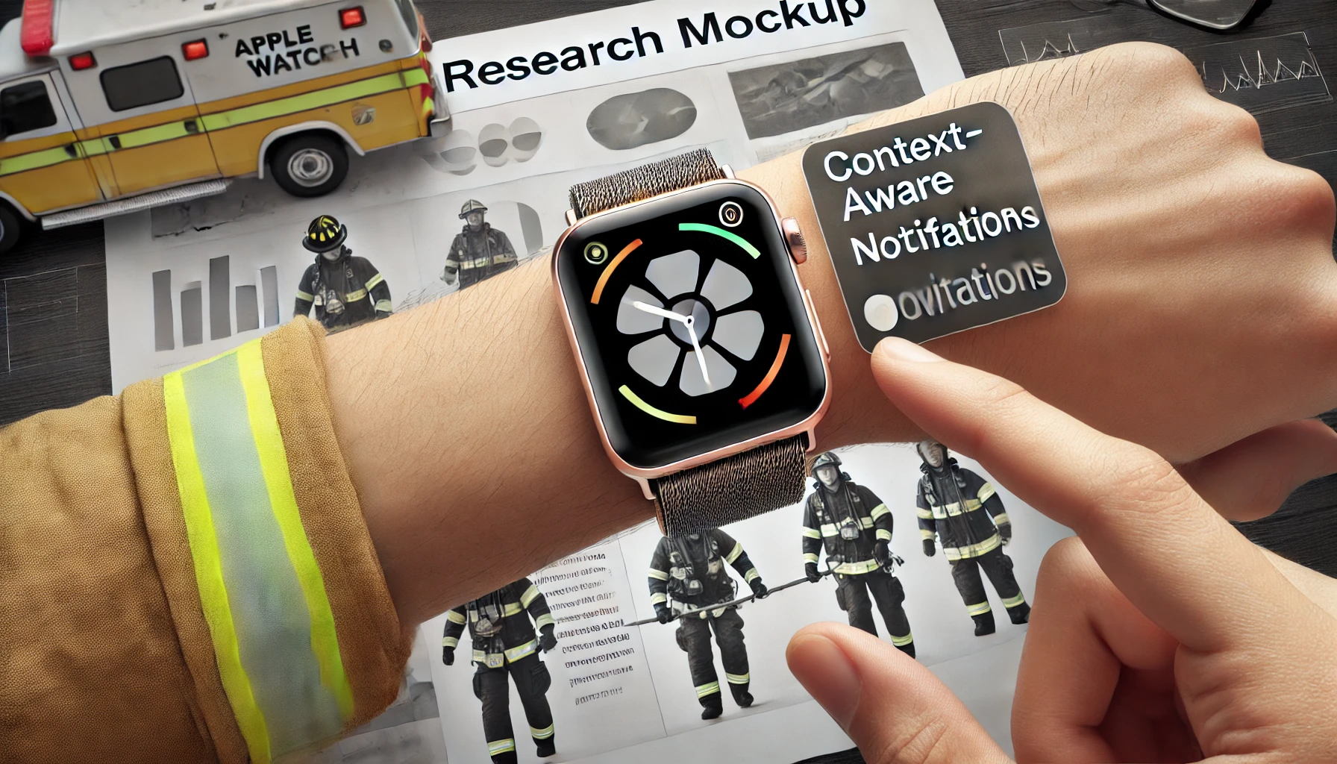
DetectWatch: Enhancing Situational Awareness and Interaction in Critical Contexts
https://www.amazon.in/Wildforlife-Anime-Detective-Conan-Collectors/dp/B0783QRQZZ
Notes:
Good afternoon, everyone. My name is John Doe, and today, I am introducing The DetectWatch. This wearable system is engineered to enhance situational awareness and interaction in high-stress environments, combining innovative features with an intuitive design that prioritizes user needs in critical scenarios.

Slide 2
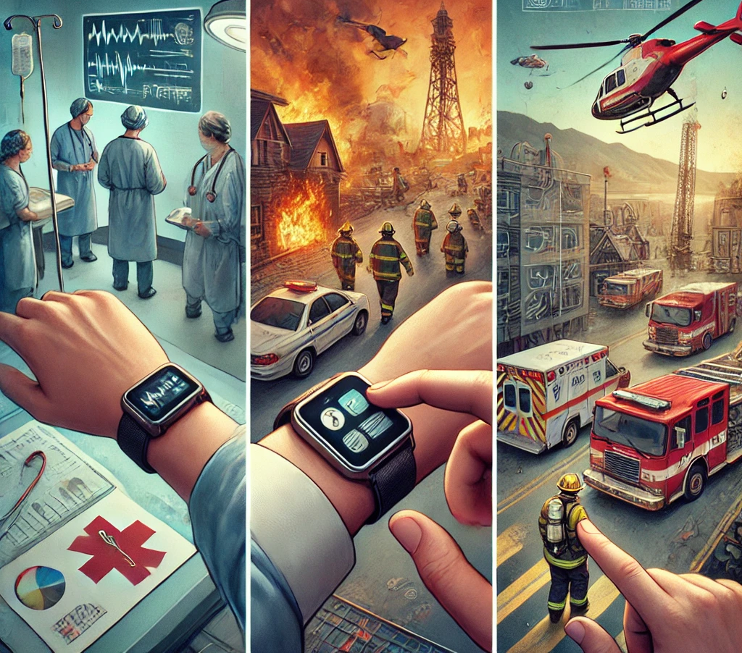
Motivation
Importance of situational awareness in critical environments
e.g., healthcare, emergency response, military operations
Existing gaps in supporting real-time interaction and awareness in dynamic and high-stress scenarios.
The need for a wearable solution that integrates seamlessly with users' workflows to enhance their situational awareness without adding cognitive load.
Notes:
First let’s talk about our motivation. In environments like healthcare, emergency response, and military operations, maintaining situational awareness is crucial for decision-making and performance. However, current systems often fall short in providing real-time support that adapts to the dynamic and high-stress nature of these settings. This motivated us to explore a solution that seamlessly integrates with the user's workflow, offering enhanced situational awareness without increasing cognitive load.

Slide 3
Previous Research
"AlertMe: Enhancing Medical Staff Response Time Through Wearable Notifications"
"SituAware: A Context-Aware Framework for Emergency Response Systems"
"WristSense: A Wearable Device for Real-Time Monitoring in High-Risk Environments"
Limitations:
Lack of integration with existing workflows
Excessive cognitive demands
Poor adaptability to rapidly changing contexts
Notes:
To build upon the existing body of work, we reviewed several notable studies. 'AlertMe' focuses on enhancing medical staff response times through wearable notifications, while 'SituAware' presents a context-aware framework tailored for emergency response systems. 'WristSense' explores real-time monitoring in high-risk environments using wearable devices. While these studies contribute valuable insights, they often suffer from poor integration with existing workflows, excessive cognitive demands, and limited adaptability to rapidly changing contexts. Our work aims to address these challenges.

Slide 4
Method: DetectWatch
AI-driven context recognition to adapt notifications in real-time.
Wearable device with context-aware notification system.
Integration with existing communication systems for seamless operation.
Multi-modal feedback based on criticality and context.
Notes:
Our proposed solution, DetectWatch, is a wearable device designed as a smartwatch equipped with a context-aware notification system. The system utilizes multi-modal feedback—both visual and haptic—tailored to the criticality of the situation and the user's context. We implemented AI-driven context recognition that allows DetectWatch to adapt notifications in real-time. Furthermore, DetectWatch integrates with existing communication systems to ensure seamless operation within established workflows.

Slide 5
Demo
Law enforcement and security
Emergency medical services
Corporate and diplomatic security
Extreme sports and adventure scenarios
https://youtube.com/shorts/VFOCTCb_omM?si=GAUVNkwgAcPmFsbt
Notes:
In this demo, you can see how the DetectWatch is built to help users. The watch automatically detects when user is in a high-stress scenario and provides users a notification for situational awareness. As you can see on the left, it switches interface so that the user can see relevant users and communicate with other peple to address the given critical situations.

Slide 6
Evaluation Study and Findings
Study with 60 participants (20 healthcare, 20 emergency response, 20 military).
Metrics:
Response time improvement (avg. 25% faster).
User satisfaction (avg. 4.6/5).
Reduction in cognitive load (measured by NASA-TLX, avg. 20% decrease).
Feedback:
"DetectWatch allowed me to stay focused on the task while staying informed."
"The haptic feedback was subtle but effective in keeping me aware of critical updates."
Notes:
"To evaluate DetectWatch, we conducted a study with 60 participants, representing healthcare, emergency response, and military sectors. We focused on three key metrics: response time, user satisfaction, and cognitive load. Our results showed an average response time improvement of 25%, with participants responding faster to critical updates. User satisfaction was high, with an average rating of 4.6 out of 5. Importantly, we observed a 20% reduction in cognitive load, measured by the NASA-TLX scale. Participants praised DetectWatch for allowing them to stay focused while remaining informed, and they found the haptic feedback subtle yet effective."

Slide 7
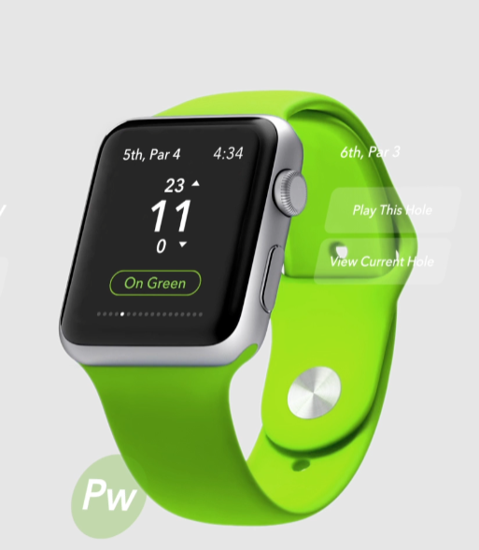
Conclusion and Future Work
Summary of contributions:
Developed Detective Watch, a context-aware wearable for critical environments.
Demonstrated significant improvements in response time and user satisfaction.
Future work:
Expanding DetectWatch to other critical domains (e.g., industrial safety).
Exploring machine learning models for even more precise context recognition.
Long-term field studies to assess sustained impact.
Notes:
In conclusion, DetectWatch represents a significant advancement in enhancing situational awareness and interaction in critical environments. We have demonstrated its effectiveness in improving response times and user satisfaction while reducing cognitive load. Moving forward, we plan to expand DetectWatch to other critical domains, such as industrial safety, and explore more advanced machine learning models for even more precise context recognition. Additionally, we aim to conduct long-term field studies to assess the sustained impact of DetectWatch in real-world settings. Thank you for your attention, and I look forward to your questions

