Slide 1
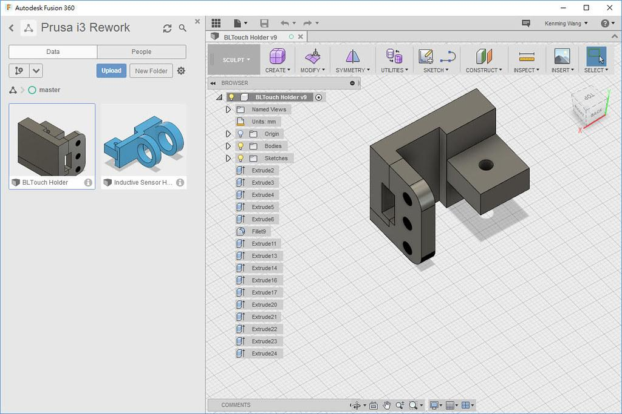
Installing Fusion 360 and Building a Simple Cube
Notes:
Good evening, everyone! Today, I'll be guiding you through the process of installing Fusion 360, a powerful CAD software, and demonstrating how to create a simple 3D model of a cube. This presentation is perfect for beginners, and by the end, you'll have a solid foundation to start exploring Fusion 360 further.

Slide 2
Introduction to Fusion 360
What is Fusion 360?
Cloud-based 3D CAD, CAM, and CAE tool
Key features and uses
Industrial and mechanical design
Simulation
Collaboration
Machining
System requirements
Compatible operating system
Enough RAM
Sufficient graphics capabilities
Notes:
Fusion 360 is a cloud-based 3D CAD, CAM, and CAE tool that brings together industrial and mechanical design, simulation, collaboration, and machining in a single package. It’s widely used in various industries, from product design to manufacturing. Before we dive into the installation, it's important to ensure your system meets the necessary requirements, including a compatible operating system, enough RAM, and sufficient graphics capabilities.

Slide 3
Downloading Fusion 360
Step1: Visit the Autodesk Fusion 360 Website
Open your web browser and go to Autodesk Fusion 360
Step2: Sign in or Create an Autodesk Account
Sign in: Click “Sign in” on the page
If you don't have an account, select "Create Account" and fill in your details.
Verify your email if needed
Step3: Download the Fusion 360 Installer
Choose your version: Select the appropriate option (free trial, educational, or subscription).
Download: Click the "Download" button and save the installer to your computer.

Slide 4
Installing Fusion 360
Step4: Install Fusion 360
Run the installer: Locate the downloaded file and double-click it.
Follow the on-screen instructions to complete the installation.
Step5: Start Using Fusion 360
Launch Fusion 360: Sign in if prompted, and complete any setup steps.
You’re now ready to start using Autodesk Fusion 360!

Slide 5
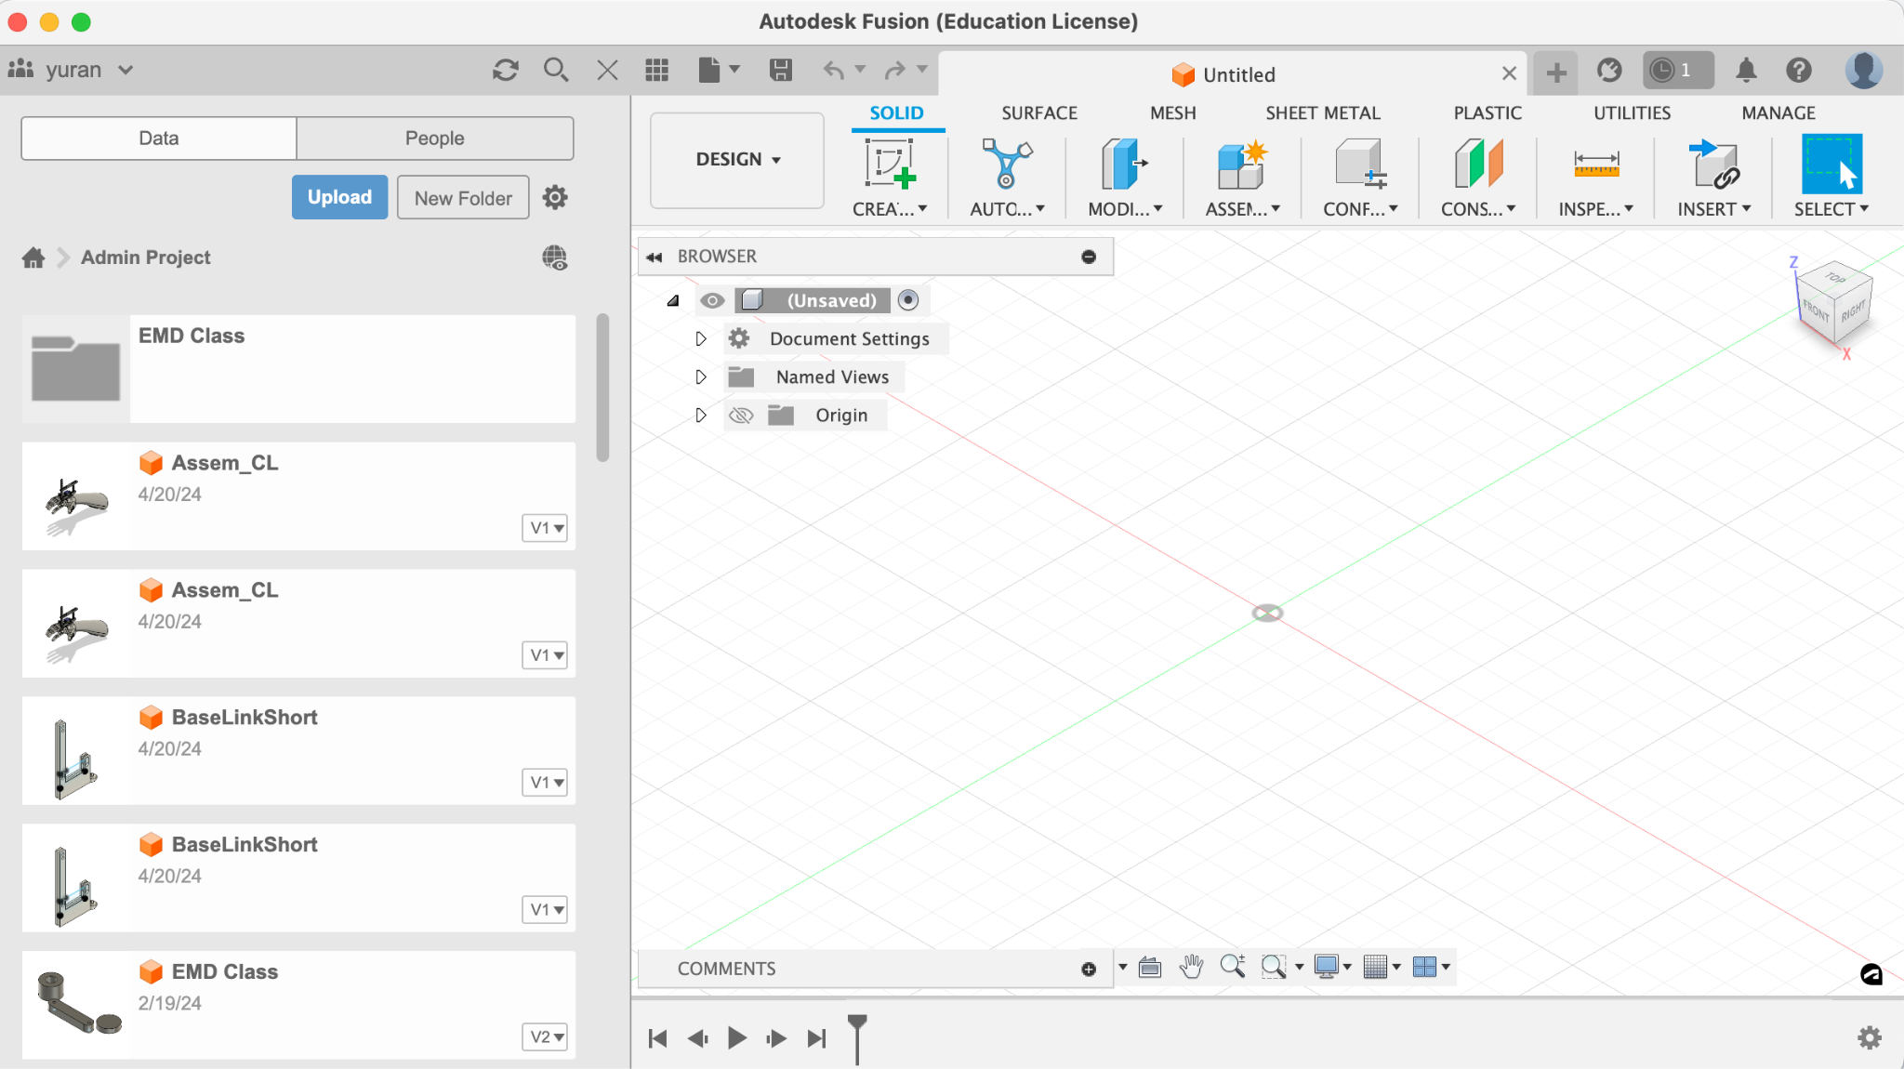
Creating a New Project and Workspace Setup
Notes:
Slide 5: Creating a New Project and Workspace Setup
Bullet Points:
Launch Fusion 360
Create a new project
Set up the workspace
Script: "Now that Fusion 360 is installed, let's start by launching the software. The first thing you'll do is create a new project to organize your designs. Once the project is created, you'll be directed to the workspace. Here, you can set up your environment by choosing the right units and views that best suit your needs for creating models."

Slide 6
Building a Simple Cube Model
Notes:
Slide 6: Building a Simple Cube Model
Bullet Points:
Create a new sketch
Draw a square on the XY plane
Extrude the square to create a cube
Script: "With the workspace ready, we can now create our first 3D model—a simple cube. Begin by creating a new sketch on the XY plane. Use the rectangle tool to draw a square, ensuring all sides are equal. Next, finish the sketch and use the 'Extrude' tool to pull the square into the third dimension, forming a cube. This is your first 3D model in Fusion 360!"

Slide 7
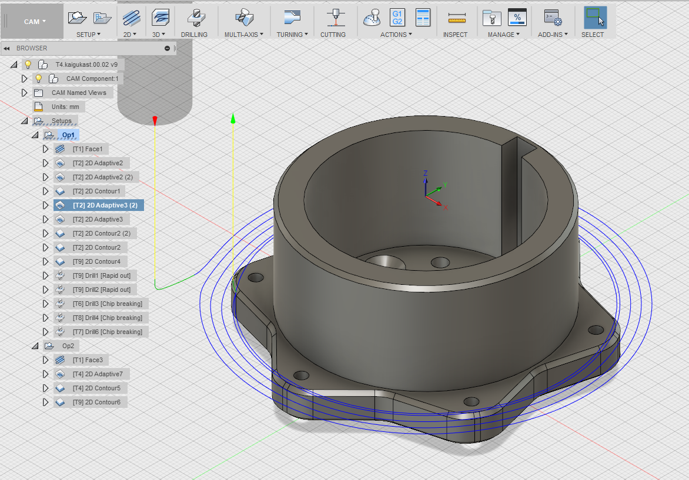
Conclusion and Next Steps
Fusion 360 offers a wide range of tools and features that allow you to design complex models, simulate their behavior, and even prepare them for manufacturing.
Notes:
Slide 7: Conclusion and Next Steps
Bullet Points:
Recap of the installation process
Recap of building the cube
Encouragement to explore further features
Script: "In summary, we’ve covered the installation of Fusion 360 and walked through the creation of a simple 3D cube model. This is just the beginning. Fusion 360 offers a wide range of tools and features that allow you to design complex models, simulate their behavior, and even prepare them for manufacturing. I encourage you to explore these features and start creating more advanced models as you become more comfortable with the software. Thank you for your attention, and I'm happy to answer any questions you might have."

