Slide 1
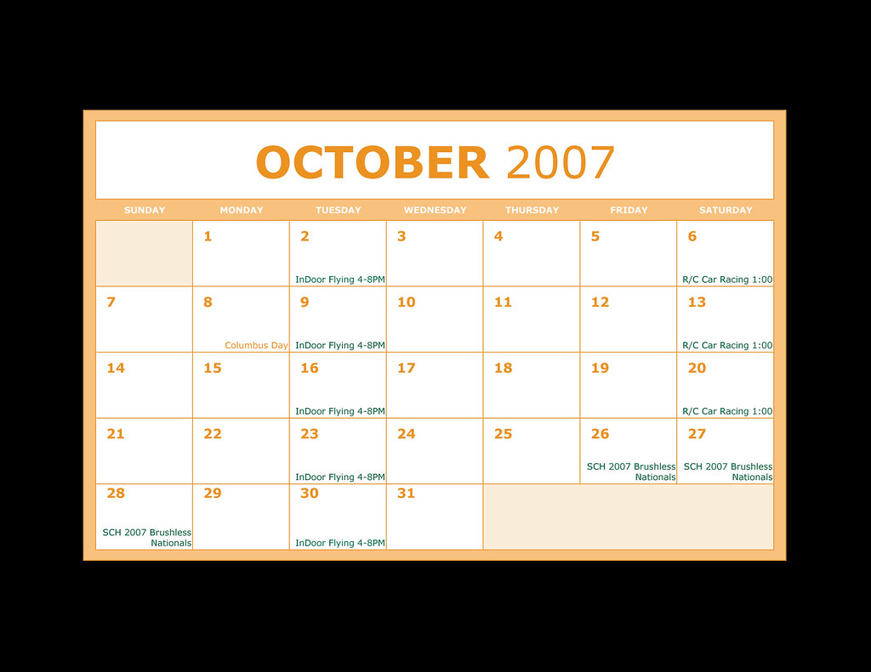
Mastering Time Management: Essential Skills for Productivity
A Step-by-Step Guide
Notes:
https://www.wikihow.com/Improve-Time-Management-Skills
Good [morning/afternoon], everyone. My name is [Your Name], and today I'll be sharing a concise guide on how to improve your time management skills. Whether you're a student, professional, or just looking to optimize your daily routine, these tips will help you make the most of your time."

Slide 2
What is Time Management? & Setting Clear Goals
Definition: Planning and controlling time spent on activities.
Importance: Boosts efficiency and productivity, reduces stress.
SMART Goals:
Specific, Measurable, Achievable, Relevant, Time-bound.
Align with long-term objectives and break down into manageable tasks.
Notes:
Time management involves planning and controlling how much time you dedicate to various tasks. It’s essential for increasing efficiency, reducing stress, and improving work-life balance. The first step in mastering this skill is setting clear, SMART goals—Specific, Measurable, Achievable, Relevant, and Time-bound. These goals give you direction and make it easier to break down larger tasks into manageable pieces.

Slide 3
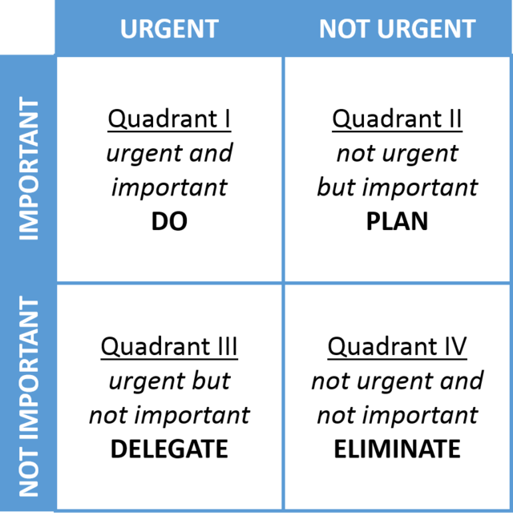
Prioritize Your Tasks
Eisenhower Matrix:
Urgent vs. Important tasks.
Focus on high-impact tasks.
Avoid multitasking
Single-task focus leads to better results.
Notes:
Once you’ve set your goals, the next step is to prioritize your tasks. Using tools like the Eisenhower Matrix, you can distinguish between urgent and important tasks. Prioritize high-impact activities that align with your goals. Also, avoid multitasking—it’s more effective to focus on one task at a time, ensuring higher quality and faster completion.

Slide 4
Create a Schedule
Notes:
Effective scheduling is crucial to good time management. Use planners to organize your day, week, and month, assigning specific time blocks to each task. Don’t forget to include breaks and buffer times. This not only helps prevent burnout but also provides flexibility to handle unexpected interruptions.

Slide 5

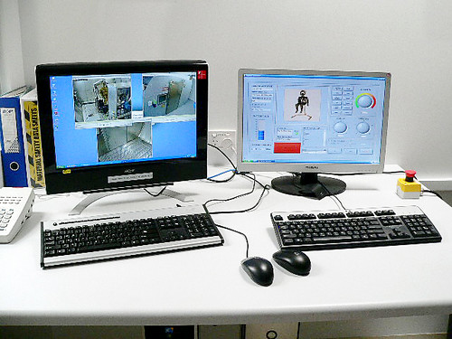
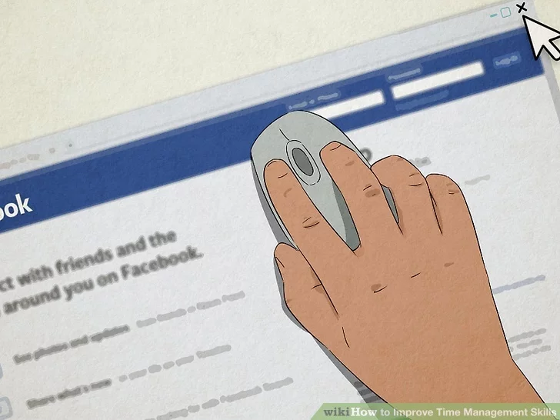
Eliminate Distractions
Identify common distractions
e.g., social media, noise
Create a focused work environment.
Use apps and tools to block distractions.
Notes:
To maximize your productivity, it’s essential to eliminate distractions. Identify what typically pulls your attention away—whether it’s social media, noise, or other interruptions. Create a focused work environment and consider using apps or tools that help you block these distractions, especially during critical work periods.

Slide 6

Review and Reflect
Notes:
Finally, effective time management requires continuous improvement. Regularly review your progress toward your goals, and be open to adjusting your strategies if something isn’t working. Reflecting on your successes and challenges will help you refine your approach and keep improving over time.

Slide 7
Closing Thoughts
Setting clear goals
Prioritizing tasks
Creating effective schedules
Eliminating distractions
Reviewing your progress
Enhance your productivity and make the most of each day!
Notes:
In closing, mastering time management involves setting clear goals, prioritizing tasks, creating effective schedules, eliminating distractions, and continuously reviewing your progress. By applying these strategies, you can significantly enhance your productivity and make the most of each day. Thank you for your attention, and I hope these tips help you on your journey to better time management."

