Slide 1

Integrating Ansible With CI/CD Process

Slide 2
Purpose:
Main aim is to demonstrate how to use Ansible for environment provisioning and application deployment in a Continuous Integration/Continuous Delivery (CI/CD) process using a Jenkins pipeline
The purpose of using Ansible in the pipeline flow is to reuse roles and Playbooks for provisioning, leaving Jenkins only as a process orchestrator instead of a shell script executor.

Slide 3

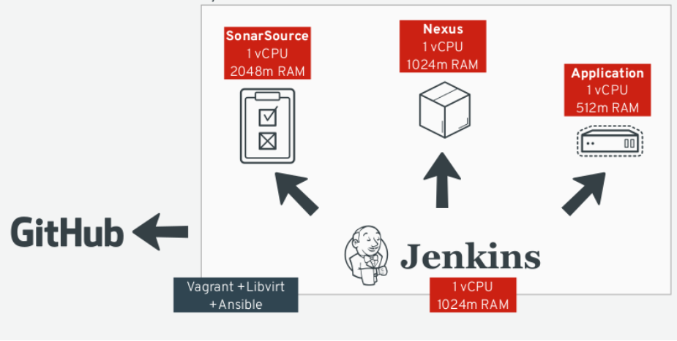
Infrastructure Architecture

Slide 4
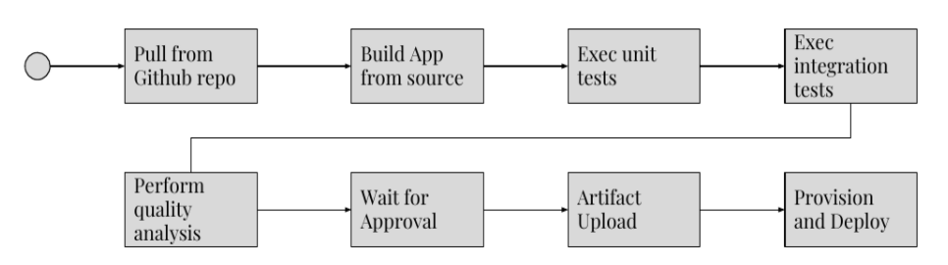
Pipeline Flow

Slide 5
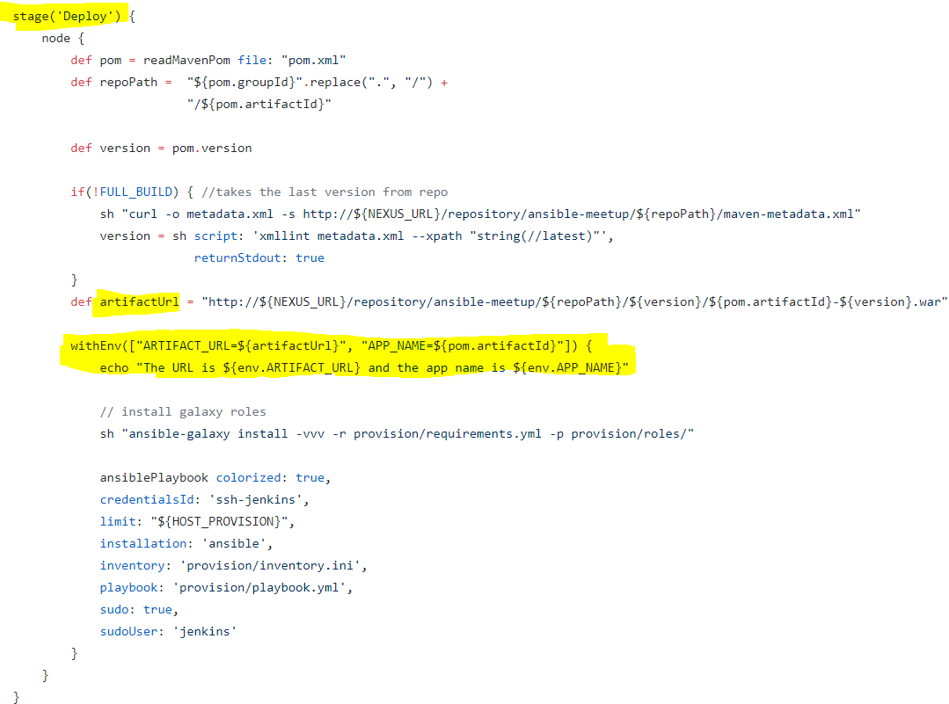
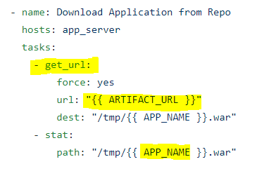
Ansible Integration With Artifactory
The pipeline flow just sets the required parameters like the compiled artifact URL and the target host to execute the Ansible Playbook afterward.

Slide 6
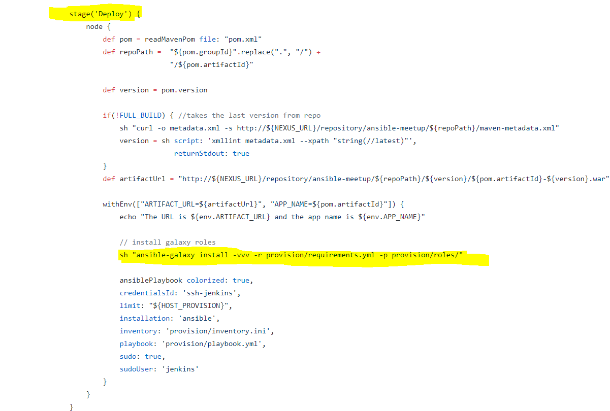
Ansible Jenkins Plugin
By using the Ansible Jenkins plugin, it was possible to call this Playbook from the pipeline by setting the variables required to execute it.

Slide 7

Ansible played a fundamental role twice
First, We can automate whole infrastructure like Jenkins Server, Maven, Git, Sonar Server, Nexus Or Jfrog artifactory and some dependencies for pipeline setup. (Infrastructure provisioning )
Second, as a tool to deploy our application through Jenkins pipeline. (Application Deployment)
The pipeline has been designed to prepare the application binaries, now called “artifact”, and to upload them in Nexus/JFrog. The artifact can be reached in Nexus by an URL usually called Artifact URL. Ansible is also part of the pipeline and will receive the Artifact URL as the input for deployment.
Thus, Ansible will be responsible not only for the deployment but also for the infrastructure provisioning.

