Slide 1
GSUB Shopping System
Team: UNITY
Bountang Her (Coordinator)
Aamir Shaikh
Jeongsu Park
Ortagus Winfrey

Slide 2
Roles
Bountang Her - Team Coordinator, UML Document Handler, and UI Tester.
Aamir Shaikh - UI Designer, UI Tester, and UML Document Assistant.
Jeongsu Park - Java Coder, Schedule Coordinator, UI Tester, and Database Programmer.
Ortagus Winfrey - UI Tester, Database Assistant, and UML Document Assistant.

Slide 3
Introduction
Team Unity’s goal is to build a GSUB shopping system that services to the well-being of GSU students, providing an optimal alternative option in mitigating their spendings, by exponentially reducing the costs of textbooks. GSU Books (GSUB) shopping system is a web base application for GSU students to purchase used books at a discounted rate. The user can navigate and browse through the system contents, looking for particular books to purchase. When user decides upon the book of interest, he/she will make a login account with GSUB before purchasing.
With an existing account, and the user could buy or sell their books within the application.
Notes:
All were using NETBEANS 8.2

Slide 4
Project Information
The Java project consists of 25 Java Classes.
~6900 lines of code at the current time.
Collaboration Done via Slack, Trello, and Github.
Final Deliverable is currently 51 pages.
Java Swing utilized to create the GUI.
3rd party libraries used
SQLite/DBJC, RS2XML.JAR(rs2xml is a jar library that can be used to make the result set of a query an input for the table model is pretty useful)
FTP Cost analysis is 1590.
Notes:
RS2XML used to populate and join the jtable.
Sqlite-JDBC Library used to connect sqlite with Java

Slide 5
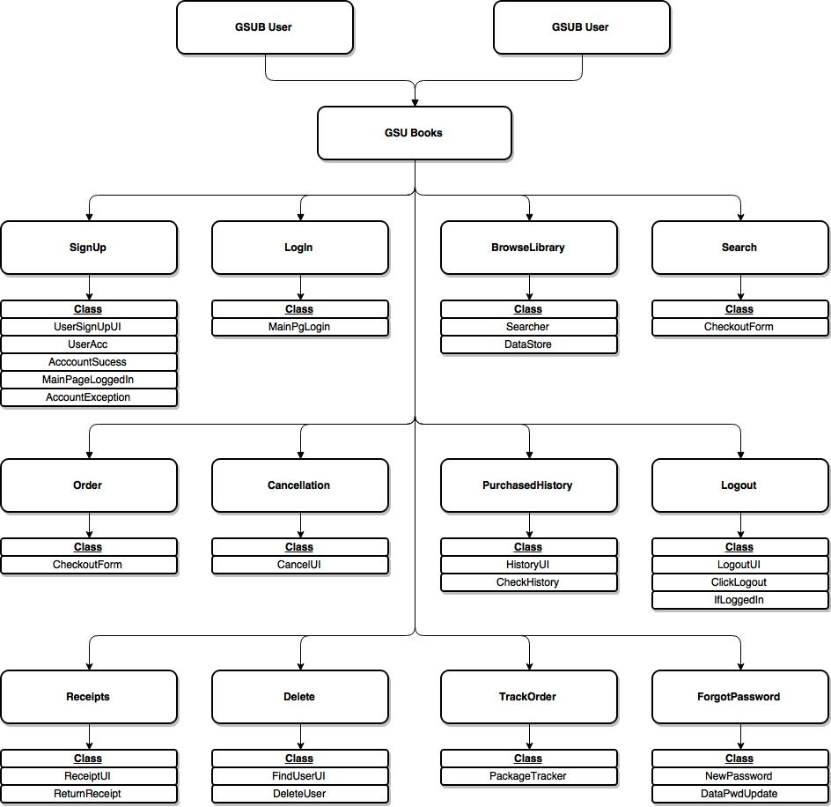
System Draft

Slide 6
Use Cases
Sign-up
Login
Forgot Password
Browse Library
Search
Place an order
Cancel Order
History
Logout
Track Order

Slide 7
Sign-up Case
The user is prompted to give an Email, a password, and a nickname.
The email used to set up the account must be a GSU email.

Slide 8
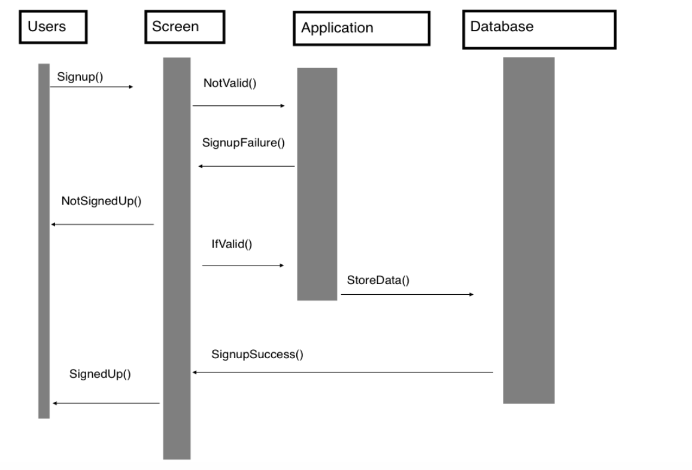
Sign-up Diagram

Slide 9
Login Case
The user uses the email and password they entered on the registration page to log into the system.
From here the user is transported to the main screen again, but at this point a “My Acct” button is present that can take them to their account page.

Slide 10
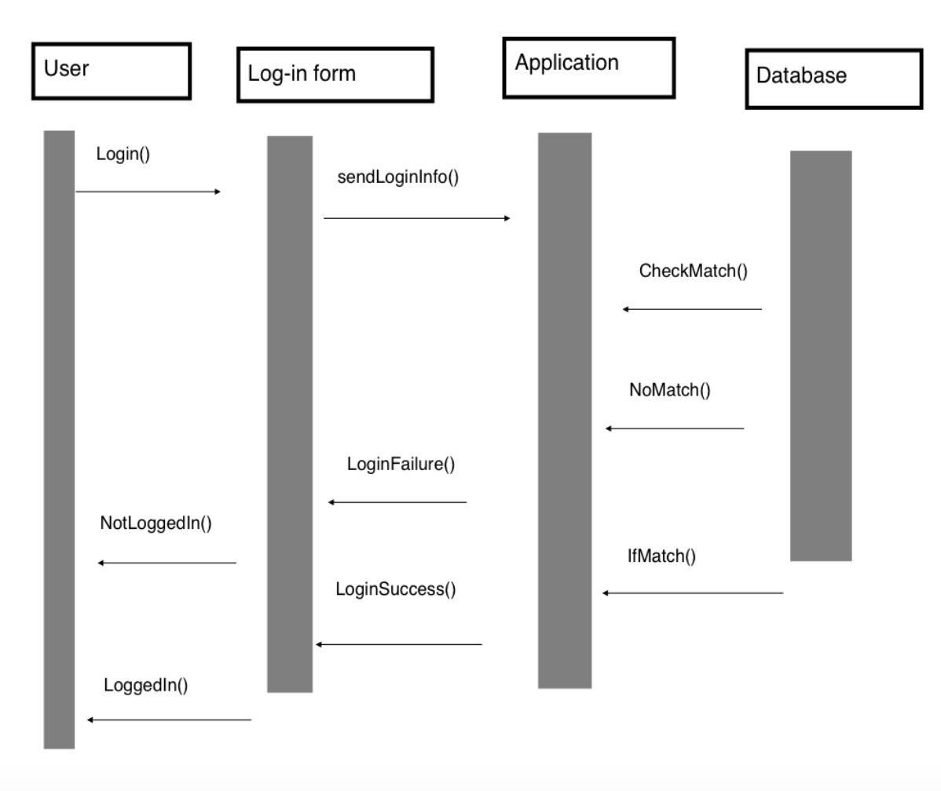
Login Diagram

Slide 11
Forgot Password
The user puts in the email, and nickname they used to sign up for the system on the signup page.
If the email and nickname matches what is present in the database then the password is returned via a prompt box.

Slide 12
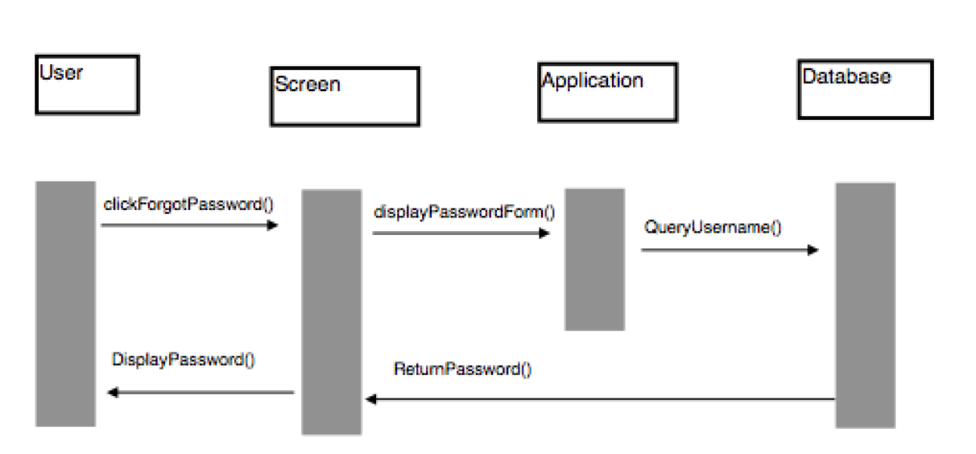
Password Diagram

Slide 13
Browse Library
Here the user is able to see what is currently stored in the library.
Books that have been added to the database are present here.

Slide 14
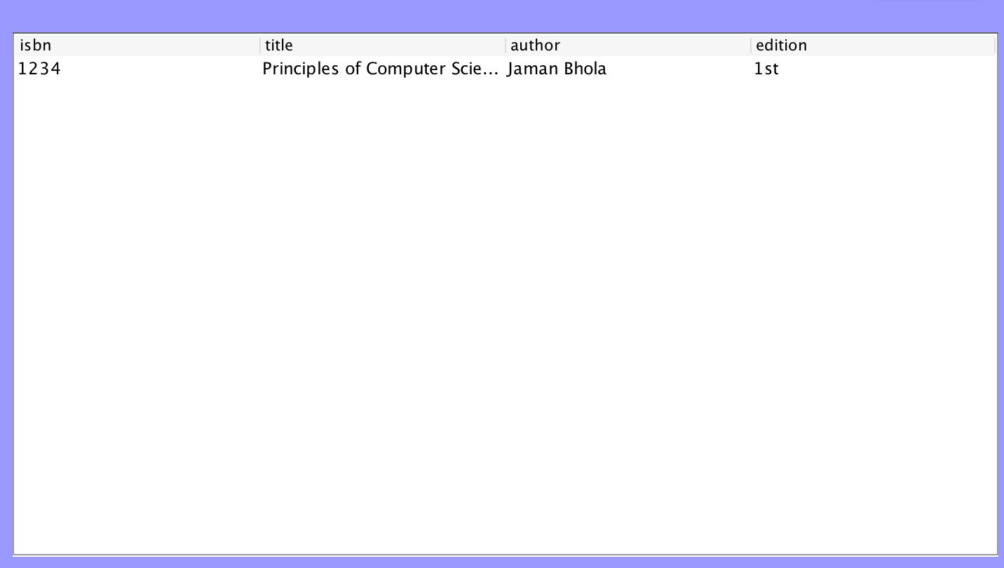
Browse Picture

Slide 15
Search
The user is able to search through the Library using the only ISBN number.
If present in the database this information shows up for them in the application .

Slide 16
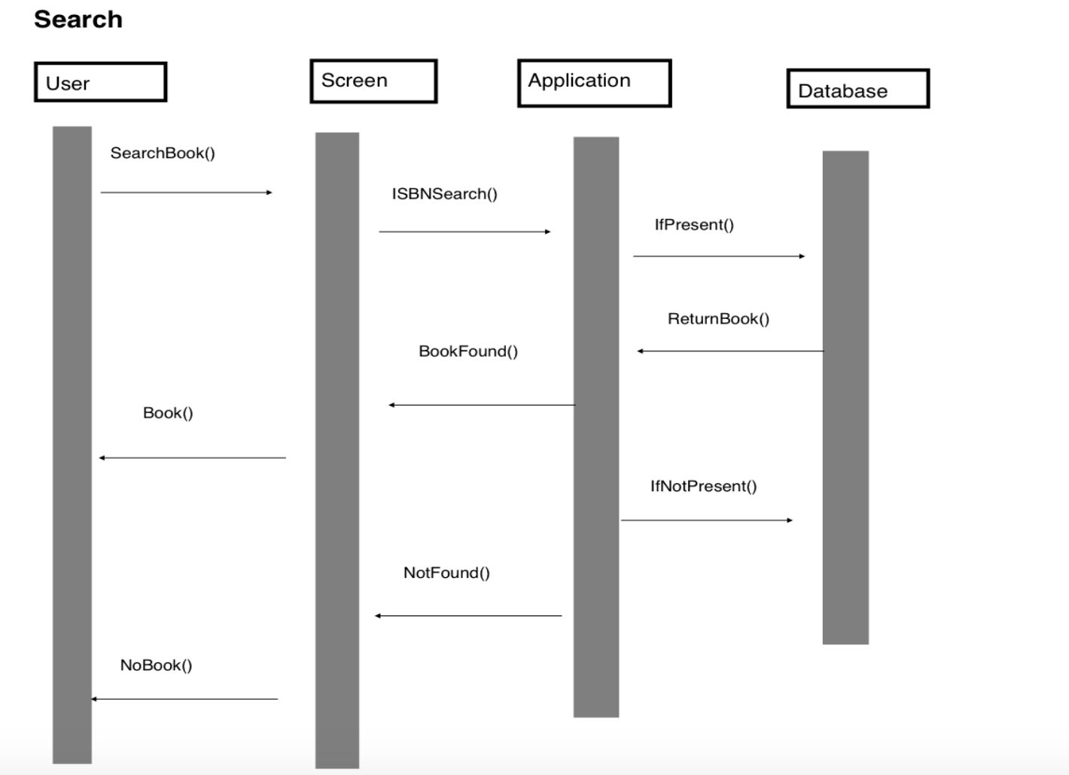
Search Diagram

Slide 17
Remove from the Cart
When in the cart page if the user clicks on the book a new page is presented to them.
This asks the user if they want to remove the selected book from their cart.
From here the user is able to remove the book from their cart, or allow them to keep it there.

Slide 18
Place Order
When a book is added to the cart the user is able to view it on their cart page.
When the proceed to checkout button is clicked on the user is able to enter in their details to purchase the book.
These details includes a shipping address prompt first, followed by a payment page which includes: Billing address,Card Name,Card type, etc

Slide 19
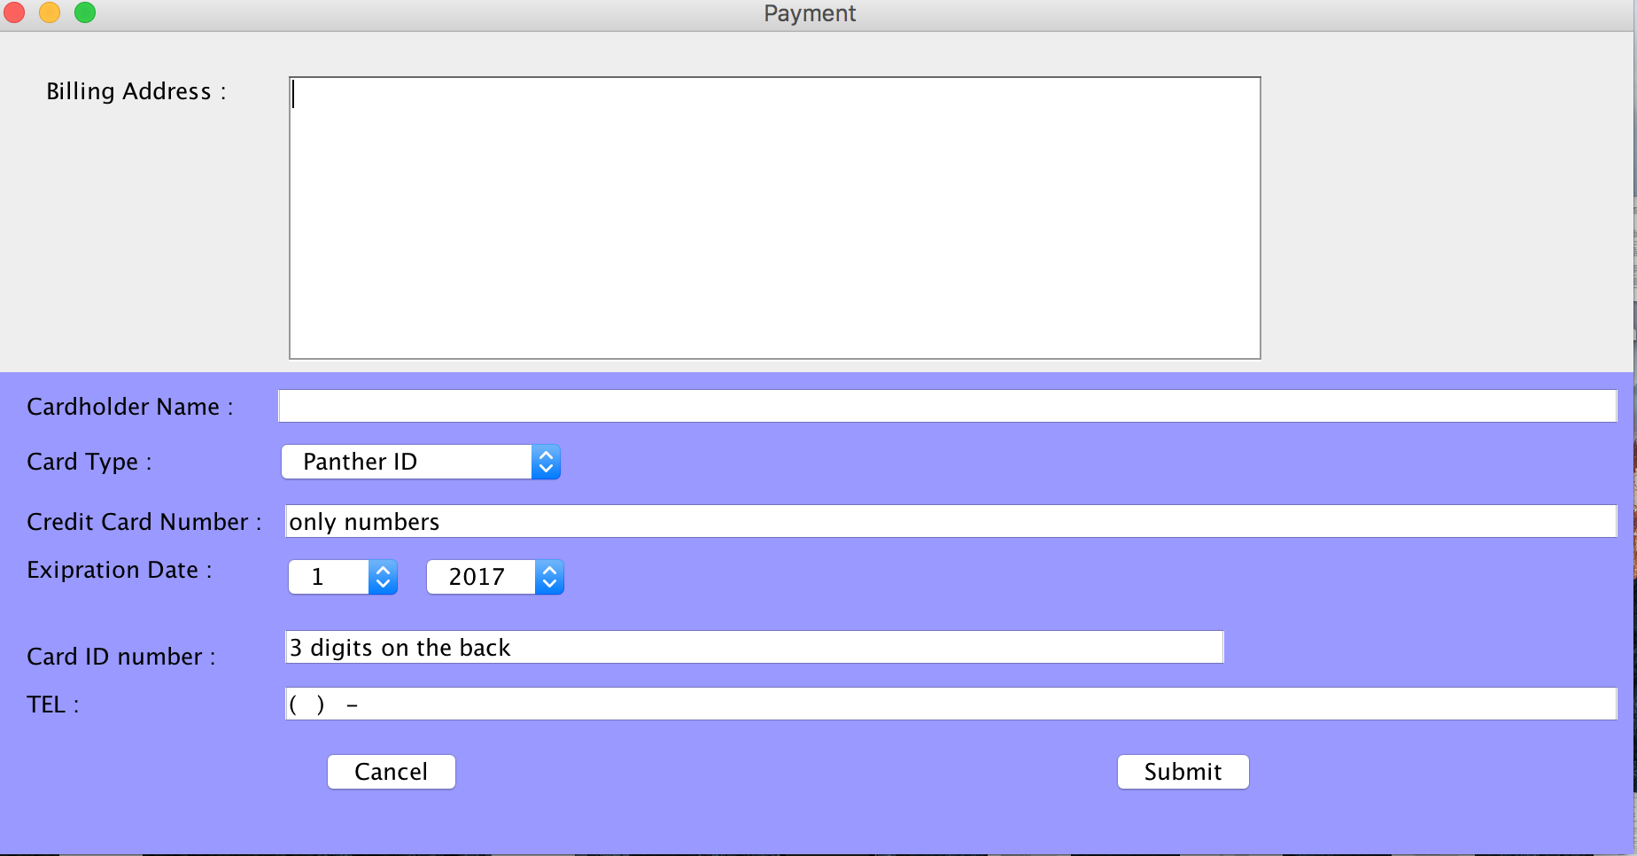
Order Image

Slide 20
Account Page
On the account page the top box shows which book is currently being sold by the user.
The middle box corresponds to the tracking portion of the program. Books which are being shipped are displayed in this box.
The bottom box shows the books which have been sold by the user.

Slide 21
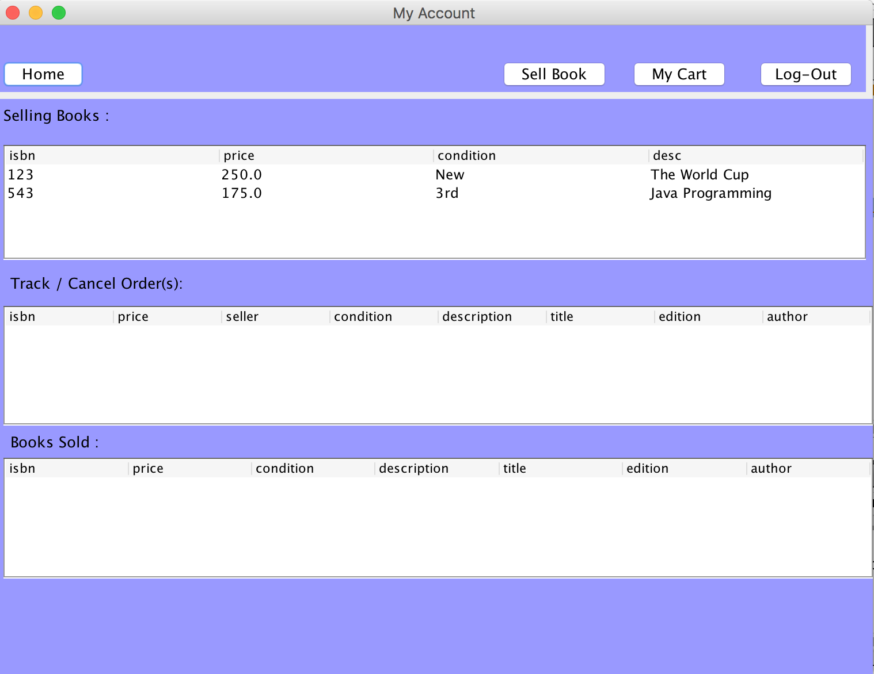
Account Picture

Slide 22
Tracking
A book that is clicked on in the tracking box on the account page brings up a page to show a tracking page.
A box showing the address the user entered when purchasing the book is displayed on the page.
Another option to cancel the order is also present on this page.

Slide 23
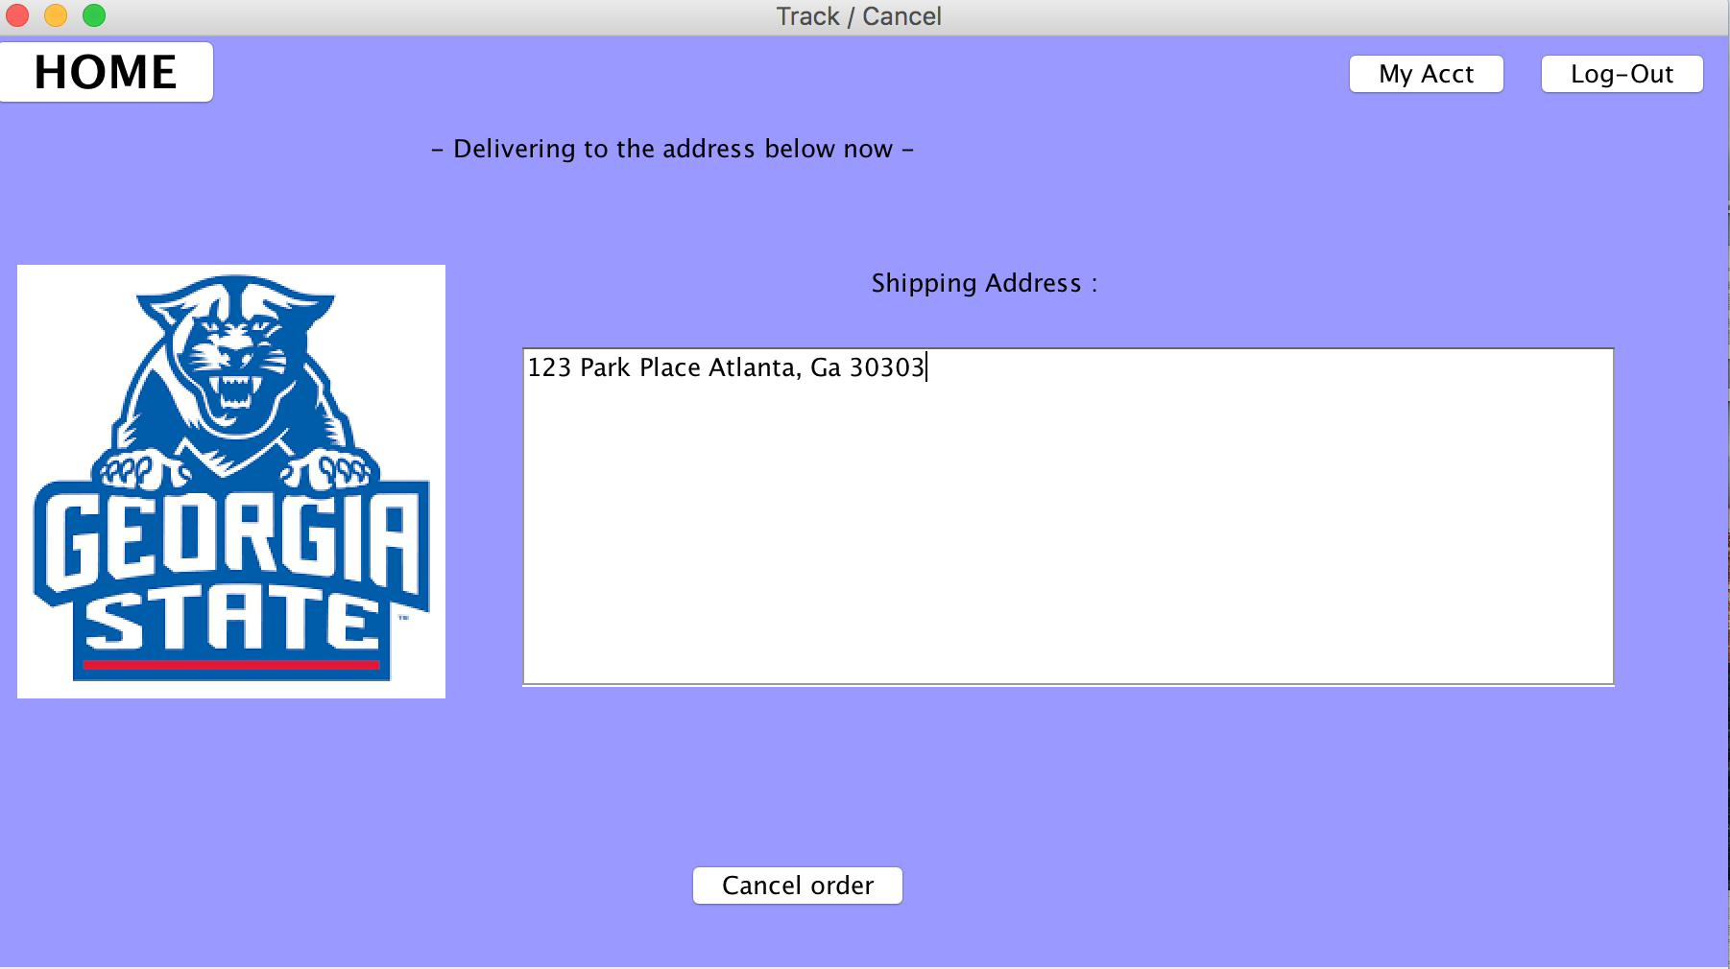
Tracking Picture

Slide 24
Logout
The user is able to end their session within the system.
The user clicks the logout button, and then is transported back to the main page of the application.

Slide 25
Database Design
Database designed with SQLITE
Implemented to not only contain the User information, but also the information of the books that would be stored into the system.
Full Interaction with the application.
The connection with the database is closed and reopened as the user moves through the pages. Designed to help with SQLite functionality.
Notes:
The Database closes between pages because Sqlite only allows one process to write the Database at once(Database locks)

Slide 26
Database Tables
Log2-gsuemail(Varchar) Primary key
Inventory-ISBN(Integer) Primary key
OpenInventory -Price(Double), ISBN(Integer), and Seller(Varchar) Primary Key
Cart3-Price(Double), ISBN(Integer), Buyer(Varchar), and Seller(Varchar) Primary Key
Address-Buyer(Varchar) Primary key
Cardinfo1-Cardnumber(Integer) Primary key
Notes:
ISBN used because it is able to give specific book and edition.

Slide 27
Demonstration

Slide 28
Summary
Aside from making a user friendly ecommerce system, team Unity’s ultimate goal was to get a better understanding on what it’s like working in team development, and discovering new applications to work with. Our team came together knowing that one member can be more knowledgeable in programming than the other. Putting aside our insecurities, we had to be humble to one another, and be willing to take the opportunity to learn and fine-tune our weaknesses.

