Slide 1
Binary Tree based Distributed Content Searching System with Subtree-level Logging
Gandhar Vaidya(830506349) and Rohit Iyer( )

Slide 2
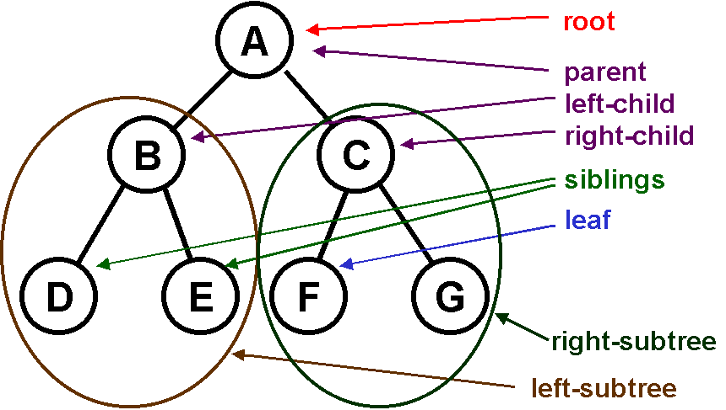
Background
Binary Tree is a type of data structure which has 3 pointers.
The “root” pointer points to the topmost node in the tree.
The left and the right pointers recursively point to smaller “subtrees” on either side of the tree.
All the elements in the left sub-tree are less or equal to the node and the ones in the right subtree are greater or equal to the node.
The nodes at the very bottom edge of the tree have empty subtrees and are called leaf nodes.
Lookup time for a particular node in a binary search tree is logN in average case.

Slide 3
Motivation
Many wide-spread applications make use of DHT based P2P technology as their groundwork due to its scalability, robustness, and efficiency in load balancing .
Applications like file sharing, communication and live video streaming are usually in a large distributed network environment.
Complex query processing is a major issue for DHT for an efficient and effective search in large data repositories.
Towards the goal of supporting complex queries in DHT-based P2P systems, this project or idea or algorithm??? focuses on the usage of binary tree to build a tree-based index.

Slide 4
Architecture
The nodes are placed in a binary tree structure.
Every node maintains three pointers – right , left and the root.
All message will contain a key representing an existing node or a resource in the system and will be propagated within the tree.
This will generate a response from the node with that particular key referring to a node in its right or left sub-tree (In case of JOIN the subtree does not exist yet).
The identifier space gets halved as we move down from the root ( parent ) at each level of the tree.
The flow will be in a circular key identifier space but DHT is based on root’s key.
The root is given key 0 and all other nodes in the system will have keys relative to the root depending on their position i.e. ( left or right subtree ).

Slide 5
Algorithm
Queries can be generated at any node in the network and the queries propagate towards the root , in the left or right subtree.
DHT is based on root’s key wherein root has 0 key and all other nodes have keys assigned relative to the root. ( depending on their position )
JOIN and SEARCH messages will be issued with a key representing a live node in the system and will propagate and eventually yield a response from a node with that particular key.
This key might be present in its right or left subtree except for the fact the subtrees do not exist until now.
Whenever a parent node leaves – a REJOIN message is sent by that parent for its children to stay connected to the network and find a new parent.

Slide 6
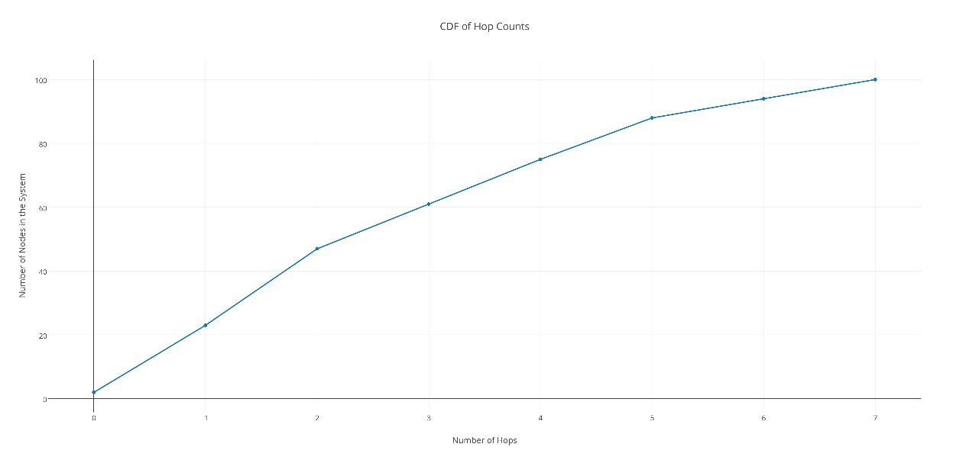
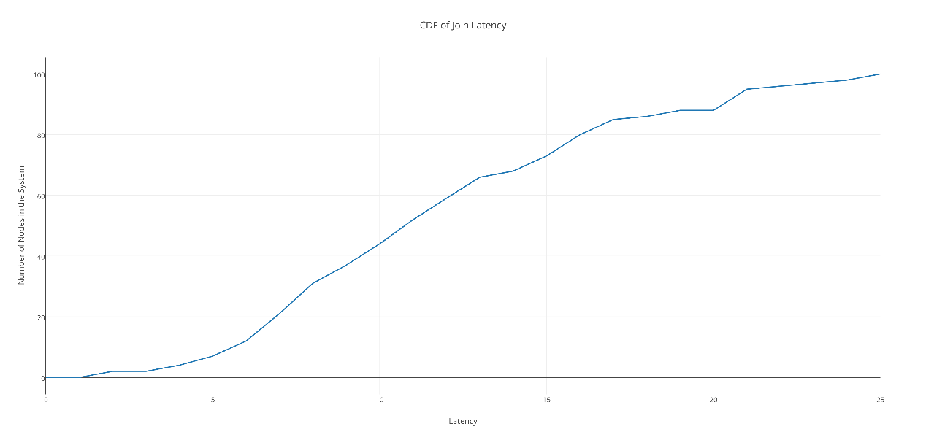
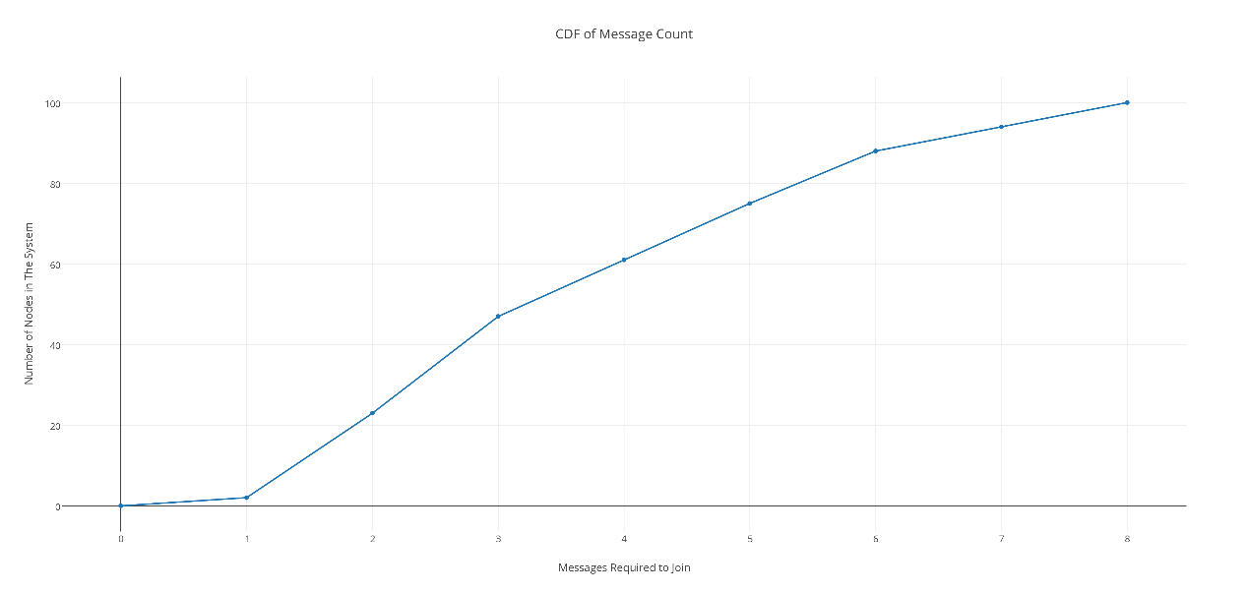
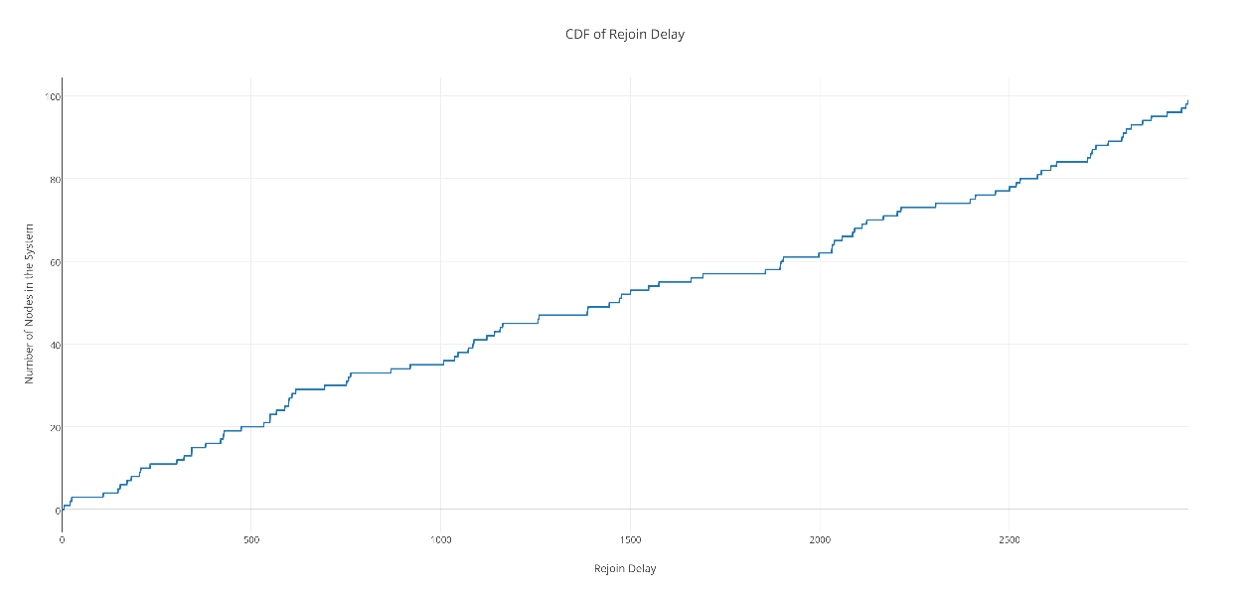
Results

Slide 7
Applications
Multicast
Multicasting applications send small messages to a large number of recipients at the same time without the need to establish point to point connections. The emphasis of such applications is speed over reliability. In other words, it is more important to send timely data than to ensure any specific message is actually received.
Subtree logging system
Sub-tree logging propagates log entries generated locally towards the root while logging them at intermediate nodes as well.
Narrowing the errors found in the system to a particular sub-tree or parent.

Slide 8
Conclusion and Future Scope
This tree based data structure allows us to locate a node in O(logN) time where N = number of nodes.
There is no need of a LEAVE protocol since node departures are automatically taken care of by rejoining mechanism used in the system for the departing nodes’ children.
The children of the departing node send JOIN requests if their parent leaves the network and get connected at appropriate locations.
This structure can be used for multicast purpose since we use just a single source in the network.
Support for splay operations can be provided

Slide 9
References
http://cslibrary.stanford.edu/110/BinaryTrees.html#s1
https://msdn.microsoft.com/en-us/library/hh556229(v=vs.110).aspx
http://ajbasweb.com/old/ajbas/2014/December/356-360.pdf
http://research.ijcaonline.org/volume62/number12/pxc3884923.pdf

