Slide 1
Integration of Multiple Static Analysis Tools in a Single Interface
G. S. Varma
Supervisors:
Prof. Dr. Eric Bodden
Dr.-Ing. Ben Hermann

Slide 2
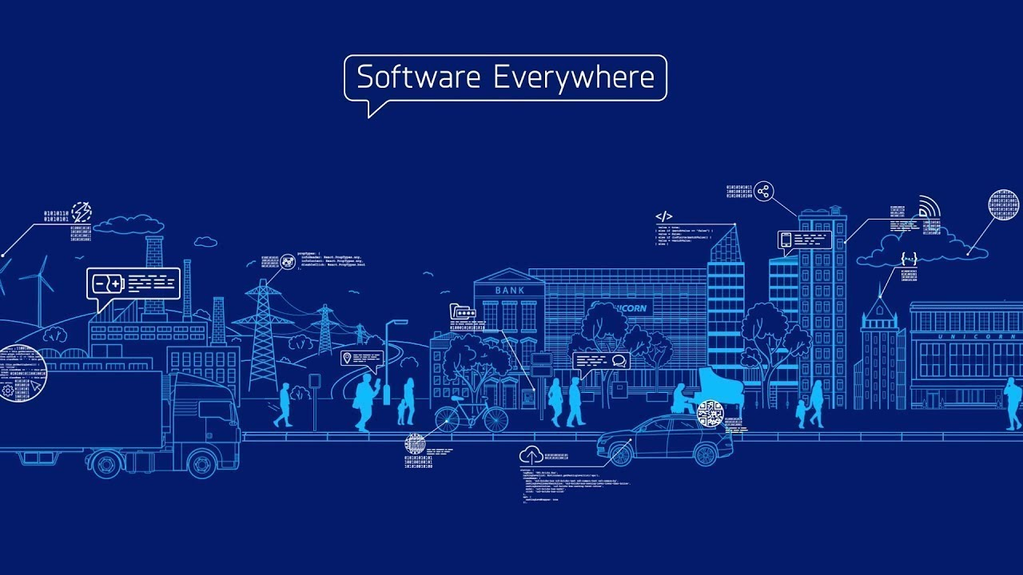
https://unicorn.com/en/software-everywhere

Slide 3

“ $1.1 Trillion in Assets Affected by Software Bugs in 2016 “
Software Fail Watch Annual Report,
Tricentis
https://www.tricentis.com/news/software-fail-watch-says-1-1-trillion-in-assets-affected-by-software-bugs-in-2016/

Slide 4

Static Code Analysis
It helps in prevention of bugs.
It examines code without execution.
Detects vulnerabilities :
- Injections
- Cross Site Scripting (XSS)
- Buffer Overflow, and Dead Code etc.
Designing code analyses for Large Software Systems (DECA). url: https://www.hni.uni-paderborn.de/swt/lehre/deca/.

Slide 5

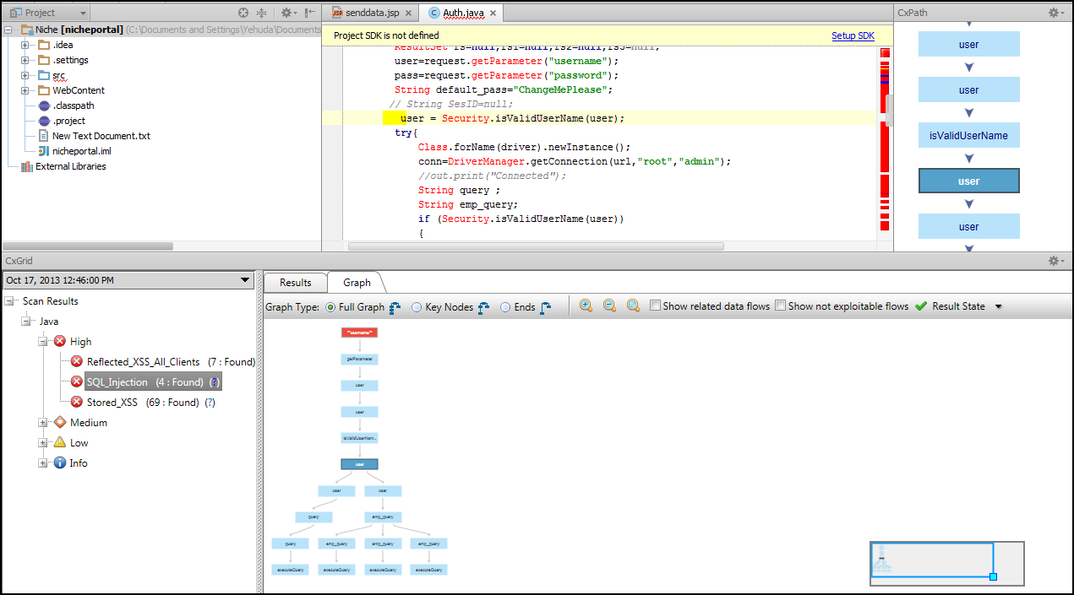

Static Code Analysis
Tools :
IDE notifications
IDE tools
Dedicated tools
Linters
CLI tools
Checkmarx – Application Security Testing and Static Code Analysis. url: https://www.checkmarx.com/
CxViewer - Plugins | JetBrains, url: https://plugins.jetbrains.com/plugin/7593-cxviewer
FindBugs™ - Find Bugs in Java Programs. url: http://findbugs.sourceforge.net/.

Slide 6
Static Code Analysis
Johnson et. al.
Tool output
Result understandability
Christakis et. al.
Usability Issues
Brittany Johnson, Yoonki Song, Emerson Murphy-Hill, and Robert Bowdidge. 2013. Why don't software developers use static analysis tools to find bugs?. In Proceedings of the 2013 International Conference on Software Engineering (ICSE '13). IEEE Press, Piscataway, NJ, USA, 672-681.
Maria Christakis and Christian Bird. 2016. What developers want and need from program analysis: an empirical study. In Proceedings of the 31st IEEE/ACM International Conference on Automated Software Engineering (ASE 2016). ACM, New York, NY, USA, 332-343. DOI: https://doi.org/10.1145/2970276.2970347

Slide 7
Multiple Tools
Developers use multiple static analysis tools each having own coverage.
Research trends:
Prioritise the bug warning alerts
( Flynn et. al. )
Merges 3 tools for Java to show warnings
( Meng et. al. )
Lori Flynn, William Snavely, David Svoboda, Nathan VanHoudnos, Richard Qin, Jennifer Burns, David Zubrow, Robert Stoddard, and Guillermo Marce-Santurio. 2018. Prioritizing alerts from multiple static analysis tools, using classification models. In Proceedings of the 1st International Workshop on Software Qualities and Their Dependencies (SQUADE '18). ACM, New York, NY, USA, 13-20. DOI: https://doi.org/10.1145/3194095.3194100
N. Meng, Q. Wang, Q. Wu and H. Mei, "An Approach to Merge Results of Multiple Static Analysis Tools (Short Paper)," 2008 The Eighth International Conference on Quality Software, Oxford, 2008, pp. 169-174.doi: 10.1109/QSIC.2008.30

Slide 8
Multiple Tools
Tricorder
ReviewBot
Separate bug coverage by separate tool
Evaluation: Summative – Click rates
(Sadowski et. al. )
Parfait
Scalability ( easy , expensive analysis )
Precision ( bug track – real, no, potential )
(Cifuentes et. al. )
But USABILITY is not addressed…
Caitlin Sadowski, Jeffrey van Gogh, Ciera Jaspan, Emma Söderberg, and Collin Winter. 2015. Tricorder: building a program analysis ecosystem. In Proceedings of the 37th International Conference on Software Engineering - Volume 1 (ICSE '15), Vol. 1. IEEE Press, Piscataway, NJ, USA, 598-608.
Cristina Cifuentes and Bernhard Scholz. 2008. Parfait: designing a scalable bug checker. In Proceedings of the 2008 workshop on Static analysis (SAW '08). ACM, New York, NY, USA, 4-11. DOI=http://dx.doi.org/10.1145/1394504.1394505

Slide 9
Problem Statement
How to integrate the results of multiple static analysis tools
in a unified user interface?
3 Research Questions

Slide 10
Research Question 1
How to display results of the same codebase from
different analysis tools?

Slide 11
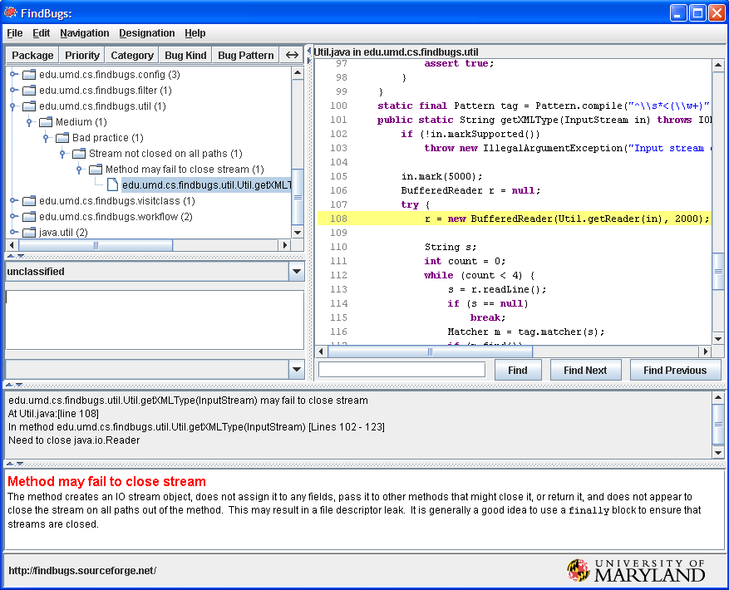
What Current Tools do? - RQ 1: .. display results!
FindBugs

Slide 12
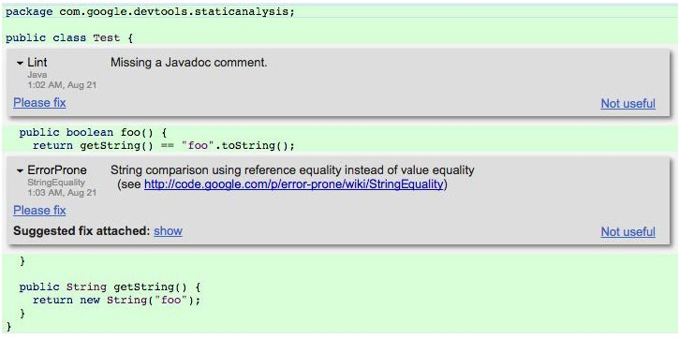
What Current Tools do? - RQ 1: .. display results!
Tricorder

Slide 13
Research Question 2
What feedback works to know that the bug fixing is on-going?
What current tools do?
Traditional approach – Nightly Builds

Slide 14
Research Question 3
How to carry traceability of bug fixing?

Slide 15
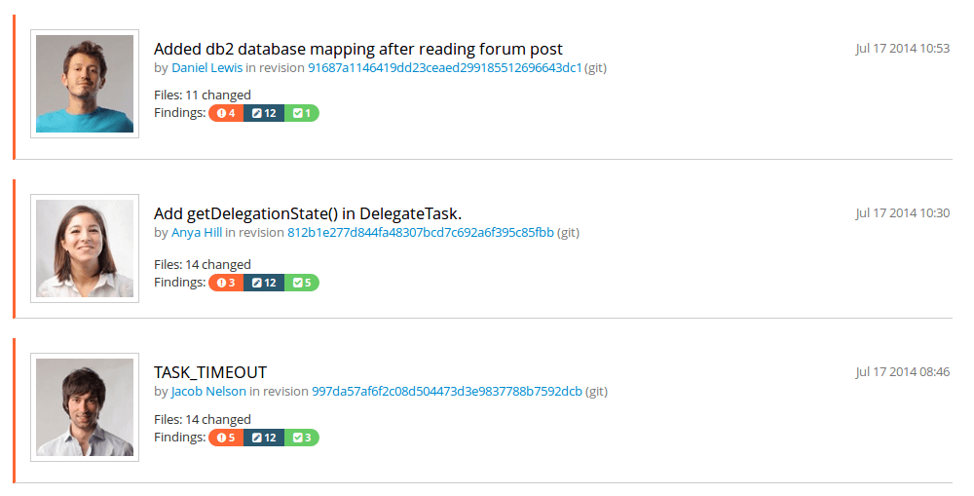
What Current Tools do? - RQ 3: .. traceability!
Teamscale
Teamscale. url: https://www.cqse.eu/en/products/teamscale/features/.

Slide 16
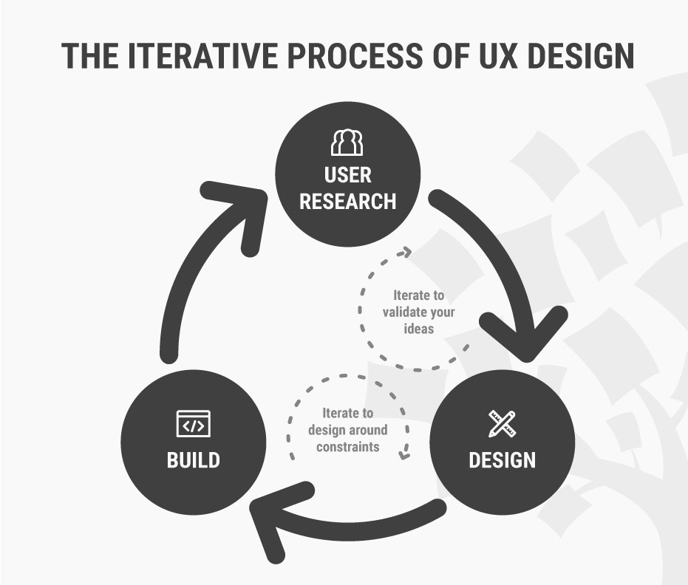
Our Approaches
How to Change Your Career from Graphic Design to UX Design. url: https://www.interaction-design.org/literature/article/ how-to-change-your-career-fromgraphic-design-to-ux-design.

Slide 17
Our Approaches
Software Engineering disciplines:
Complex datasets
Compiler reporting
Continuous integration
Refactoring tools
Issue tracker
Stack Overflow
Gamification
Usability Engineering

Slide 18

Our Approaches – research existing scenarios!
Complex datasets:
Dix et. al. - complex grouping and linking of datasets for Spreadsheets application
Design lesson : extensibility of columns
Issue tracker
Baysal et. al. :
Information overload
Expressiveness
Alan Dix, Rachel Cowgill, Christina Bashford, Simon McVeigh, and Rupert Ridgewell. 2016. Spreadsheets as User Interfaces. In Proceedings of the International Working Conference on Advanced Visual Interfaces (AVI '16), Paolo Buono, Rosa Lanzilotti, and Maristella Matera (Eds.). ACM, New York, NY, USA, 192-195. DOI: https://doi.org/10.1145/2909132.2909271
Olga Baysal, Reid Holmes, and Michael W. Godfrey. 2014. No issue left behind: reducing information overload in issue tracking. In Proceedings of the 22nd ACM SIGSOFT International Symposium on Foundations of Software Engineering (FSE 2014). ACM, New York, NY, USA, 666-677. DOI: https://doi.org/10.1145/2635868.2635887

Slide 19
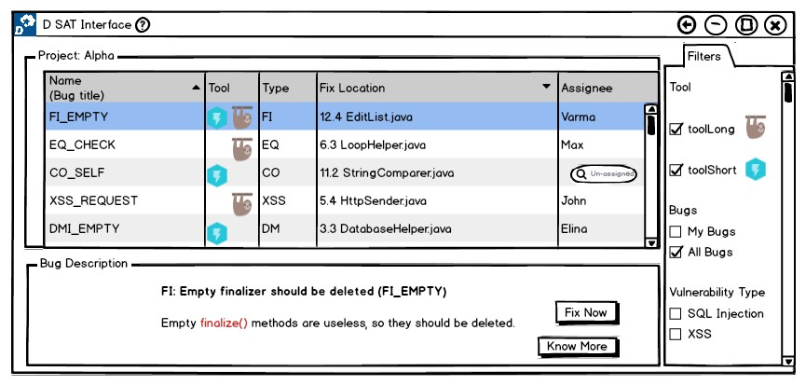
Example: RQ 1 - .. display results!
Prototype 1

Slide 20
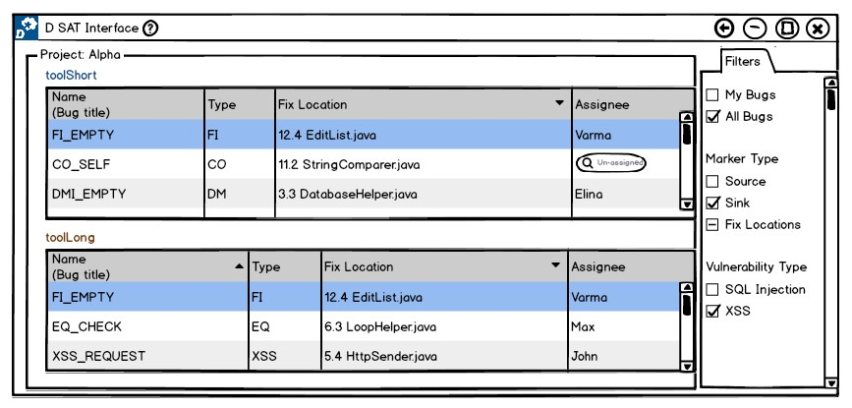
Example: RQ 1 - .. display results!
Prototype 2

Slide 21
Evaluation
Experimental Design
Recruit Test Users
Order of evaluation altered
Usability inspection methods: Cognitive Walkthrough, Heuristic Evaluation
Perform Tasks
Example: Find a bug which is reported in common by available tools.

Slide 22
Evaluation – Usability Inspection Methods
Cognitive Walkthrough
For each step to a predefined task, the following aspects are analysed.
Will the user try and achieve the right outcome?
Will the user notice that the correct action is available to them?
Will the user associate the correct action with the outcome they expect to achieve?
If the correct action is performed; will the user see that progress is being made towards their intended outcome?
Jakob Nielsen. “Usability inspection methods”. In: Conference companion on Human factors in computing systems. ACM. 1994, pp. 413–414.

Slide 23
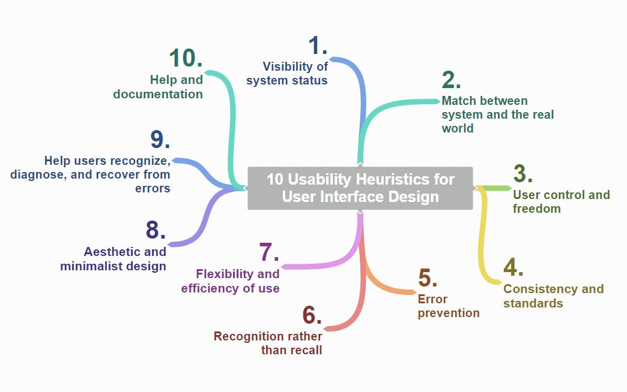
Evaluation – Usability Inspection Methods
Heuristic Evaluation
10 Heuristics for User Interface Design: Article by Jakob Nielsen. Available online at https://www.nngroup.com/articles/ten-usability-heuristics/, checked on 5/1/2019. Image credits: Miran Janezic

Slide 24
Evaluation – Usability Inspection Methods
Heuristic Evaluation
Each problem w.r.t. a heuristic is rated accordingly; 0 – 4
0 - do not agree this is a usability problem
1 - cosmetic problem
2 - minor usability problem
3 - major usability problem ( important to fix )
4 - usability catastrophe ( imperative to fix )
Comparative Study

Slide 25
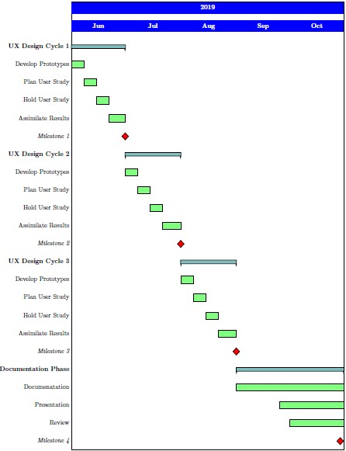
Time Plan
Official Time: 5 Months
Milestones: 4
Notes:
Official Time Frame : 5 Months [ May – September ]
4 Milestones, Each Month with weekly tasks
UX Design Cycle Iteration 1
UX Design Cycle Iteration 2
UX Design Cycle Iteration 3
Thesis Documentation

Slide 26
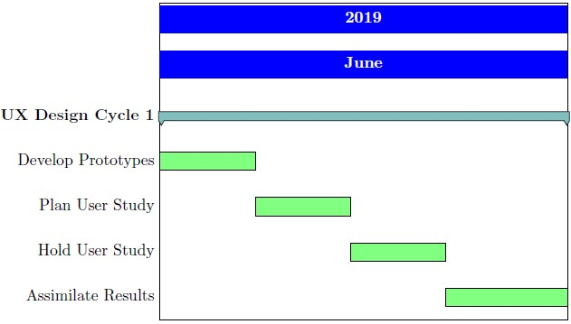
Milestones 1 2 3
Similarly in July and August...

Slide 27
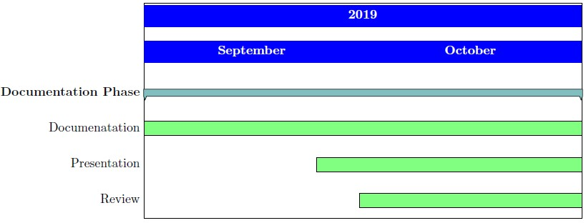
Milestone 4

Slide 28
Summary
Importance of Static Analysis tools
Usage of Multiple Static Analysis tools
Need for a single user interface for multiple tools
This Thesis work follows UX Design Cycle to achieve usable prototypes focussing on research questions such as,
How to display results of the same codebase from different analysis tools?
What feedback works to know that the bug fixing is on-going?
How to carry traceability of bug fixing?

