Slide 1
Integration of Multiple Static Analysis Tools in a Single Interface
Author
G. S. Varma
Supervisors:
Prof. Dr. Eric Bodden
Dr.-Ing. Ben Hermann

Slide 2


Slide 3

“ $1.1 Trillion in Assets Affected by Software Bugs in 2016 “
Software Fail Watch Annual Report,
Tricentis

Slide 4

Static Code Analysis
It helps in prevention of bugs.
It examines code without execution.
Detects Vulnerabilities :
- Injections
- Cross Site Scripting (XSS)
- Buffer Overflow, and Dead Code etc

Slide 5


Static Code Analysis
Tools :
IDE Notifications
IDE tools
Dedicated tools
Linters
CLI tools

Slide 6
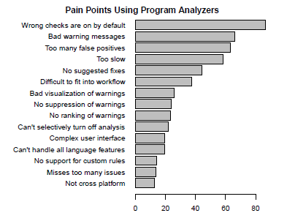
Static Code Analysis
Usability Issues
- Christakis, Maria; Bird, Christian (2016): What developers want and need from program analysis: an empirical study.
- Johnson, Brittany; Song, Yoonki; Murphy-Hill, Emerson; Bowdidge, Robert (2013): Why don't software developers use static analysis tools to find bugs?

Slide 7
Multiple Tools
Developers seem to use multiple static analysis tools each having own coverage.
Research trends:
Using multiple static analysis tools in order to prioritise the bug warning alerts
( Lori et. al. )
Using results of three different static analysis tools for a programming language, Java and merges them together in order to show warnings to the developer.
( Na Meng et. al. )
But USABILITY is not addressed…

Slide 8
Problem Statement
How to integrate the results of multiple static analysis tools
in a unified user interface?

Slide 9
Research Questions
How to display results of the same codebase from different analysis tools?
What feedback works to know that the bug fixing is on-going?
How to carry traceability of bug fixing?

Slide 10
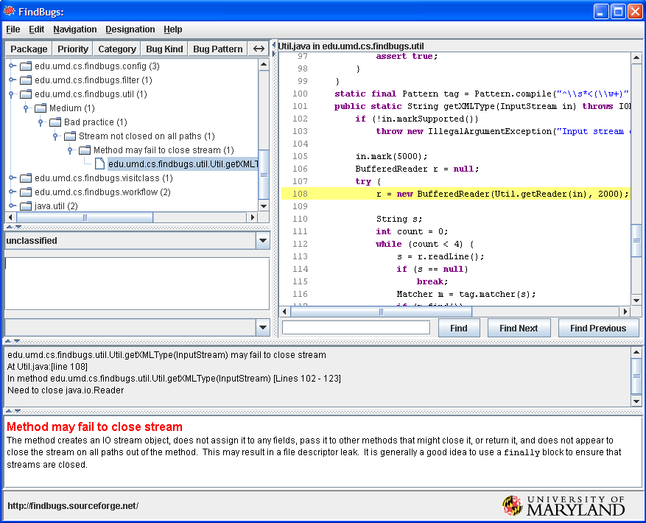
What Current Tools do? - RQ 1
FindBugs

Slide 11
What Current Tools do? - RQ 2
FindBugs

Slide 12
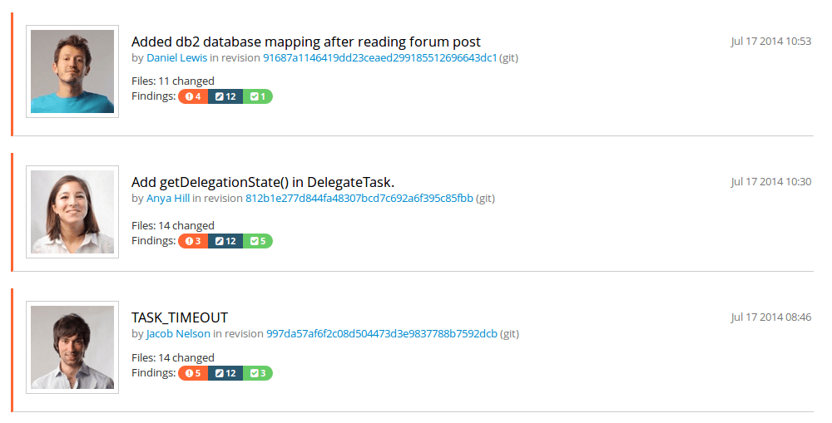
What Current Tools do? - RQ 3
TeamScale

Slide 13
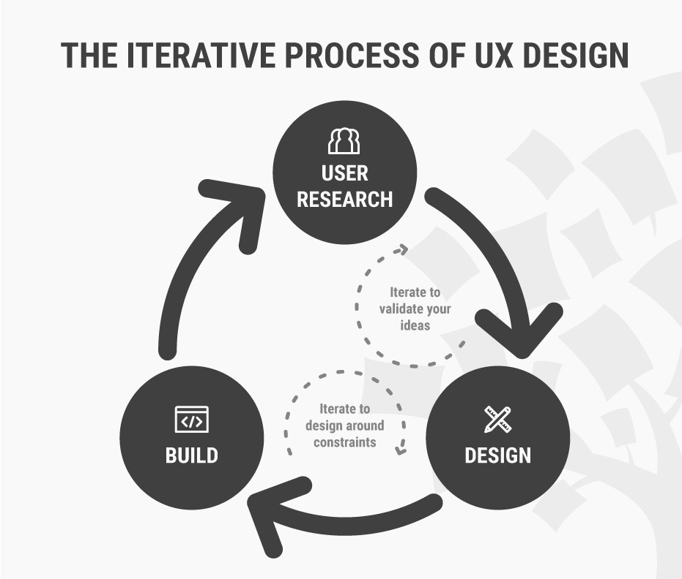
Our Approaches
Research Methodology - UX Design Cycle

Slide 14
Our Approaches
Software Engineering disciplines:
Complex datasets
Compiler reporting
Continuous integration
Refactoring tools
Issue tracker
Stack Overflow
Gamification
Usability Engineering

Slide 15

Our Approaches
Complex datasets:
Dix et. al. - more complex grouping and linking of datasets in the context of a user interface of Spreadsheets application.
Design lesson : extensibility of columns
Gaur et. al. - linear search problem in indexing as it takes more time for large volumes of data. So, different parameters are introduced to decrease computation time.
Example: Searching for toy
RQ 1
RQ 2

Slide 16
Our Approaches
Compiler reporting
Horning et. al
error logging with statistics
stating what kind of bugs are not found along with bugs found
RQ 1

Slide 17
Our Approaches
Refactoring tools
Dustinca
- barrier of discoverability
introduced a smart tag for code can be refactored.
'on-board' phase _ Gamification
Hayashi et. al. - task level commits in order to maintain edit history
RQ 3
RQ 3

Slide 18
Our Approaches
Issue tracker
Baysal et. al. :
Information overload
Expressiveness
Ideal to describe the priory as per team decision instead of personal choice.
RQ 1

Slide 19
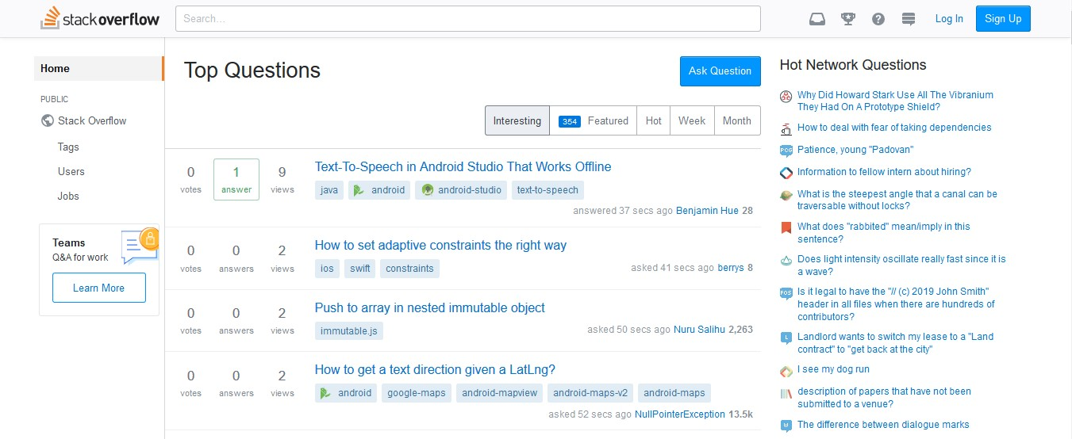
Our Approaches
Stack Overflow
- Wang et. al. : 10934198 questions on a 'User Interface' topic
- Treude et. al. : 72.30 % questions have between 2 and 4 tags
RQ 1

Slide 20
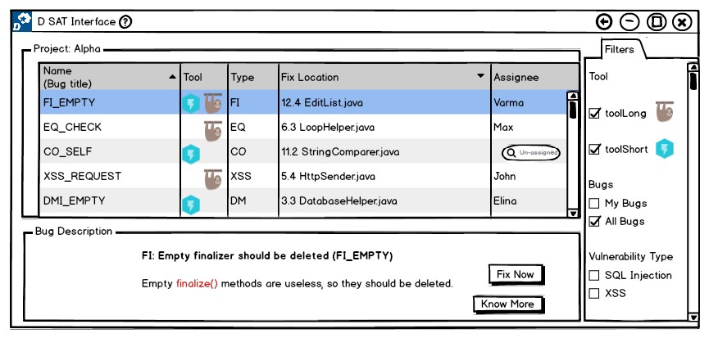
Example: RQ 1
Prototype 1

Slide 21
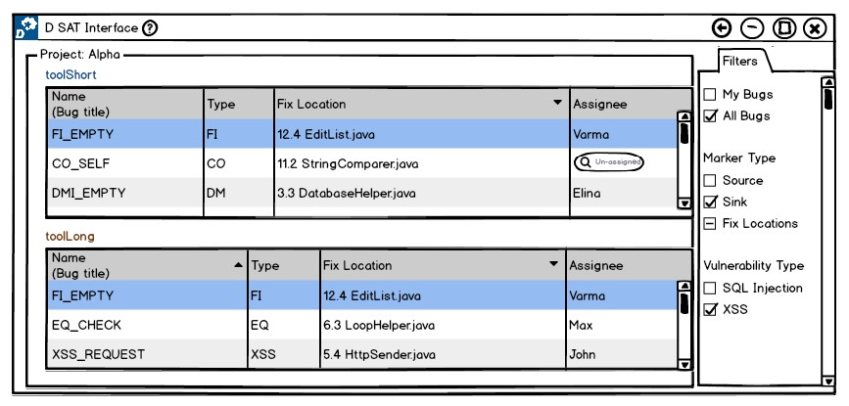
Example: RQ 1
Prototype 2

Slide 22
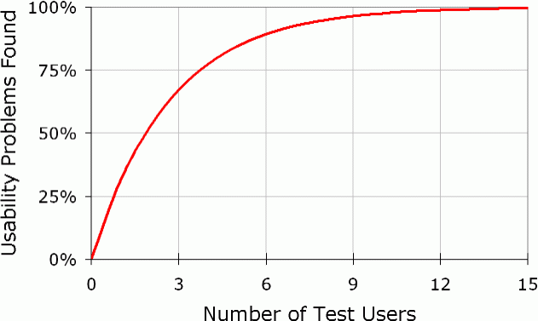
Evaluation
Experimental Design
Number of Test Users:
Dr. Nielsen recommends – 5
Nielsen, Jakob, and Landauer, Thomas K.:
"A mathematical model of the finding of usability problems,"
Order of evaluation:
Users tend to learn – order of presenting prototyes is altered

Slide 23
Evaluation – Usability Inspection Methods
Cognitive Walkthrough
For each step to a predefined task, the following aspects are analysed.
Will the user try and achieve the right outcome?
Will the user notice that the correct action is available to them?
Will the user associate the correct action with the outcome they expect to achieve?
If the correct action is performed; will the user see that progress is being made towards their intended outcome?

Slide 24
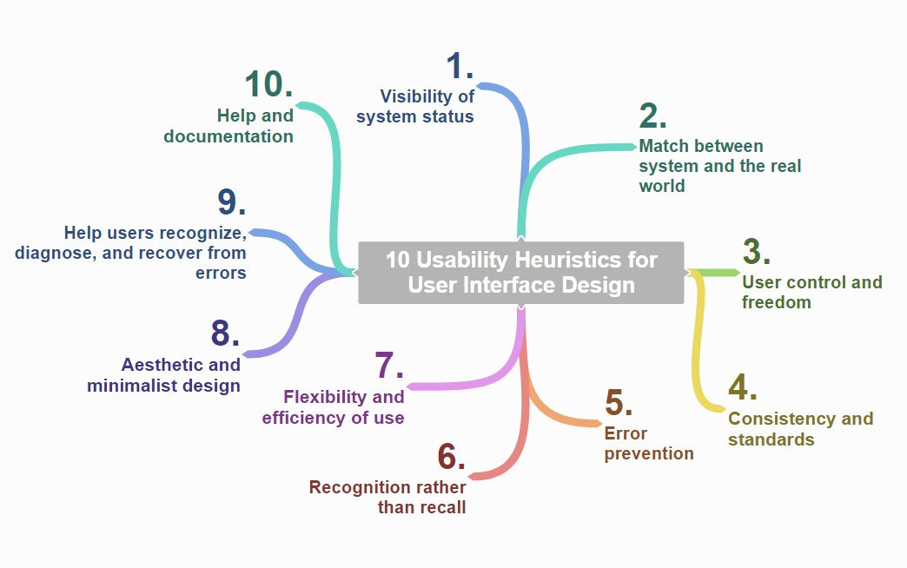
Evaluation – Usability Inspection Methods
Heuristic Evaluation

Slide 25
Evaluation – Usability Inspection Methods
Heuristic Evaluation
Each problem w.r.t. a heuristic is rated accordingly; 0 – 4
0 - do not agree this is a usability problem
1 - cosmetic problem
2 - minor usability problem
3 - major usability problem ( important to fix )
4 - usability catastrophe ( imperative to fix )
Comparative Study

Slide 26
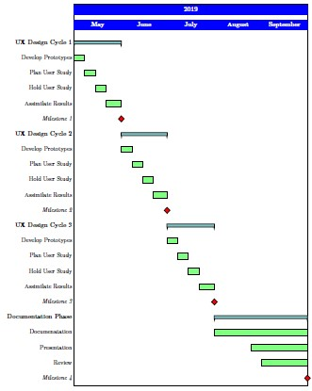
Time Plan
Official Time: 5 Months
Milestones: 4
Notes:
Official Time Frame : 5 Months [ May – September ]
4 Milestones, Each Month with weekly tasks
UX Design Cycle Iteration 1
UX Design Cycle Iteration 2
UX Design Cycle Iteration 3
Thesis Documentation

Slide 27
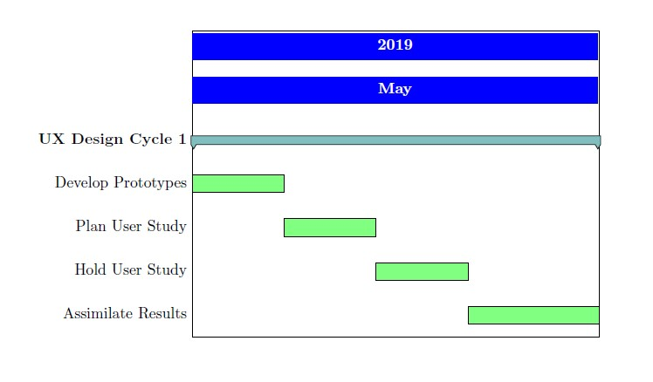
Milestones 1 2 3
Similarly in June and July ...

Slide 28
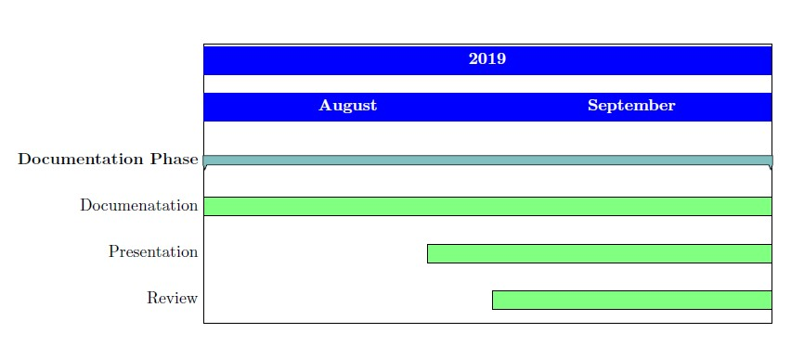
Milestone 4

Slide 29
Summary
Importance of Static Analysis tools
Usage of Multiple Static Analysis tools
Future scope of SARIF
Need for a single user interface for multiple tools
It should be Usable
This Thesis follows UX Design Cycle to achieve usable prototypes.

