Slide 1
Integration of Multiple Static Analysis Tools in a Single Interface
G. S. Varma
Supervisors:
Prof. Dr. Eric Bodden
Dr.-Ing. Ben Hermann

Slide 2
Problem Statement
How to integrate the results of multiple static analysis tools
in a unified user interface?
3 Research Questions

Slide 3
Research Questions
RQ 1: How to display results of the same codebase from different analysis tools?
RQ 2: What feedback works to know that bug fixing is on-going?
RQ 3: How to carry traceability of bug fixing?

Slide 4
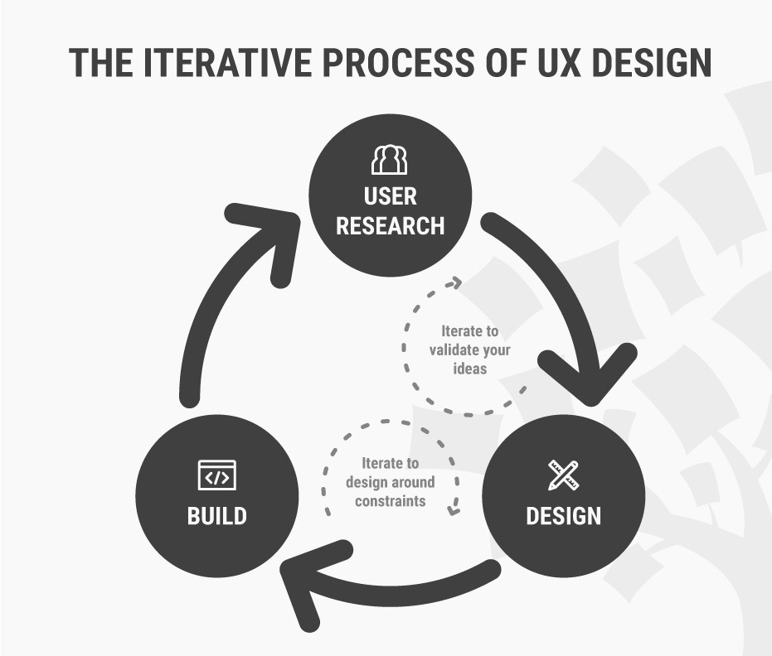
Research Methodology
How to Change Your Career from Graphic Design to UX Design. url: https://www.interaction-design.org/literature/article/ how-to-change-your-career-fromgraphic-design-to-ux-design.

Slide 5
Our Approaches
Software Engineering disciplines:
Complex datasets
Compiler reporting
Continuous integration
Refactoring tools
Issue tracker
Stack Overflow
Gamification
Usability Engineering

Slide 6

Evaluation
Experimental Design
Recruit Test Users
Order of evaluation altered
Perform Tasks ( Metric 1 – Task Success )
Likert Scale ( Metric 2 – Perceived Usability )
Voting ( Metric 3 – Preferred Design )
Usability inspection methods: Cognitive Walkthrough
Rensis Likert. “A technique for the measurement of attitudes.” In: Archives of psychology (1932).

Slide 7
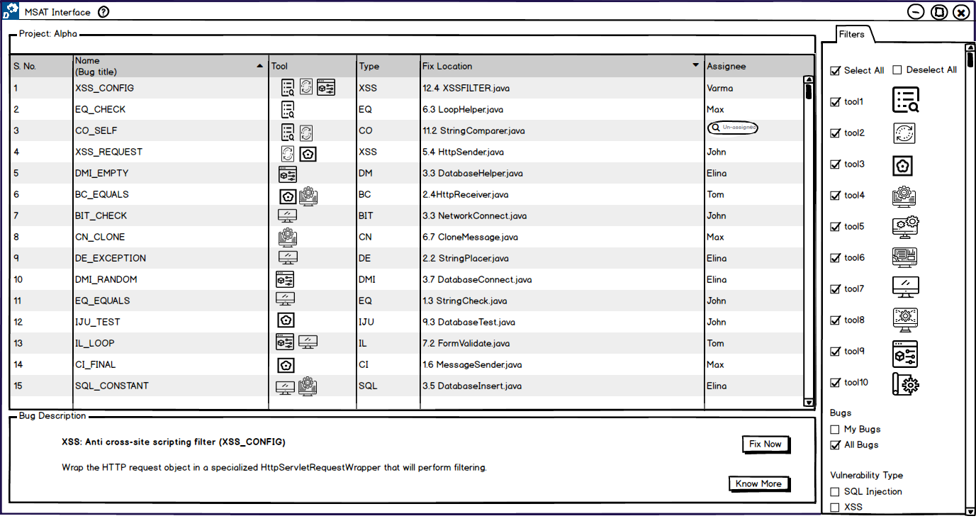
Analysis View

Slide 8
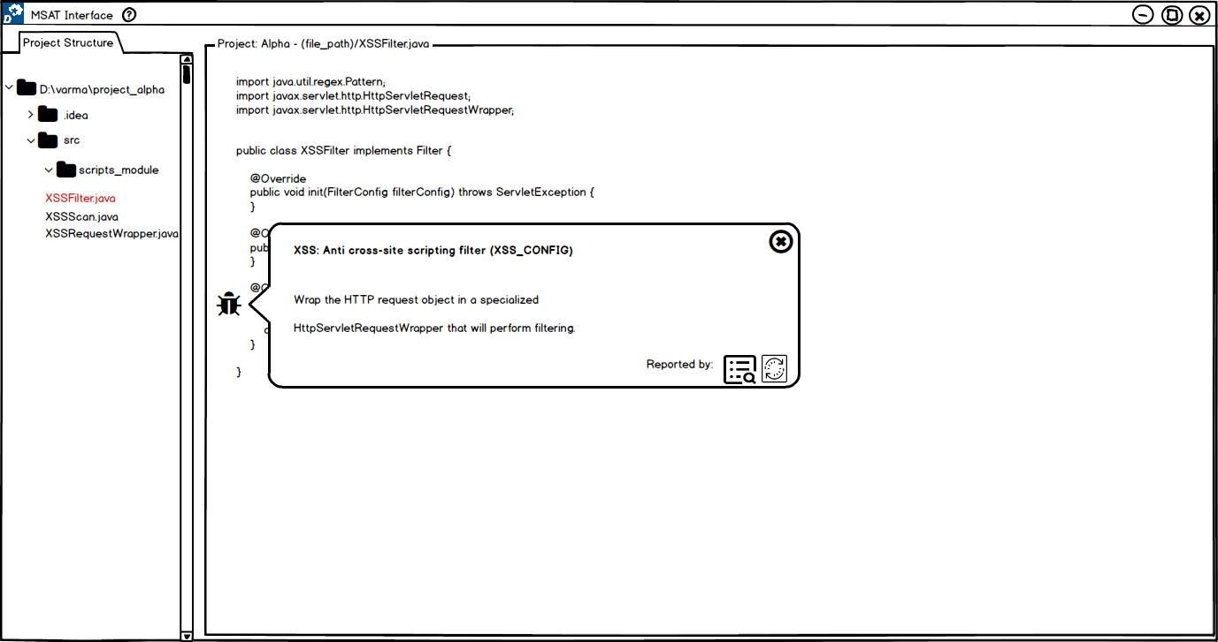
Code View

Slide 9
UX Design Cycle 1

Slide 10

UX 1
Users: 5
Sub research questions: 9
Each session: ~ 90 minutes

Slide 11
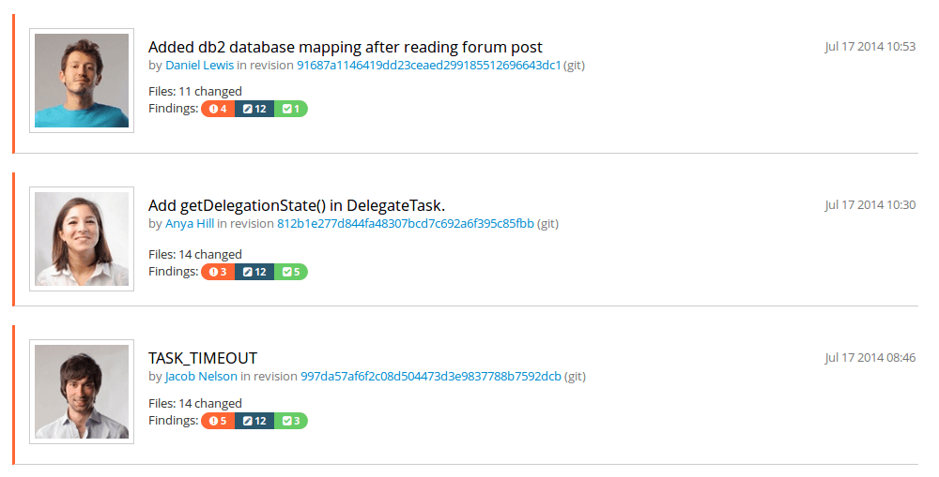
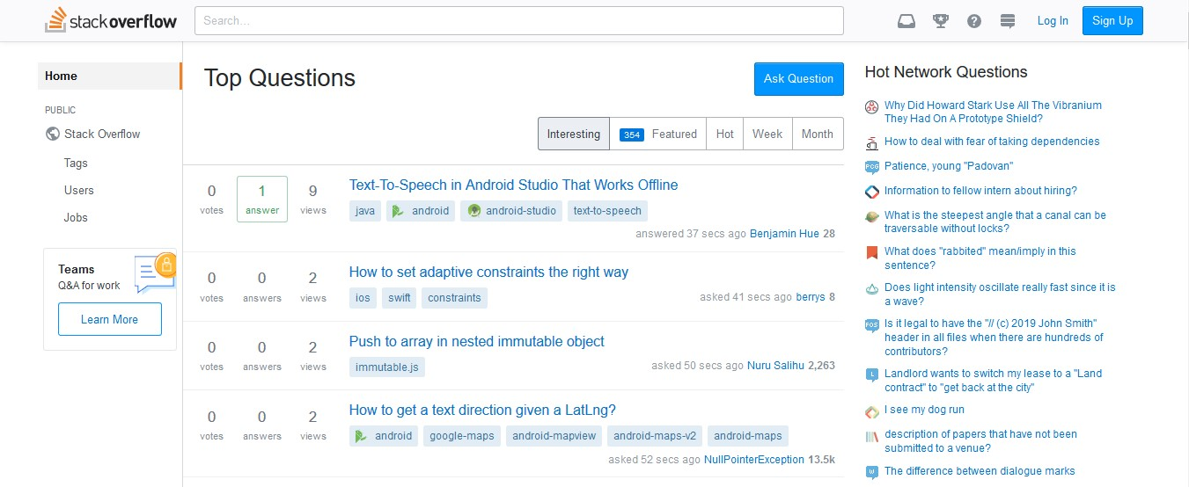
UX 1 | Analysis View
RQ 1 ( display ) How to display results of the same codebase from different analysis tools? | Tags Single List Separate List Statistics Screen
RQ 2 ( feedback ) What feedback works to know that bug fixing is on-going? | Animated Icons Progress Bar Popup
RQ 3 ( trace ) How to carry traceability of bug fixing? | Numbers

Slide 12
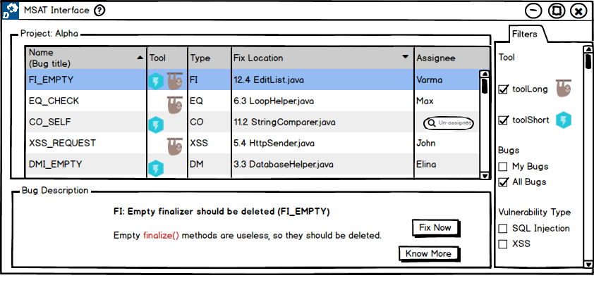
[ RQ 1.1 ] Does a separate list or single list help the user to identify the common bug?
Single List

Slide 13
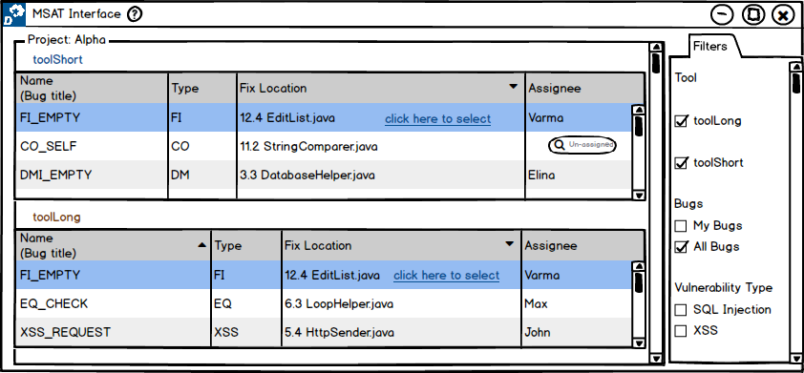
[ RQ 1.1 ] Does a separate list or single list help the user to identify the common bug?
Seperate List

Slide 14
[ RQ 1.1 ] Does a separate list or single list help the user to identify the common bug?
Results:
 | Single List | Separate List
Task Success | 100 % | 100 %
Usability | 8 | 7.6
Votes | 2 | 3
Separate List – “more effective when using more tools”

Slide 15
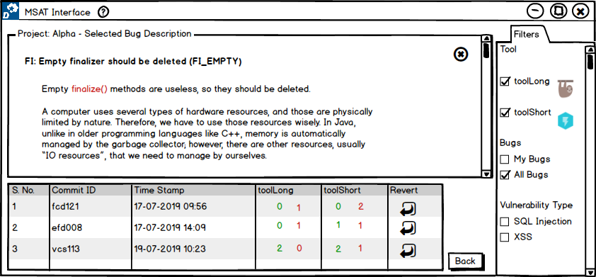
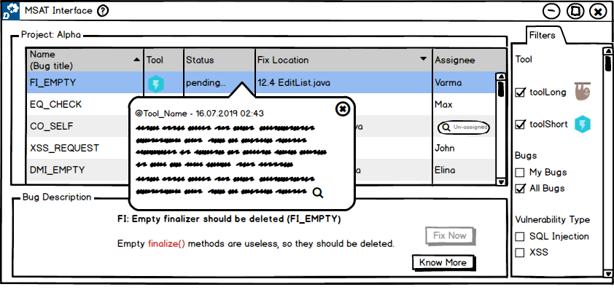
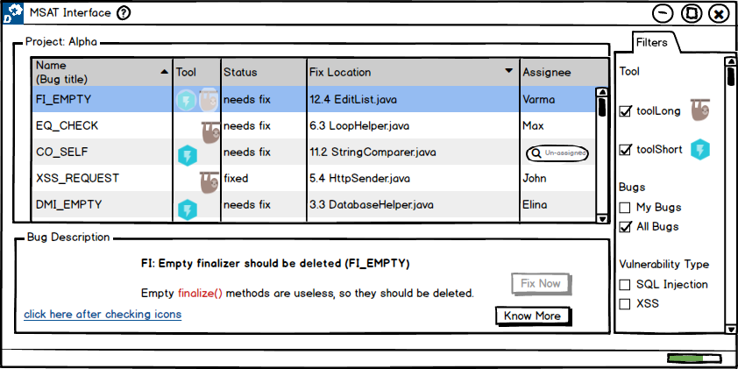
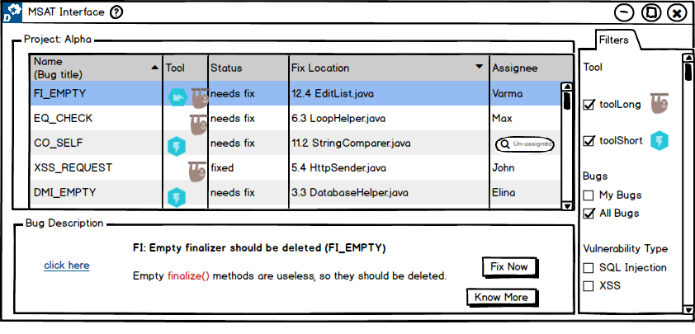
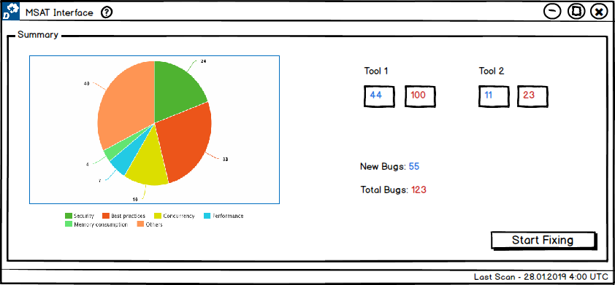
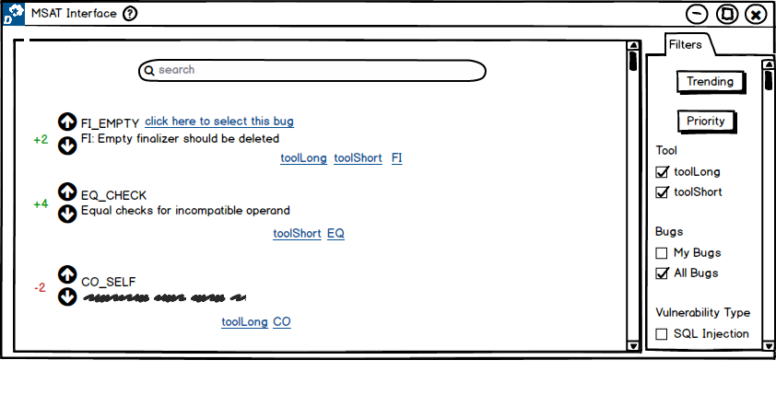

UX 1 - Findings | Analysis View
RQ 1 ( display ) | Tags Single List Separate List Statistics Screen
RQ 2 ( feedback ) | Animated Icons Progress Bar Popup
RQ 3 ( trace ) | Numbers

Slide 16
UX 1 – Lessons
Analysis View
Improvisations for next UX cycle:
Increase code base
Volume of bugs ( + scroll )
Integrate more tools
Code view perspective
+ new sub RQ’s

Slide 17
UX Design Cycle 2

Slide 18

UX 2
Users: 7
Sub research questions: 9
Each session: ~ 105 minutes

Slide 19

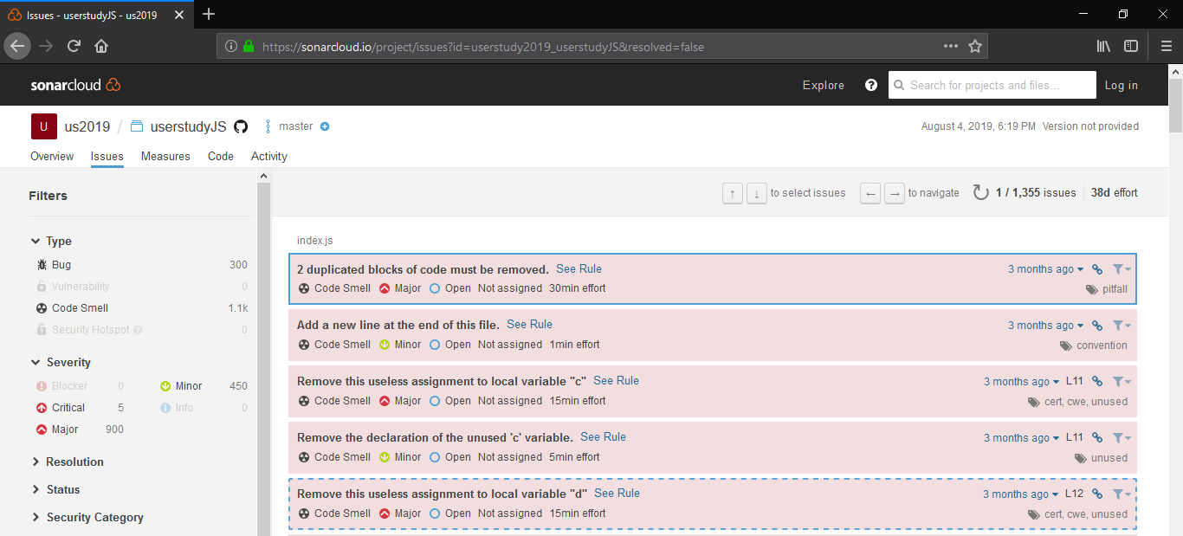
UX 2 | Analysis View | Code View
RQ 1 ( display ) | Tags Single List Separate List | Multiple Icons Single Icon
RQ 2 ( feedback ) | Animated Icons Progress Bar Popup | Toasts ( alerts ) Spinner ( status )
RQ 3 ( trace ) | Numbers Adjectives | Before/After
30min effort

Slide 20
[ RQ 1.1 ] Does a separate list or single list help the user to identify the common bug?
Single List

Slide 21
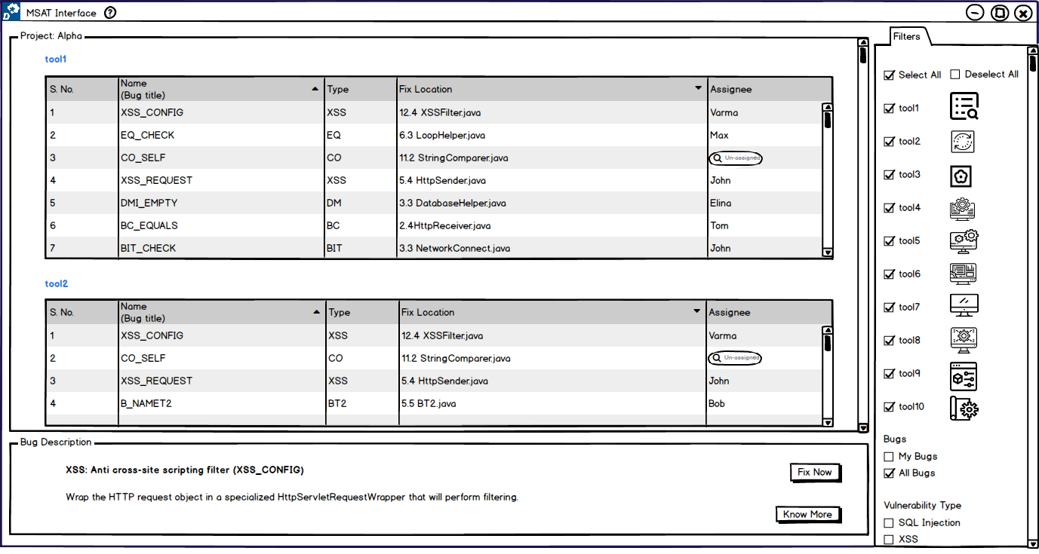
[ RQ 1.1 ] Does a separate list or single list help the user to identify the common bug?
Separate List

Slide 22
[ RQ 1.1 ] Does a separate list or single list help the user to identify the common bug?
Results:
 | Single List | Separate List
Task Success | 71.43 % | 42.85 %
Usability | 8.14 | 5.43
Votes | 5 | 0
Single List – “effortless to perceive, more user friendly”

Slide 23
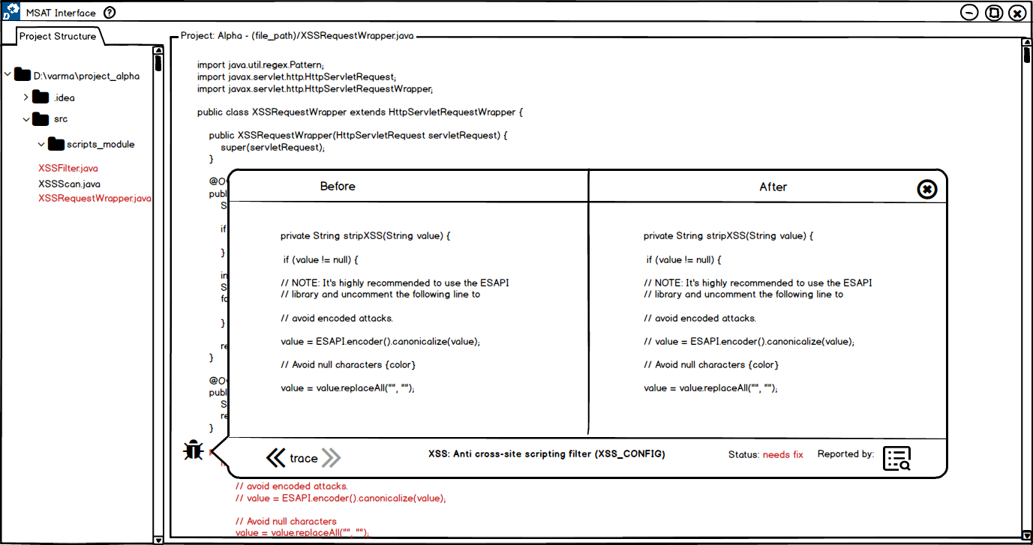
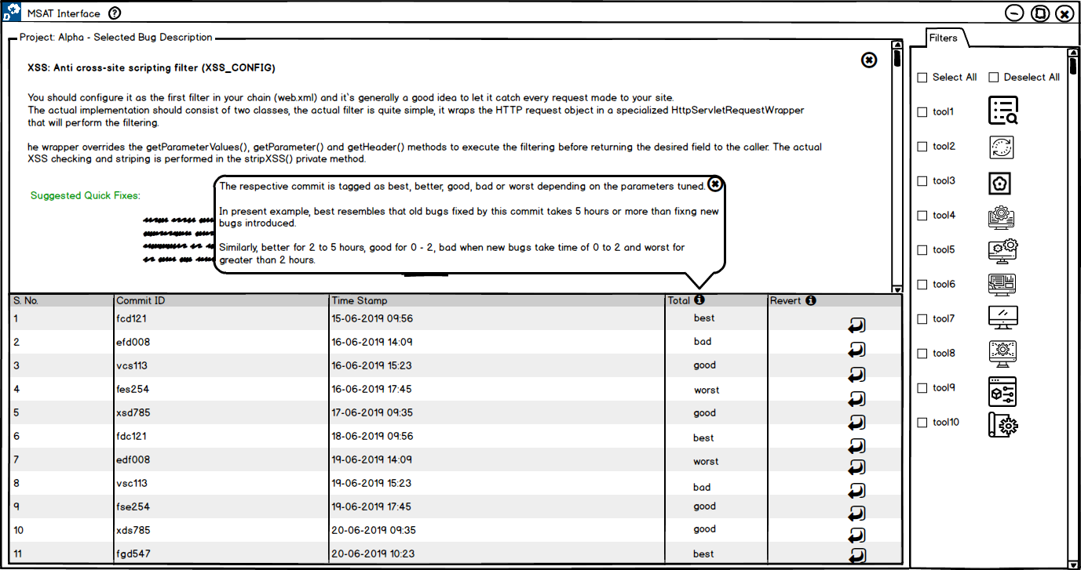
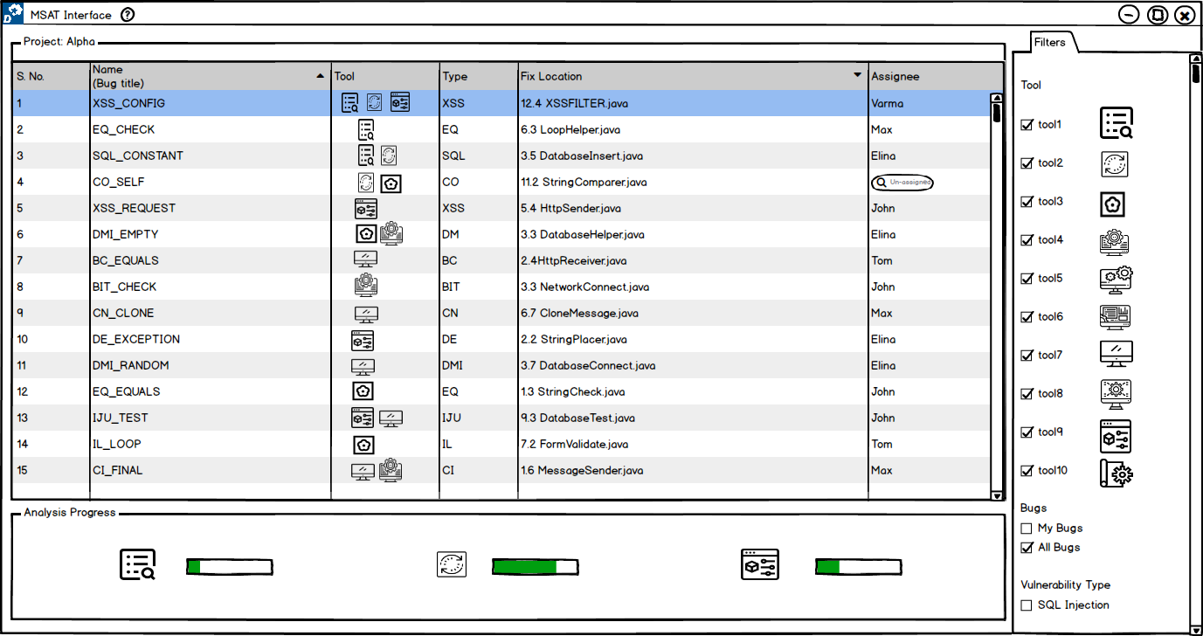
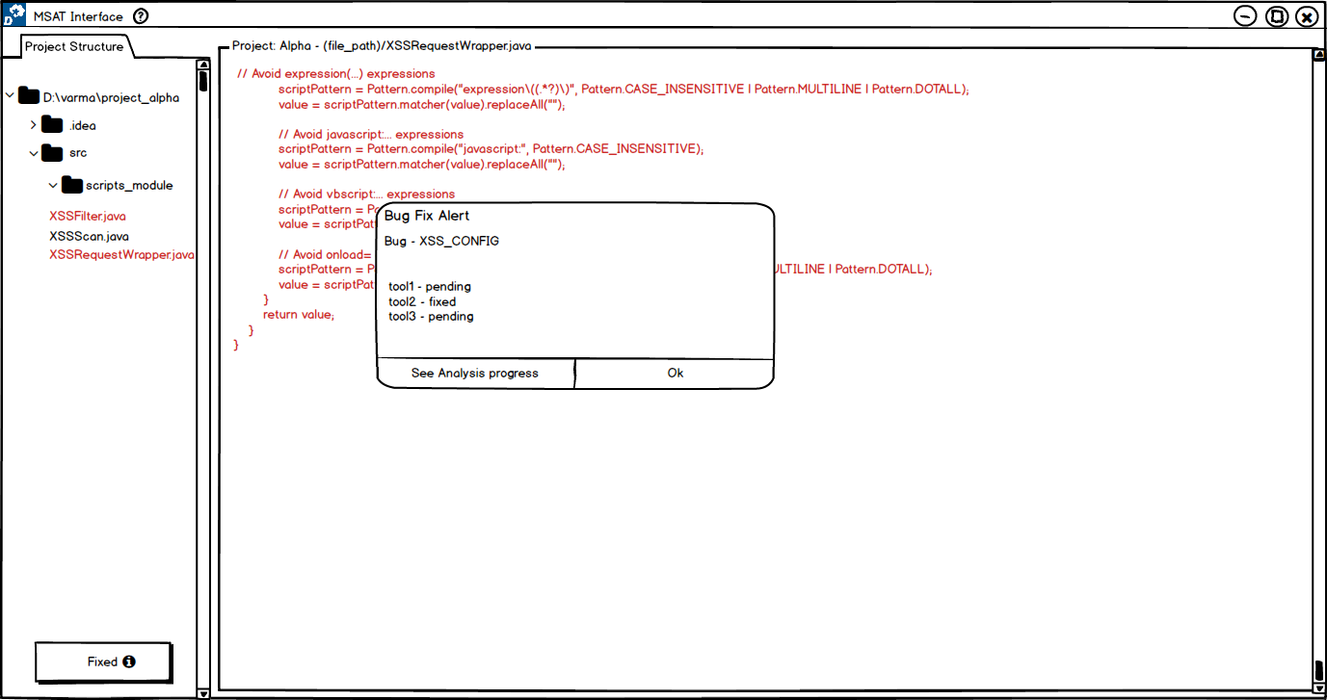
UX 2 - Findings | Analysis View | Code View
RQ 1 ( display ) | Tags Single List Separate List | Multiple Icons Single Icon
RQ 2 ( feedback ) | Animated Icons Progress Bar Popup | Toasts ( alerts ) Spinner ( status )
RQ 3 ( trace ) | Numbers Adjectives | Before/After

Slide 24
UX 2 – Lessons
Analysis View
Code View
UX 1 Scalability
Improvisations for next UX cycle:
UX 2 Scalability
+ new sub RQ’s

Slide 25
UX Design Cycle 3

Slide 26
UX 3
Users: 5
Sub research questions: 13
Each session: ~ 120 minutes

Slide 27
UX 3 | Analysis View | Code View
RQ 1 ( display ) |  | Next List view Bug icons Table view Vertical view Horizontal view Similar boxes Similar list
RQ 2 ( feedback ) | Animated Icons Progress Bar Popup | Toasts ( alerts ) Spinner ( status )
RQ 3 ( trace ) |  | Before/After Table view

Slide 28
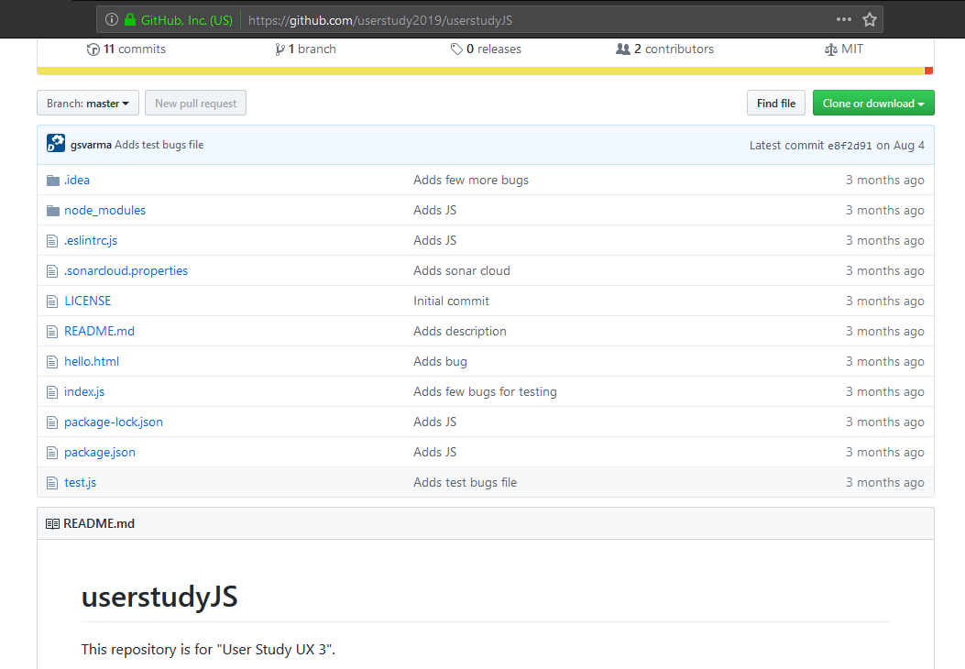
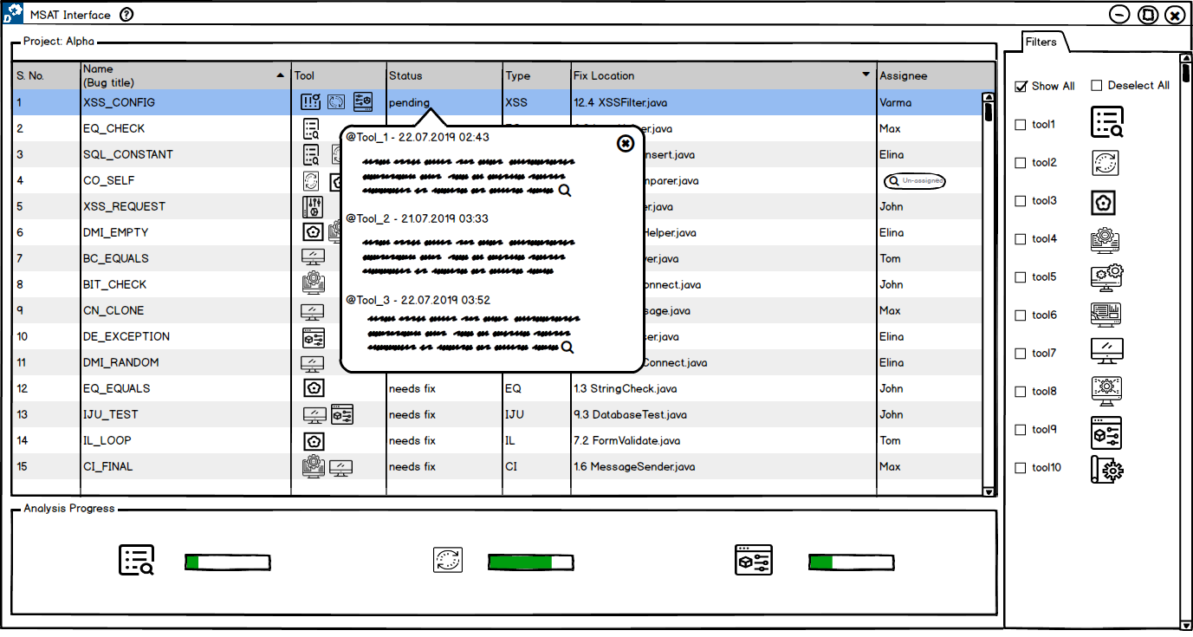
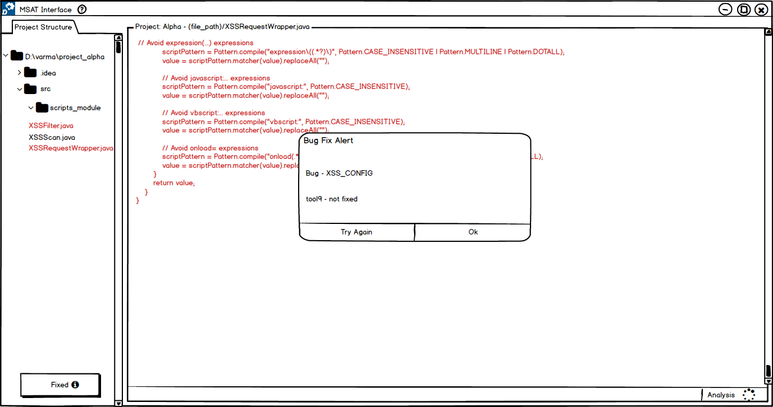
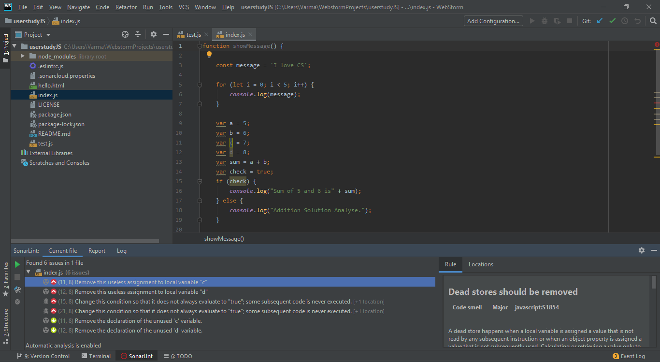
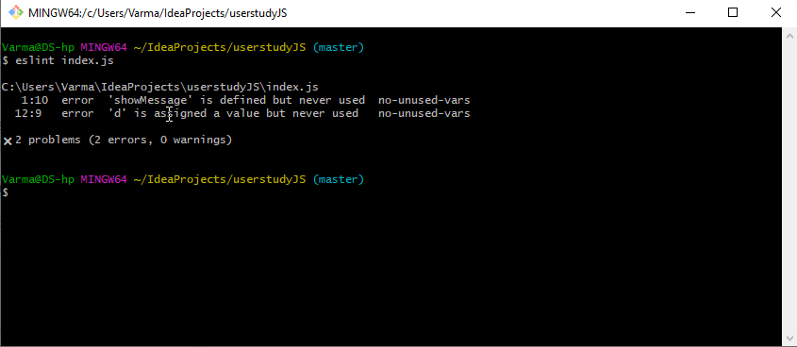



[RQ 2.1] How usable are each feedback functionality compared to the scenario of using uniﬁed UI to native UIs?
Evaluation Setup: 3 native UI tools for a JavaScript project.
CLI – ESLint
IDE – SonarLint
WEB - SonarQube
ESLint – The pluggable linting utility for JavaScript and JSX. url: https://eslint.org/
Sonarlint - Fix issues before they exist. url: https://www.sonarlint.org/
Sonarqube - Code Quality and Security . url: https://www.sonarqube.org/

Slide 29
[RQ 2.1] How usable are each feedback functionality compared to the scenario of using uniﬁed UI to native UIs?
*
*
Almost all users agreed the ideas being novel and hardly present with native UIs.
Result | MSAT-UI* | Native UIs
Animated Icons | 8.4 | 0
Progress Bar | 7.6 | 0.8
Pending Status Popup | 7.8 | 0
Alerts | 9.2 | 0
Status | 8.8 | 4
*Multiple Static Analysis Tools – User Interface

Slide 30
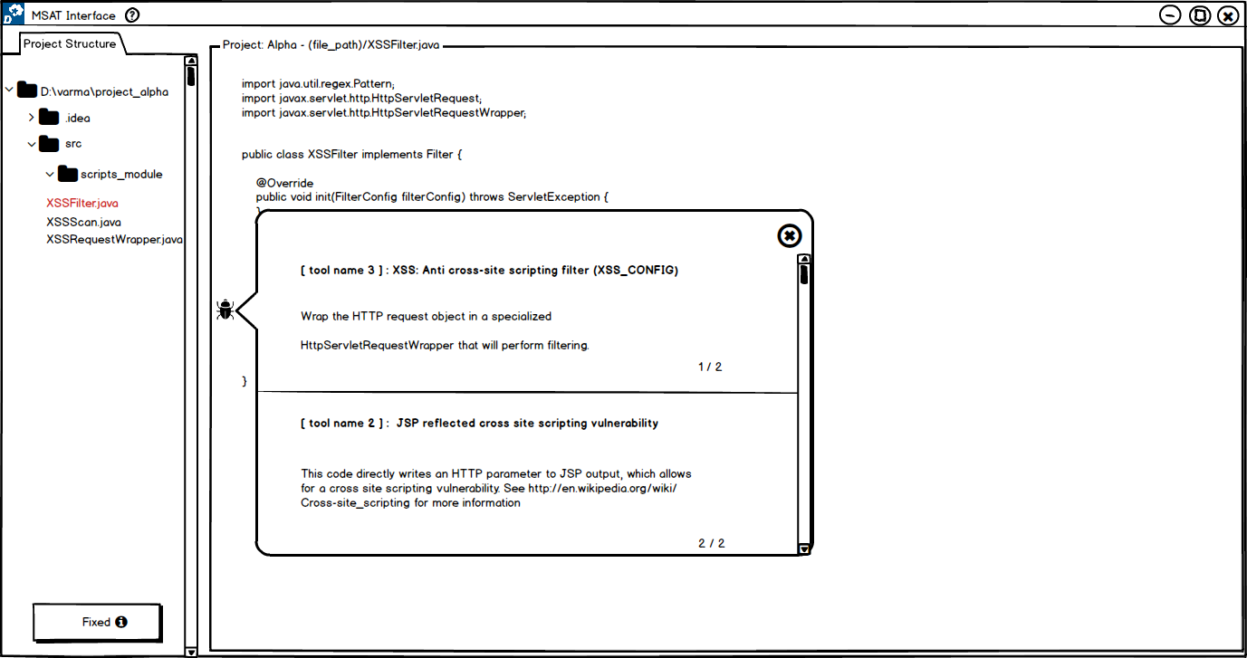
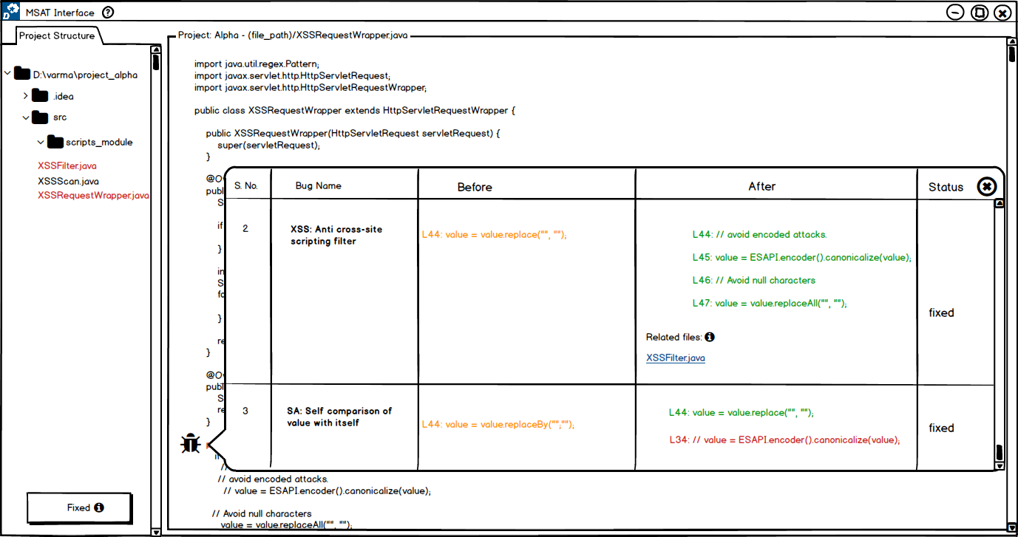
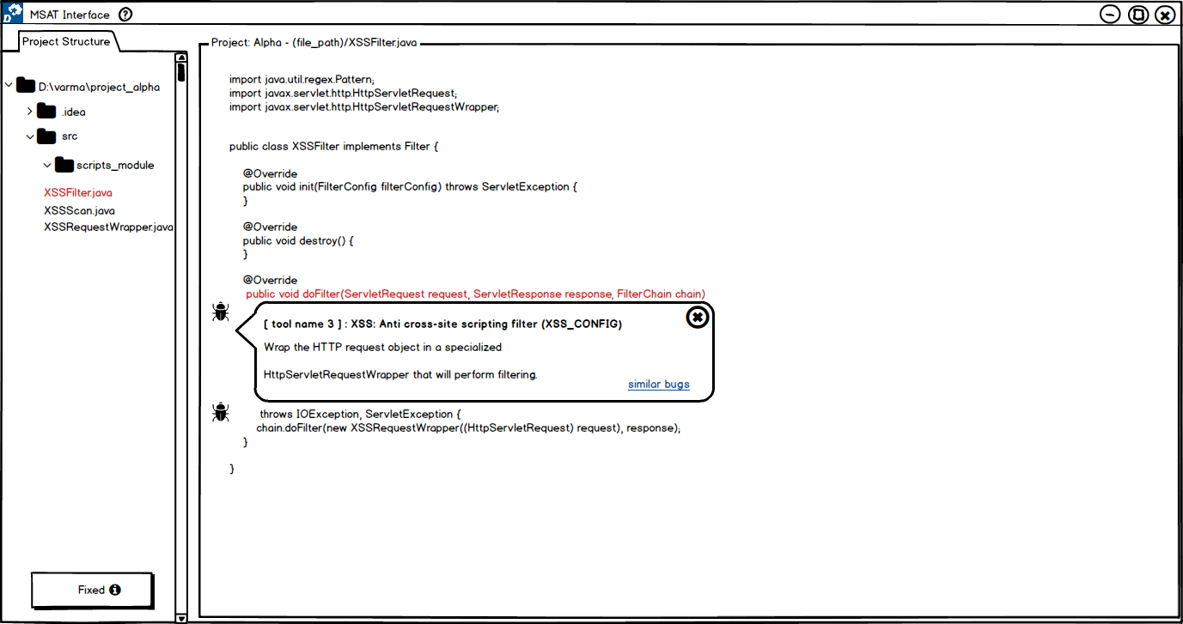
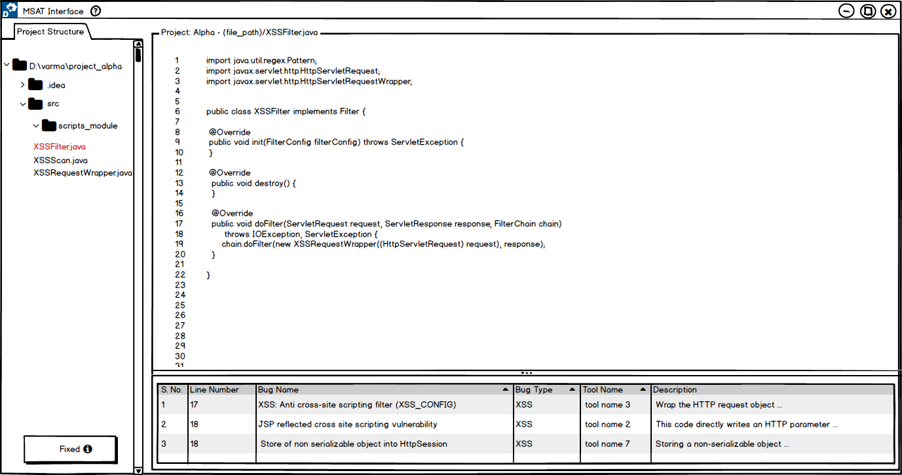
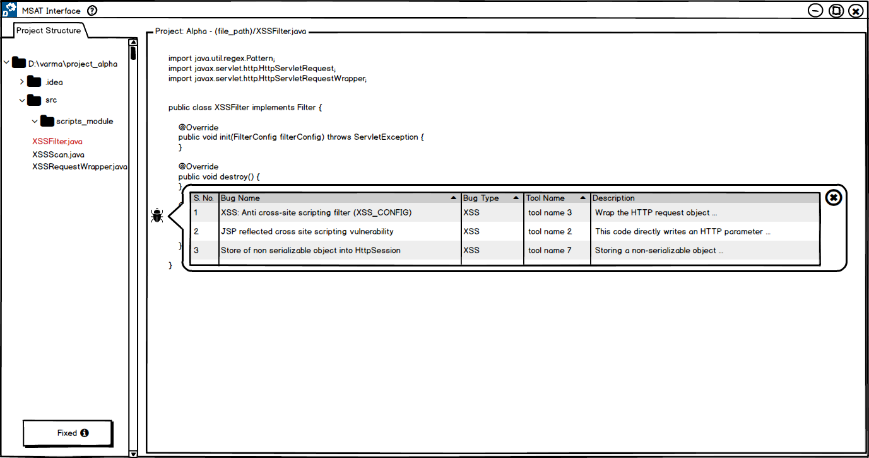
UX 3 - Findings | Analysis View | Code View
RQ 1 ( display ) |  | Next List view Bug icons Table view Vertical view Horizontal view Similar boxes Similar list
RQ 2 ( feedback ) | Animated Icons Progress Bar Popup | Toasts ( alerts ) Spinner ( status )
RQ 3 ( trace ) |  | Before/After Table view

Slide 31
Findings
 | Analysis View | Code View
RQ 1 ( display ) | Single list | List view Single icon Table view Similar list
RQ 2 ( feedback ) | Animated Icons Progress Bar Popup | Toasts ( alerts )
RQ 3 ( trace ) | Adjectives | Table view

Slide 32


Limitations
Number of participants: >
UX 1 – 5
UX 2 – 7
UX 3 – 5
Priming, Recency bias: Latin Square partition
Closed Study, Design Tool
Why You Only Need to Test with 5 Users. url: https://www.nngroup.com/articles/why-you-only-need-to-test-with-5-users
Balsamiq – Rapid, effective and fun wireframing software. url: https://balsamiq.com/

Slide 33
Future Work
Q. Would having tabs help scale the tools visibility with bugs results?
Q. Do graphs help in understanding the bugs reported?
RQ 4: How is teamwork facilitated in bug fixing in context of multiple tools?
… many more!

Slide 34
Summary
Importance of Static Analysis tools
Usage of Multiple Static Analysis tools
Need for a single user interface for multiple tools
This thesis work followed UX Design Cycle to achieve usable prototypes focussing on primary research questions such as,
How to display results of the same codebase from different analysis tools?
What feedback works to know that bug fixing is on-going?
How to carry traceability of bug fixing?

