Slide 1
Integration of Multiple Static Analysis Tools in a Single Interface
G. S. Varma
Supervisors:
Prof. Dr. Eric Bodden
Dr.-Ing. Ben Hermann

Slide 2
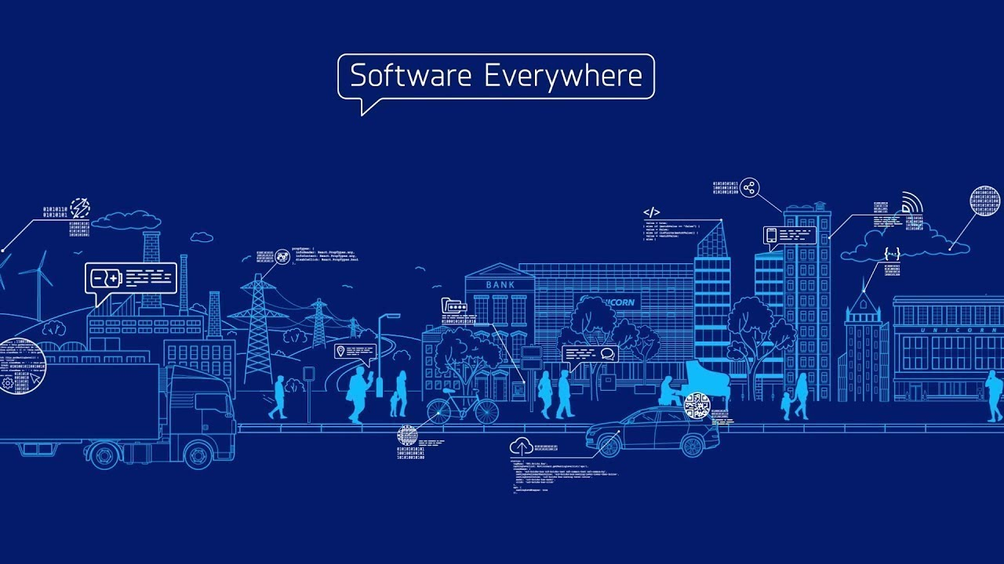

Slide 3
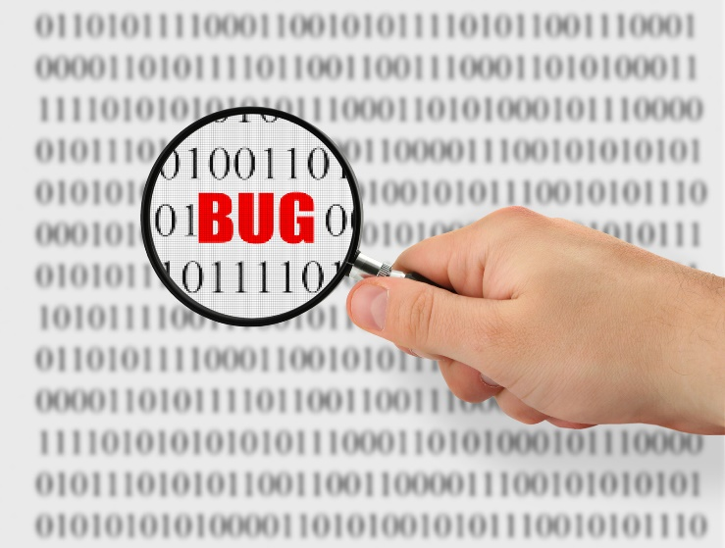
“ $1.1 Trillion in Assets Affected by Software Bugs in 2016 “
Software Fail Watch Annual Report,
Tricentis

Slide 4
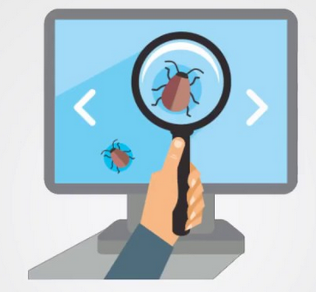
Static Code Analysis
It helps in prevention of bugs.
It examines code without execution.
Detects Vulnerabilities :
- Injections
- Cross Site Scripting (XSS)
- Buffer Overflow, and Dead Code etc

Slide 5


Static Code Analysis
Tools :
IDE Notifications
IDE tools
Dedicated tools
Linters
CLI tools

Slide 6
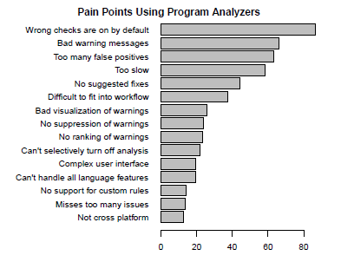
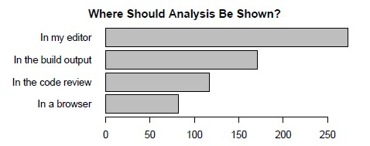
Static Code Analysis
Usability Issues
Christakis et. al.
Brittany et. al.
Tool output
Result understandability
Survey responses

Slide 7
Multiple Tools
Developers use multiple static analysis tools each having own coverage.
Research trends:
Prioritise the bug warning alerts
( Lori et. al. )
Merges 3 tools for Java to show warnings
( Na Meng et. al. )

Slide 8
Multiple Tools
Tricorder
ReviewBot
Separate bug coverage by separate tool
Evaluation: Summative – Click rates
(Caitlin et. al. )
Parfait
Scalability ( easy , expensive analysis )
Precision ( bug track – real, no, potential )
(Cristina et. al. )
But USABILITY is not addressed…

Slide 9
Problem Statement
How to integrate the results of multiple static analysis tools
in a unified user interface?
3 Research Questions

Slide 10
Research Question 1
How to display results of the same codebase from
different analysis tools?

Slide 11
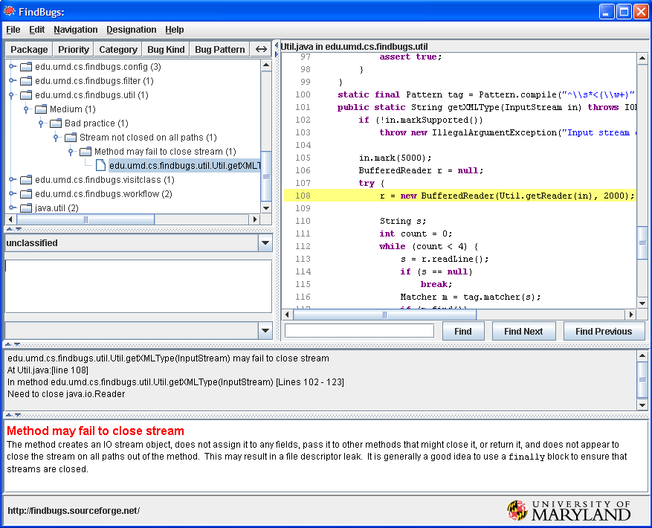
What Current Tools do? - RQ 1
FindBugs

Slide 12
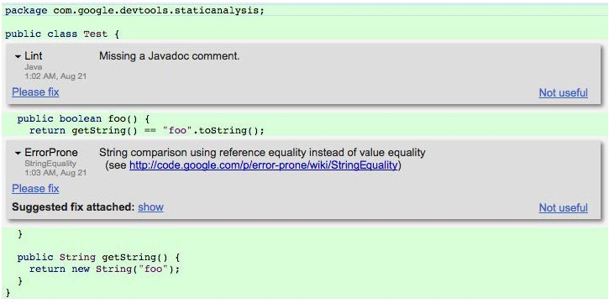
What Current Tools do? - RQ 1
Tricorder

Slide 13
Research Question 2
What feedback works to know that the bug fixing is on-going?
What current tools do?
Traditional approach – Nightly Builds

Slide 14
Research Question 3
How to carry traceability of bug fixing?

Slide 15
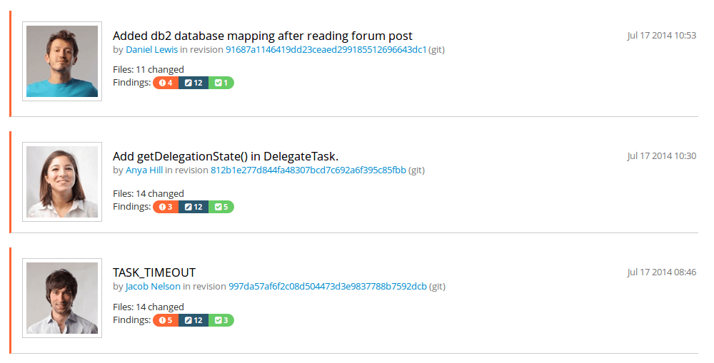
What Current Tools do? - RQ 3
TeamScale

Slide 16
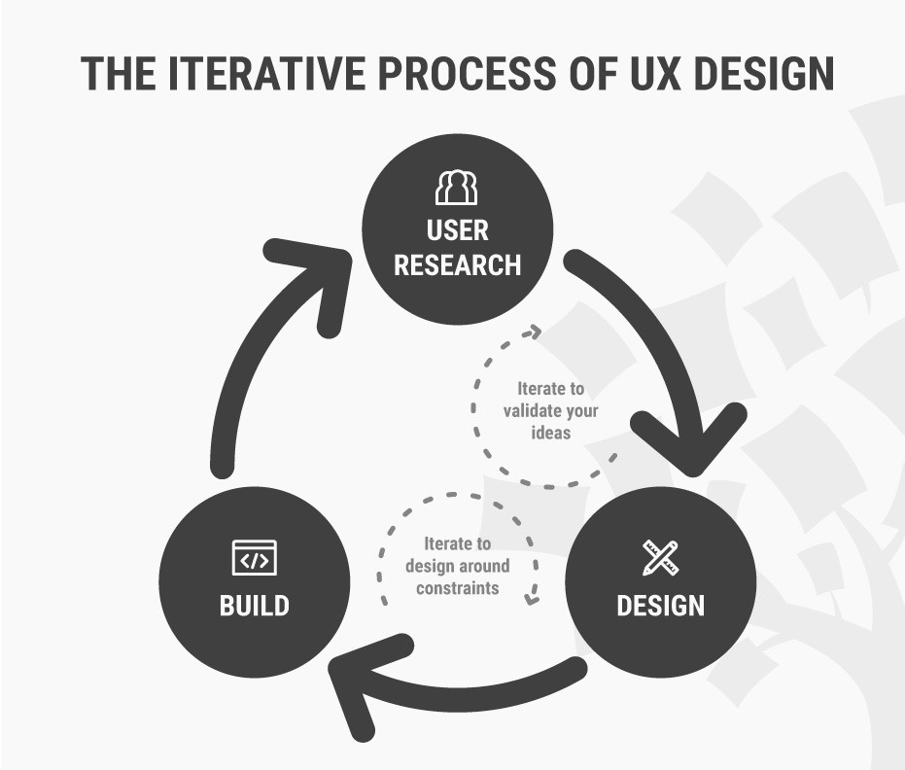
Our Approaches

Slide 17
Our Approaches
Software Engineering disciplines:
Complex datasets
Compiler reporting
Continuous integration
Refactoring tools
Issue tracker
Stack Overflow
Gamification
Usability Engineering

Slide 18

Our Approaches
Complex datasets:
Dix et. al. - complex grouping and linking of datasets for Spreadsheets application
Design lesson : extensibility of columns
Issue tracker
Baysal et. al. :
Information overload
Expressiveness

Slide 19
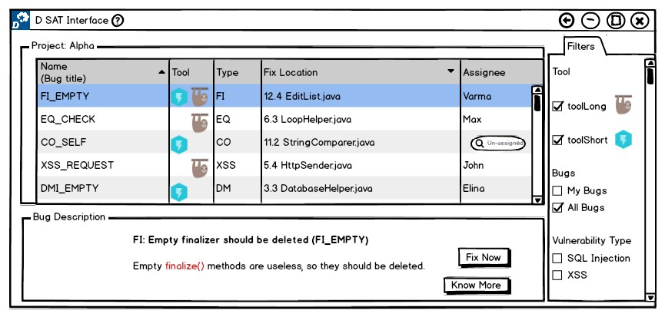
Example: RQ 1
Prototype 1

Slide 20
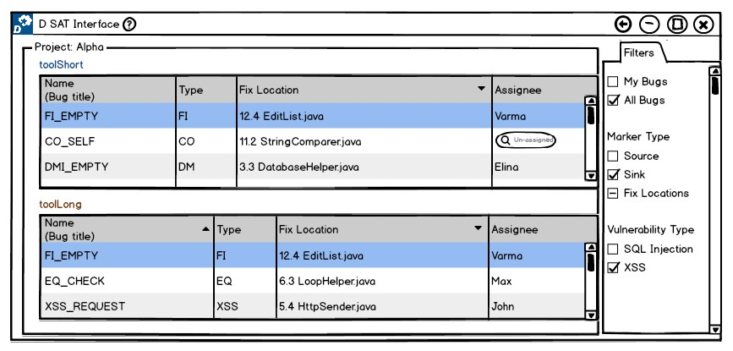
Example: RQ 1
Prototype 2

Slide 21
Evaluation
Experimental Design
Recruit Test Users
Order of evaluation altered
Perform Tasks
Example: Find a bug which is reported in common by available tools.

Slide 22
Evaluation – Usability Inspection Methods
Cognitive Walkthrough
For each step to a predefined task, the following aspects are analysed.
Will the user try and achieve the right outcome?
Will the user notice that the correct action is available to them?
Will the user associate the correct action with the outcome they expect to achieve?
If the correct action is performed; will the user see that progress is being made towards their intended outcome?

Slide 23
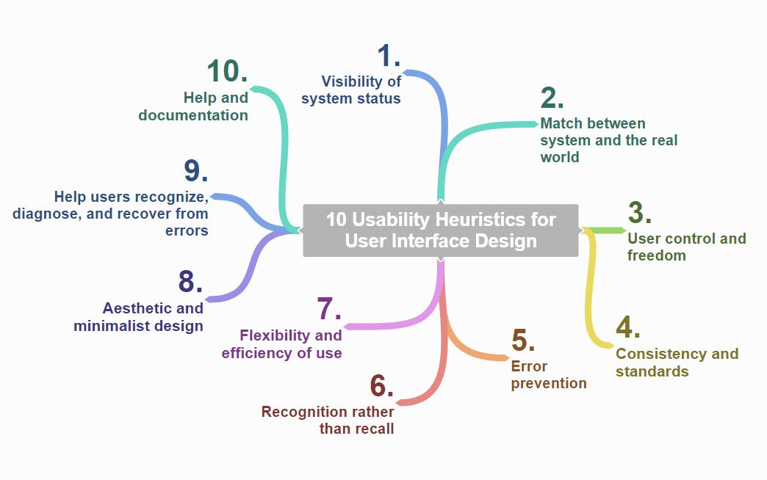
Evaluation – Usability Inspection Methods
Heuristic Evaluation

Slide 24
Evaluation – Usability Inspection Methods
Heuristic Evaluation
Each problem w.r.t. a heuristic is rated accordingly; 0 – 4
0 - do not agree this is a usability problem
1 - cosmetic problem
2 - minor usability problem
3 - major usability problem ( important to fix )
4 - usability catastrophe ( imperative to fix )
Comparative Study

Slide 25
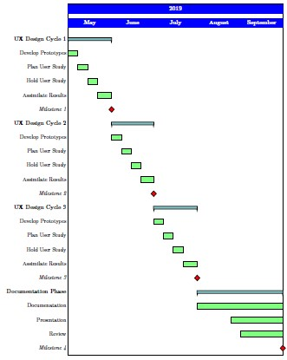
Time Plan
Official Time: 5 Months
Milestones: 4
Notes:
Official Time Frame : 5 Months [ May – September ]
4 Milestones, Each Month with weekly tasks
UX Design Cycle Iteration 1
UX Design Cycle Iteration 2
UX Design Cycle Iteration 3
Thesis Documentation

Slide 26
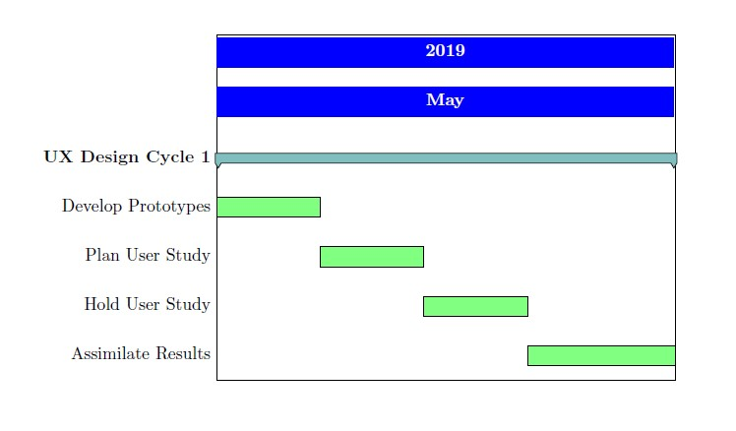
Milestones 1 2 3
Similarly in June and July ...

Slide 27
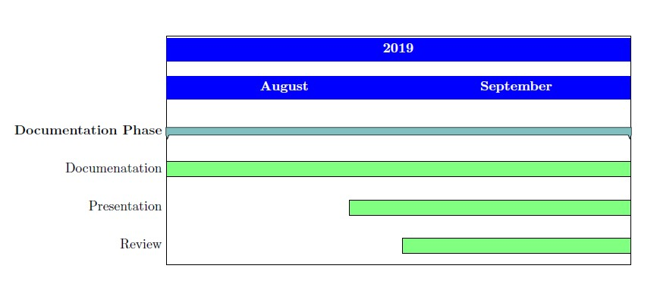
Milestone 4

Slide 28
Summary
Importance of Static Analysis tools
Usage of Multiple Static Analysis tools
Need for a single user interface for multiple tools
This Thesis work follows UX Design Cycle to achieve usable prototypes focussing on research questions such as,
How to display results of the same codebase from different analysis tools?
What feedback works to know that the bug fixing is on-going?
How to carry traceability of bug fixing?

