Slide 1
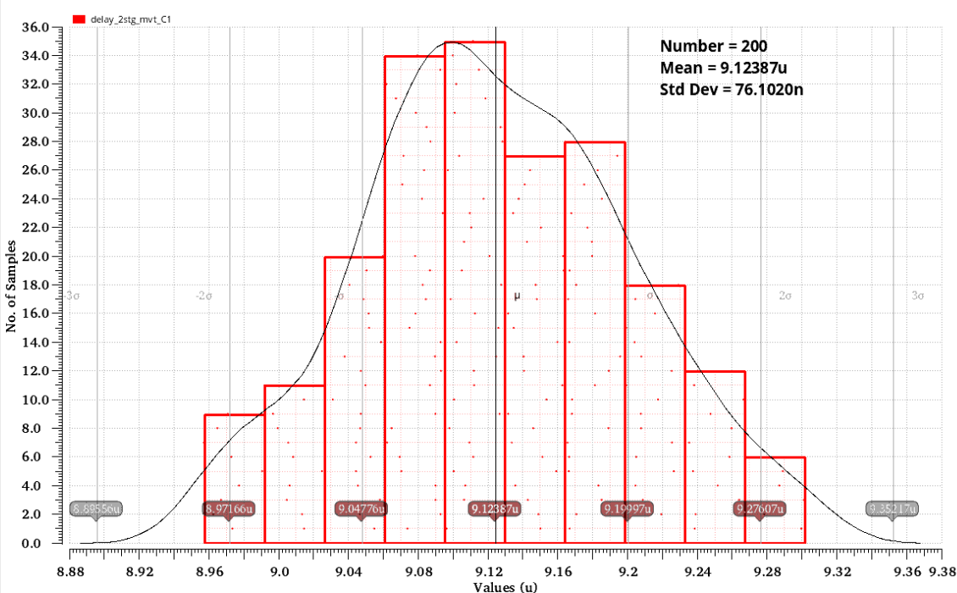
ALPHA Data Flow Simulation Updates (28-MAY-2021)
Updated with Mismatch Simulation results, completed
Results from temporal simulation:
76 | ns | spread due to mismatch
4 | ns | clock
4096 | counts | 12-bit Wilkinson run-out
16384 | ns | Vramp time
0.004639 | ratio
1800 | mV | dynamic range
0.439453 | mV/lsb
0.109863 | mV/ns
8.349609 | mV spread
19 | ADC counts spread
4.5 | ADC counts noise (assumed)
1.98 | mV noise

Slide 2
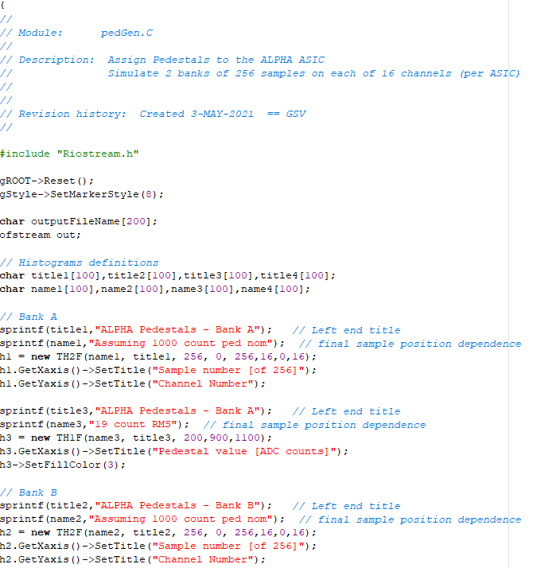
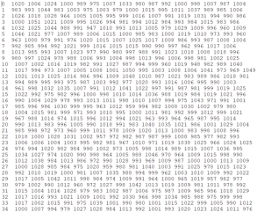
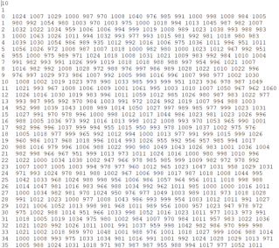
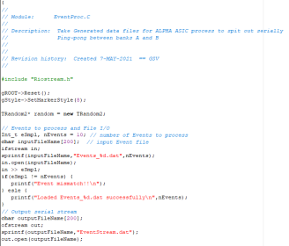
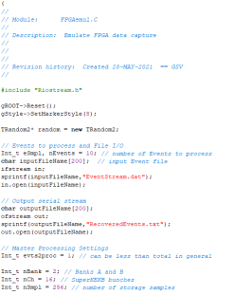
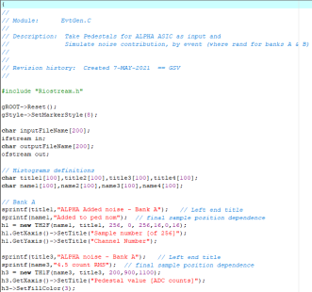
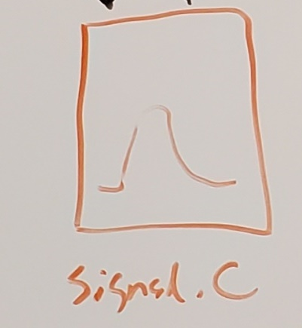
Event Generator/processor
PedGen.C
peds.dat
Verify processing by reproducing pedestals from noisy data
For 10 events
(first # in file)
Events_10.dat
EventProc.C
FPGAemul.C
Events_10.dat
Pedestal offset
Pedestal RMS
# Events to process
Random trig rate
EvtGen.C
# Events
RMS noise
Can also inject signals, in principle (not yet implemented)
2

Slide 3
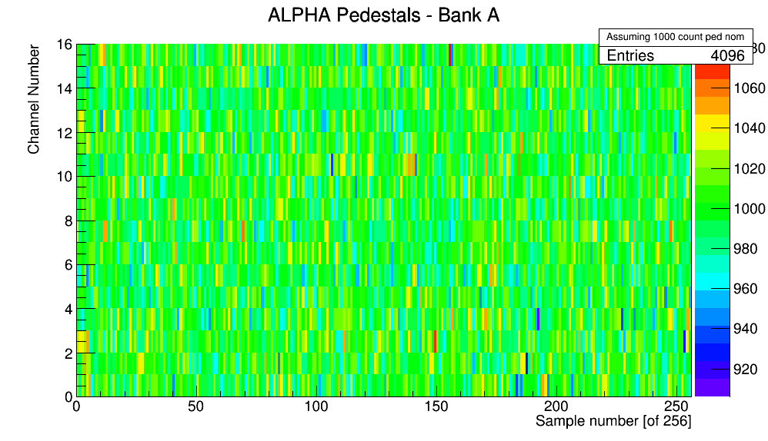
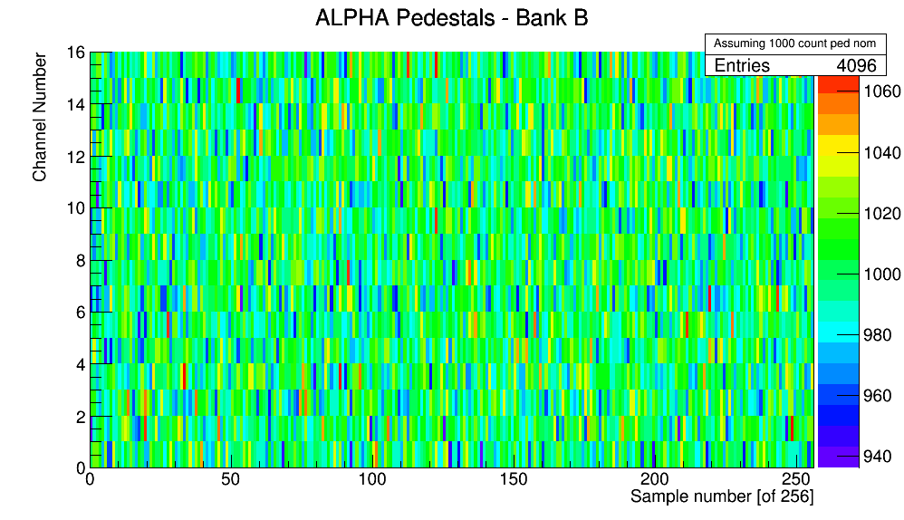
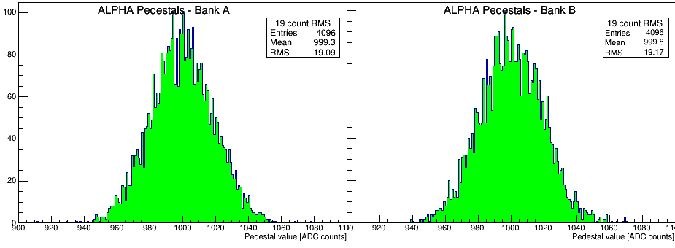
Pedestal Generator [PedGen.C]
3

Slide 4
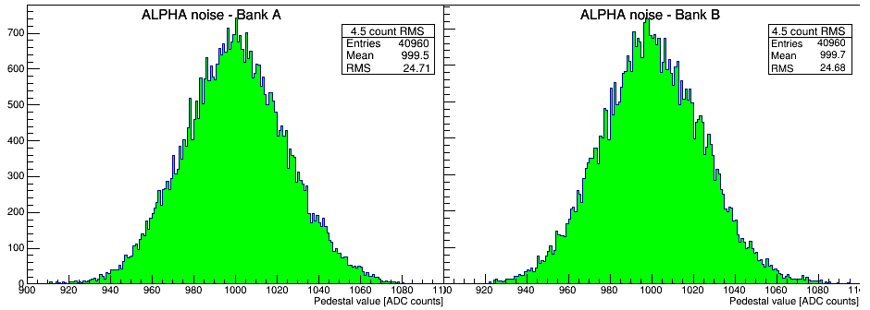
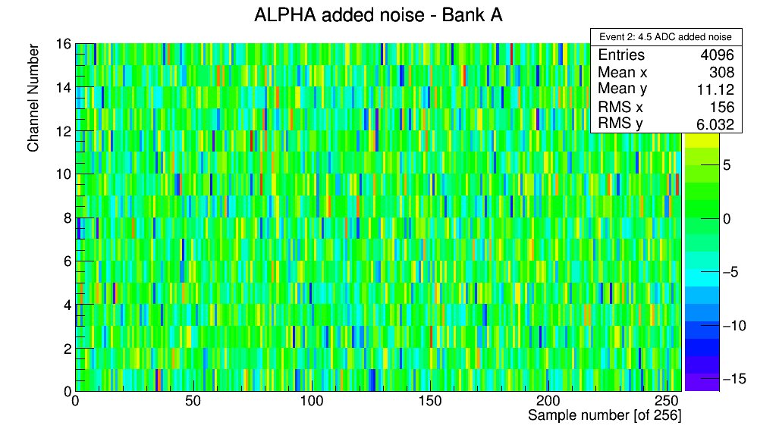
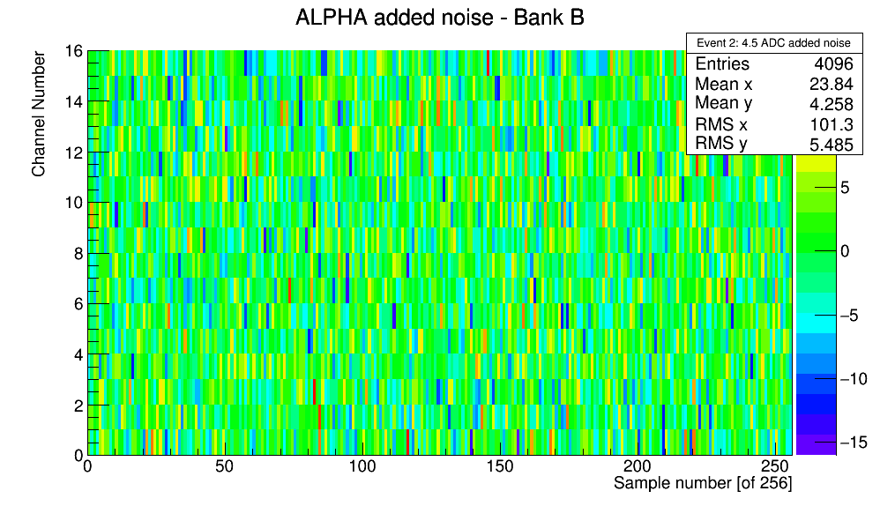
Event Generator [EvtGen.C]
10 Events, 4.5 ADC counts noise (~2mV)
4

Slide 5
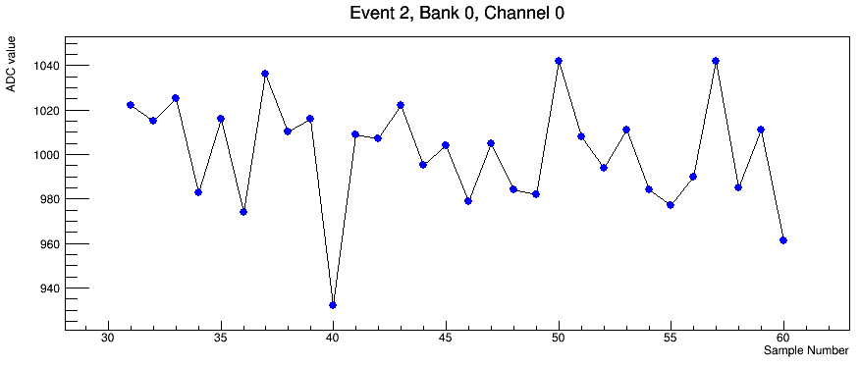
Without Pedestal Subtraction
Could never see a small signal

Slide 6
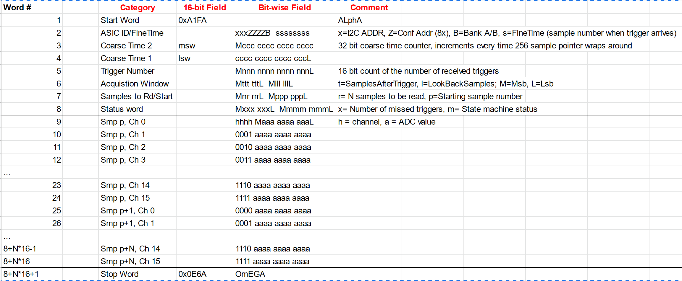
Emulate Streaming: Event Format
6

Slide 7
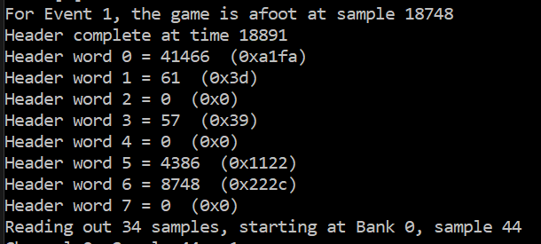
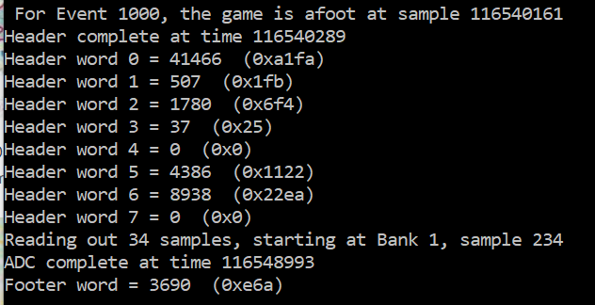
FPGA Event Extraction
Generated serial stream file has spaces between each bit (C++ issue)
For Event 1, the game is afoot at sample 18748
raw[0] = a1fa
raw[1] = 3d
raw[2] = 0
raw[3] = 39
raw[4] = 0
raw[5] = 1122
raw[6] = 222c
raw[7] = 0
Header complete at time 18876
Header word 0 = 41466 (0xa1fa)
Header word 1 = 61 (0x3d)
Header word 2 = 0 (0x0)
Header word 3 = 57 (0x39)
Header word 4 = 0 (0x0)
Header word 5 = 4386 (0x1122)
Header word 6 = 8748 (0x222c)
Header word 7 = 0 (0x0)
Reading out 34 samples, starting at Bank 0, sample 44
Channel 0, Sample 44 = 999
raw[8] = 58fb
Channel 1, Sample 44 = 1043
raw[9] = 5ac9
Channel 2, Sample 44 = 1012
raw[10] = 599c
Channel 3, Sample 44 = 1021
raw[11] = 59b1

Slide 8
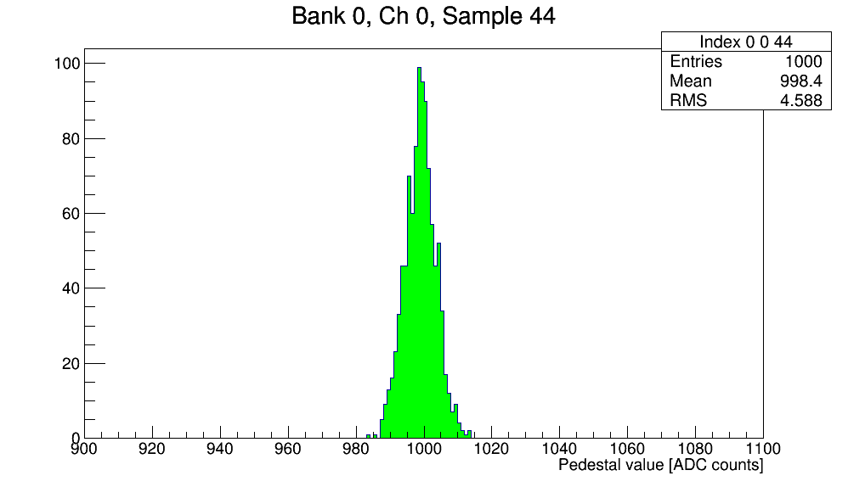
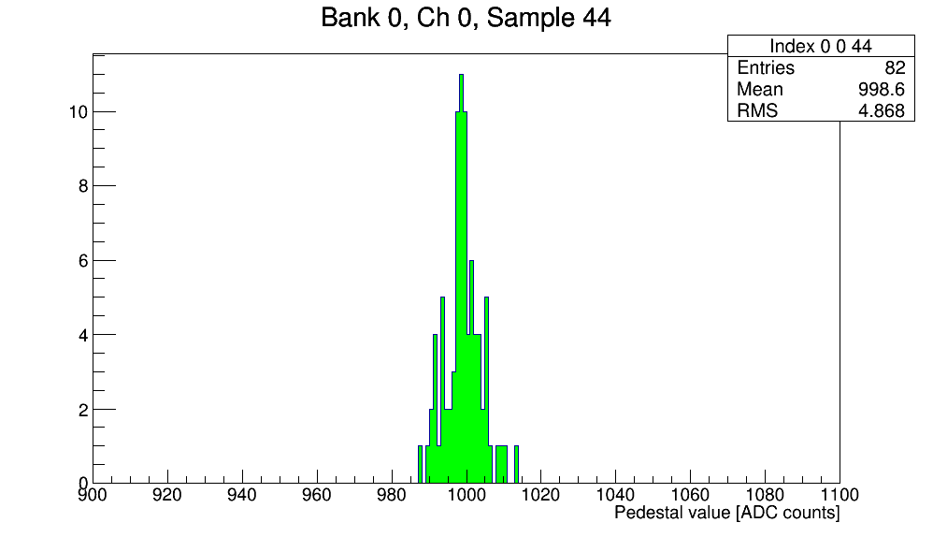
First Sample: Bank 0, Ch 0, Sample 44
Event Generator FPGA emulation (recovery)
Ped truth = 999

Slide 9
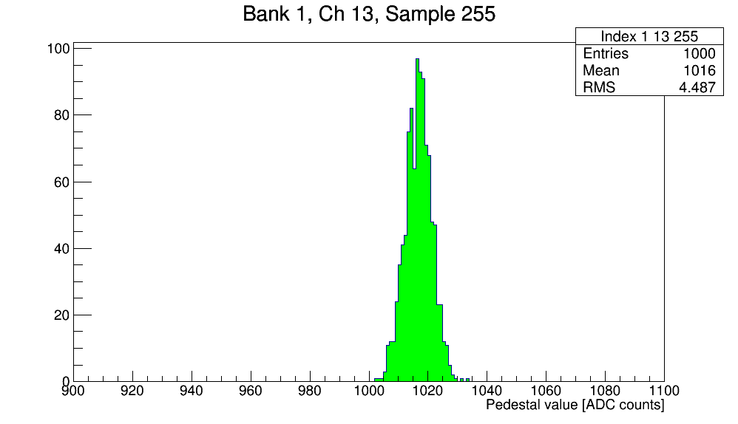
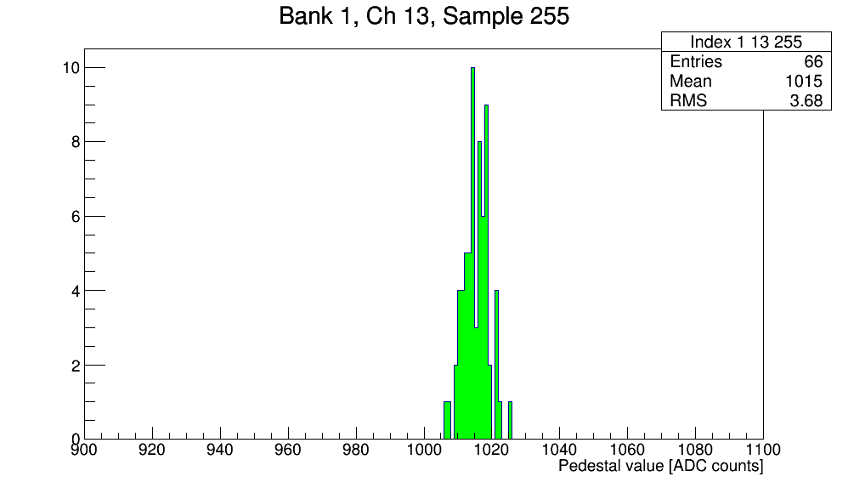
Another Random Sample
Event Generator FPGA emulation (recovery)

Slide 10
Pedestal Validation
PedGen.C
peds.dat
Verify processing by reproducing pedestals from noisy data
For 10 events
(first # in file)
Events_10.dat
EventProc.C
FPGAemul.C
Events_10.dat
Pedestal offset
Pedestal RMS
# Events to process
Random trig rate
EvtGen.C
# Events
RMS noise
Can also inject signals, in principle (not yet implemented)
10

Slide 11
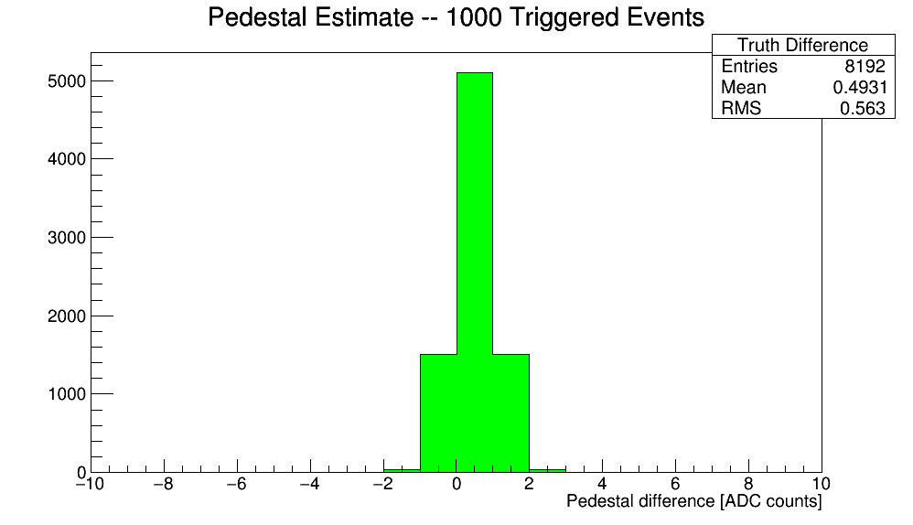
Variance (1k triggered events)
Extracted versus pedestal truth

Slide 12
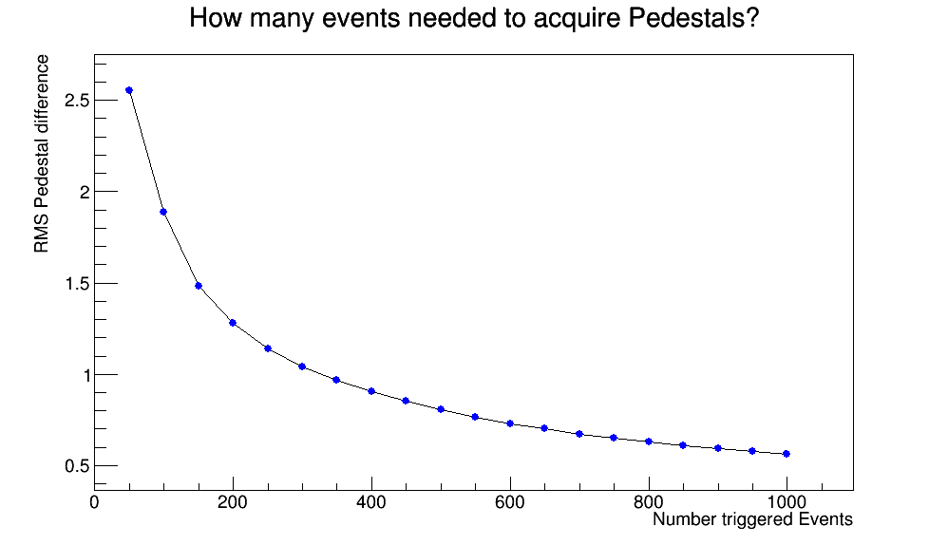
How many events needed for a good pedestal?
Surprisingly few (34 samples/triggered event)

Slide 13
ALPHA Simulation Notes/caveats
Generated serial stream file has spaces between each bit (C++ issue)
There are probably still a few bugs

Slide 14
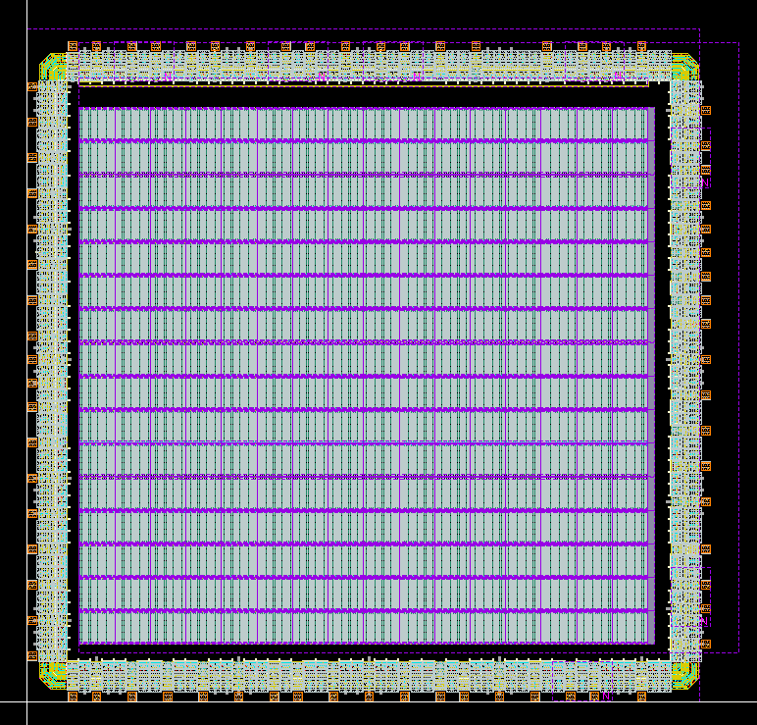
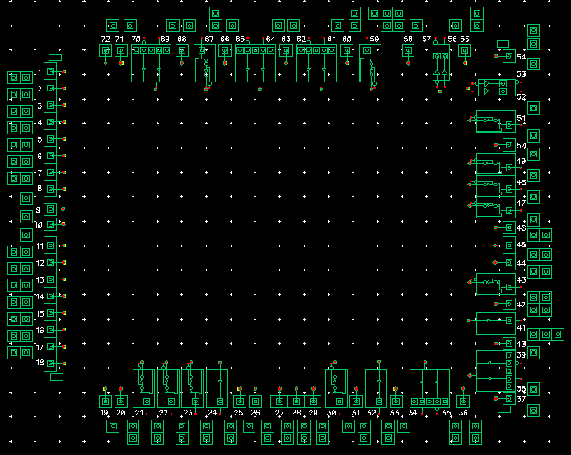
Padring and die size (estimate)
Currently 5.01mm x 5.19mm (~26mm [25mm is min.])
Analog core, preliminary padring/die size complete
Space for digital, I2C ?

Slide 15
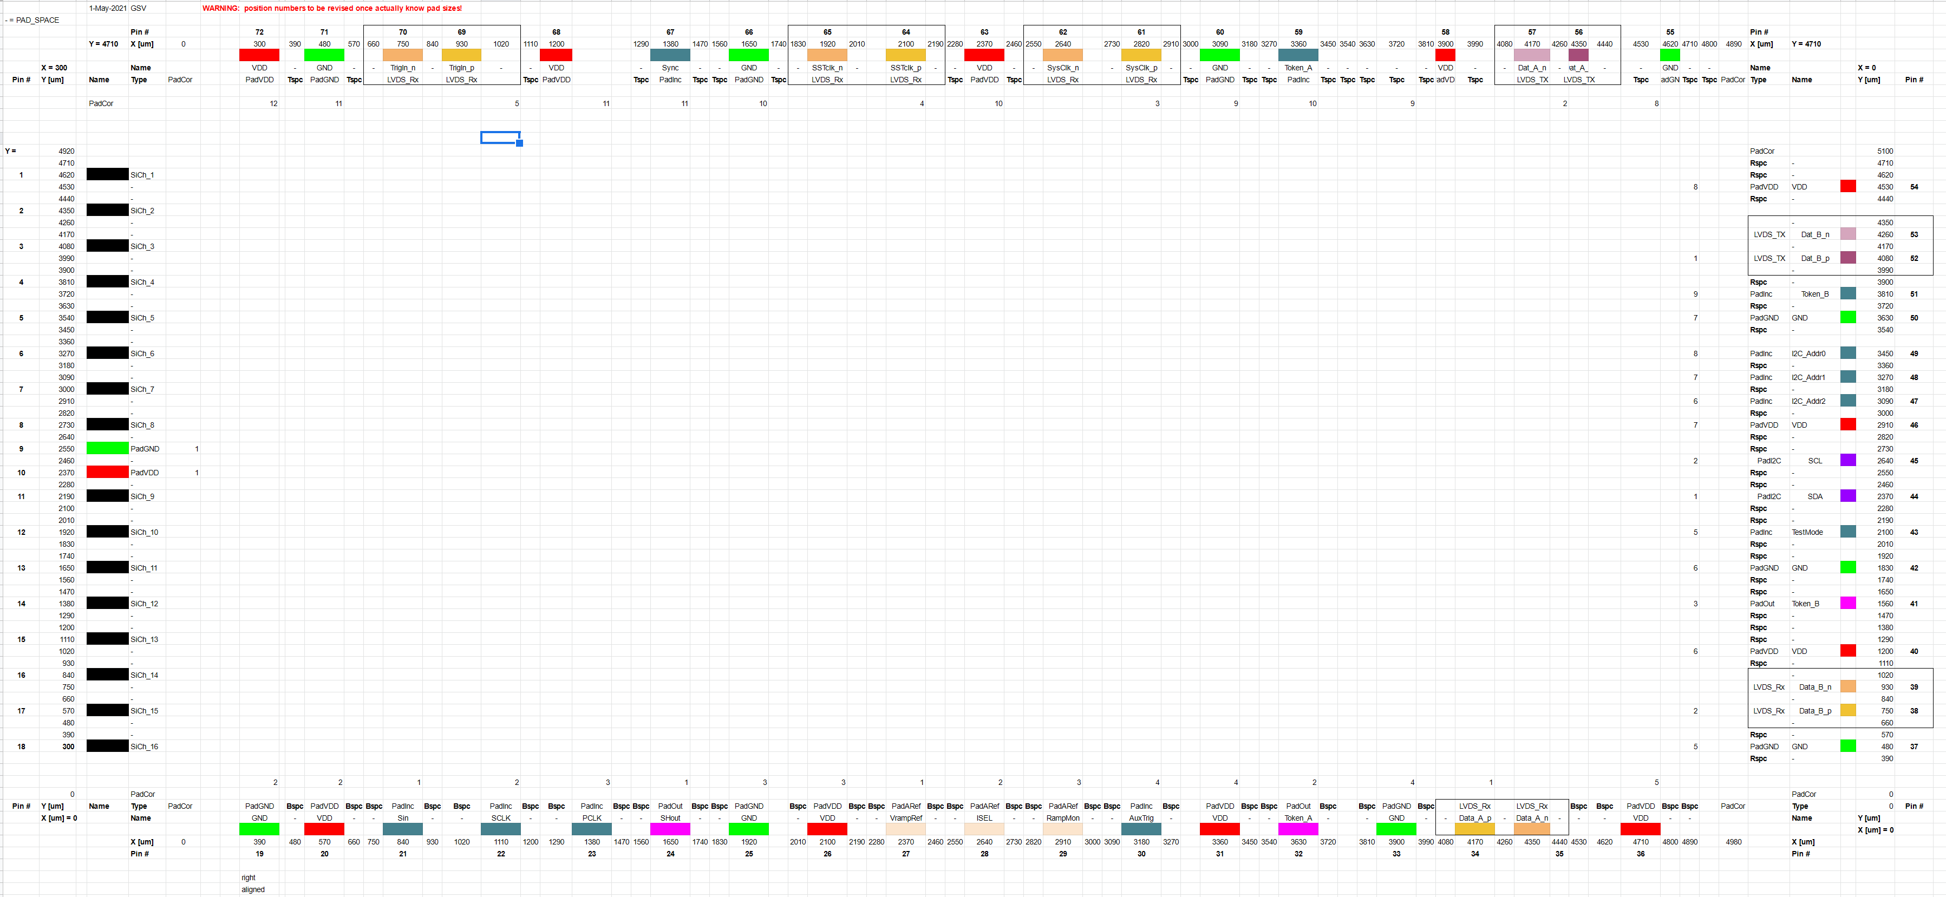
Online documentation
Google link by request
15

