Slide 1


| Tech Management, SRI-B
CLAWS
CLASH OF THE
M S Ramaiah Institute of Technology
Terminal Crew
The intelligent terminal agent that keeps your processes running — even when you're away.
1. Venkata Sai G S
2. K M Dushyanth Gowda
3. Abhishek R Hedge
4. Rohan Joshi

Slide 2
DevSync
Problem Statement : Hours Lost to Idle Terminals
Content — Why Theme 3 (Productivity Platforms)
Why this theme: We chose Productivity Platforms because developers waste hours every day to a problem nobody has solved — idle terminal prompts. Every developer runs long processes (ML training, Docker builds, CI/CD pipelines, database migrations) that unpredictably pause for user input. When the developer is away — at lunch, in a meeting, or asleep — the process just… stops. Expensive GPU time ticks away doing nothing.
What problem are you solving: Terminal processes halt mid-execution waiting for a simple Y/N response. There is no intelligent tool that can:
1. Detect when a process is genuinely waiting for input (vs. just logging output)
2. Reason about what the safe response is, using project context
3. Notify the developer on their phone with a smart recommendation
4. Inject the response back into the terminal — resuming execution instantly
Who faces it (persona): ML Engineers running overnight training jobs on cloud GPUs ($2.50/hr wasted per idle hour)
DevOps Engineers managing CI/CD pipelines and Docker builds across multiple servers
Backend Developers running database migrations that halt for confirmation
Any developer who has ever come back to their desk only to find their terminal stalled at `[Y/n]:`
Why it's important: A single ML training stall on an A100 GPU costs ~$2.50/hour in wasted compute
Enterprise teams report 4-6 terminal prompts per day interrupting flow state
There is zero developer tooling that addresses this. The terminal hasn't been modernized since the 1970s.

Slide 3
DevSync
Current Solution & Gaps: Everything Existing Falls Short
TOOL | WHAT IT DOES | WHAT'S BROKEN
tmux / screen | Keeps terminal session alive | Still requires manual intervention — you must SSH back and respond yourself. Zero intelligence.
`yes \| command` | Pipes "yes" to every prompt blindly | Extremely dangerous — no context awareness. Will happily say "yes" to `DROP TABLE users`. Can cause irreversible data loss.
SSH Keep-alive | Prevents SSH disconnection | Only prevents disconnection — does nothing about process prompts. Complex setup.
Custom scripts / expect | Hardcoded response automation | Brittle, per-command, no AI reasoning. Breaks the moment a new prompt appears.
What's missing (the gap): No existing tool combines intelligent prompt detection, context-aware AI reasoning, and mobile-first remote response into a single system. There is zero AI-powered solution for autonomous terminal process management.
Opportunity: Build an intelligent agent that wraps any terminal process, distinguishes real prompts from log noise using AI, reasons about the safest action using project-specific rules, and lets developers respond from their phone — turning every terminal session into an autonomous, intelligent workflow.

Slide 4
DevSync
Our Solution: Meet DevSync
What we’ve Built An AI-powered terminal agent that monitors your local processes, intercepts input prompts, reasons about them using your project context, and lets you respond from your phone — keeping your jobs running while you're away.
Key Features: 🔒 Danger Word Blocking — "DROP", "DELETE", "PURGE", "DESTROY" auto-block AI suggestions and force manual response
📊 Health Monitoring — Real-time CPU%, RAM tracking via psutil
📝 Full Session Logging — Every stdout line, silence event, and injection is logged to JSON
📋 Session Summary — Post-mortem delivered to Telegram: duration, prompts resolved, errors detected
🐳 Docker-native — Single `docker-compose up --build` to deploy the entire system
P.T.O

Slide 5
DevSync
Idea
Core Ideas: 1. Smart Process Wrapping — DevSync wraps any terminal command using a Python PTY (pseudo-terminal). Your process runs exactly as normal, but DevSync silently monitors every line of stdout in real-time.
2. 3-Layer Prompt Detection — A hybrid classifier that never misses a real prompt:
- Layer 1: Regex pattern matching — catches `[Y/n]`, `Password:`, `Overwrite?`, etc. instantly
- Layer 2: Error signature detection — catches stack traces, fatal errors
- Layer 3: LLM Fallback (Groq + Llama 3.3 70B) — if stdout goes silent for 10+ seconds with no regex match, the AI analyzes the last 20 lines to determine if the process is waiting
3. Context-Aware AI Reasoning — Powered by `SOUL.md` (Project Memory), DevSync reads your project-specific rules before making any recommendation. Example: "overwrite checkpoints: Y if on experiment branch" or "Alert always on DROP/DELETE/PURGE".
4. Telegram Mobile Response — Instant push notification to your phone with the detected prompt, AI recommendation, and one-tap buttons (✅ Yes / ❌ No / ✏️ Custom / 🔒 Auto). Your response is injected back into the process stdin — it resumes immediately.

Slide 6
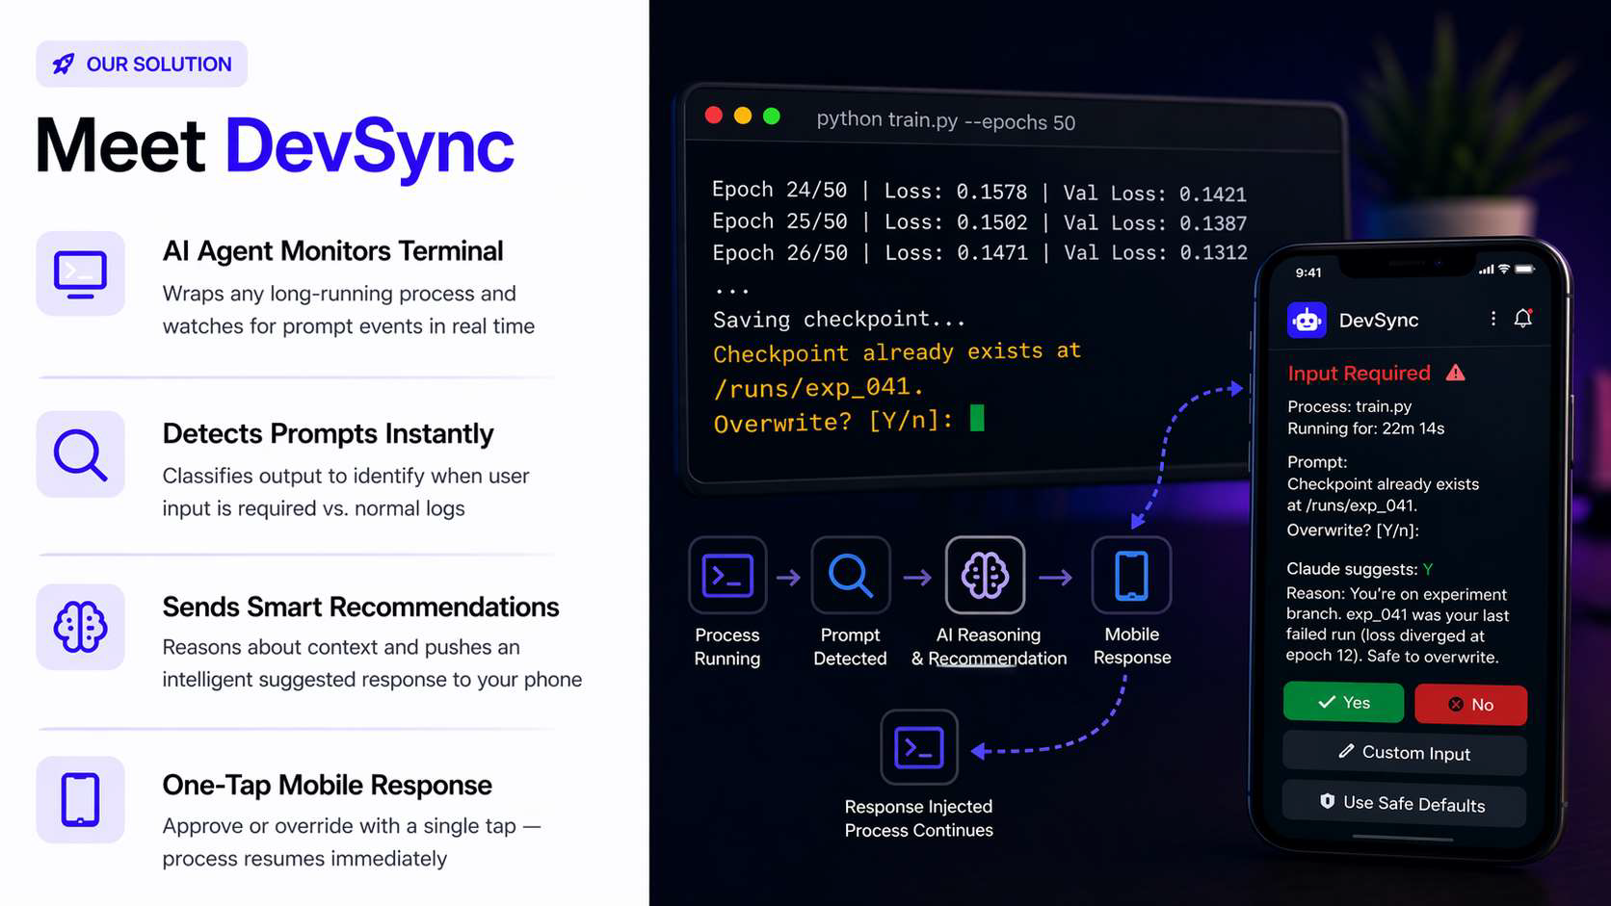
DevSync
Idea

Slide 7
DevSync
Demo/Product Walkthrough : Five Steps to Uninterrupted Execution
STEP | ACTION | WHAT HAPPENS
1. Wrap | Developer runs: devsync run python train.py | DevSync spawns the process inside a PTY wrapper. Stdout monitoring begins. Gateway WebSocket connects.
2. Detect | Training reaches: Checkpoint exists at /runs/exp_041. Overwrite? [Y/n]: | Stdout goes silent → 10s threshold → Classifier fires: Regex match on [Y/n] → classified as INPUT_REQUIRED
3. Reason | AI engine activates | SOUL.md loaded → Groq API called with terminal context → Returns: {recommendation: "Y", reason: "Safe to overwrite on experiment branch", risk: "low"}
4. Alert | Telegram notification hits your phone | Rich formatted message: Process name, runtime, prompt text, AI suggestion with reason, risk level + inline buttons
5. Respond | You tap ✅ Yes from your phone | Contract D sent via WebSocket → Response injected into process stdin → Continuing training... → Process resumes

Slide 8
DevSync
Idea
Key Moment — HIGH RISK scenario:
- Later, the script hits: `WARNING: This will DROP TABLE users. Confirm? [Y/n]:`
- DevSync detects "DROP" → Danger Word Override activates
- AI suggestion is BLOCKED — no auto-approve allowed
- Telegram shows: `🚨 HIGH RISK DETECTED — Manual response required`
- Developer must consciously choose — preventing catastrophic accidents

Slide 9
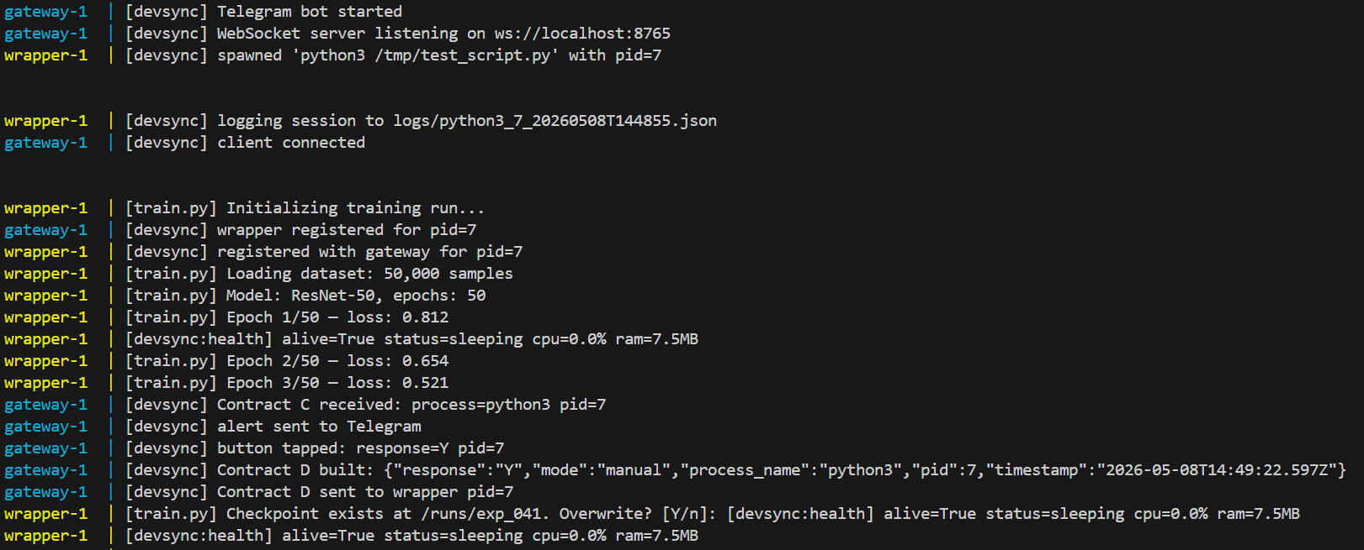
DevSync
Idea
Terminal during Telegram bot connection after docker-compose up --build and a low risk/normal alert being reproduced

Slide 10
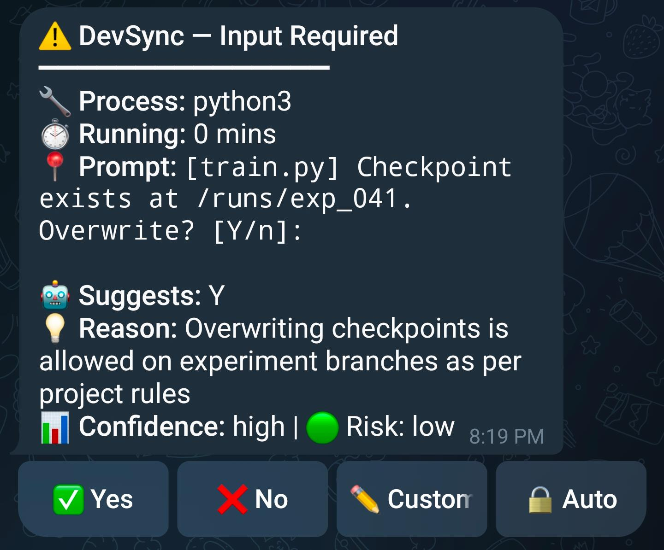
DevSync
Idea
Low Risk/Normal alert
In Telegram

Slide 11
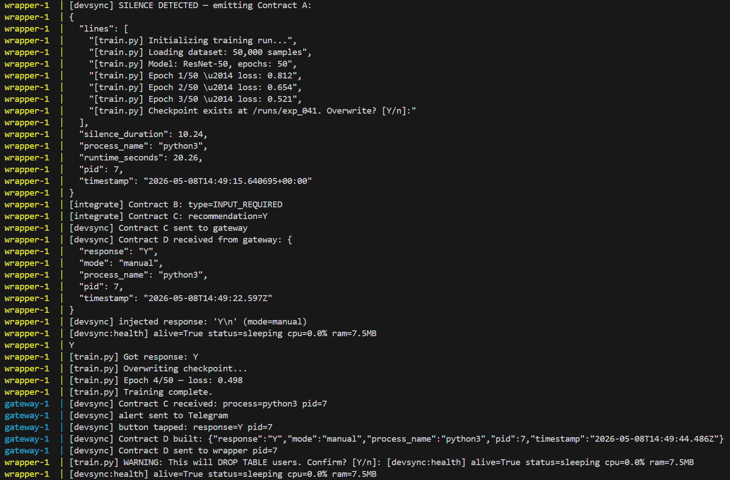
DevSync
Terminal after injecting Yes
Idea

Slide 12
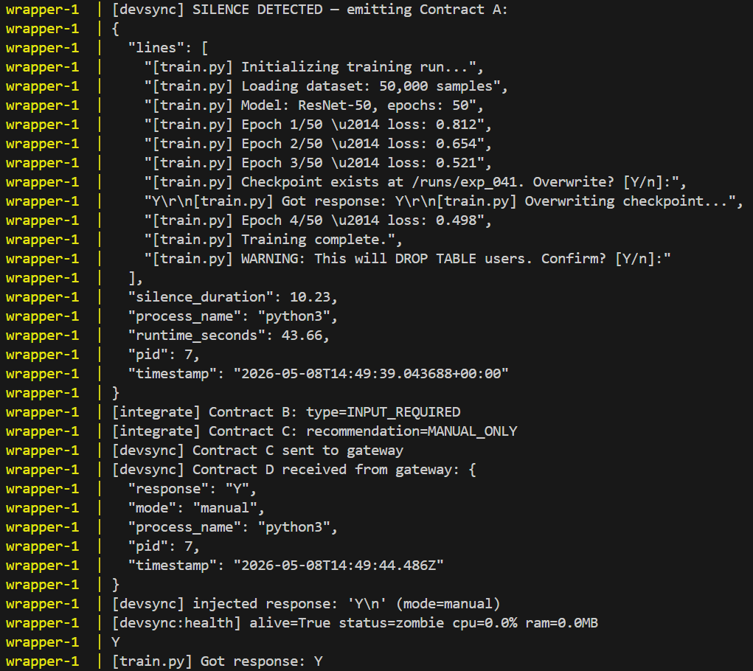
DevSync
Idea
HIGH RISK alert

Slide 13
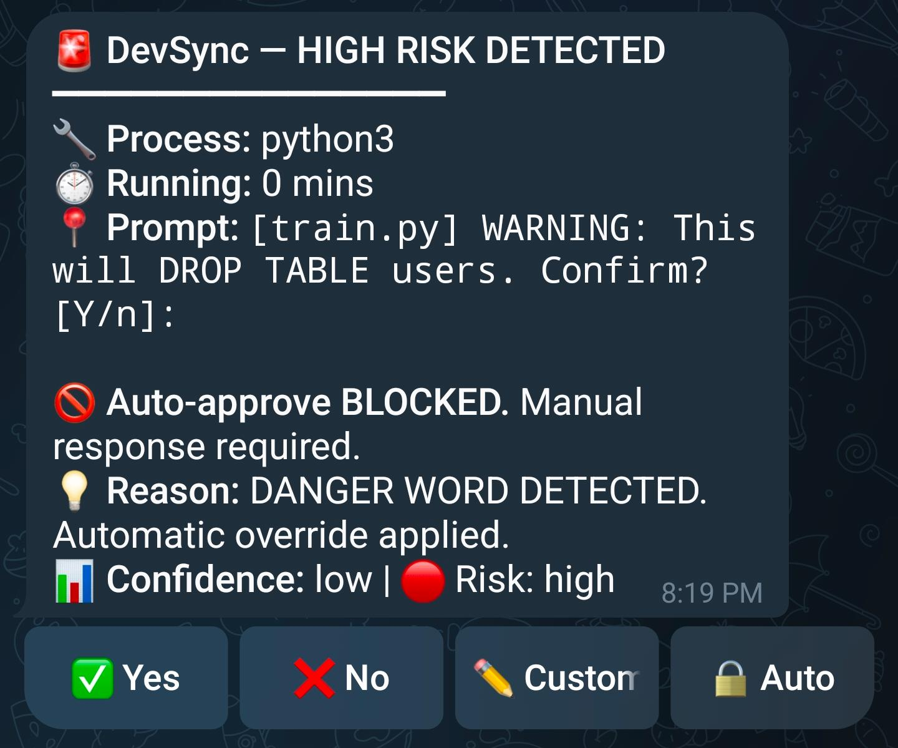
DevSync
Idea
HIGH RISK alert
In Telegram

Slide 14
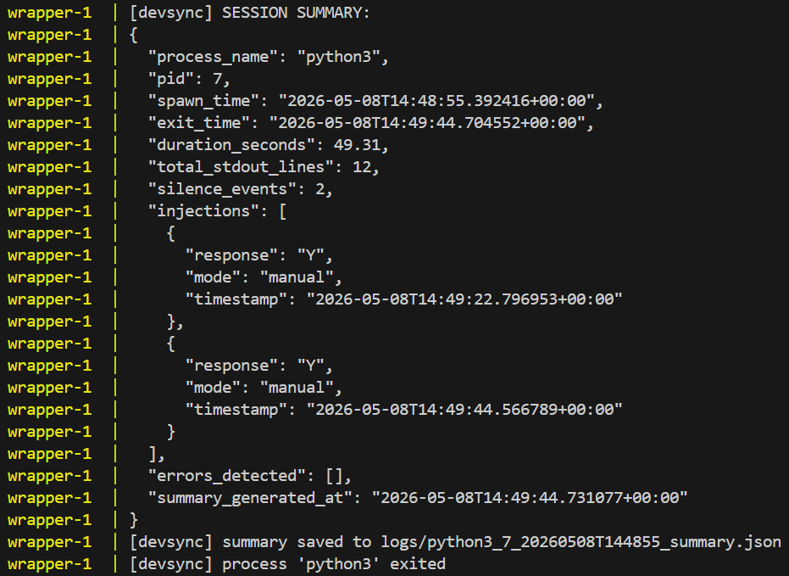
DevSync
Idea
Terminal after injecting Yes

Slide 15
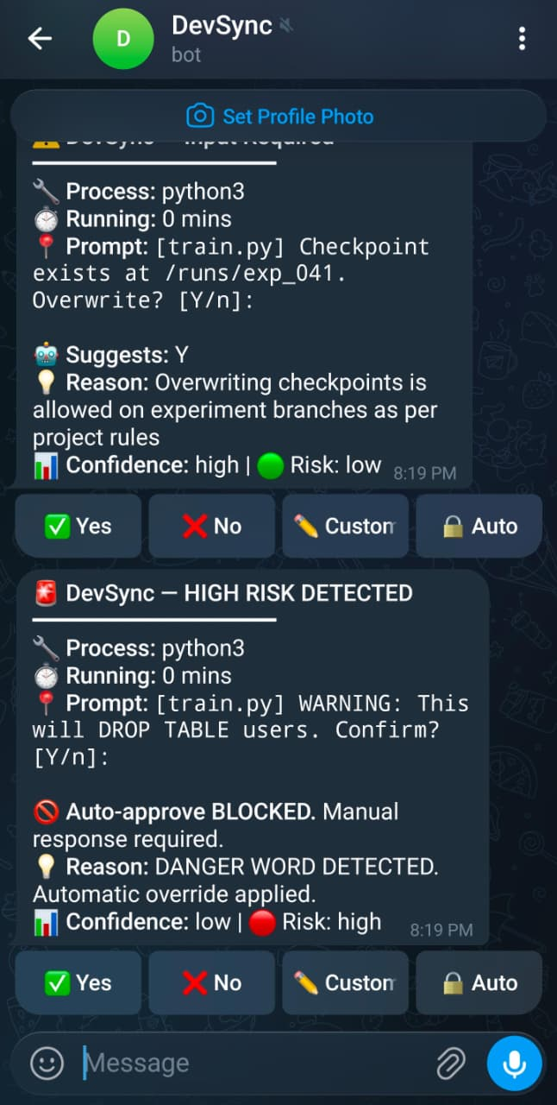
DevSync
Idea
Screenshot of the Telegram Bot

Slide 16
DevSync
Tech & Architecture: System Architecture — Modular. Intelligent. Secure.
Tech Stack :
Technology | Role
Python 3.11 | Core wrapper (PTY/psutil), Classifier, Reasoning Engine
Groq API (Llama 3.3 70B) | Ultra-fast LLM inference for prompt classification & context-aware reasoning
Node.js 18 | WebSocket gateway server, Telegram Bot integration
Telegram Bot API | Mobile-first notification & response interface
Docker + Docker Compose | Single-command deployment, service isolation
WebSocket (ws) | Real-time bidirectional communication between wrapper ↔ gateway
psutil | Process health monitoring (CPU%, RAM, alive status)

Slide 17
DevSync
Idea
Content — AI Usage
AI Model: Groq — Llama 3.3 70B Versatile
- Classifier LLM Fallback: Analyzes terminal output to detect if process is waiting (temperature=0.1, JSON mode)
- Reasoning Engine: Reads SOUL.md + terminal context → generates structured recommendation (Y/N/CUSTOM with reason, confidence, risk)
- Response format: Forced JSON schema for deterministic parsing
Framework: OpenClaw-aligned architecture — SOUL.md for project memory, modular agent loop, channel adapter pattern (Telegram)
Content — System Flow (Simple)
Process stdout → Python Wrapper (PTY) → Classifier (Regex + LLM) → Reasoning Engine (Groq + SOUL.md) → Gateway (WebSocket) → Telegram Bot → User taps → Contract D → Wrapper injects stdin → Process resumes

Slide 18
DevSync
Idea
Contract | From → To | Content
A | Wrapper → Classifier | stdout lines, silence duration, PID, process name
B | Classifier → Reasoning | event type (INPUT_REQUIRED/ERROR/NOISE), prompt text, context
C | Reasoning → Gateway | recommendation (Y/N/MANUAL), reason, confidence, risk
D | Gateway → Wrapper | user response, mode (manual/auto), PID for injection
We had decided to go with Claude API, but due to the mandatory topup of tokens/tickets for the API to actually work, we decided to change and use GROQ API for the rest of the Project.

Slide 19
DevSync
Idea
AI Disclosure
Category | Detail
AI within the solution | Groq API (Llama 3.3 70B Versatile) — used for terminal prompt classification fallback and context-aware reasoning
AI for development | GitHub Copilot / ChatGPT used for code scaffolding, debugging, and documentation
AI for artifacts | AI-assisted creation of pitch deck visuals, README, and presentation content

Slide 20
DevSync
Impact & Use cases: Real-World Impact — Zero Idle Time. Zero Interruptions.
Content — Real Life Scenarios
Scenario 1: ML Training at 3 AM 🌙 A machine learning engineer kicks off a 50-epoch ResNet training run on a cloud A100 GPU ($2.50/hr) before going to bed. At 3:17 AM, the script hits a checkpoint overwrite prompt. Without DevSync: the GPU sits idle for 6 hours until the engineer wakes up — $15 wasted. With DevSync: a Telegram notification arrives, the AI recommends "Yes — safe to overwrite", the engineer taps from bed, training resumes in under 10 seconds.
Scenario 2: CI/CD Pipeline in a Meeting 📊 A DevOps engineer triggers a production deployment pipeline. Mid-meeting, the pipeline pauses for a `Proceed with migration? [Y/n]:` confirmation. Without DevSync: the deployment stalls until the meeting ends — blocking the entire release. With DevSync: a phone buzz, one tap, pipeline continues. Zero disruption.

Slide 21
DevSync
Idea
Scenario 3: Database Migration Safety Net 🛡️ A junior developer accidentally runs a migration script that hits `DROP TABLE users. Confirm?`. Without DevSync: a single careless keystroke could wipe production data. With DevSync: the `DROP` danger word triggers a 🚨 HIGH RISK block — AI auto-approve is disabled, forcing the developer to consciously acknowledge the risk. Disaster averted.
Scenario 4: Docker Build Farm at Scale 🐳 A team runs 12 parallel Docker builds across staging servers. Three of them hit different prompts at different times.
Without DevSync: someone has to monitor all 12 terminals. With DevSync: each prompt arrives as a separate Telegram alert with context. The lead developer resolves all three from their phone in under a minute.
Content — Scale Potential
- Individual developer → saves 30-60 mins/day of terminal babysitting
- Engineering team (10 devs) → saves 5-10 hours/day combined
- Enterprise (GPU clusters) → prevents thousands of dollars in wasted compute monthly
- Open source potential → every developer using a terminal is a potential user

Slide 22
DevSync
Idea

Slide 23
DevSync
Differentiation: Why DevSync Stands Out
Feature | tmux/screen | yes\|command | SSH keep-alive | DevSync
Keeps session alive | ✅ | ❌ | ✅ | ✅
Detects prompts | ❌ | ❌ | ❌ | ✅ 3 layer AI
Context-aware reasoning | ❌ | ❌ | ❌ | ✅(SOUL.md + LLM)
Mobile notification | ❌ | ❌ | ❌ | ✅(Telegram)
Safe for destructive ops | ❌ | 🚫 Dangerous | ❌ | ✅(Danger blocking)
One-tap response | ❌ | ❌ | ❌ | ✅

Slide 24
DevSync
Idea
Strong MOATs
MOAT 1: SOUL.md — Project Memory 🧠
No other tool learns your project. DevSync reads a plain-text `SOUL.md` file containing your project-specific rules ("overwrite checkpoints: Y if on experiment branch", "Alert always on DROP/DELETE"). This means recommendations are customized per project, not generic. As OpenClaw evolves, this becomes durable cognitive memory — surviving restarts, LLM swaps, and context window limits.
MOAT 2: 3-Layer Hybrid Classifier 🎯
Our classifier uses a fast→smart escalation pattern: instant regex for known prompts (0ms), error pattern detection for crashes, and an LLM fallback (Groq — sub-200ms latency) for unknown prompts after silence threshold. This hybrid approach achieves near-zero false positives — you're never interrupted for log noise, only real prompts. No existing tool does this.

Slide 25
DevSync
Idea

Slide 26
DevSync
Idea
Demo Link:
Content - GitHub Repo:
🔗 “https://github.com/gsvenkatsai/DevSync” (branch: `dev`)
Demo Video:
🎬 “https://drive.google.com/file/d/1GBw_srea7mPhZGU-7P4IoZ1_yiL7pHpO/view?usp=drive_link”
Documents Submitted:
📄 DevSync_Final_Pitch.pdf — Complete 10-page pitch deck
📄 SOUL.md — Project Memory file (shipped with the repo)
📄 This PPT — terminal_crew.pptx
How to Run (Setup Instructions):
> git clone https://github.com/gsvenkatsai/DevSync.git
> cd DevSync && git checkout dev
> cp .env.example .env # Add your Telegram + Groq keys
> docker-compose up --build

Slide 27
DevSync
Idea
What's Next — The DevSync Roadmap:
Content — Future Scope & Extras
Immediate Next Steps: 🔔 Multi-channel support — Discord, Slack, WhatsApp (OpenClaw supports all of these via ProtocolAdapter)
📱 Auto-mode — AI auto-responds for low-risk prompts without user intervention (currently tap-only for safety)
🧠 Learning from history — DevSync remembers past decisions and adapts SOUL.md recommendations over time
📊 Dashboard — Web UI for monitoring all active processes, history, and analytics
OpenClaw Alignment: DevSync is built on the same principles as OpenClaw:
- SOUL.md for behavioral boundaries — same as OpenClaw's personality layer
- Channel adapter pattern — Telegram today, any OpenClaw-supported channel tomorrow
- Local-first architecture — your data stays on your hardware, swap LLMs freely
Docker-native isolation — secure execution sandbox
What We Learned: Building a contract-based microservice architecture (Contracts A→B→C→D) made the system modular and testable
- Groq's sub-200ms inference on Llama 3.3 70B made LLM-in-the-loop viable for real-time terminal monitoring
- The PTY wrapper approach is language-agnostic — it works with Python, Node, shell scripts, Docker, anything.

