Slide 1


MuSQLE: Distributed SQL Query Execution Over Multiple-Engine Environments
Victor Giannakouris, Nikolaos Papailiou, Dimitrios Tsoumakos and Nectarios Koziris
National Technical University of Athens, Ionian University

Slide 2
Outline
Database Systems and SQL Frameworks Variety
The need of integration
Existing integration solutions
The need of Multi-Engine optimization
MuSQLE: Multi-Engine SQL Query Execution
Processing a query using MuSQLE
Experimental Evaluation

Slide 3
Big Data – The three Vs
Data Volume
  Large amounts of data
  Complex SQL queries
Data Velocity
  Rate of growth
Data Variety
  Diversity of data sources
  Need of integration of different data sources and formats

Slide 4

One size does not fit all
Each system provides specific internal optimizations
There is no system that offers high performance for all kinds of data
Heterogeneous systems
  Also called polystores
  Hybrid infrastructures
  Consists of different kinds of databases

Slide 5




Many different database systems
Relational Databases
  Disk-based (PostgreSQL)
  In-Memory (MemSQL)
  Column-Stores (MonetDB)
NoSQL Databases
  Document Stores (MongoDB)
  HDFS
    Parquet
    Json

Slide 6


Plethora of SQL-based frameworks
Spark SQL
  Allows querying data with SQL using DataFrames
  Main memory processing using RDDs
  Compatible with a lot of external datasources
PrestoDB
  Distributed SQL query engine
  Connectors for various systems including Hive, Cassandra, Postgres etc.

Slide 7
Querying tables in multi-engine environments
In most scenarios we need to query tables stored in different engines
Many existing solutions solve this problem
  Extract-Transform-Load (ETL)
  Spark SQL, PrestoDB
Existing systems does not take advantage of each engine's internal mechanisms
  Lack of performance

Slide 8
Querying tables in multi-engine environments
Existing systems needs to fetch the whole tables before the query execution
That leads in to drawbacks
  Network latency
  Ignorance of each engine's internal optimizer
In many cases it is more efficient to execute part of a query inside the external engine and fetch the result
  Smaller data to transfer
  Taking advantage of the engine's optimizer

Slide 9
Example Case
SELECT *
FROM customer, nation, region, orders, lineitem
WHERE c_nationkey = n_nationkey AND c_orderkey = o_orderkey
AND o_orderkey = l_orderkey
AND r_name = 'EUROPE'
Spark SQL Plan
Table Locations
customer
nation
region
order
lineitem

Slide 10
The MuSQLE System
Multi-Engine query processing over Spark SQL
Execution of traditional SQL queries over multiple-engine environments
Engine-aware, cost-based optimizer
Intermediate result movements between engines
Simple integration with new engines using an Engine API

Slide 11
Architecture

Slide 12
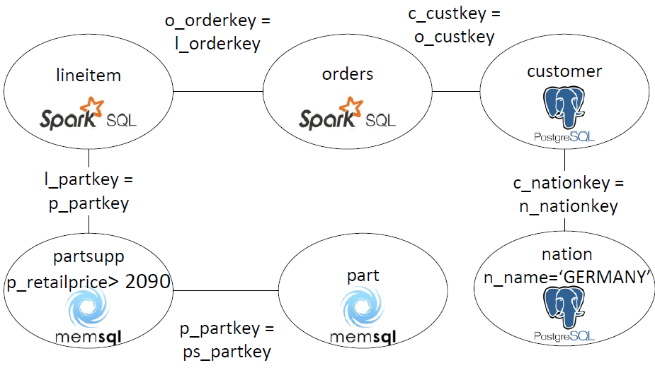
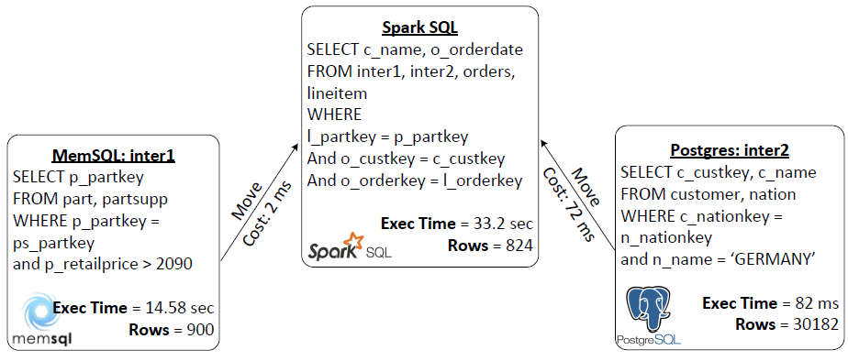
Query Processing
SELECT *
FROM customer, nation, region, orders, lineitem
WHERE c_nationkey = n_nationkey AND c_orderkey = o_orderkey
AND o_orderkey = l_orderkey
AND r_name = 'EUROPE'

Slide 13
Engine API
Development of new connectors
Easy integration with new engines
Five basic methods
  getCost(query: String)
  getMoveCost(plan: QueryPlan)
  moveResult(result: QueryPlan)
  inject(plan: QueryPlan)
  execute(query: String)

Slide 14
Experiments - Setup
Synthetic SQL queries
TPC-H tables
Scale factors: 5 GB, 20 GB, 50 GB
Locations
  All tables in all engines
  Tables stored in different engines
Query categories
  Join-only
  Join-filter

Slide 15
Experiments - Infrastructure
Spark SQL Cluster
  1 Master Node
  5 Worker nodes
MemSQL Cluster
  1 Master Aggregator
  5 Aggregators
PostgreSQL
  1 Single VM
Each VM consists of 4 VCPUs and 8 GB RAM

Slide 16
Execution Times
All tables in all engines

Slide 17
Execution Times
Tables in different engines

Slide 18
Example query 1

Slide 19
Example query 2

Slide 20
Conclusions

Slide 21
Questions?

