Slide 1
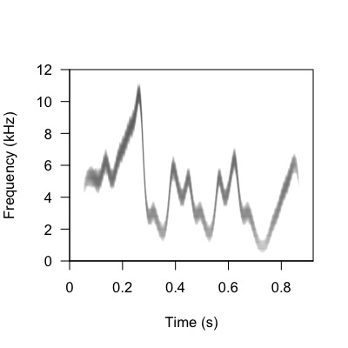
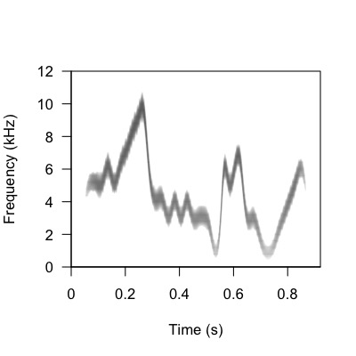
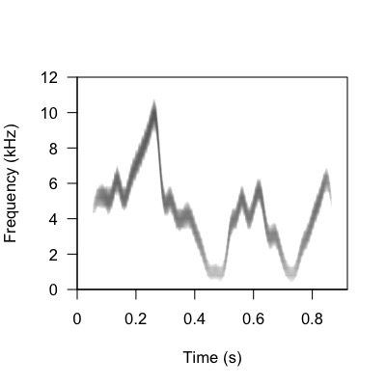
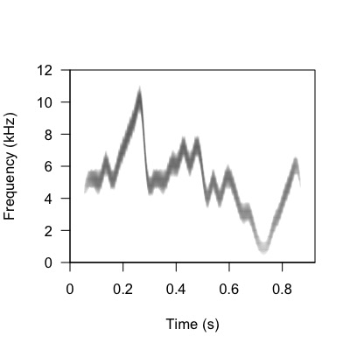
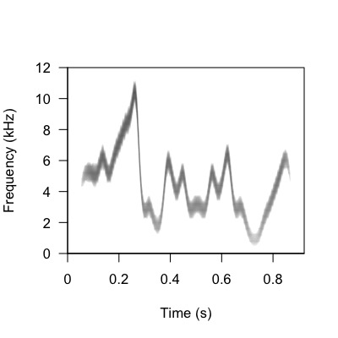
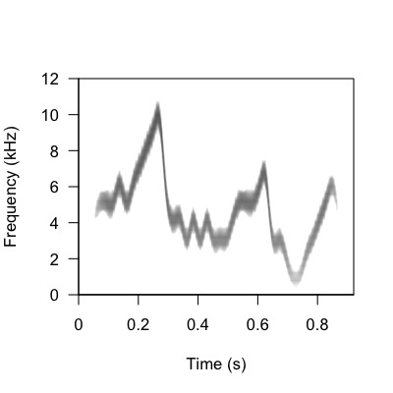
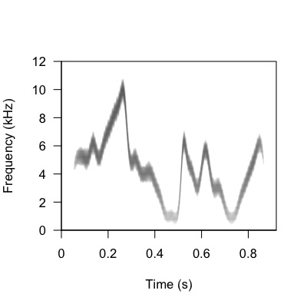
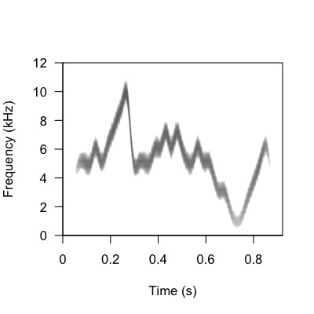

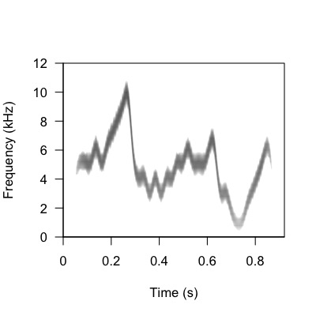
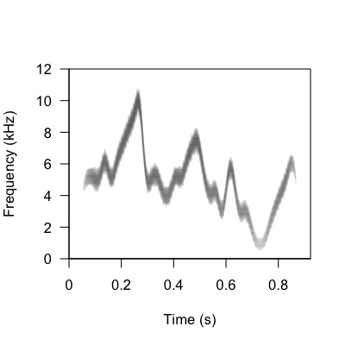
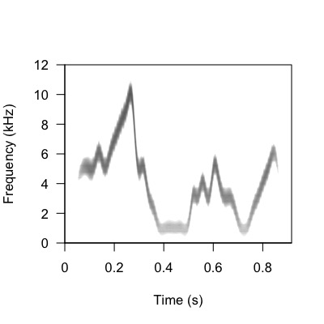
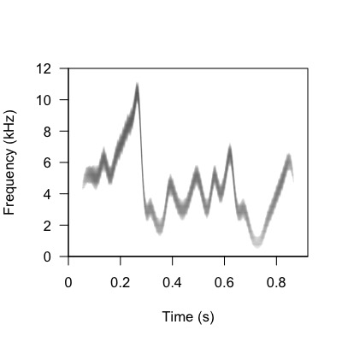

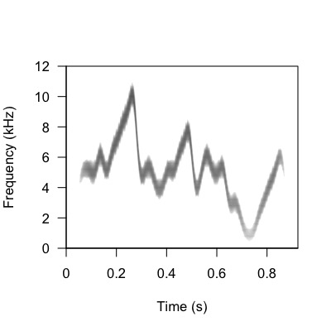
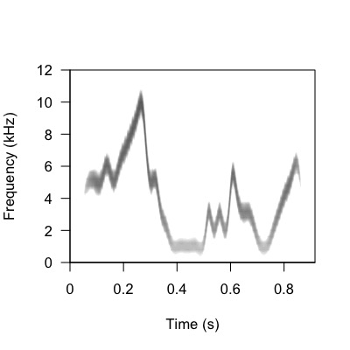
Individual 1
Individual 1
Individual 1
Individual 1
Group Info Dataset
Group A
Group B
Group A
Group B
Individual 2
Individual 2
Individual Info Dataset
Individual 2
Individual 2
Notes:
Group Information Dataset
Group A = Group 1
Individual 1 = Individual 1, calls 1 and 3
Individual 2 = Individual 3, calls 1 and 3
Group B = Group 2
Individual 1 = Individual 4, calls 1 and 2
Individual 2 = Individual 6, calls 1 and 2
Individual Information Dataset
Group A = Group 4
Individual 1 = Individual 6, calls 2 and 4
Individual 2 = Individual 10, calls 1 and 3
Group B = Group 5
Individual 1 = Individual 9, calls 4 and 5
Individual 2 = individual 10, calls 4 and 5
Remove frequence and time on individual specs and add

Slide 2
Group Info Dataset
Individual 1
Individual 1
Group A
Group B
Individual 2
Individual 2
Notes:
Group Information Dataset
Group A = Group 1
Individual 1 = Individual 1, calls 1 and 3
Individual 2 = Individual 3, calls 1 and 3
Group B = Group 2
Individual 1 = Individual 4, calls 1 and 2
Individual 2 = Individual 6, calls 1 and 2
Individual Information Dataset
Group A = Group 4
Individual 1 = Individual 6, calls 2 and 4
Individual 2 = Individual 10, calls 1 and 3
Group B = Group 5
Individual 1 = Individual 9, calls 4 and 5
Individual 2 = individual 10, calls 4 and 5
Remove frequence and time on individual specs and add

