Slide 1

gswong.github.io/CO2Navi
(Sorry! Last part is case sensitive!)
Team Members:
Annmarie Gary Kyle Tudor

Slide 2
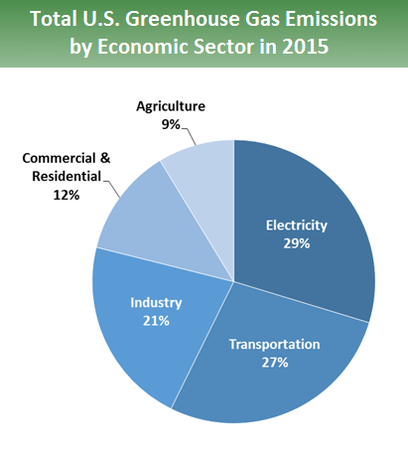
Tackling the CO2 Problem
Large scale problem
Harms communities with fragile infrastructure
Transportation accounts for a large portion
https://www.epa.gov/ghgemissions/sources-greenhouse-gas-emissions

Slide 3
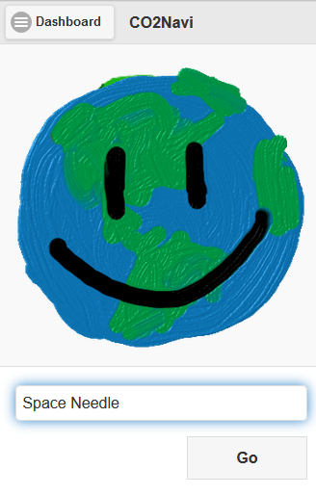
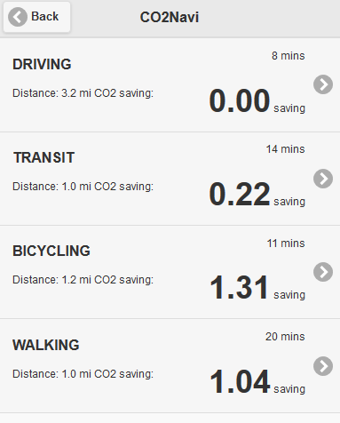
Encourage change in behaviors on a small scale
Influence people to change travel behaviors one trip at a time

Slide 4
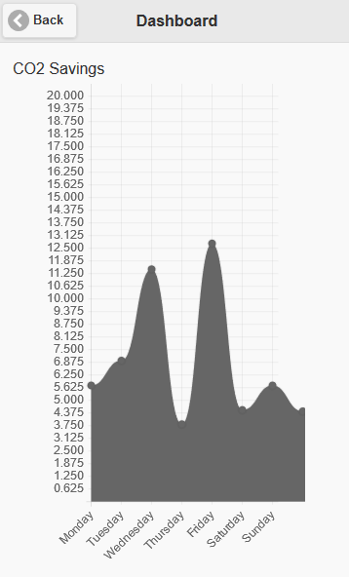
Build momentum over time
Track CO2 savings history for impact over time

Slide 5
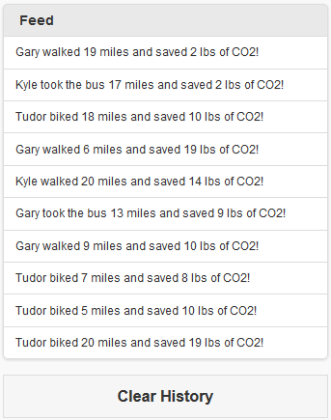
Scale out over social networks
Drive hype by seeing friends contribute to CO2 savings

Slide 6
Reflections on the Hackathon
Learned to design for positive reinforcement
Next step is to rest and rebound for the next opportunity
Continue to contribute creativity and hard work to the community

