Slide 1
Leader Election

Slide 2
Leader Election (LE) problem
In a DS, it is often needed to designate a single processor (i.e., a leader) as the coordinator of some forthcoming task (e.g., find a spanning tree using the leader as the root)
In a LE computation, each processor must decide between two internal states: either elected (won), or not-elected (lost).
Once an elected state is entered, processor is always in an elected state: i.e., irreversible decision
In every admissible execution, exactly one processor (the leader) enters an elected state

Slide 3
Leader Election in Ring Networks
Initial state
(all not-elected)
Final state
leader

Slide 4
Why Study Rings?
Simple starting point, easy to analyze
Abstraction of a classic LAN topology
Lower bounds and impossibility results for ring topology also apply to arbitrary topologies

Slide 5
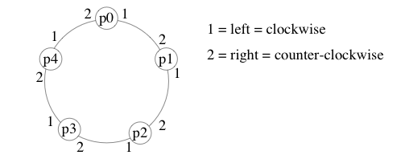
Sense-of-direction in Rings
In an oriented ring, processors have a consistent notion of left and right
For example, if messages are always forwarded on channel 1, they will cycle clockwise around the ring

Slide 6
LE algorithms in rings depend on:
Anonymous Ring
Non-anonymous Ring
Size of the network n is known (non-unif.)
Size of the network n is not known (unif.)
Synchronous Algorithm
Asynchronous Algorithm

Slide 7
LE in Anonymous Rings
Every processor runs the same algorithm
Every processor does exactly the same
execution

Slide 8
Impossibility for Anonymous Rings
Theorem: There is no leader election algorithm for anonymous rings, even if
  the algorithm knows the ring size (non-uniform)
  in the synchronous model
Proof Sketch (for non-unif and sync rings):
  Every processor begins in same state (not-elected) with same outgoing msgs (since anonymous)
  Every processor receives same msgs, does same state transition, and sends same msgs in round 1
  And so on and so forth for rounds 2, 3, …
  Eventually some processor is supposed to enter an elected state. But then they all would.

Slide 9
Initial state
(all not-elected)
Final state
leader
If one node is elected a leader,
then every node is elected a leader

Slide 10
Impossibility for Anonymous Rings
Since the theorem was proven for non-uniform and synchronous rings, the same result holds for weaker models:
  uniform
  asynchronous

Slide 11
Rings with Identifiers, i.e., non-anonymous
Assume each processor has a unique id.
Don't confuse indices and ids:
  indices are 0 to n - 1; used only for analysis, not available to the processors
  ids are arbitrary nonnegative integers; are available to the processors through local variable id.

Slide 12
Overview of LE in Rings with Ids
There exist algorithms when nodes have unique ids.
We will evaluate them according to their message (and time) complexity. Best results follow:
asynchronous ring:
  Θ(n log n) messages
synchronous ring:
  Θ(n) messages, pseudo-polynomial time complexity
All bounds are asymptotically tight (though we will not show lower bounds).

Slide 13
Asynchronous Non-anonymous Rings
W.l.o.g: the maximum id node is elected leader
8
1
2
5
6
3
4
7

Slide 14
An O(n²) messages asyncronous algorithm: the Chang-Roberts algorithm
Every process sends an election message with its id to the left if it has not seen a message with a higher id
Forward any message with an id greater than own id to the left
If a process receives its own election message it is the leader
It is uniform: number of processors does not need to be known to the algorithm

Slide 15
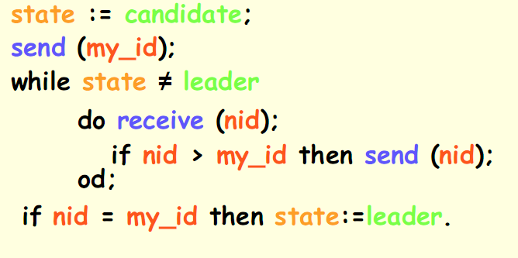
Chang-Roberts algorithm: pseudo-code for P_{i}

Slide 16
Chang-Roberts algorithm: an execution
1
8
8
Each node sends a message with its id
to the left neighbor
1
5
2
2
5
6
3
6
3
4
7
7
4

Slide 17
If: message received id current node id
Then: forward message
5
8
1
2
5
8
6
7
3
4
7
6

Slide 18
If: message received id current node id
Then: forward message
8
1
7
2
5
6
3
8
4
7

Slide 19
If: message received id current node id
Then: forward message
7
8
1
2
5
6
3
4
7
8

Slide 20
If: message received id current node id
Then: forward message
8
1
2
5
6
3
4
8
7

Slide 21
If: a node receives its own message
Then: it elects itself a leader
8
8
1
2
5
6
3
4
7

Slide 22
If: a node receives its own message
Then: it elects itself a leader
8
1
leader
2
5
6
3
4
7

Slide 23
Analysis of Chang-Roberts algorithm
Correctness: Elects processor with largest id.
  msg containing that id passes through every processor
Message complexity: Depends how the ids are arranged.
  largest id travels all around the ring (n msgs)
  2nd largest id travels until reaching largest
  3rd largest id travels until reaching largest or second largest
  etc.

Slide 24
Worst case: O(n²) messages
Worst way to arrange the ids is in decreasing order:
  2nd largest causes n - 1 messages
  3rd largest causes n - 2 messages
  etc.
n
1
n-1
2
n-2
n-3

Slide 25
Worst case: O(n²) messages
n
n messages
1
n-1
2
n-2
n-3

Slide 26
Worst case: O(n²) messages
n
n-1 messages
1
n-1
2
n-2
n-3

Slide 27
Worst case: O(n²) messages
n
n-2 messages
1
n-1
2
n-2
n-3

Slide 28
Worst case: O(n²) messages
Total messages:
n
1
n-1
2
…
n-2
n-3

Slide 29
Best case: O(n) messages
Total messages:
n
n-1
1
n-2
…
2
3

Slide 30
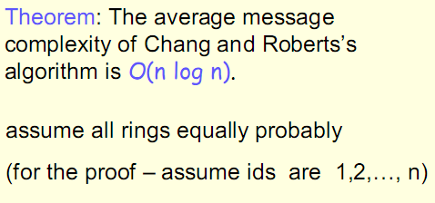
Average case analysis CR-algorithm

Slide 31
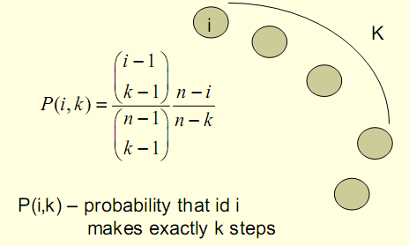

Average case analysis CR-algorithm
Probability that the k-1 neighbors of i are less than i
Probability that the k-th neighbor of i is larger than i

Slide 32
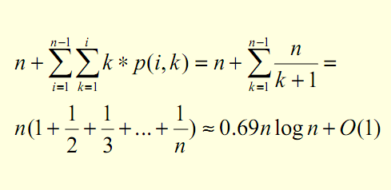
Average case analysis CR-algorithm
Therefore, the expected number of steps of
msg with id i is E_{i}(n)=P(i,1)*1+P(i,2)*2+…P(i,n)*n.
Hence, the expected total number of msgs is:

Slide 33
Can We Use Fewer Messages?
The O(n²) algorithm is simple and works in both synchronous and asynchronous model.
But can we solve the problem with fewer messages?
Idea:
  Try to have msgs containing larger ids travel smaller distance in the ring

Slide 34
An O(n log n) messages asyncronous algorithm: the Hirschberg-Sinclair algorithm
Again, the maximum id node is elected leader
8
1
2
5
6
3
4
7

Slide 35
Hirschberg-Sinclair algorithm (1)
Assume ring is bidirectional
Carry out elections on increasingly larger sets
Algorithm works in (asynchronous) phases
P_{i} is a leader in phase r=0,1,2,… iff it has the largest id of all nodes that are at a distance 2^{r} or less from it; to establish that, it sends probing messages on both sides
Probing in phase r requires at most 4·2^{r} messages for each processor trying to become leader

Slide 36
nodes
8
nodes
1
2
5
6
3
4
7

Slide 37
Hirschberg-Sinclair algorithm (2)
Only processes that win the election in phase r can proceed to phase r+1
If a processor receives a probe message with its own id, it elects itself as leader
It is uniform: number of processors does not need to be known to the algorithm

Slide 38
Phase 0: send(id, current phase, step counter)
to 1-neighborhood
1
8
8
1
8
5
2
2
1
2
5
6
3
5
6
4
6
3
3
7
4
7
7
4

Slide 39
If: received id current id
Then: send a reply(OK)
8
1
2
5
6
3
4
7

Slide 40
If: a node receives both replies
Then: it becomes a temporal leader
and proceed to next phase
8
1
2
5
6
3
4
7

Slide 41
Phase 1: send(id,1,1) to left and right
adjacent in the 2-neighborhood
8
8
1
8
2
5
5
6
5
6
6
3
7
4
7
7

Slide 42
If: received id current id
Then: forward(id,1,2)
8
6
1
8
5
2
5
8
7
6
3
7
6
4
5
7

Slide 43
At second step: since step counter=2, I’m on
the boundary of the 2-neighborood
If: received id > current id
Then: send a reply(id)
8
1
2
5
6
3
4
7

Slide 44
If: a node receives a reply with another id
Then: forward it
If: a node receives both replies
Then: it becomes a temporal leader
8
1
2
5
6
3
4
7

Slide 45
Phase 2: send id to -neighborhood
8
1
8
2
5
8
7
7
6
3
4
7

Slide 46
At the step:
If: received id current id
Then: send a reply
8
1
2
5
6
3
4
7

Slide 47
If: a node receives both replies
Then: it becomes the leader
8
1
2
5
6
3
4
7

Slide 48
Phase 3: send id to 8-neighborhood
⇒ The node with id 8 will receive its own probe message, and then becomes leader!
8
1
leader
2
5
6
3
4
7

Slide 49
In general:
n nodes
Θ(log n) phases
8
1
leader
2
5
6

Slide 50
Analysis of H&S algorithm
Correctness: Similar to C&R algorithm.
Message Complexity:
  Each msg belongs to a particular phase and is initiated by a particular proc.
  Probe distance in phase i is 2^{i}
  Number of msgs initiated by a proc. in phase i is at most 4*2^{i} (probes and replies in both directions)

Slide 51
Message complexity
Max # messages per leader
Max # current leaders
Phase 0: 4
Phase 1: 8
…
Phase i:
…
Phase log n:

Slide 52
Message complexity
Max # messages per leader
Max # current leaders
Phase 1: 4
Phase 2: 8
…
Phase i:
…
Phase log n:
Total messages:

Slide 53
Can We Do Better?
The O(n log n) algorithm is more complicated than the O(n²) algorithm but uses fewer messages in worst case.
Works in both synchronous and asynchronous case.
Can we reduce the number of messages even more? Not in the asynchronous model:
Thr: Any async. LE algorithm requires Ω(n log n) messages.

Slide 54
An O(n) msgs. Synchronous Algorithm
must be known (i.e., it is non-uniform)
The node with smallest id is elected leader
There are phases: each phase consists of n rounds
If in phase k=0,1,,… there is a node with id k
  this is the new leader, and let it know to all the other nodes
  the algorithm terminates

Slide 55
Phase 0 (n rounds): no message sent
48
9
22
15
nodes
16
33
24
57

Slide 56
Phase 1 (n rounds): no message sent
48
9
22
15
nodes
16
33
24
57

Slide 57
… Phase 9
new leader
48
9
22
15
nodes
16
33
24
57

Slide 58
Phase 9 (n rounds): n messages sent
new leader
48
9
22
15
nodes
16
33
24
57

Slide 59
Phase 9 (n rounds): n messages sent
new leader
48
9
22
15
nodes
16
33
24
57
Algorithm Terminates

Slide 60
Phase 9 (n rounds): n messages sent
new leader
48
9
22
15
nodes
16
33
24
57
Total number of messages:

Slide 61
Algorithm analysis
Correctness: Easy to see ☺
Message complexity: O(n), which can be shown to be optimal ☺
Time complexity: O(n*m), where m is the smallest id in the ring ⇒ not bounded by any function of n ☹
Other disadvantages:
  Requires synchronous start
  Requires knowing n (non-uniform)

Slide 62
Another Synchronous Algorithm
Works in a slightly weaker model than the previous synchronous algorithm:
  processors might not all start at same round; a processor either wakes up spontaneously or when it first gets a message
  uniform (does not rely on knowing n)
  IDEA: messages travel at different “speed” (the leader’s one is the fastest)

Slide 63
Another Synchronous Algorithm
A processor that wakes up spontaneously is active; sends its id in a fast message (one edge per round)
A processor that wakes up when receiving a msg is relay; never in the competition
A fast message carrying id m becomes slow if it reaches an active processor; starts traveling at one edge per 2^{m} rounds
A processor only forwards a msg whose id is smaller than any id it has previously sent
If a proc. gets its own id back, elects self

Slide 64
Algorithm analysis
Correctness: convince yourself that the active processor with smallest id is elected.
Message complexity: Winner's msg is the fastest. While it traverses the ring, other msgs are slower, so they are overtaken and stopped before too many messages are sent.

Slide 65
Message Complexity
Divide msgs into four types:
  fast msgs
  slow msgs sent while the leader's msg is fast
  slow msgs sent while the leader's msg is slow
  slow msgs sent while the leader is sleeping
Next, count the number of each type of msg.

Slide 66
Number of Type 1 Messages
(fast messages)
Show that no processor forwards more than one fast msg:
Suppose p_{i} forwards p_{j} 's fast msg and p_{k} 's
fast msg. When p_{k} 's fast msg arrives at p_{j} :
  either p_{j} has already sent its fast msg, so p_{k} 's msg becomes slow (contradiction)
  p_{j} has not already sent its fast msg, so it never will (contradiction)
Number of type 1 msgs is O(n).
p_{k}
p_{j}
p_{i}

Slide 67
Number of Type 2 Messages
(slow msgs sent while leader's msg is fast)
Leader's msg is fast for at most n rounds
  by then it would have returned to leader
Slow msg i is forwarded n/2^{i} times in n rounds
Max. number of msgs is when ids are as small as possible (0 to n-1 and leader is 0)
Number of type 2 msgs is at most
∑n/2^{i} ≤ n
n-1
i=1

Slide 68
Number of Type 3 Messages
(slow msgs sent while leader's msg is slow)
Maximum number of rounds during which leader's msg is slow is n*2^{L} (L is leader's id).
No msgs are sent once leader's msg has returned to leader
Slow msg i is forwarded n*2^{L}/2^{i} times during n*2^{L} rounds.
Worst case is when ids are L to L+n-1
Number of type 3 msgs is at most
∑n*2^{L}/2^{i} ≤ 2n
L+n-1
i=L

Slide 69
Number of Type 4 Messages
(slow messages sent while leader is sleeping)
Claim: Leader sleeps for at most n rounds. Proof: Indeed, it can be shown that the leader will awake after at most k≤n rounds, where k is the counter-clockwise distance in the ring between the leader and the closest active processor which woke-up at round 1 (prove by yourself!)
Slow message i is forwarded n/2^{i} times in n rounds
Max. number of messages is when ids are as small as possible (0 to n-1 and leader is 0)
Number of type 4 messages is at most
∑n/2^{i} ≤ n
n-1
i=1

Slide 70
Total Number of Messages
We showed that:
  number of type 1 msgs is at most n
  number of type 2 msgs is at most n
  number of type 3 msgs is at most 2n
  number of type 4 msgs is at most n
Thus total number of msgs is at most
5n=O(n).

Slide 71
Time Complexity
Running time is O(n 2^{m}), where m is smallest id.
Even worse than previous algorithm, which was O(n m)
⇒ The advantage of having a linear number of messages is paid by both the algorithms with a number of rounds which depends on the minimum id ☹

Slide 72
Summary of LE algorithms on rings
Anonymous rings: no any algorithm
Non-anonymous asynchronous rings:
  O(n²) algorithm (unidirectional rings)
  O(n log n) messages (optimal, bidirectional rings)
Non-anonymous synchronous rings:
  O(n) messages, O(nm) rounds (non-uniform, all processors awake at round 1)
  O(n) messages, O(n2^{m}) rounds (uniform)

Slide 73
LE algorithms on general topologies
Anonymous: no any algorithm (of course…)
Non-anonymous asynchronous systems:
  O(|E|+n log n) messages
Non-anonymous synchronous systems:
  O(|E|+n log n) messages, O(n log n) rounds
Homework: think to complete graphs…

Slide 74
Exercise: Write the pseudo-code and execute the slow-fast algorithm on the following ring, assuming that p₁, p₅, p₈ will awake at round 1, and p₃ will awake at round 2.
p₁
p₈
3
1
p₂
5
p₇
7
p₃
2
11
p₄
p₆
8
6
p₅

