Slide 1
Lecture 14. System Design:
Restaurant Example
Object Oriented Modeling Technology
面向对象建模技术
Professor: Yushan Sun
Spring Term 2019

Slide 2
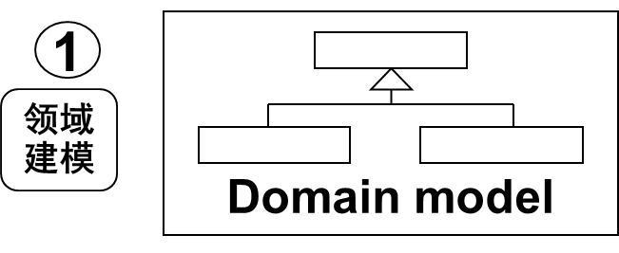
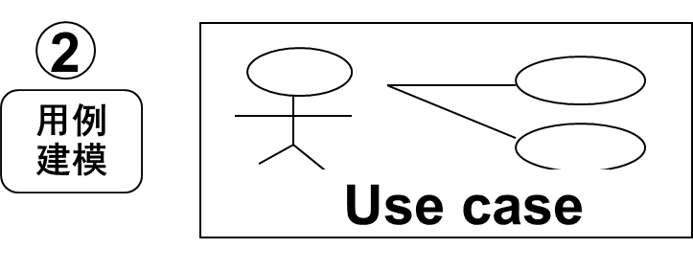
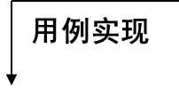
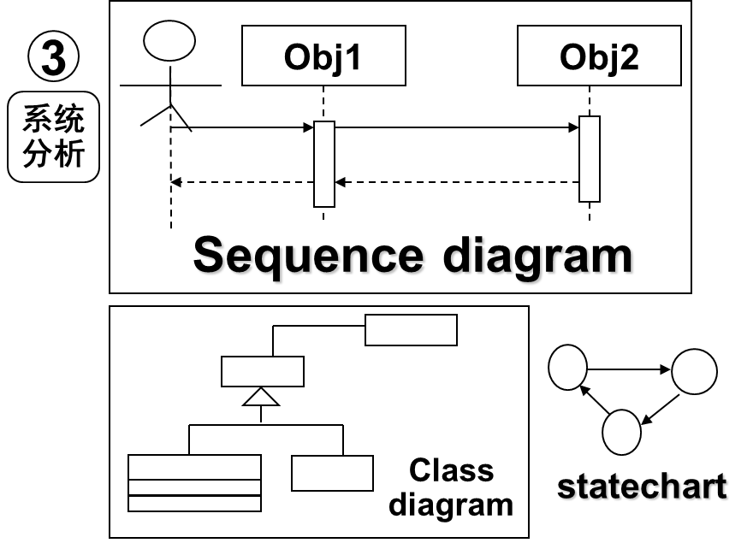
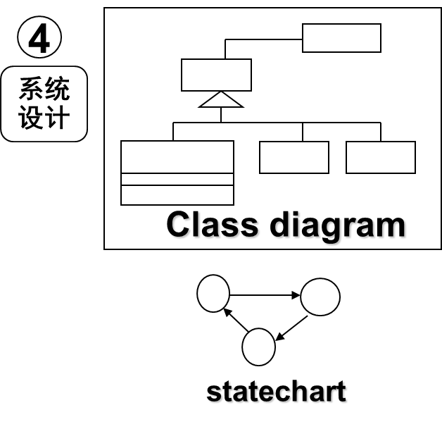
面向对象分析、设计的主要步骤以及产生的主要文件

Slide 3
Presentation
BookingSystem
Restaurant
StaffUI
date
1
getBookings()
getCustomer()
getTable()
makeReservation()
makeWalkIn()
Cancel()
display()
makeReservation()
makeWalkIn()
recordArrival()
selectBooking()
undateDisplay()
*
*
*
1
Table
Booking
covers
date
time
number
places
*
分析类图
current
getDate()
getDetails()
setArrivalTime()
setTable()
Bookings for the same table must not overlap
0..1
selected
*
WalkIn
Reservation
1
Customer
*
arrivalTime
name
phoneNumber
setArrivalTime()
Storage
Database

Slide 4
6-RESTAURANT SYSTEM-DESIGN
Chapter 5已经完成了应用层用例实现。
We have finished application-layer use case realizations in Chapter 5.
本章任务是将建模应用到整个系统（包括其他层）
Now we extend this level of modeling to the whole system.

Slide 5
6-RESTAURANT SYSTEM-DESIGN
本章研究输入, 输出, 永久数据存储
Now, some basic strategies for handling
  Input, output and
  persistent storage
will be discussed
从分析得到的类图需要细化。
The analysis class diagram will be refined to contain fuller information about
  data types,
  message parameters and
  so on.
Presentation
Application
Storage

Slide 6
6-RESTAURANT SYSTEM-DESIGN
Some assumptions
饭店定单系统是桌面单用户. The restaurant booking system will be implemented as a single-user desktop application (在局域网下，稍加修改，可以是多用户的).
Java应用,基于Windows的用户界面. We will design it as a Java application with a window-based user interface.
用关系型数据库存储永久数据. A relational database will be used to store permanent data about bookings, customers and so on.

Slide 7
内容提要：
Receiving Input From The User (Mark Priestley: 6.1)
Producing Output (Mark Priestley: 6.2)
Observer Pattern
An Example of in the observer pattern
Back to the Restaurant reservation system
参考教材：Mark Priestley, Object oriented design with UML

Slide 8
Receiving Input From The User
从用户接收输入

Slide 9
6.1 RECEIVING INPUT FROM THE USER
评论：在分析阶段，用户输入端系统消息被直接发送到应用层的BookingSystem, 这不合适。
In system analysis, system messages from the user were directed to a control object BookingSystem, which is an application layer object,
This is not proper.
这样做不合适
: Staff
: BookingSystem

Slide 10
正确的做法：
应该利用表现层 对象
  接收用户输入，并且
  将请求转发到控制对象
We should use an object in the presentation layer to receive user input and forward requests on to the control object.
  The object in the presentation layer that receives user input can reasonably be characterized as a boundary object.

Slide 11
显示层
应用层
presentation
Application
submit(date)
Display(date)
:BookingSystem
:StaffUI
staff
边界对象StaffUI接受消息，然后传递给应用层的控制器对象BookingSystem
The 'StaffUI' boundary object receives this message, and then delegates the responsibility for dealing with it to the control object in the application layer.
Fig 6.1 collaboration diagram to handle a system message

Slide 12
显示订单用例的进一步解释(考虑到用户图形界面)
About 'Display bookings' use case
    the user first selects an appropriate menu option, which causes a dialogue box to appear
    the user enters the required date
    The user clicks an 'OK' button to submit the request to the system.
menu
dialogue box
date

Slide 13
用户与系统的交互产生的事件必须由系统处理
The users interact with the system by using a GUI, and so events generated needs to be handled by the system.
事件将被用户界面捕捉,并且发送到定单系统
The events would be detected by the user interface, and passed on to the booking system as a ‘getBooking' message
See Fig 6.2.

Slide 14
表示层
应用层
/Current: Booking
: Staff
:StaffUI
: BookingSystem
选择了一
个订单
mouseDown(pos)
getBookings(time, table)
getDetails()
Pos：屏幕上的鼠标点击处座标
In the message
getBookings(time, table) the position is replaced by a table number and a time which enables the booking system to identify a unique booking.
Fig 6.2. select a booking

Slide 15
应用层与显示层的关系
应用层不应该知道StaffUI的任何细节。The application layer should not know anything about the details of the interface
StaffUI翻译鼠标坐标到对于应用有用的信息。StaffUI translates mouse coordinates into information that is meaningful to the application.
StaffUI 还负责产生输出。StaffUI is also for producing the displayed output, by mapping the table numbers and times of the bookings to the relevant screen co-ordinates.

Slide 16
调换桌位(拖拽方式)
Move a booking from one table to another can be done by dragging the booking rectangle from one location on the screen to another.
Corresponding user-generated events:
  'mouse down'
  'mouse move'
  'mouse up'

Slide 17
b1
b5
t11
t12
t13
t14
t15
b2
b3
t21
t22
t23
t24
t25
b4
t31
t32
t33
t34
t35
b6
b7
t41
t42
t43
t44
t45
b8
b9
t51
t52
t53
t54
t55
调换桌位(拖拽方式)

Slide 18
:Staff
:StaffUI
:BookingSystem
你的代码
mouseDown(pos)
getBookings(time, table)
mouseMove(pos)
你的代码
将调用其它对象，例如
Booking对象的setTable()方法
mouseUp(pos）
transfer(time, table)
只有mouse up时，消息才最后被送到booking system
Fig 6.3. transferring a booking to a new table

Slide 19
边界对象必须记忆用户交互的当前状态以及何时给系统发送消息
Boundary object must remember the current state of the interaction with the user and when to send a system message.
问题：怎样记录当前状态？

Slide 20
回答：可以使用一些变量记录状态
例如：state
Return

Slide 21
PRODUCING OUTPUT
产生输出

Slide 22
6.2 PRODUCING OUTPUT
用户图形界面的责任：
The 'StaffUI’ class has two distinct roles:
  1）将用户信息发送到控制类.
  It receives messages from the user and
  forwards them to the controller class,
  2）将系统返回的数据显示给用户.
  It also plays the role of a view class:
  Display the output from the system.

Slide 23
输出机制:每当应用数据状态改变时,数据在屏幕上的显示也应该被相应地被更新.
Whenever the state of the application data changes, the presentation of this data on the screen is updated so that what the user sees is consistent with the system state.
模型（改变时） 通知 视图
The view is informed of changes in the model.

Slide 24
实现界面更新的几种方式
Option 1: Use polling technique (意见调查)
‘StaffUI’ makes periodic enquiries of the application classes, to find out if anything has changed (传统的方法).
  Polling requires classes in the presentation layer to make calls on classes in the application layer
  例如，在StaffUI类中写一个方法，每隔3秒钟调用BookingSystem的某些方法，检查数据是否改变了。

Slide 25
6.2 PRODUCING OUTPUT
缺点：
浪费处理时间. It is expensive in terms of wasted processing time.
  系统状态通常在 两次请求之间不发生改变、作了无用功. the system state will not change from one enquiry to another, a lot of enquiries is for nothing
  数据量大时候，每检查一遍，太费劲. If there is a significant amount of data in the model, it can be quite a laborious task to examine it to see if anything has changed

Slide 26
Option 2: Use Observer Pattern (使用观察者模式)
每当状态发生改变的时候，应用层的类通知视图类，使得视图类能及时更新 The application classes inform the view classes whenever anything has changed,
  so that updates to the view only take place when required.
问题：应用层的类怎样通知显示层?

Slide 27
现在的情况适合使用观察者模式
The present situation contains elements of both these conditions:
  应用对象的改变➔视图对象改变 Change in an application object ➔change in the view object, and
  一旦有了改变，应用对象应该通知视图对象。We want the application object to notify the view object of this change
Return

Slide 28
The Observer Pattern
观察者模式

Slide 29
观察者模式
客户类协调（调用）被观察者类
与观察者类完成功能
Client
<<interface>>
Observable
<<interface>>
Observer
<<notifies>>
register(obs: Observer)
unRegister(obs:Observer)
notifyObservers()
1..* 1..*
update( s: Observable)
Observer1
Observer2
Subject
update( s: Observable)
update( s: Observable)
getState()
notifyObservers()
register(obs: Observer)
unRegister(obs:Observer)
1..* 1..*
<<retrieves state info>>
1..* 1..*

Slide 30
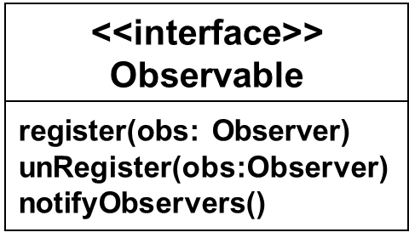
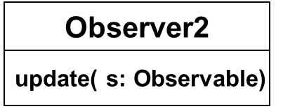
Observable S = new Subject();
Observer O = new Observer1();
S.register(O);
Client
<<interface>>
Observer
update( s: Observable)
Observer1
S(主题对象)
Subject
update( s: Observable)
O (观察者对象)
利用S调用
getState()
notifyObservers()
register(obs: Observer)
unRegister(obs:Observer)
调用update将S传入到Observer1中

Slide 31
3. Observer Pattern
DESCRIPTION
The Observer pattern is useful for designing a consistent communication model between
  Observers: a set of dependent objects and
  Subject: an object that they are dependent on.

Slide 32
3. Observer Pattern
Note:
一个主题可以有多个观察者。A subject can have more than one such observer. Each of these observers needs to know when the subject undergoes a change in its state.
主题保持一个动态列表，记录已经注册的观察者The subject must maintain a dynamic list for registering observers.
  (The subject cannot maintain a static list of such observers as the list of observers for a given subject could change dynamically).

Slide 33
3. Observer Pattern
How the observer pattern works?
Observer must register itself：
  Any object with interest in the state of the subject needs to explicitly register itself as an observer with the subject.
Observable must notify the observers：
  Whenever the subject undergoes a change in its state, it notifies all of its registered observers.
An observer can query about the state of the obsevable：
  Upon receiving notification from the subject, each of the observers queries the subject to synchronize its state with that of the subject’s.

Slide 34
3. Observer Pattern
Two ways to notify the observers:
The push model(将观察者所需数据全部推给观察者, 此时update方法为update(Object a)): The subject should send the state information that the observers may be interested in
The pull model(主题提供接口，供观察者访问，此时update方法为update(Observable obs)): The subject should provide an interface that enables observers to query the subject for the required state information to update their state.

Slide 35
3. Observer Pattern
Advantages of the Observer pattern:
可以动态添加观察者而不需要影响主题。
Different observers can be added dynamically without requiring any changes to the Subject class.
2. 当主题的状态或者逻辑发生变化的时候，观察者不受影响。
When the state or logic of the subject changes, observers remain unaffected
Return

Slide 36
An example in the observer pattern

Slide 37
4. Example in Observer Pattern
Example: There are two groups of animals, tiger group and antelope group, both watching the grass state of a great plain.
  When the grass becomes green, both antelope and tiger group will come, and
  When the grass becomes yellow, both antelope and tiger group will leave.
In such case, we can use observer pattern
  Encapsulate the great plain as a class that implements interface Observable, and
  encapsulate the Tiger and Antelope as two classes that implement interface Observer

Slide 38
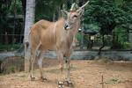


羚羊
老虎
被观察者
观察者

Slide 39
<<interface>>
Observable
<<interface>>
Observer
notifies
1 1..*
action( s: Observable)
notifyObservers()
register(obs: Observer)
unRegister(obs:Observer)
TigerGUI
AntelopeGUI
PlainGUI
action(s Observable)
action(s Observable)
1 1..*
notifyObservers()
register(obs: Observer)
unRegister(obs:Observer)
1 1..*
使用观察者模式设计的非洲草原-羚羊-老虎程序

Slide 40
Observable p = new PlainGUI();
Observer o1 = new AntelopeGUI();
Observer o2 = new TigerGUI();
p. register(o1);
p. register(o2);
p. notifyObservers();
Client
<<interface>>
Observer
PlainGUI
notifies
action( s: Observable)
o1
o2
notifyObservers()
register(obs: Observer)
unRegister(obs:Observer)
getGrassState();
TigerGUI
AntelopeGUI
action(s Observable)
action(s Observable)

Slide 41
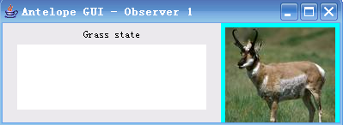
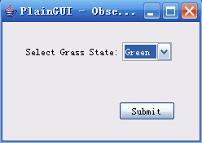
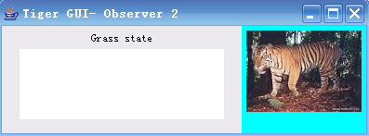
Initial graphical interface for observable and observers

Slide 42
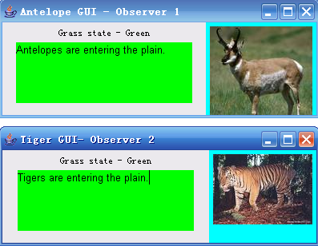
被观察者选择绿色，则观察者的页面也变成绿色

Slide 43
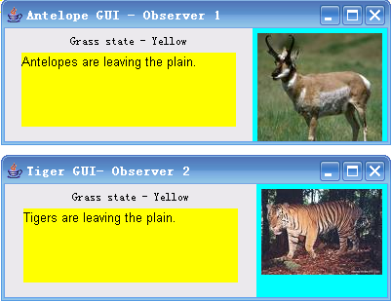
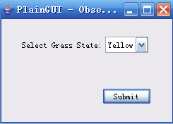
被观察者选择黄色，则观察者的页面也变成黄色

Slide 44
public interface Observable {
public void notifyObservers();
public void register(Observer obs);
public void unRegister(Observer obs);
}

Slide 45
public class PlainGUI extends JFrame implements Observable{
public PlainGUI() throws Exception {
observersList = new Vector();
//… …
}
public void register(Observer obs) {
observersList.addElement(obs);
}
public void unRegister(Observer obs){
observersList.removeElement(obs);
}
public void notifyObservers() {
for (int i = 0; i < observersList.size(); i++) {
Observer observer = (Observer) observersList.elementAt(i);
observer.takeAction(this);
}
}
}

Slide 46
class ButtonHandler implements ActionListener {
public void actionPerformed(ActionEvent e) {
if (e.getActionCommand().equals(SUBMIT)) {
String state = (String)stateCmBox.
getSelectedItem();
setGrassState(state);
notifyObservers();
}
}
}// end of class

Slide 47
public interface Observer {
public void takeAction(Observable subject);
}

Slide 48
public class AntelopeGUI extends JFrame implements Observer{
public AntelopeGUI(PlainGUI objPlainGUI) throws Exception{
plainGuiObj = objPlainGUI;
}
public void takeAction(Observable subject) {
if (subject == plainGuiObj) {
grassState = plainGuiObj.getGrassState().trim();
if (grassState.compareTo("Green")== 0 ) {
actionText.setBackground(Color.green);
actionText.setText("Antelopes entering the plain.");
}
else if (grassState.compareTo("Yellow")== 0 ){
actionText.setBackground(Color.yellow);
actionText.setText("Antelopes leaving the plain.");
}
} } }

Slide 49
public class TigerGUI extends JFrame implements Observer{
public TigerGUI(PlainGUI objPlainGUI) throws Exception {
plainGuiObj = objPlainGUI;
}
public void takeAction(Observable subject) {
if (subject == plainGuiObj){
grassState = plainGuiObj.getGrassState().trim();
if (grassState.compareTo("Green")== 0 ){
actionText.setBackground(Color.green);
actionText.setText("Tigers entering the plain.");
}
else if (grassState.compareTo("Yellow")== 0 ){
actionText.setBackground(Color.yellow);
actionText.setText("Tigers leaving the plain.");
}
} } }

Slide 50
public class TestObserverObservable {
public static void main(String[] args) {
//create an observable object
PlainGUI plainObj= new PlainGUI();
//Create Observer objects
new TigerGUI ( plainObj );
new AntelopeGUI( plainObj );
}
}
Return

Slide 51
Back to the Restaurant reservation system
在饭店订餐系统中使用观察者模式

Slide 52
Presentation
StaffUI
观察者
update()
Application
1
BookingSystem
*
<<interface>>
BookingObserver
register(obs: Observer)
notifyObservers()
getBookings()
update()
被观察者
观察者接口
Fig 6.4 Applying the Observer pattern

Slide 53
6.2 PRODUCING OUTPUT
希望被通知的类应该实现接口
In the application layer, an interface is defined that must be implemented by any class that wishes to be informed about relevant changes to the model.
这些类被称为观察者。
Such classes are known as observers.
The interface is very simple, consisting of a single operation “update”, which can be called whenever the display needs to be updated.

Slide 54
6.2 PRODUCING OUTPUT
观察者模式的实现依赖于多态与动态绑定
The use of observer pattern depends on
  polymorphism and
  dynamic binding.
观察者可以是任何类，但是BookingSystem仅仅通过接口访问该类
The observers could be of any class whatsoever, but the booking system only accesses them through this interface, defined in the application layer, so that the layered architecture of the system is preserved.

Slide 55
6.2 PRODUCING OUTPUT
每当‘StaffUl’ 对象接受到‘updateDisplay’ 消息，他需要发现什么改变了。
Once a 'StaffUl' object receives an 'updateDisplay' message, it needs to find out what has changed.
StaffUl对象查询BookingSystem对象，看看是哪些订单信息需要在屏幕上刷新
Simple solution: the 'StaffUl' simply requests from the BookingSystem a list of all the bookings that are to be displayed and then completely refreshes the display.

Slide 56
6.2 PRODUCING OUTPUT
Fig 6.5 shows the interactions that take place when the display is actually updated.
The 'notify Observers‘ operation in the 'BookingSystem' class simply sends the 'update' message to each observer, and so it replaces the 'updateDisplay' message in diagrams such as Figure 5.4.
For simplicity, this message has been omitted from Fig 6.5.

Slide 57
6.2 PRODUCING OUTPUT
:Restaurant
: Staff
/BookingObserver:StaffUI
:BookingSystem
submit(date)
display(date) )
getBookings(date)
update()
return bookings
需要知道哪些内容需要刷新呢？
getDate()
告诉观察者，我改变了,代替了图5.4中的
updateDisplay
方法
getBookings()
Return Bookings
假设BookingObserver
对象对提交的数据没有记载
Figure 6.5 Display bookings: design view

Slide 58
6.2 PRODUCING OUTPUT
因为在表示层和应用层之间使用了观察者模式，使得
BookingSystem调用了StaffUI；这一点违反了层
次架构单向调用的假设。但是这种调用增加了程序效率，
是值得的。
In fig 6.5, it looks as if the booking system and user interface objects are communicating directly with each other,
  and hence that an application object is dependent on an object in the presentation layer.
Reason: because that the user interface object implements the observer interface shown in Fig 6.4.

Slide 59
6.2 PRODUCING OUTPUT
各个对象的责任
BookingSystem: record information about the day currently being displayed:
  assuming that the user has requested a different date, the information for that date must first be retrieved from the restaurant object,
Restaurant: maintain information about all the bookings known to the system.

Slide 60
StaffUI: display a set of bookings, and it must request from the BookingSystem the date and the set of bookings to display.
  We are not assuming that the user interface remembers these bookings,
  though there are potential performance improvements to be made in the future by having it cache some information about the bookings.

Slide 61
Presentation
<<interface>>
BookingObserver
StaffUI
update()
BookingSystem
Restaurant
date
1
getBookings()
getCustomer()
getTable()
makeReservation()
makeWalkIn()
+ add0bserver(o: BookingObserver)
+ cancel()
+ getBookings(): Set(Booking)
+ getDate(): Date
+ makeReservation()
+ makeWalkln()
+ notify0bservers()
+ recordArrival()
+ selectBooking()
+ setDate(d: Date)
+ transfer()
*
*
*
1
Table
Booking
covers
date
time
number
places
*
current
getDate()
getDetails()
setArrivalTime()
setTable()
Bookings for the same table must not overlap
0..1
selected
*
WalkIn
Reservation
1
Customer
*
arrivalTime
name
phoneNumber
setArrivalTime()

Slide 62
类BookingSystem中的方法
+ add0bserver(o: BookingObserver)
+ notify0bservers() //通知用户图形界面关于应用层的状态改变
+ cancel() //取消一个选定的订单
+ getBookings(): Set(Booking) //格式待定
+ getDate(): Date //Date的格式待定
+ makeReservation (covers, date, time, tno, name, phone)
+ makeWalkln(covers, date, time, tno)
+ recordArrival() //记录已经有预定的客人的到达
+ selectBooking()
+ setDate(d: Date) //设定日子，其中参数Date的格式未定
+ transfer() //更换餐桌

Slide 63
类BookingObserver中的 方法
update() //被调用的时候，负责更新用户图形界面

Slide 64
Restaurant中的方法
getBookings()
getCustomer() //创建或者获取Customer对象
getTable() //创建或者获取Table对象
makeReservation(covers, date, time, tno, name, phone) //创建订单对象

Slide 65
Booking类中的属性与方法
属性：
-covers: int
-date: int
-time: int
方法：
+getDate() //返回一个订单的日期
+getDetails() // 返回一个订单的详细信息：customer name, phone
// num, table, covers, date, time
+setArrivalTime() //设定客户到达时间的缺省实现
+setTable() // 为了某一个订单具体地设定一张桌子

Slide 66
Reservation类的属性与方法
属性
arrivalTime
方法：除了其超类中的方法以外，还有如下的子类的特有的方法
setArrivalTime() //实际设定到达时间，重载超类里面的同名方法
WalkIn类的属性与方法
属性
暂无
方法：除了其超类中的方法以外，暂时没有子类的方法
暂无

Slide 67
Customer类的属性与方法
属性
-name
-phoneNumber
方法：暂无
Table类的属性与方法
属性
-number
-places
方法：
暂无
Return

