Slide 1
1.3 Functional Area Information Systems
1. Marketing and Sales
Legal requirements
and job information
Customer
HR
Sales order
Hiring needs and
personnel information
Order status
Sales forecasts
and sales orders
M/S
Sales order
data
Product
availability data
and order status
P/MM
Cost/profit
analysis
A/F

Slide 2
1.3 Functional Area Information Systems
2. Production and Materials Management
Legal requirements
and job information
Raw materials
availability and
delivery
Suppliers
HR
Orders for raw
materials and
supplies
Hiring needs and
personnel information
Production
plans,materials,
and inventory
P/MM
Product
availability
data and
order status
Sales data and
manufacturing
cost analysis
A/F
Sales forecasts
and sales order
M/S

Slide 3
1.3 Functional Area Information Systems
3. Accounting and Finance
Legal requirements
and job information,
payroll and benefit
expense data
Customer
HR
Payment
Invoices and
credit memos
Hiring needs and
personnel information
A/F
Sales data and
manufacturing
cost analysis
Cost/profit
analysis
Production plans,
materials, and
inventory data
Sales order
data
P/MM
M/S

Slide 4
1.3 Functional Area Information Systems
4. Human Resources
Hiring needs and
personnel information
A/F
Payroll and benefit/expense
data,legal requirements
and job information
Legal requirements
and job information
HR
Legal requirements
and job information,
Hiring needs
and personnel
information
P/MM
Hiring needs
and personnel
information
M/S

Slide 5
Organizational Units
Shipping point
Sales organization
Sales office
Sales group
Division
Supply Chain Scenarios
Direct sale to industrial consumer
Direct sale to internal consumer
Direct sale to retail company
Customer order processing MTO
Third-party-order processing
Sales Logistics
Business Objects
Business Partner
Sales order
Bill of material
Customer inquiry
Customer quotation
Business Process
Mailing Campaign processing
Customer quotation processing
Billing
Rebate processing
72

Slide 6
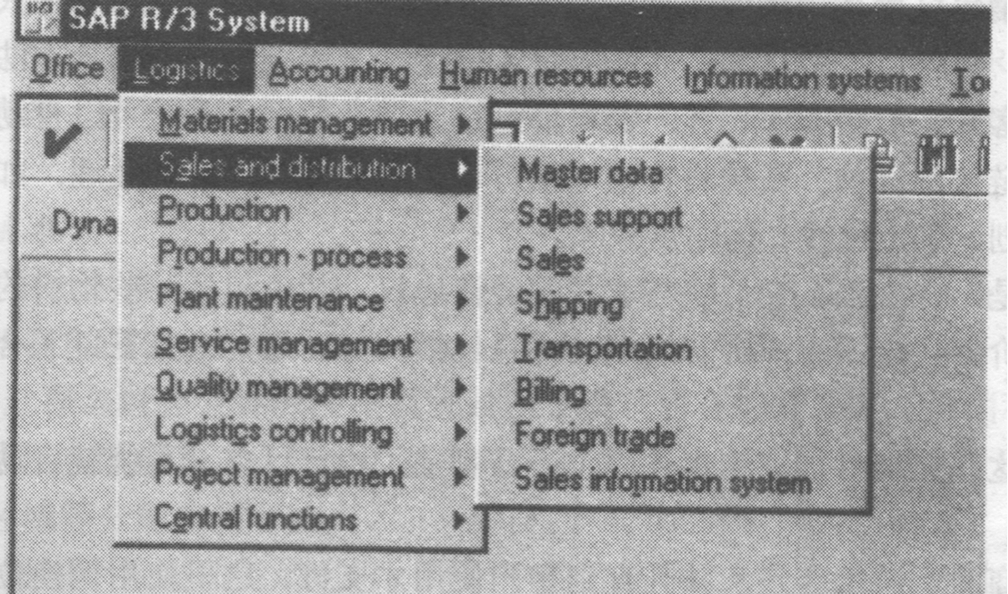

Slide 7
5.1 Standard order handling scenario
sales
inq/quo
proc.
cust.
outline
agree.
Sales
order
Custom.
Rebate
process.
Infor.
system
Sales
support
shipping.
Quality
manag.
Trans-
potation.
Billing
ware-
house
manage.
Foreign
trade.
Credit
manage.
Fig 5-2 Value chain: Direct sale to an industrial customer
73

Slide 8
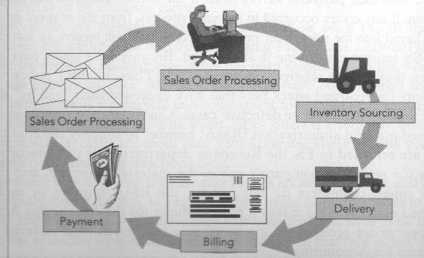

Slide 9
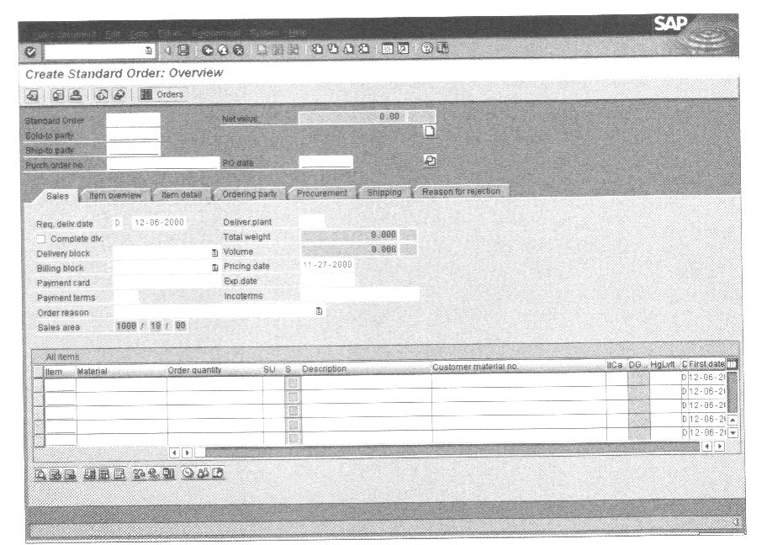
5a

Slide 10
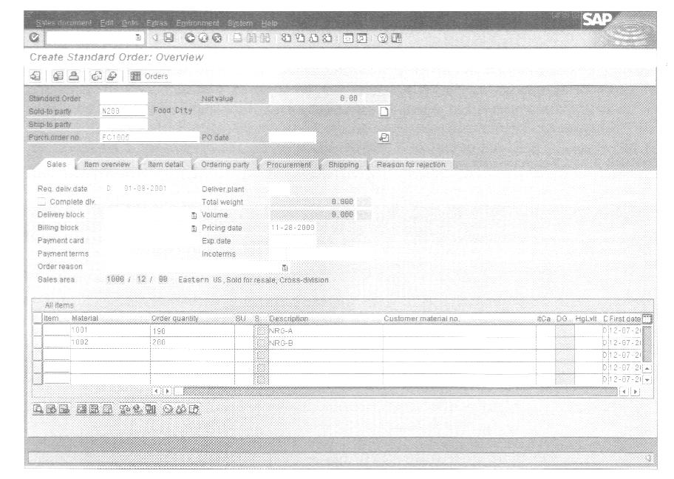
5b

Slide 11
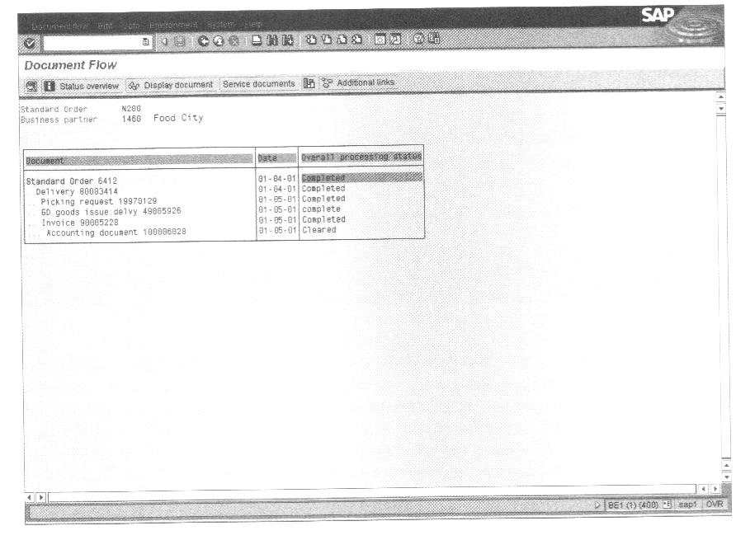
5c

Slide 12
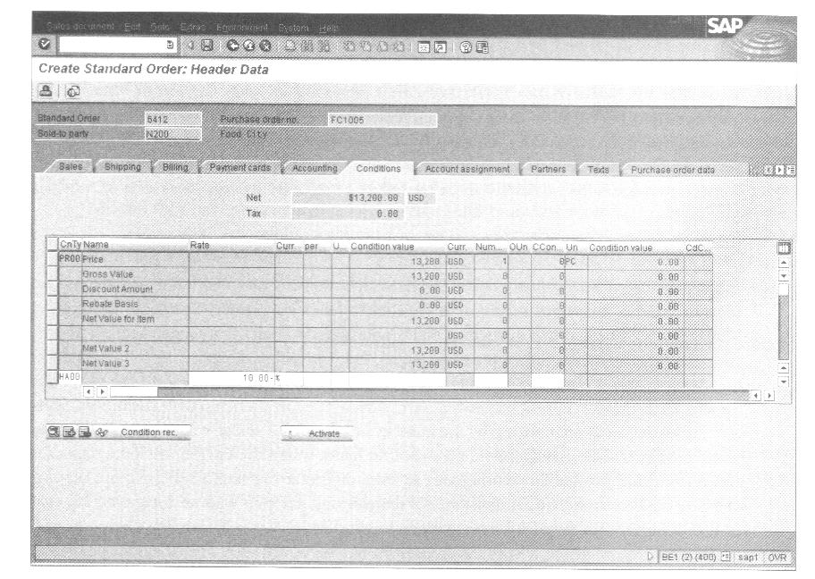
5d

Slide 13
Supply Chain Scenarios
Sales-order-related production
Production by lot size
Sales-order-related repetitive manufacturing
Project-oriented make-to-order production
Production replenishment
Organizational Units
Plant
Storage location
Work center/resource
MRP area
Production
Business Process
Sales and operations planning
Demand management
Material requirements planning
Master production scheduling
Goods receipt processing from production
Business Objects
Material
Production order
Bill of material
Sales and operations plan
Master recipe
100

Slide 14
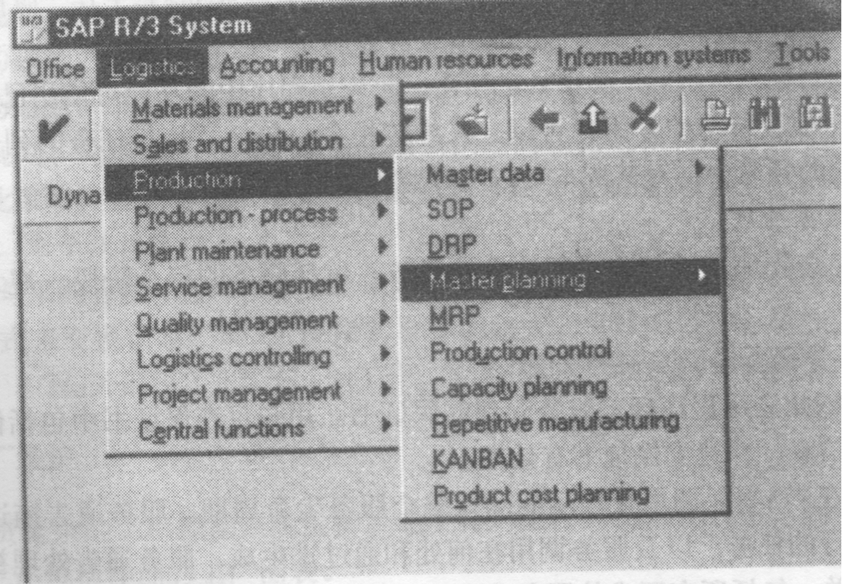

Slide 15
6.1 Production by lot size
Inspect. Check
by lot parallel
w/ prod.
Quality
inspect.
After
prod.
Prod.
Order
creation
Prod.
Order prelim
costing
Prod.
Order
execution
Capacity
planning
Defects
recording
QM cost
input
Infor.
system
Material
stocking
Capacity
planning
Insp.point
related to
process.
Fig 6-2 Value chain: Production logistics
101

Slide 16
Sales Forecasting
Sales and Operations Planning
Demand Management
Detailed Scheduling
MRP
Purchasing
Production

Slide 17
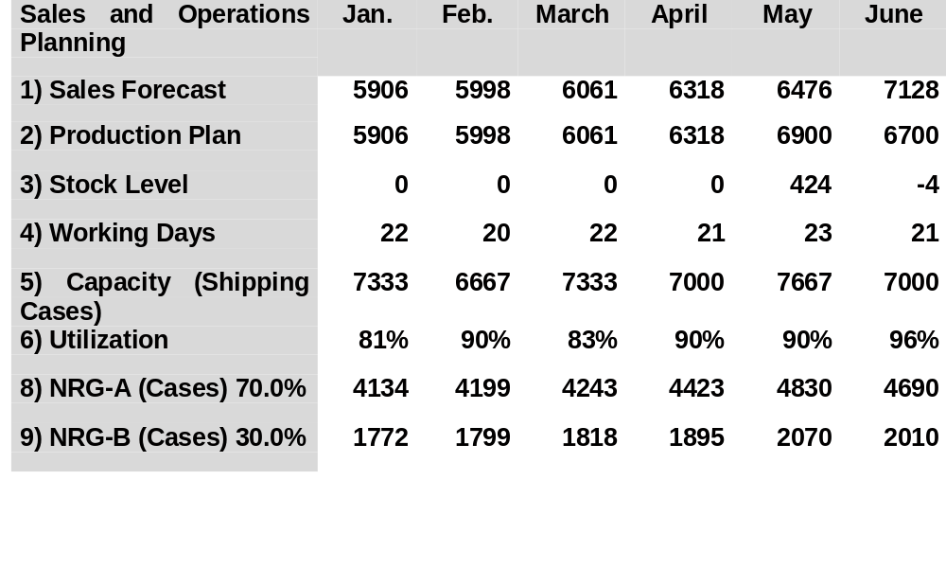
Fitter Snacker’s sales and operations plan for January through June

Slide 18
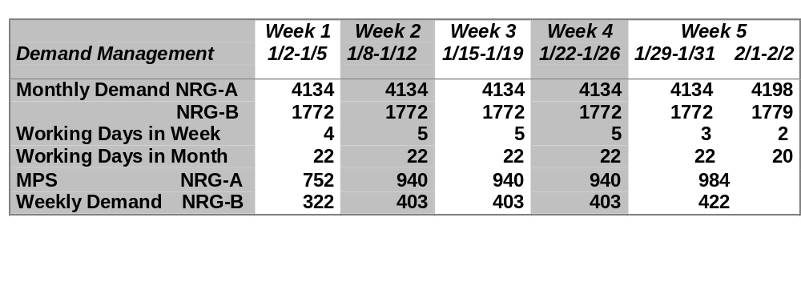
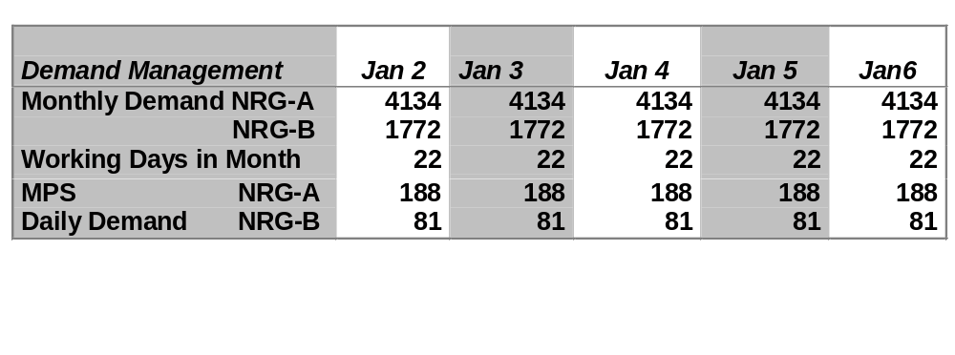
Fitter Snacker’s production plan for January: The first five weeks of production are followed by a day-by-day disaggregation of week 1

Slide 19
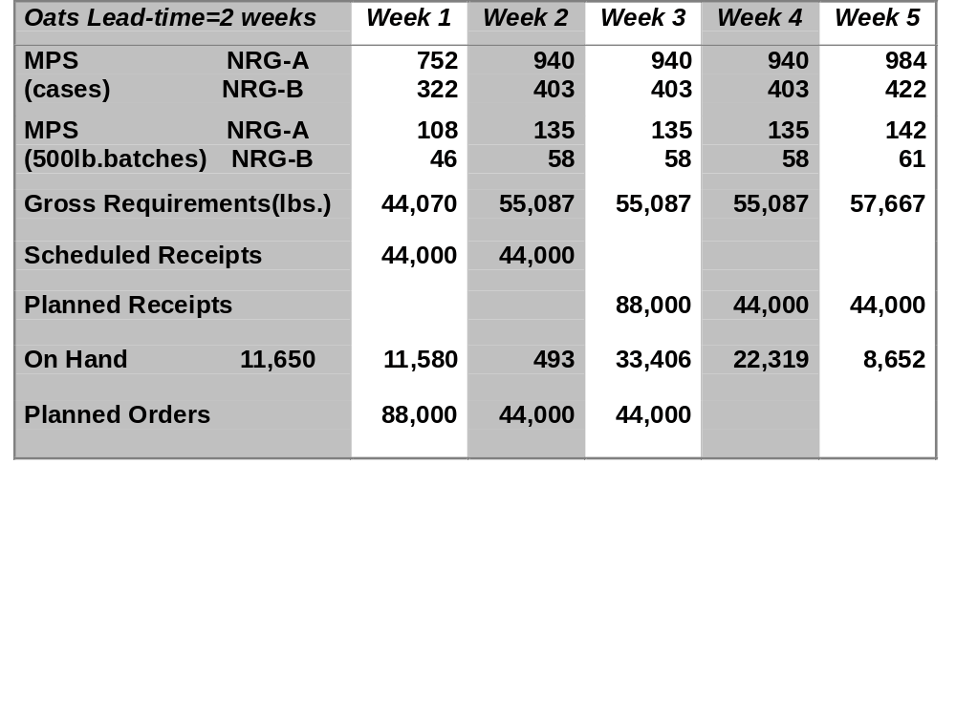
The MRP record for Fitter Snacker, weeks 1 through 5

Slide 20
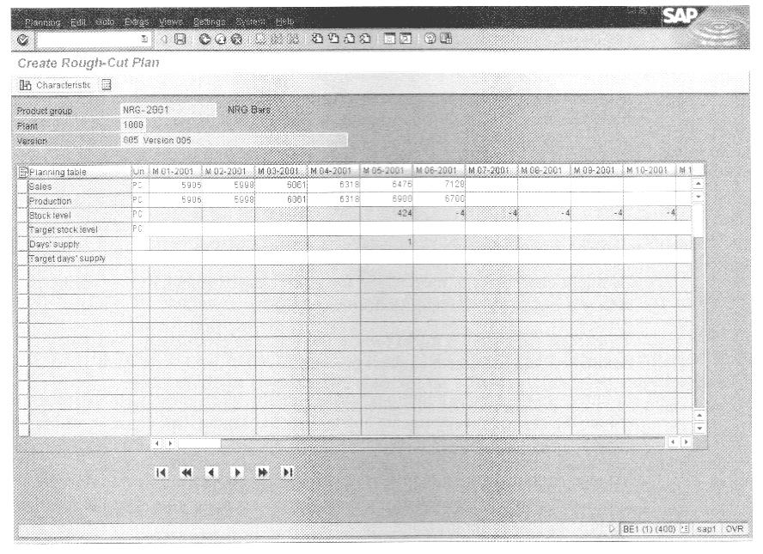
6a

Slide 21
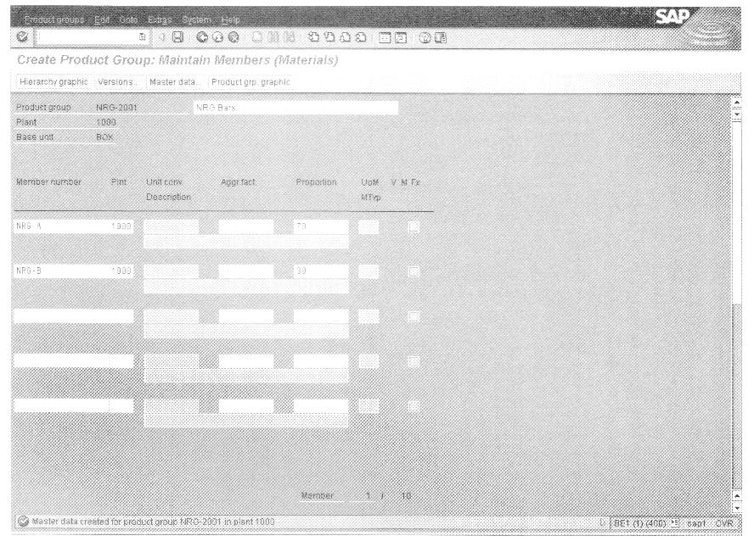
6b

Slide 22
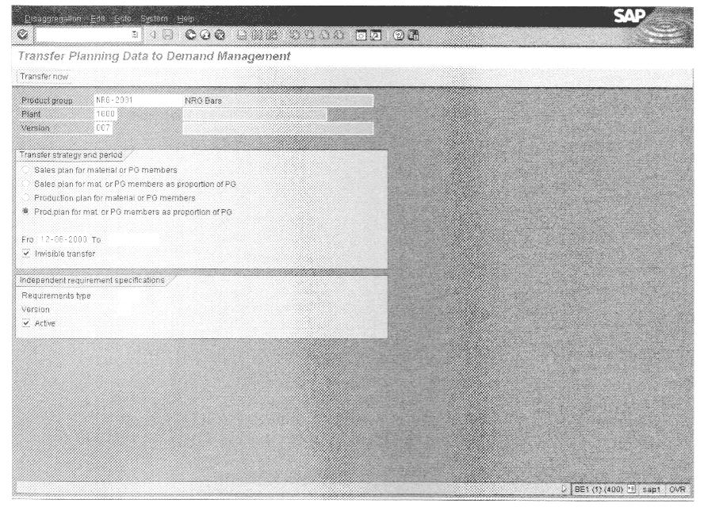
6c

Slide 23
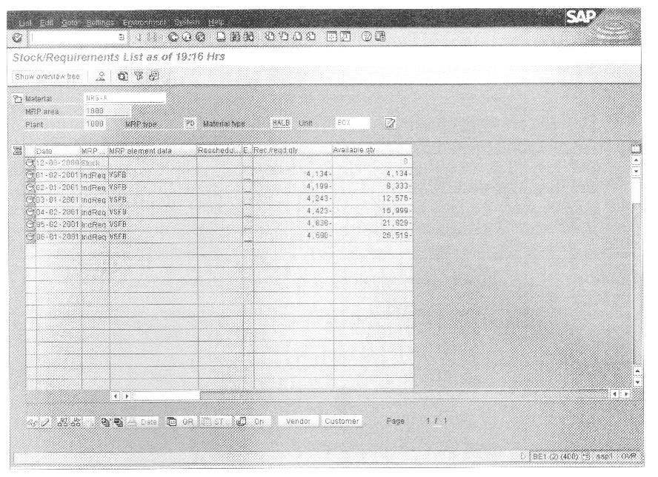
6d

Slide 24
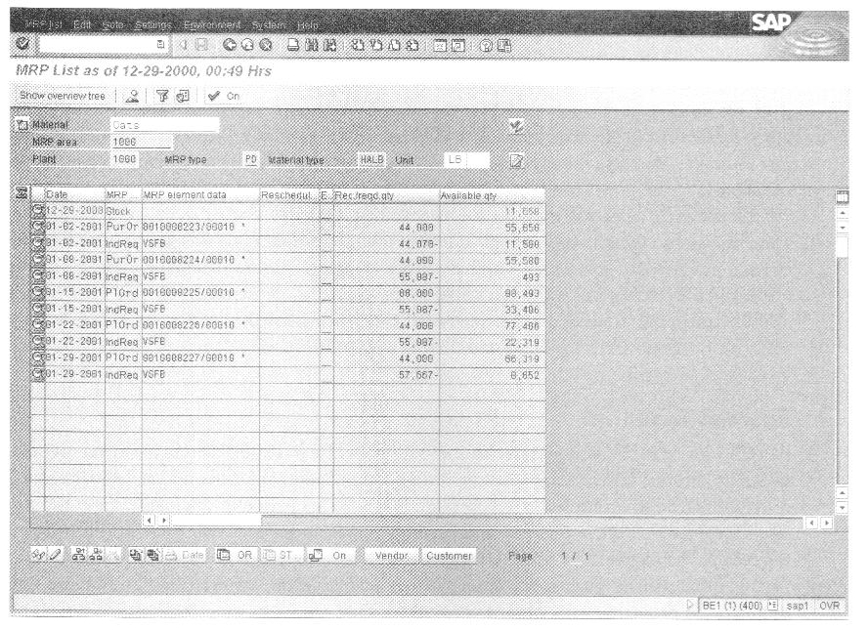
6e

