Slide 1
Software Architecture
软件体系结构
Lecture 6. Event-based Software Architecture
基于事件的软件体系结构
Professor:
Yushan (Michael) Sun
Fall 2020

Slide 2
Lecture 4. Event-based Software Architecture
Content of the lecture
基于事件系统的概念
事件处理策略
使用观察者模式设计的事件系统的例子

Slide 3
Concept of Event-based System
基于事件系统的概念

Slide 4
1. Concept of Event-based System
显式调用. Explicit Invocation:
Traditionally, in a system in which the component provides a collection of
  routines and functions, such as an object-oriented system,
components typically interact with
each other by explicitly invoking
those routines.

Slide 5
1. Concept of Event-based System
显式调用的特点：调用者必须知道被调用者的类名、构造方法（包括参数）与要调用的方法（包括参数）
Explicit invocation: the invoking object must know the name of the class being invoked and the method (including parameters) in the class
op1(p1, p2)
Op3(p1, p2, p3)
op2(p)

Slide 6
1. Concept of Event-based System
事件系统使用隐式调用
Event system uses implicit invocation:
In an event based system, an event will invoke some procedures and the procedures will run automatically.
Event system uses implicit invocation.

Slide 7
1. Concept of Event-based System
基于事件系统的定义：
Definition of an event-based system:
An event based system is such a system in which procedures are not invoked directly (that means, indirectly, or implicitly).
What is a procedure （什么是过程）?
A procedure is a module in program design language, with or without parameters.
It is executed by procedural calls. The result will be
  assigned to the calling parameter, or to
  modify a gloabal variable within this subroutine.

Slide 8
1. Concept of Event-based System
事件广播与处理机制
Event broadcast and processing mechanism:
广播机制. A component can broadcast one or more events.
注册机制. Other components in the system can register an interest in an event
系统调用. Once an event is broadcasted, the system will automaticaly invoke all of the procedures that have registered for the event. ("implicitly“
事件发布者可能不负责调用

Slide 9
1. Concept of Event-based System
Bradcast events
Register for
BMW
Buy()
Event space
The method in the object will automatically run once the registered event is triggered
eve= “BMW”
Broadcast events
Register for BMW
Buy()
Event-based system: event broadcast, event
registration, method being called automatically

Slide 10
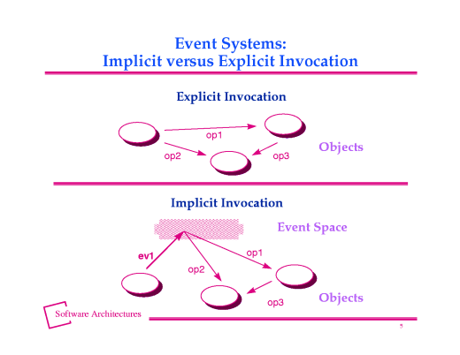
1. Concept of Event-based System
显式调用与隐式调用的区别
想调用谁，就直接调用
  一个对象广播一个事件到事件空间
  系统自动调用
  所有已经注册
  了该事件的过程

Slide 11
1. Concept of Event-based System
Structure of a component (部件结构)
Components: the components in an implicit invocation style are modules whose interfaces provide both
  a collection of procedures (functions in C++, methods in Java) and
  a set of events

Slide 12
1. Concept of Event-based System
例：使用事件系统架构设计的股票交易系统部分组件
Pr 1
Et 1
Et 2
Proc1
中石油=15元
Proc2
中石化=10元
Proced 1
Evt1
中国铝业
Proced 2
Evt2
中国航空
Proced 3
Evt 1
Evt 2

Slide 13
1. Concept of Event-based System
一个事件系统的例子
集成开发环境(IDE)的例子
Consider an integrated Development Environment for C, C++ or Java.
Such IDE consists of tools such as
  编辑器. Editors for source code,
  变量监控器. Variable monitors,
  调试器. A debugger, etc.
Such systems usually utilize an event based Architecture.

Slide 14
1. Concept of Event-based System
Debugger
Editor
Variable monitors

Slide 15
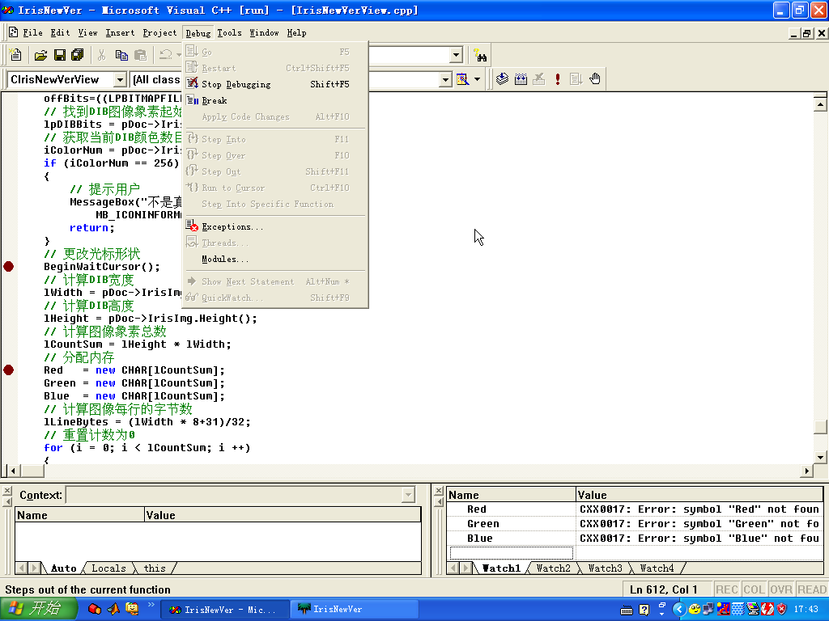

Slide 16
1. Concept of Event-based System
Editors and variable monitors register for the debugger's breakpoint events.
Debugger
Debugger’s
Break-point events
我注册
我注册
Variable monitors
Editor
Legend:
Register event
Send event

Slide 17
1. Concept of Event-based System
When a debugger stops at a breakpoint, it announces an event that allows the system to automatically invoke procedures of those registered tools.
Debugger
Run debugger
广播事件
Break-point event hit
调用
调用
Editor
Variable monitors

Slide 18
1. Concept of Event-based System
These procedures might
  scroll an editor to the
  appropriate source line or
  display the value of
  monitored variables.
Debugger
Editor
Variable monitors
注：
调试器仅仅广播了一个事件，但是不知道其它的组件将要做什么。
松耦合
Source file
Bbbbbbbbbbbbbb
Cccccccccccccc
Dddddddddddddd
Eeeeeeeeeeeee
Fffffffffffffffffffffffffffffffff
Gggggggggggggggggg
hhhhhhhhhhhhhhhhhhh
emp=“张虹”
salary=2348
Back

Slide 19
Strategy of Events Handling
事件处理策略

Slide 20
2. Strategy of Events Handling
当一个事件被广播了，系统将自动调用那些已经注册了的组件. When an event is announced, the system itself automatically invokes all of the procedures that have been registered for that event.
问题：怎样将事件发送到已经注册了的组件中呢?
Strategies:
  有独立事件调度模块的系统。Systems with a separate dispatcher module
  无中心事件调度模块的系统。Systems without central dispatcher module

Slide 21
2. Strategy of Events Handling
事件调度模块的责任
What the dispatcher module does?
The dispatcher module is responsible for
    接收事件。receiving all incoming events and
    分发事件。dispatching them to other modules in the system.

Slide 22
2. Strategy of Events Handling
Strategy 1. Systems with Separate Dispatcher
Module (有独立事件调度模块的系统)
分发事件
Dispatcher
调度模块
读取
事件
Event space
事件广播

Slide 23
2. Strategy of Events Handling
调度模块以两种方式分发事件
Two ways to dispatch events
The dispatcher may broadcast events to all modules in the system
The dispatcher sends an event just to those modules that registered for that event: Publish/Subscribe strategy (发布/订阅策略)

Slide 24
2. Strategy of Events Handling
The dispatcher may broadcast events to
all modules in the system
Dispatcher
调度模块
Module 1
Module 2
Module 3

Slide 25
2. Strategy of Events Handling
The dispatcher sends an event just to those
modules that registered for that event:
publisher
dispatcher
I did not register and so I did not get event
subscriber
subscriber
subscriber
Publish event
2. Publish/Subscribe strategy
Subscribe
Send event

Slide 26
2. Strategy of Events Handling
Strategy 2. Systems without a central dispatcher
module (无独立事件调度模块的系统)
listen
Event Space
listen
listen
listen
listen
Observable/Observer modle

Slide 27
2. Strategy of Events Handling
This modle is usually called observable/Observer
每个模块都允许其它模块对其所发送的事件感兴趣
Each module allows other modules to declare
interest in events that it is sending.
只将事件发送给注册者
Whenever a module sends an event it sends
that event to exactly those modules that
registered interest in that event.

Slide 28
2. Strategy of Events Handling
Observable
Observer
Observer
Observer
Observable/Observer modle
(被观察者/观察者模型)
Legend:
Register event
Send event
Back

Slide 29
Example Design of an event system
Using the Observer Pattern
一个使用观察者模式进行事件
系统设计的例子

Slide 30
4. Design Examples Using the Observer Pattern
观察者模式可被用来设计与实现比较简单的事件系统
观察者模式可以被认为是Observable/Observer 模型（事件空间包含在Observables里面）的一个实现。

Slide 31
Observerble/Observer example
4. Design Examples Using the Observer Pattern
Example: 机场信息显示的例子。 The airport information system is to receive incoming air flight information and inform the customers information, including on time, delay, and other information about all the arrival airplanes and departure airplanes
InforCenter class: collect all air flight information
Classes:
VoiceInfo: broadcast air flight info to all travelers
WordInfo: display word info onto LED display

Slide 32
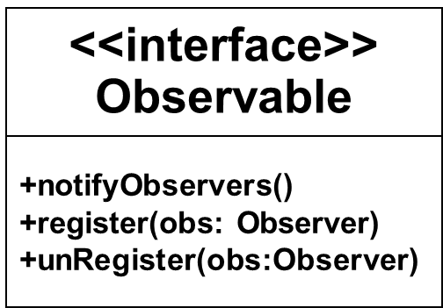
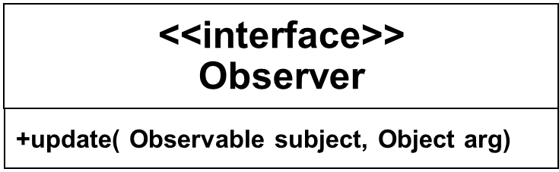
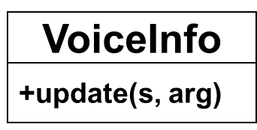
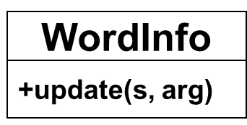
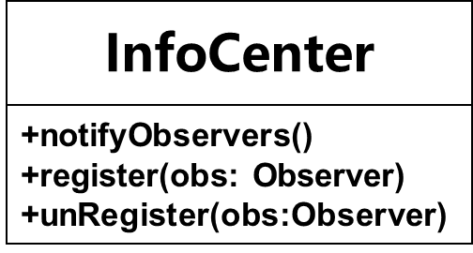
4. Design Examples Using the Observer Pattern
notifies
1 1..*
1 1..*
1 1..*
利用观察者模式设计的机场信息发布系统

Slide 33
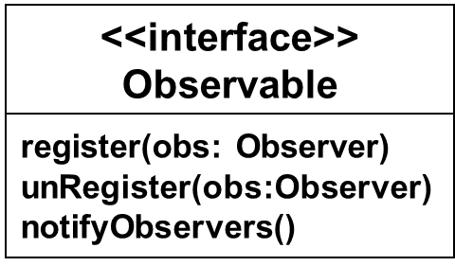
Observable c = InfoCenter()
Observer v = new VoiceInfo();
Observer w = new WordInfo();
c.register(v);
c.register(w);
Client
<<interface>>
Observer
+update(Observable subject, Object arg)
VoiceInfo
WordInfo
c(主题), arg(事件)
c(主题), arg(事件)
InfoCenter
update( c，arg)
update( c, arg)
v (观察者对象)
w (观察者对象)
传入c, arg
利用c调用
利用c调用
getState()
notifyObservers()
register(obs: Observer)
unRegister(obs:Observer)
传入c, arg
利用观察者模式设计的机场信息发布系统的典型交互

Slide 34
4. Design Examples Using the Observer Pattern
Design highlights: Two interfaces
  Observable
  Observer
with exactly all of their methods claimed in the design.
In InfoCenter, you need to implement all the methods:
  notifyObservers()
  register(obs: Observer)
  unRegister(obs:Observer)

Slide 35
4. Design Examples Using the Observer Pattern
In the VoiceInfo and WordInfo, you need to implement the method
  update(Observable subject, Object arg)
Back

