Slide 1
Software Architectures
Lecture 7: Client/Server Software Architecture
Professor:
Yushan (Michael) Sun
Fall 2020

Slide 2
Contents:
1. 客户端-服务器架构的概念
客户端-服务器架构的演化
2层与3层客户端-服务器架构的比较
3层层次架构与3层客户端-服务器架构的比较
Java EE 架构

Slide 3
Concept on Client-server
Software Architecture
客户端-服务器架构的概念

Slide 4
Concept on Client-server Software Architecture
客户端-服务器架构的定义
定义: 客户端-服务器架构是一个多样化的、基于消息的、模块
化的基础架构. 其目的是改善 Client/Server software
architecture is a versatile, message-based and modular
infrastructure that is intended to improve
  可用性(Usability) more efficient to use, easier to learn, more satisfying to use
  灵活性(Flexibility) designs that can adapt when external changes occur （电脑客户端，手机客户端）
  互操作性(Interoperability) the ability of diverse systems and organizations to work together (inter-operate)), and
  可伸缩性(Scalability) from 3,000 customers to 20,000 customers
Notes:
Client could be a high performance computing machine, while the server could be a lightweight notebook computer
Definition is changing; used in different contexts by different people
Focusing on Software definition
So many applications that use a network – Many different architectures but all considered client/server

Slide 5
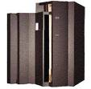
Concept on Client-server Software Architecture
客户端(Client): A Requestor of Services, a piece of software
服务器(Server): A Provider of Services, a piece of software
交互方式：A client and a server communicate with each other (e.g. by SQL statements)
硬件无关：Hardware (Physical separation) is not relevant
平台无关：Platform ( Wintel, Unix…) is not relevant

Slide 6
Concept on Client-server Software Architecture
客户端-服务器架构的动机
Motivation of client/server architecture:
To share resources among many users
  client software interacts with end user
  server software interacts with shared resource(s)
DB
DB
DB
DB
DB
DB
End user
Client software
Server software
Shared resources
Back
Notes:
How did this come about?
Many users trying to access a single resource made it very slow

Slide 7
Evolution of Client-server Architecture
客户端-服务器架构的演化

Slide 8
Evolution of Client-server Architecture
一层客户端-服务器架构 (mainframe, -1970’s):
From 1960’s to 1970’s, mainframe computers were used. Mainframe computer application can be regarded as one tire client/sever application. There are two ways for the mainframe to work.
批处理(Batch Processing): The batch processing queues up programs so that as soon as one completed, the next would start. To support a batch processing operation, some card punch writers would be used by programmers to write their programs "offline". Then the “program” in the punched card were submitted to the operations team, who would schedule them for running.

Slide 9
Evolution of Client-server Architecture
Prog5
Prog4
Prog3
Prog2
Prog1
Magnetic tapes with recorded program
排队等候执行他们的应用程序
Main frame computer
没有互联网的时代
Batch Processing: programs are queued to wait
for execution

Slide 10
Evolution of Client-server Architecture
时间共享(Time-sharing). Time-sharing is the
sharing of a computing resource among many
users by means of multiprogramming and
multi-tasking (concept: in 1960s, used widely
in the 1970s)
By allowing many users to interact concurrently with a single computer, time-sharing greatly lowered the cost of providing computing capability, made it possible for individuals and organizations to use a computer without owning one

Slide 11
Evolution of Client-server Architecture
Prog 1
多用户同时运行
他们的应用程序
Prog 2
Prog 3
Prog 4
Prog 5
Main frame computer
Time-sharing: allows a large number of users to interact concurrently with a single computer.

Slide 12
Evolution of Client-server Architecture
客户端与服务器的出现
As time passed, computer prices were lower and lower, corporations separated mainframe-based applications into
  client and
  server
components

Slide 13
Evolution of Client-server Architecture
文件共享架构 (File Sharing Architecture)
PC requests file (records) from a file server
Business logic all on client, shared resources on server
Works when data volume are low

Slide 14
Evolution of Client-server Architecture
Business logics
all on client
LAN
file
File
server
file
File calls
file
files
Application clients
Sharing files across a network

Slide 15
Evolution of Client-server Architecture
具体步骤：
Application 1 fetches a file and then writes to the new line and then sends it back to the file server
Sun, Mike | 356821 | TV | 888.56
Lee, Mary | 842674 | radio | 65.44
Juell, Paul | 257215 | Telephone | 97.05
Nygard, Ken | 573245 | Microwave oven | 56.88
Magel, Ken | 834265 | refrigerator | 988
Hunt, Paul | 332184 | Bicycle | 523
Eric, Vosika | 257652 | Watch | 1005
A file

Slide 16
Evolution of Client-server Architecture
Application 2 fetches a file and then writes to the new line and then sends it back to the file server
Liu, feng | 221231 | camera | 506.00
Sun, Mike | 356821 | TV | 888.56
Lee, Mary | 842674 | radio | 65.44
Juell, Paul | 257215 | Telephone | 97.05
Nygard, Ken | 573245 | Microwave oven | 56.88
Magel, Ken | 834265 | refrigerator | 988
Hunt, Paul | 332184 | Bicycle | 523
Eric, Vosika | 257652 | Watch | 1005
A file

Slide 17
Evolution of Client-server Architecture
两层客户端-服务器架构
2-Tier Client/Server: Databases replaced File Server
Word “Client/Server” traditionally associated with desktop PC connected over a network to a SQL-database server
Server’s database system (typically RDBMS) can answer a user’s query (SQL)
Advantage: Lowered network usage because sending queries and responses rather than files

Slide 18
Evolution of Client-server Architecture
DBMS, Legacy & other
Resource Managers,
Part of business logics
GUI & Applications,
Part of business logics
Program for accessing
DB
SQL calls
Database
Server
(DBMS)
SQL
Calls
SQL
SQL
SQL
tier 1
tier 2
2-Tier Client/Server: Databases replaced File Server

Slide 19
Evolution of Client-server Architecture
Contents of 2-Tier Client/Server
Tier 1: GUI + Business Logic,
Tier 2: Database + Shared Resources +
Business Logic (少量的程序)
2-Tier is simple
  Small departmental decision support
  Simple Web publishing applications
Notes:
Hard to support hundreds of individual user installations/upgrades etc. with slow bandwidth

Slide 20
Evolution of Client-server Architecture
应用程序被写在客户端或数据库服务器
Application or business logic either resides on the client or on the database server in the form of stored procedures (存储过程)
More complex applications
= fatter clients
= more expensive PC’s for each user
由PB和VB开发的数据库应用程序具有2层的客户端-服务器架构
Database applications developed by Power Builder and VB have 2-tire client-server structure: front end + database
Notes:
~286/486 speed processors (pre-pentium)

Slide 21
Evolution of Client-server Architecture
两层客户端-服务器架构的优点:
与文件共享系统相比，因为两层客户端-服务器发送请求与回答而不是文件，从而降低了网络使用。

Slide 22
Evolution of Client-server Architecture
两层客户端-服务器架构的缺点：
  局域网应用: 它是单一服务器且以局域网为中心的，所以难以扩展至大型企业广域网或 Intranet；
  受限于供应商：程序的升级维护必须由供应商重新开发扩展；
  数据库开发商的锁定：因为你的GUI代码直接与DB服务器绑定。依赖于一个特定的开发商的技术使得你会很困难或者很高的费用使用别的开发商的产品，也就是说，更换其它产品困难。

Slide 23
Evolution of Client-server Architecture
程序配置困难：当配置到远程的环境时候，两层的C/S结构管理起来比较困难。尤其是对于胖客户端的情况，就更难管理；
程序维护困难：胖客户端导致程序维护困难：用户必须在客户端安装特定的客户端应用程序，而且当越来越多的企业的业务逻辑写在客户端应用程序中的时候，程序维护变得越来越困难。
软件升级困难：需要每个客户端都要安装新的客户端应用程序

Slide 24
Evolution of Client-server Architecture
3层客户端-服务器架构
为了克服2层客户端-服务器架构的缺点，引进了3层客户端-服务器架构
To overcome the shortcomings of 2-tire client/server architecture, 3-tire client/server architecture is used as below
3-Tier Client/Server
Tier 1: GUI,
Tier 2: Business Logic,
Tier 3: Data
Adds a middle tier between the client (UI) and the server (DBMS)

Slide 25
Evolution of Client-server Architecture
Database, DBMS, Legacy & other Resource Managers
Application
Services
Business logic
GUI
Browser
请求
SQL
Database
Server
(DBMS)
Application
Server
RPC
ORB
MOM
HTTP
SQL
Data
Access
tier 1
tier 2
tier 3
Run GUI
DB access program
客户端
应用服务器
数据库服务器
3 tire client/Server Architecture

Slide 26
Evolution of Client-server Architecture
3层客户端-服务器架构是最流行的架构
3-tire client/server architecture is the most popular architecture
所有的多层客户端-服务器架构(例如：JavaEE)均为由3层客户端-服务器架构扩充而来
All other multiple client/server architecture are derived from the 3-tire client/server architecture
The application layer in the 3-tire client/server design can be divided into several layers.

Slide 27
Evolution of Client-server Architecture
Client Tier
PC
GUI
Business Logic tire
Application
Server
问题：这是几层架构？
3层客户端-服务器架构
还是6层客户端-服务器架构
Database Tire
DB &
DBMS
DB Server
Back
A special 3-tire client/server program

Slide 28
Comparison of 2- and 3-Tier
Client-server Architecture
2层与3层客户端-服务器架构的比较

Slide 29
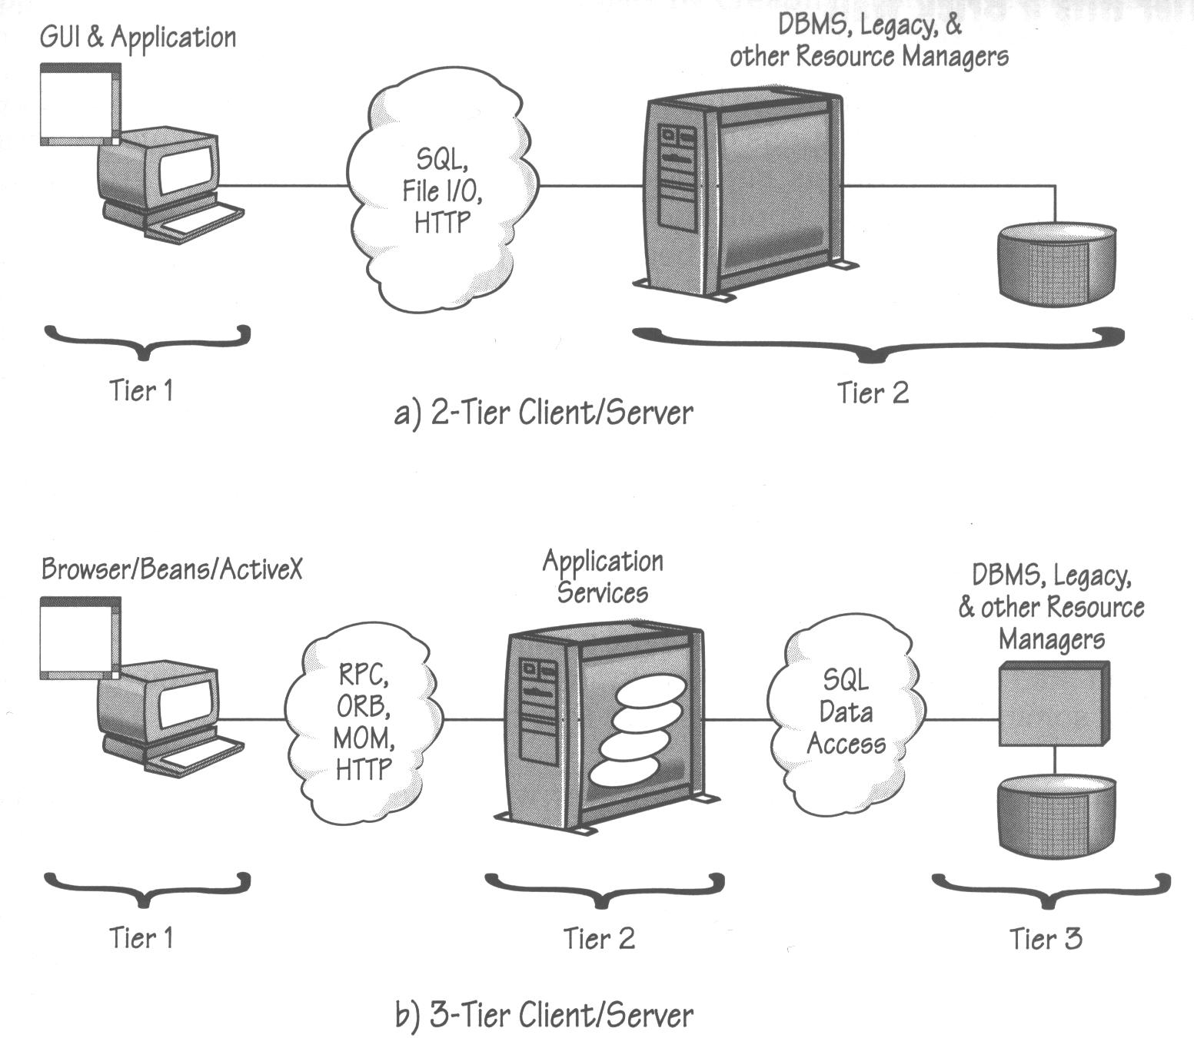
Comparison of 2- and 3-Tier client-server

Slide 30
Comparison of 2- and 3-Tier client-server
Advantages (over 2 tire client server architecture):
三层客户端-服务器架构更容易维护。Application logic becomes separated from the GUI and the database; Changes in one tier should not affect the other tiers
三层客户端-服务器架构可以有瘦客户端。In mordern 3-tire client server architecture, all business logics are in the server, and the server is also responsible for generating web client, and so in the client machine, what is needed is windows operating system with browser. Using the browser, the web pages can be downloaded from the server to the client (in this sense, the client tire is very thin).

Slide 31
Comparison of 2- and 3-Tier client-server
3. 在三客户端-服务器架构中，各层开发语言可以是
互相独立的。
3-tired client/server architecture has language
independent property, e.g., Client could be
written in Java, server could be written in C++.
  Use Corba, in this case, to connect object in Java and object in C++
4. 三层客户端-服务器架构可以连接到多个数据库。
Can pool database connections
Back
Notes:
TP = Transaction Processing
Define Load Balancing, Failover
Closer reflection of how the business viewed an organization

Slide 32
Comparison of 3-layered Architecture and 3-tiered Client/server Architecture
3层层次架构与3层客户端-服务器架构的比较

Slide 33
4. 三层层次架构与三层客户端-服务器软件体系结构的区别
三层层次架构（包括显示层，应用层与永久数据保持层）中的层指的是逻辑意义上的层。这些层，可以部署在同一台计算机上，当然也可以部署在不同的计算机上。
三层客户端-服务器架构里面所涉及的层指的是物理意义上的层。
  客户端运行在PC上；
  应用层被部署与运行在应用服务器上；
  数据层包含数据库与数据库管理系统软件，被部署与运行在数据库服务器上。

Slide 34
4. 三层层次架构与三层客户端-服务器软件体系结构的区别
Client
PC
Presentation
Layer
Application
Layer
Application Server
应用
服务器
Permanent Data
Storage Layer
Database Server
(DBMS)
数据库
服务器
Database
三层客户端-服务器架构
三层层次架构

Slide 35
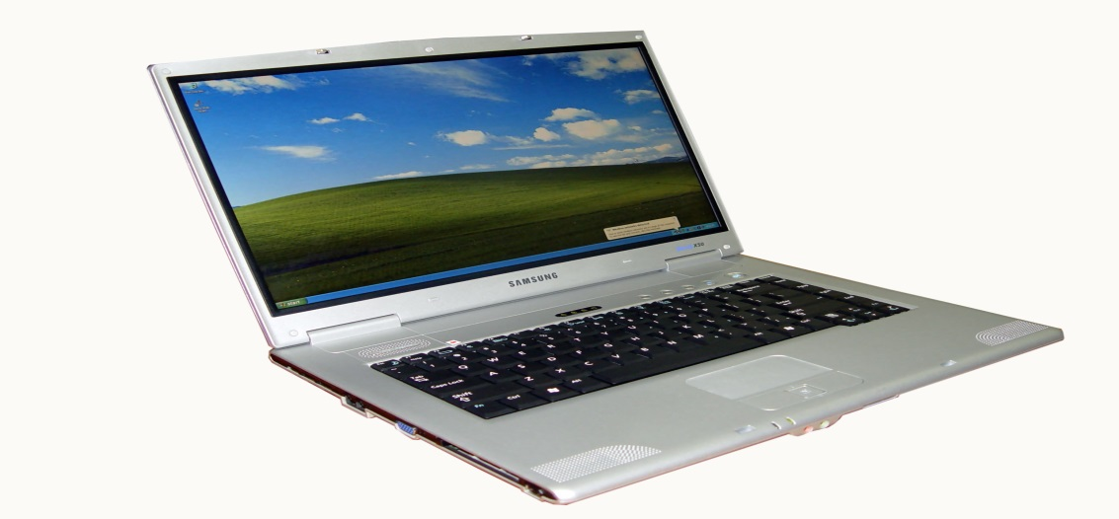
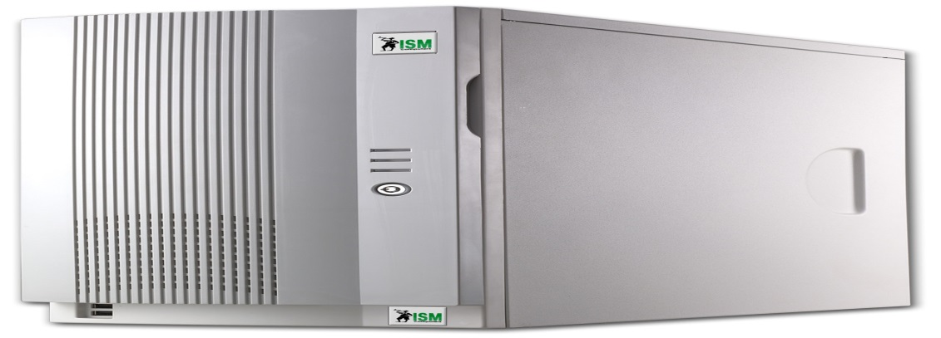
Browser/
Beans/
ActiveX
三层客户端-
服务器架构
Application
Services
Business logic
Databse, DBMS,
Legacy & other
Resource Managers

Slide 36

Browser/
Beans/
ActiveX
三层客户端-
服务器架构
Presentation Layer
Business logic Layer
DB Access Layer
Database, DBMS,
Legacy & other
Resource Managers

Slide 37
4. 三层架构与三层客户端-服务器软件体系结构的区别
例子：
假如我们要利用三层客户端-服务器架构设计一个运行于Web上的简单的网上运动会管理系统。
则我们可能将软件系统设计为如下图所示的系统。

Slide 38
4. 三层架构与三层客户端-服务器软件体系结构的区别
Client Tier
GUI
PC
Presentation Layer
运动会业务逻辑
Application
Server
Business logic Layer
DB Access Layer
Database Tire
数据库与DBMS
DB Server
An example design of a 3-tire client/server program

Slide 39
4. 三层架构与三层客户端-服务器软件体系结构的区别
注意到，在本设计中，对于三层的客户端-服务器架构的应用层部分，设计为一个通常意义下的三层的层次架构。
该架构包含显示层，用于生成用户图形界面，具体地说，图形界面生成代码被部署在服务层，但是生成的界面被显示在客户端PC上。
应用层包含所有的业务逻辑核心代码，永久数据保持层包含所有的数据库访问代码，例如JDBC代码。
实际上，层次架构里面的所谓的三个层都被部署在应用服务器上。因此，本设计可以被认为是应用了三层的客户端-服务器架构，其中在应用层中，包含了通常意义下的一个三层架构的程序。

Slide 40
4. 三层架构与三层客户端-服务器软件体系结构的区别
不要以为所有的程序都允许在互联网上
在现实的软件开发中，除了运行在互联网上的程序外，还有很多程序不运行在互联网上，例如
  Matlab软件，就是运行在桌面的软件；Matlab提供了强大的计算、仿真、绘图等功能因此，通常意义下的层次架构也具有广泛的用途
  智能无人机控制软件
  制造业软件

Slide 41
JaveEE Architecture

Slide 42
5. JaveEE Architecture
Client Tire
运行在
客户机
Web Client running in Web Browser,
Optional Java
Beans
Client computer
Application Client
Container
Application Client,Optional Java Beans
Web Tire
Java Bean
Components
(optional)
Web Pages
Web
Container
Servlets
运行在
JavaEE
服务器
Java EE
Server
Business tire
EJB
Container
Java persistence
Entities
Message Driven
Beans
Back
Session Beans
运行在
数据库
服务器
EIS Tire
Database Server
Database and
Legacy system

