Slide 1
Introduction to Software Architecture
Professor:
Yushan (Michael) Sun
Fall 2020
QQ群“2020秋学期-软件体系结构与设计模式-课程群”
QQ群号码：1044354600

Slide 2
房屋设计的例子1
Introduction to Software Architecture
门
民房设计：只有一个房间的房子

Slide 3
Introduction to Software Architecture
房屋设计的例子2
Kitchen
Dining-room
Bathroom
Studyroom
客厅(living room)
Bedroom1
Bedroom2
门
民房设计：有许多房间，每个房间都有其特定的功能

Slide 4
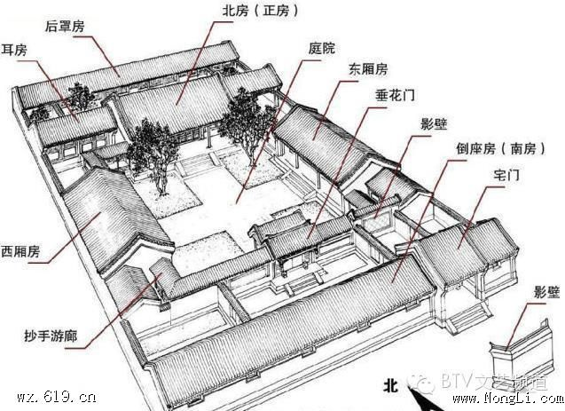
Introduction to Software Architecture
老北京四合院的架构： 由很多房屋组成，每个房屋都有其特
定的功能，房屋的位置与房屋之间的关系也很重要。

Slide 5
Introduction to Software Architecture
软件（程序）设计的例子
3层层次架构包含3层
每一层都包含特定
的功能：
表示层：用户图形界面
应用层：业务逻辑都在这一层
数据库访问层：包含所以的数据库访问方法
b) 各层之间有调用关系
Presentation Layer
Application Layer
Permanent Data Storage Layer
Database

Slide 6
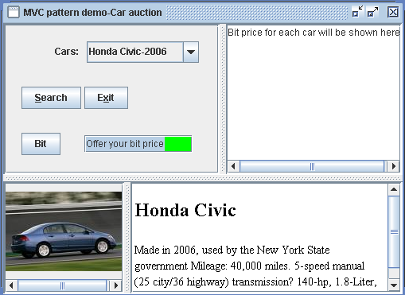
Introduction to Software Architecture
二手车拍卖系统的例子
二手车拍卖系统用户图形界面

Slide 7
二手车拍卖系统程序设计的例子
Introduction to Software Architecture
JPanel
CarAuctionGUI
+getSelectedCar(): String //get user input
+getBitPrice(): String //get user input bit price
+extractCarList(): String[] //display car list
+setUpCarList(JComboBox cmbCarList,String[] carList) //add car list onto cmbCarList
+constructCarFileUrl(String carChosen): URL //produce an UML based on car name
+updateCarDescription(JEditorPane editorPane, URL url) //update car description
+showBitPrice(JTextArea bitShownText, String price ) display bit price
+produceCarImaIcon(String carChosen): ImageIcon //produce image icon for car
+updateCarPicture(JLabel imgLabel,ImageIcon imgIcon) //update car picture
#createImageIcon(String path): ImageIcon
二手车拍卖系统的类图设计-单独一个类的情况

Slide 8
CarAuctionGUI
Controller
getSelectedCar()：String
getBitPrice()：String
getCarList()：String[]
setUpComboBox(String[] carList)：void
objCarGUI:CarAuctionGUI
cm: CarModel
civ: CarGUIView
cb: CarBitView
carPrice: String
private String[] carList
<<interface>>
Observable
actionPerformed(ActionEvent e): void
+register(Observer obs)：void
+notifyObservers(): void
<<interface>>
Observer
update(Observable subject): void
CarModel
String[] carNameList;
String bitPrice;
CarGUIInfoView
CarBitInfoView
+setCarList(String[] cars)：void
+getCarList(): String[]
+setSelectedCar(String sCar): void
+getSelectedCar(): String
+setBitPrice(String bPrice): void
+getBitPrice(): String
+setCarFileURL(): void
+getCarFileURL(): URL
+setupImageIcon(): void
+getImageIcon(): ImageIcon
+register(Observer obs)：void
+notifyObservers(): void
model: CarModel
imagePane: JScrollPane
model: CarModel
bitText: JTextArea
+update(): void
+update(): void
使用MVC 架构设计的二手车拍卖系统：容易维护、扩展

Slide 9
Introduction to Software Architecture
软件设计要考虑很多因素：
  模块化(modularization) （本课程关注）
  可扩展性 (extensibility) （本课程关注）
  性能 (performance)
  安全 (security)
软件设计要借鉴成功经验
  软件设计模式 (software design patterns)
  软件体系结构 (software architecture)

Slide 10
软件设计模式的定义
Introduction to Software Architecture
Definition of a pattern:
“A pattern addresses a recurring design problem that arises in specific design situations and presents a solution to it”.
“设计模式处理一个特定设计情况下反复出现的设计问题,并且为其提供一个解决方案”
(Buschmann, et. al. 1996)

Slide 11
Introduction to Software Architecture
Why use software patterns （为什么使用设计模式）?
学习专家经验. Design Patterns capture expertise and make it accessible to non-experts in a standard form.
为了交流. Design Patterns facilitate communication among developers by providing a common language.
为了重复利用成功的设计. Design Patterns make it easier to reuse successful designs and avoid alternatives that diminish reusability.
提供设计修改. Design Patterns facilitate design modifications.

Slide 12
软件体系结构的定义
Introduction to Software Architecture
Definition of a software architecture :
The software architecture of a program or computing system is the structure or structures of the system, which comprise
  software components (软件组件),
  the externally visible properties of those components, and (外部可见性质)
  the relationships among them. (组件之间的关系)
  [Bass 98]

Slide 13
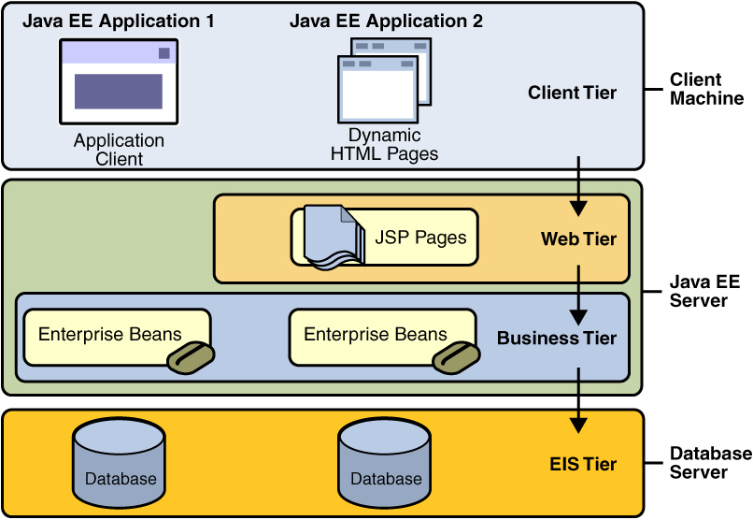
Introduction to Software Architecture
软件体系结构的例子2
Java EE Architecture

Slide 14
Introduction to Software Architecture
软件体系结构的重要意义
Three reasons why SA is important to large,
complex, software-intensive systems.
SA是交流工具。It is a vehicle for communication among stakeholders.

Slide 15
Introduction to Software Architecture
2. SA是最早的设计决策的代表。It is the representation of the earliest design decisions. It shows the tradeoffs (折衷,权衡)
  between performance and security,
  between maintainability and reliability, and
  between the cost of the current development effort and the cost of future developments in the architecture.

Slide 16
Introduction to Software Architecture
3. SA是一个系统的可重复利用的,可转移的抽象
It is a reusable, transferable abstraction of a
system. It
    can be applied to other systems exhibiting similar requirements and
    can promote large-scale reuse and software product lines.

Slide 17
Introduction to Software Architecture
预备知识: C++ or Java； Software engineering；Object oriented analysis and design
教材: 《软件设计模式与体系结构》，孙玉山，高等教
育出版社，2013年5月出版；
参考书：
  Partha Kuchana, “Software architecture
  design patterns in Java”, CRC Press LLC, 2004；
  Mary Shaw and David Garlan, “Software Architecture: Perspectives on an Emerging Discipline”。

Slide 18
其它参考书与材料（Reference books）
Introduction to Software Architecture
[1] Gamma, Helm, Johnson and Vlissides, “Design
Patterns: Elements of Reusable Software”,
1995 【这是一本由四人帮写的经典著作】
[2] James W. Cooper, “The design patterns, Java Companion”, 1998
[3] Analysis Patterns: Reusable Object Models, Martin Fowler, Addison-Wesley, 1997
[4] Java 与模式,阎宏,电子工业出版社,2005,4
[5] Paul Clements, “Software product lines: practices and patterns”.

Slide 19
Introduction to Software Architecture
课程考核方式
作业与项目：20%
  Homework: 10 homework:
  Project: 3 projects
  修改设计、编写代码
  提交时间：待定
期末考试：
final test (open-book): 80%;

