Slide 1

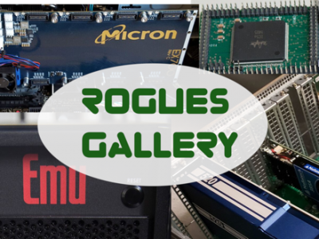
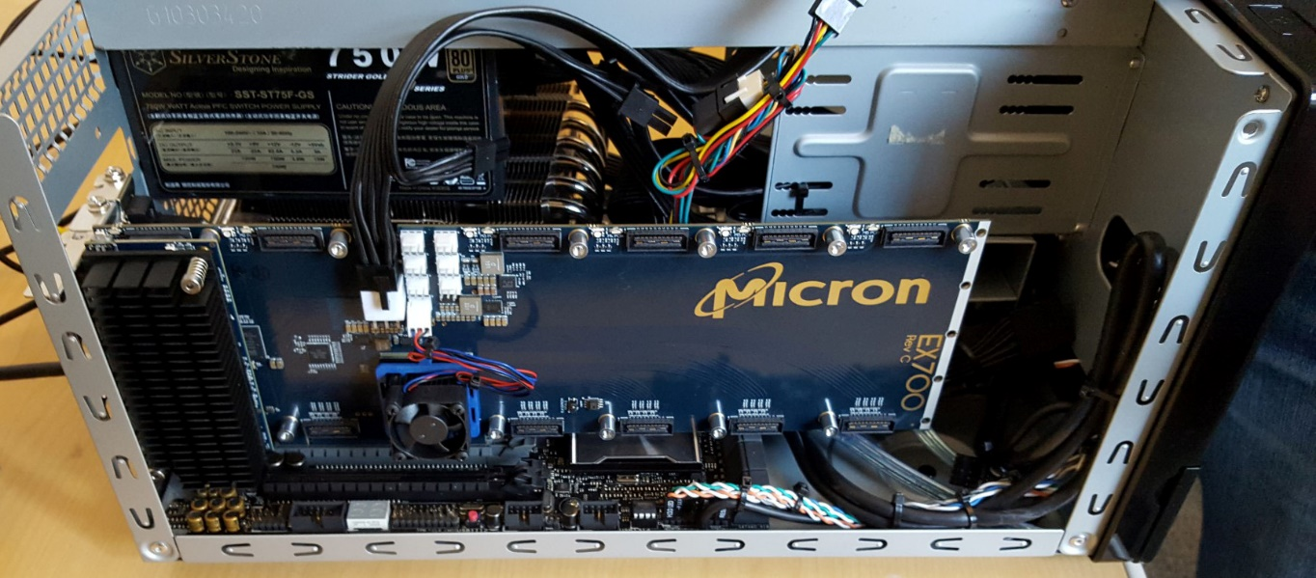
FC with RG – <Subteam Name>
<Subteam member names and (optionally) emails>
Field Programmable Analog Arrays (F
PAA): An analog programmable platform opens experiments with many neuromorphic architecture ideas. The FPAAs provide drastic improvements in performance and energy.
Project Goals:
<What is the goal of your subteam? You can use your short summary here>
<Example> The Neuro Team is working on an autonomous vehicle called NeuroCar, which utilizes brain-inspired spiking neural networks and software like ROS and Gazebo to power its computer vision and machine-learning-based decision-making capabilities. The team is working towards creating a physical prototype and test it on the Georgia Tech Autonomous Racing Facility.
Experiments and Results
<What are some key tests/experiments from your work this semester?>
Goal optimization via ROS simulation
Lessons Learned
<What are some key lessons you learned this semester?>
<Example> We learned that while ROS is good for implementing basic SLAM it is not as suitable for our target application because…
Project Overview and Methods:
<How are you going about working on this project? What tools and methods are you using?>
<Example> Our project is looking at an optimization framework that is built using ROS and Nengo. The figure below shows our basic flow diagram and…
Above: NeuroCar’s ML-inspired workflow
Right: The iterative goal-oriented process minimizes error over multiple iterations.
We ran the following simulations and found..
Next Steps and Future Challenges
<What will be tackled in future semesters, and what are future challenges?>
<Example> After implementing a simulation version of a neuromrophic feedback algorithm on the Raspberry Pi, we want to migrate this algorithm to an FPGA running the Nengo API
Currently unsolved problems include how to optimize multiple goal objectives
Raspberry Pi with edge detection
Left: A typical desktop and reconfigurable FPGA board like those used in this course
A Raspberry Pi platform was used to do camera detection. We found that birds eye view detection was best because..

