Slide 1
Vortex OpenCL Software stack
Ruobing Han
Notes:
Hello everyone, I am Ruobing. It’s my pleasure to have this chance to share some Vortex knowledge with all of you. In this slide, I will introduce the Vortex softweare stack, for how we interactive with Vortex hardward and how our software programs be compiled and executed on Vortex.

Slide 2
Agenda
POCL
Vortex GPGPU System Architecture
Notes:
Here is the agenda of my introduction. I only put some basic introduction in this slide. For more detail information, I put them together with the intrudction of executing CUDA/OpenCL on Vortex in the next part.

Slide 3
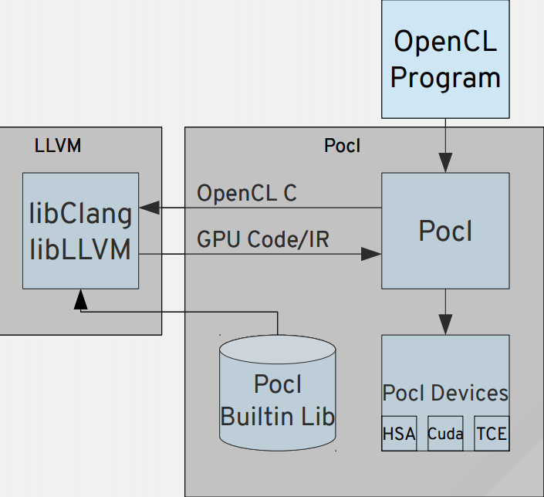
POCL: A Performance Portable OpenCL Implementation
Key Insights:
Use target-specific execution model
SIMT -> GPUs
MIMD, SIMD -> CPUs
Target-specific compiler transformations
Using LLVM
Key Features:
A single interface with multiple target devices
Support HSAIL export
Support PTX export
Support x86 export
Custom accelerator support via TCE*
Support SPIR-V import
POCL Software Stack
* TTA-based Co-design Environment - http://openasip.org/
Notes:
For Vortex software, we high depends on another project, POCL. POCL is an implementation of OpenCL. In other word, it can support executing OpenCL programs on different hardware devices. It consits of two parts: compilation and runtime. For compilation, it based on LLVM. It implements a series of LLVM translation to optimize the input OpenCL programs. It supports several backend devices, including NVIDIA GPU, x86 CPU and even customized accelerator. Besides, it accepts not only OpenCL programs, but also SPIR-V IR as input. To execute an opencl programs on a backend device. First, POCL compiles the program, and link it with hardward dependent runtime library and also Pocl's optimized hardware independent library. Then, the POCL runtime will use the devices drivers to control the devices. It will allocate and manage the memory on devices side, also send and launch the kernel to the devices and fetch the result data from devices side to host side.

Slide 4
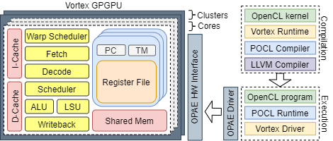
Vortex GPGPU System Architecture
Compilation:
Vortex Runtime
POCL Compiler
Execution:
Vortex Driver
POCL Runtime
4
Notes:
Thus, to support Vortex as a new backend to POCL, we need to care about the following parts: for compilation, we need to modify the POCL Compiler and provide a Vortex Runtime library. For the Vortex programs, they have different interface as other devices, thus, we have to modify the original pocl compiler to generate the programs have the interface that Vortex need. Besides, Vortex has some specific built-in functions, we have to implement these functions in Vortex Runtime library, and this library will link with the kernel at compilation time. For execution, we need to provide a Vortex Driver for POCL runtime. To integrate a new device into POCL, we have to implement some basic operations, like memory copy, memory allocation and kernel launch and put all these functions into Vortex Driver. POCL framework will use the Vortex Driver to control and communicate with Vortex.

Slide 5
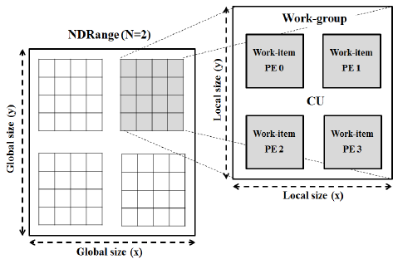
Vortex Kernel Invocation
OpenCL Work-items
Global size (X, Y)
Local size (x, y)
Vortex Work-items
Wavefronts
Threads
Distribution
POCL workgroup function
Executes all work-items in a workgroup
Distribute workgroup among all threads
All threads : wavefronts * threads
for (all threads) {
}
Wavefront 0~N
pocl::wg_func()
for (remaining threads) {
}
Wavefront (0)
pocl::wg_func()
Notes:
Among all these Vortex software stack, one the most important parts is scheduler. How to map computation to hardware is critical for achieving high performance. In opencl, work-item distributed among workgroups. As for Vortex, instead of workgroup, we use wavefront to schedule. A wavefront is a group of work items and work items within one wavefront are executed in parallel and in lock steps. In Vortex, we use wavefront as the unit for scheduling. NVIDIA GPU has a same concept named warp. In NVIDIA GPU, GPUs have the same size of warp, 32 threads within a warp. However, in Vortex, wrap size is configurable. Although this feature make Vortex more flexiable, we have to put more effort for the shcedule algorithms. Although for most high-level users, they can directly execute Vortex without worry about scheduling. If you have interest in changing Vortex's software stack to achieve high performance, these concepts are critical for you.

Slide 6
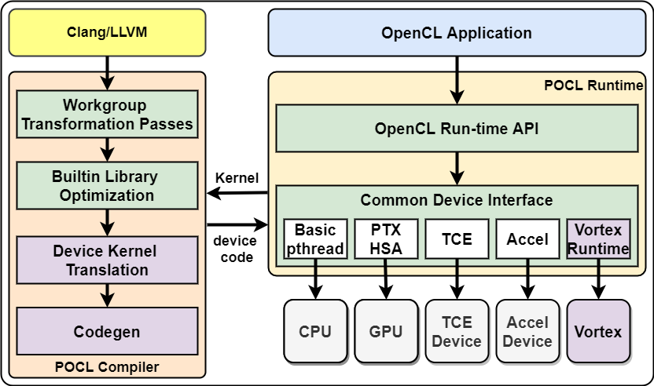
POCL Vortex Extension
Device kernel Translation
Kernel Invocation
Warp/thread scheduling
Device runtime library
Codegen
Target CPU, features, ABI
Linked libraries
Vortex runtime and other deps.
Vortex runtime
Kernel compilation
Vortex driver communication
GPU resource allocation and loading
Kernel offloading and execution
Notes:
In summary, the whole Vortex software stack is the library needed to integrate Vortex into POCL, the Vortex Runtime and Vortex Driver. Not let's go through the process of how to execute a program on Vortex. First, we compile the program with POCL Compiler. Insides the POCL compiler, Vortex runtime library will be linked with compiled kernel. Before generate the binary, as Vortex kernel has different interface, we use device kernel translation to translate the pocl generated programs. After got the generated programs, POCL runtime uses Vortex Driver to offload this kernel to Vortex and launch it.

Slide 7
Thanks for listening

