Slide 1
Support OpenCL&&CUDA on Vortex
Ruobing Han
Notes:
In this part, we will introduce how to execute OpenCL and CUDA programs on Vortex

Slide 2
Agenda
Motivation
Software stack for Vortex
OpenCL on Vortex
CUDA on Vortex

Slide 3
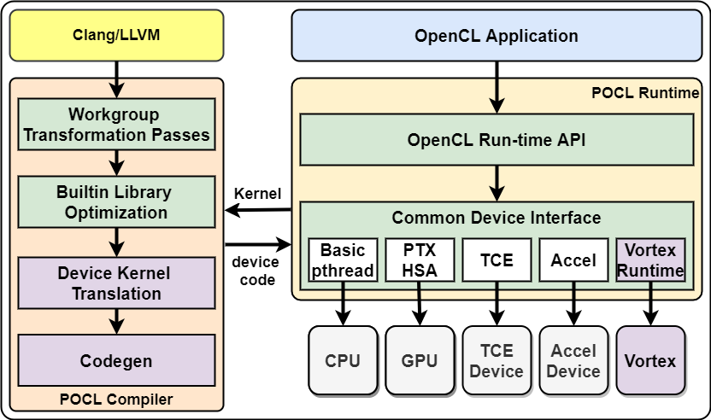
POCL Vortex Software stack
POCL runtime support both OpenCL and SPIR-V inputs
Notes:
First, let's have a review of Vortex Software stack. As introdcued before, Vortex software stack highly relies on POCL project. And POCL project is an implementation of OpenCL. Thus, it’s quite starightfoward to support OpenCL on Vortex.

Slide 4
OpenCL on Vortex
Input: OpenCL programs (host&&kernel)
Step1: Compile OpenCL kernel to risc-v binary (by POCL Compiler)
Step2: Manually edit the host OpenCL programs, to load risc-v binary as kernel.
Step3: Compile edited OpenCL host (by gcc/clang), and link with Vortex Driver.
Step4: Execute compiled OpenCL host programs with POCL Runtime, which loads risc-v binary generated in Step2 as kernel.
Notes:
Here is the steps to execute OpenCL. Now let's have a look for each step. Assuming our input is a opencl program, which consists of two parts: the host part and kernel parts

Slide 5
OpenCL on Vortex
Input: OpenCL programs (host&&kernel)
Step1: Compile OpenCL kernel to risc-v binary (by POCL Compiler)
Step2: Manually edit the host OpenCL programs, to load risc-v binary as kernel.
Step3: Compile edited OpenCL host (by gcc/clang), and link with Vortex Driver.
Step4: Execute compiled OpenCL host programs with POCL Runtime, which loads risc-v binary generated in Step2 as kernel.
NOTE:
1) integrate the Vortex Runtime library into the original POCL Compiler.
2) translate the generated kernel with Device kernel translation, as Vortex requires different kernel interface.
Notes:
In this first step, we have to compile the kernel part into risc-v binary. We will use modied POCL compiler in this step. As the original POCL doesn't support risc-v architecture. Also, after generated the POCL compiled programs, we have to further translate it with our device kernel translation, as so functions needed by Vortex, like initilization and scheduling, are not generated by POCL

Slide 6
OpenCL on Vortex
Input: OpenCL programs (host&&kernel)
Step1: Compile OpenCL kernel to risc-v binary (by POCL Compiler)
Step2: Manually edit the host OpenCL programs, to load risc-v binary as kernel.
Step3: Compile edited OpenCL host (by gcc/clang), and link with Vortex Driver.
Step4: Execute compiled OpenCL host programs with POCL Runtime, which loads risc-v binary generated in Step2 as kernel.
NOTE:
1) we only need to edit the kernel loading code (e.g. clCreateProgramWithBinary). We can reuse the other codes (e.g. set kernel arguments, create command queue).
2) we are working on totally reusing the host programs on CUDA-Vortex route.
Notes:
After we generated the binary kernel, now, for our host program, instead of loading the kernel as a text file, now it need to directly load the binary kernel. Thus, we have to manually modify the host programs. It is not a heavy workload, as we only need to modify the kernel loading code. As for the rest parts, like set kernel arguments and create command queue, we can diretcly reuse the original host codes.
Besides, currently, we are also working on automatically generate the host programs on CUDA route so that we can avoid any manually edition in the whole process.

Slide 7
OpenCL on Vortex
Input: OpenCL programs (host&&kernel)
Step1: Compile OpenCL kernel to risc-v binary (by POCL Compiler)
Step2: Manually edit the host OpenCL programs, to load risc-v binary as kernel.
Step3: Compile edited OpenCL host (by gcc/clang), and link with Vortex Driver.
Step4: Execute compiled OpenCL host programs with POCL Runtime, which loads risc-v binary generated in Step2 as kernel.
NOTE:
1) links Vortex Driver with compiled host programs, so they can communicate with Vortex devices (e.g. memory copy, kernel launch)
Notes:
In the third step, we compile the edited host programs, and link it with Vortex Driver, which is used for host programs to communicate with Vortex devices. As the compiled host programs will be executed on host machine, we can compile it with normal compiler, like gcc and clang. We do not need to use POCL compiler

Slide 8
OpenCL on Vortex
Input: OpenCL programs (host&&kernel)
Step1: Compile OpenCL kernel to risc-v binary (by POCL Compiler)
Step2: Manually edit the host OpenCL programs, to load risc-v binary as kernel.
Step3: Compile edited OpenCL host (by gcc/clang), and link with Vortex Driver.
Step4: Execute compiled OpenCL host programs with POCL Runtime, which loads risc-v binary generated in Step2 as kernel.
NOTE:
1) POCL runtime uses Vortex Driver, linked in Step3, to communicate with Vortex devices.
Notes:
Finally, we just execute the compiled host programs. It will load the risc-v binary kernel and execute it on Vortex devices by communicating with Vortex driver.

Slide 9
Execute OpenCL on Vortex with simX
simX (https://github.com/vortexgpgpu/vortex/tree/master/sim/simX):
A simulator which simulates Vortex's execution with C++ code. It's a tiny simulator aims to help developers verify the correctness of the programs efficiently.
Major functions in simX (Hints for Assignment #5):
1) std::shared_ptr<Instr> Decoder::decode(Word code, Word PC):
parse an input binary instruction and output a formatted Inst.
2) void Warp::execute(const Instr &instr, Pipeline *pipeline):
Calculate the results of the input instruction, and update the memory/register file accordingly
Notes:
Vortex programs can be execute not only on FPGA devices, but also several simulators. One of the most simple simulator, simX, is the most common choice to support deverlopers to verify the correctness. This simulator uses C++ codes to impelement Vortex execution. And it does not rely on any third party library. It's friendly to beginners. And in the following assignment parts, you will be asked to implement several features on Vortex, and I highly recommend you to execute your results on simX for debuging.

Slide 10
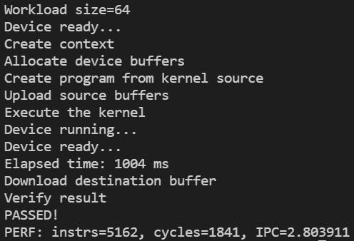
Execute OpenCL on Vortex with simX
NOTE: The commands below are just for illustration . For more detail, please see: https://github.com/vortexgpgpu/vortex/blob/master/doc/execute_opencl_on_vortex.md
1) Compile OpenCL device kernel into risc-v by Pocl compiler:
poclcc –o kernel.pocl opencl_kernel.cl
2) Compile OpenCL host and link with Vortex Driver:
g++ -o main opencl_host.cpp -lvortex
3) Execute compiled program on simX:
LD_LIBRARY_PATH=$(VORTEX_DRIVER_PATH)/simx main
Screenshot for excuting vecadd example (https://github.com/vortexgpgpu/vortex/tree/master/tests/opencl/vecadd) on simX
Notes:
To give you a better understanding, I list the commands to execute OpenCL programs on simX. First, we compile the device kernel to generate risc-v binary. They, we compile the host programs and link it with Vortex Driver. Finally, we execute the compiled host programs with simx. I also put the screen shot you are expected to get when execute vector add example

Slide 11
CUDA on Vortex
CUDA Application
SPIR-V Application
POCL runtime support both OpenCL and SPIR-V inputs
Notes:
For CUDA, not like OpenCL, which is supported by POCL naturally, we can not directly following the same route to execute it. POCL supports two format of input kernel, OpenCL format and SPIR-V format.

Slide 12
CUDA on Vortex
CUDA Application
NVPTX-SPIRV translator
SPIR-V Application
POCL runtime support both OpenCL and SPIR-V inputs
Notes:
So, to support CUDA on Vortex, we have to implement an extra step. We built a translator to translate CUDA into SPIR-V. Thus, after getting the SPIR-V, we can input it into POCL and following the same step as OpenCL.

Slide 13
Background
Code migration:
HIPIFY: Only for CUDA->HIP
SYCL: Re-implement CUDA programs by SYCL libraries
Notes:
Not like OpenCL which is proposed for targeting multi-backend devices, CUDA can only be executed by NVIDIA GPU. However, we are not the first project tries to execute CUDA on other devices. There is a previous project aims to excute CUDA on AMD GPUs, and it called HIPIFY. Thanks to the similiarilty between CUDA and HIP, the front end language for AMD devices, HIPIFY can use Regular expression to convert CUDA sourcce code to HIP source code. However, as HIP can not be execute on risc-v devices, and other front end language which supports risc-v does not have high similiarity with CUDA, we can not follow this route to solve our challenges.
For another project SYCL, it provides a high level language, which can generate programs be executed on several back-end devices, including risc-v. But it can not directly use existing cuda code. Instead, it requires users to re-implement cuda programs by apis provided by SYCL. In summary, although there are several code migration project, none of them can be used to support risc-v backend. So for the best of our knowledge, our project is the only one that supports CUDA on RISC-V backend

Slide 14
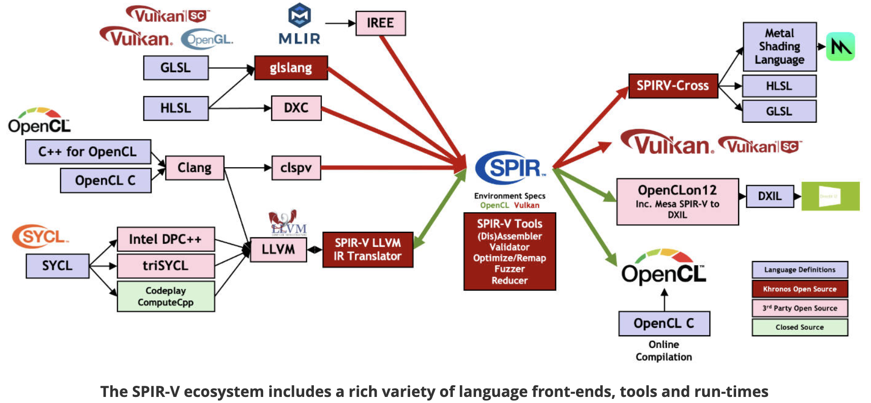
Background
Code migration:
HIPIFY: Only for CUDA->HIP
SYCL: Re-implement CUDA programs by SYCL libraries
SPIR/SPIR-V:
source: https://www.khronos.org/spir/
Notes:
Another project I want to introduce is SPIR, it is critial for the scaleable of our framework. SPIR is an IR special for high performace computing and parallel computing, can be regarded as an isolation between frontend language and backend devices. With SPIR, we can compile a source code for different backend devices. In other word, thanks for the scalbility of SPIR, our framework can not only execute CUDA on Vortex devices, but also open to execute on other devices. And we can support other frontend languages as well.

Slide 15
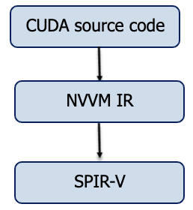
Overview of the NVPTX-SPIRV translator
clang
Notes:
Now let's have a look of the NVPYX-SPIRV translator. It consists of two step: our translator accepts CUDA source codes as inputs, then, in the first step, we use clang to compile CUDA source code into NVVM IR. NVVM IR is an intermediate representation proposed by NVIDIA, and it can be regarded as a subset of LLVM IR.

Slide 16
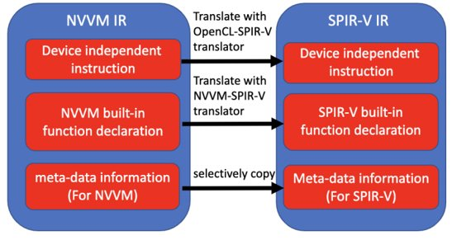
NVVM IR-SPIRV
Notes:
After that, in the second step, we need to translate a NVVM IR into SPIR-V IR. Each NVVM IR and SPIR-V IR are consists of three parts: device independent instructions, such as load, store, jump and some basical operations. Device specific built-in function, for example, NVVM and SPIR-V has different function to get the thread index and block index. As for the third part, metadata, which is used for code generation. The metadata is different between different backend devices. Thus, for these three parts, we have to handle each part separately.

Slide 17
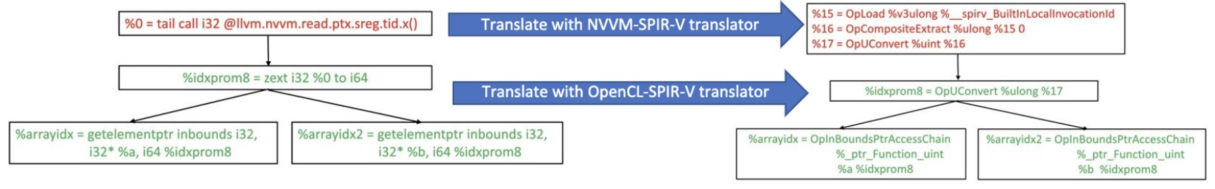
NVVM IR-SPIRV
For device independent instructions (load, store, binaryOp...): use OpenCL-SPIR-V translator
For NVVM special built-in function (llvm.nvvm.read.ptx.sreg.tid.x()...): use NVVM-SPIR-V translator
Notes:
For device indeppendent instructions, the instructions in NVVM is exactly the same in OpenCL. Thus, we can utilize the OpenCL_SPIR-V translator, a third-party library for translating between OpenCL and SPIR-V. However, we can not directly use it on NVVM special built-in functions. As these functions are speciaicly for CUDA, OpenCL does not have these features. So, our major contributions are supporting these CUDA features to be translated to SPIR-V. As for the metadata, as it's also hardware dependent, we have to also implement the translation by ourself, instead of relying on any existing third-party library.

Slide 18
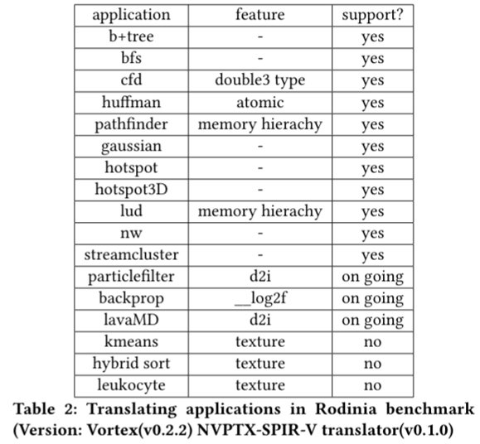
Evaluation
Notes:
To verify the Availability of our translator, we try to execute CUDA examples in Rodinia benchmark on Vortex, and get the following results. Our pipeline can support most of examples. For the remaining unsupported examples, Vortex can support them as soon as we add some mathmatical built-in function and texture memory features

Slide 19
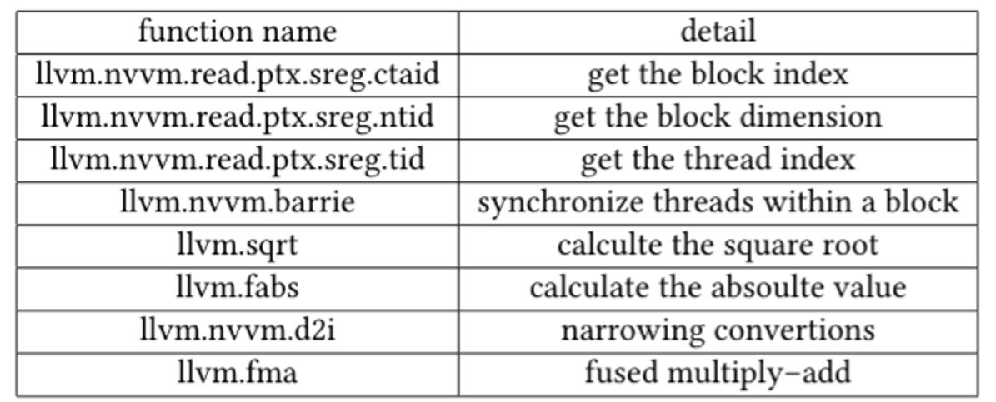
Features (NVPTX-SPIR-V translator: version v0.1.0, Vortex: version v0.2.0)
Memory hierarchy
Synchronization
Some mathematics operations (square root, log, absolute value)
Notes:
I also summary the CUDA features supported by Vortex currently. Now, Vortex can support memory hierarchy, synchronization and several mathematics operations. In the future, we will upgrade both NVPYX-SPIRV translator and Vortex so that we can high a higher coverage for CUDA programs.

Slide 20
Thanks for listening
Github link:
1) POCL (Vortex version): https://github.com/vortexgpgpu/pocl
2) NVPTX-SPIRV translator: https://github.com/vortexgpgpu/NVPTX-SPIRV-Translator
3) LLVM (Vortex version): https://github.com/vortexgpgpu/llvm
Contact information:
Ruobing Han (hanruobing@gatech.edu)
Notes:
Last but not least, all our corresponding repo are open-sourced. If you interested in any part of them, you can directly access the source code on github. If you have any questions, please feel free to contact me. Thanks for your listening.

