Slide 1


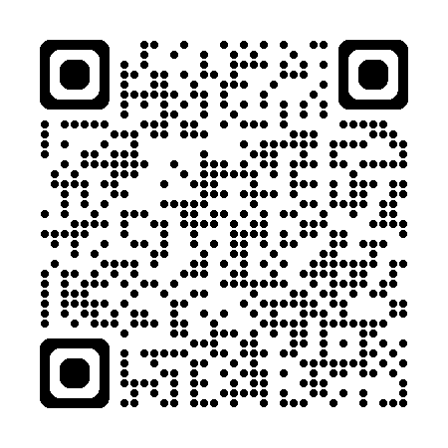
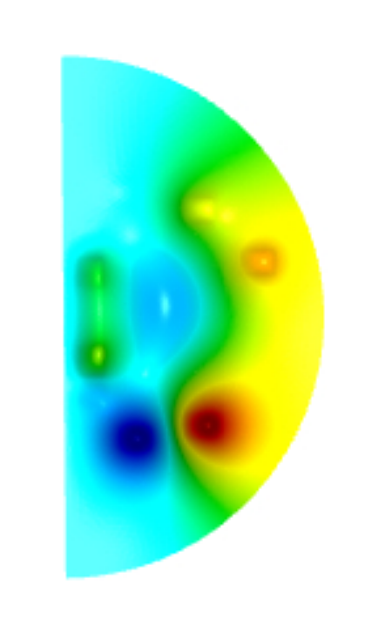
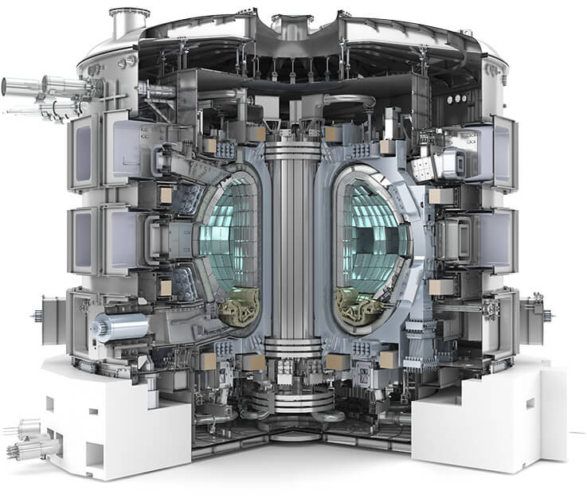


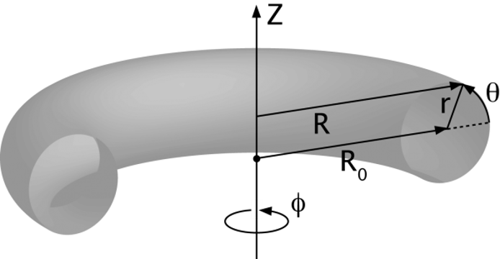





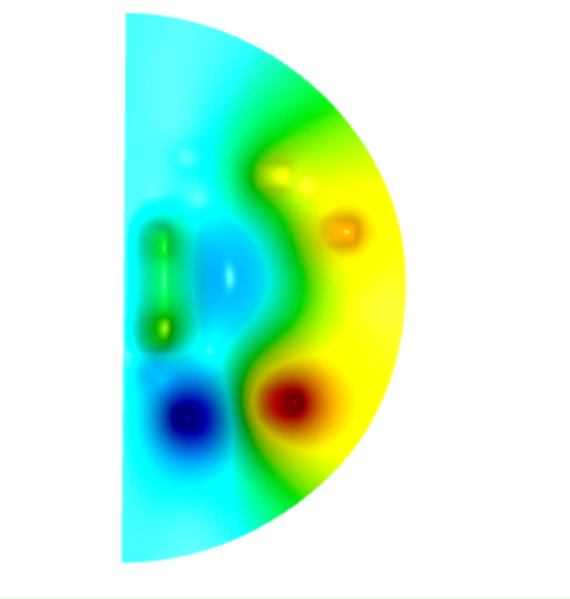
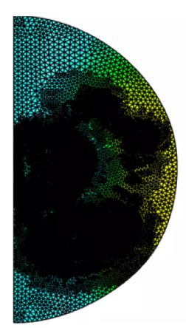
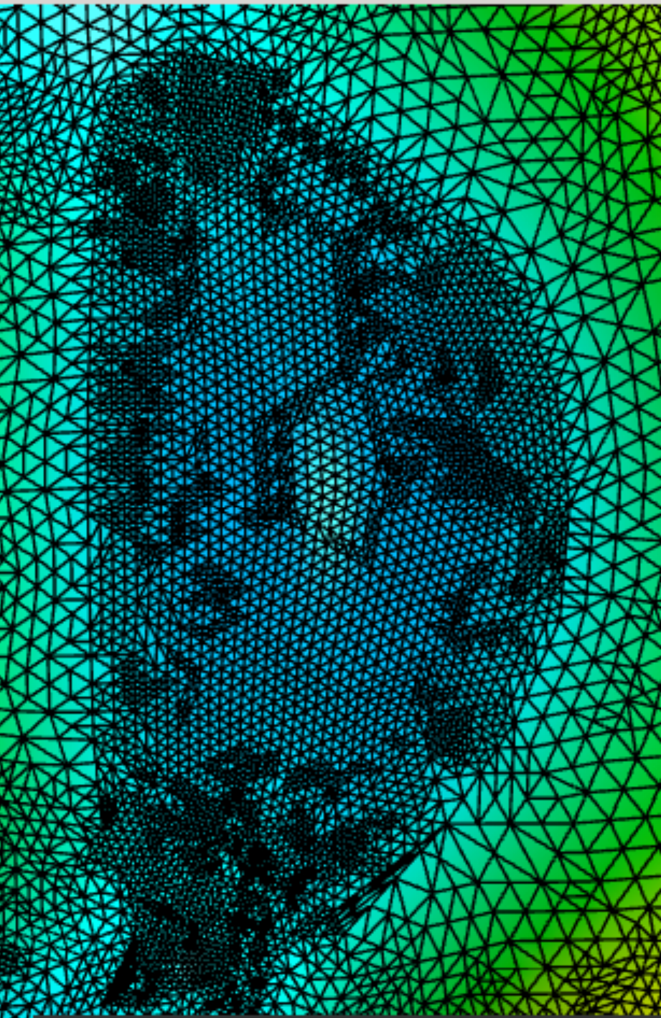
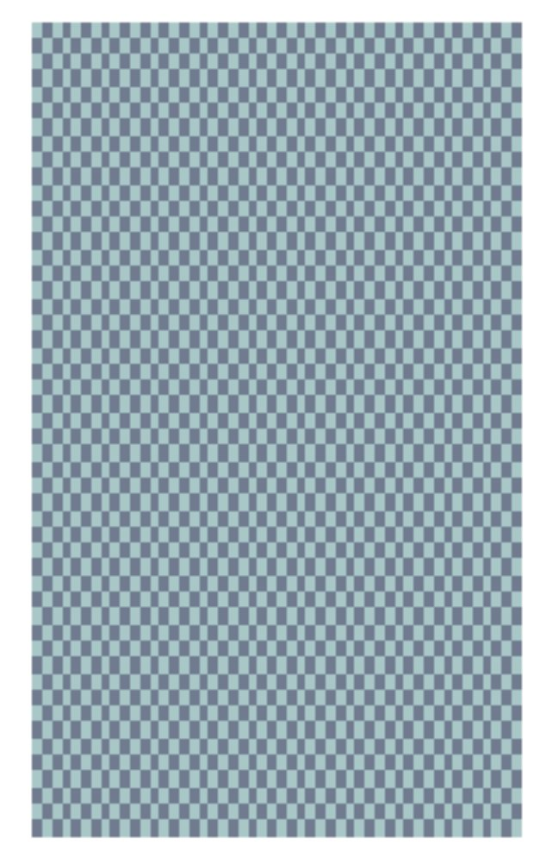
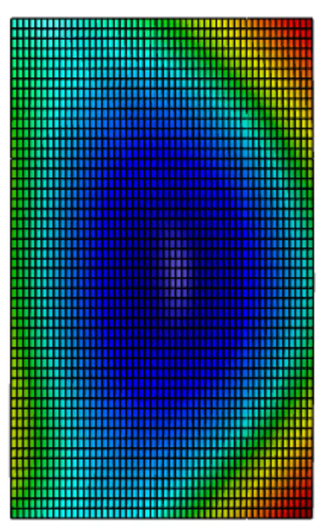


MFEM-Based Tokamak Equilibrium Solver
Students: Saisruthi Bandla (sbandla3@gatech.edu), Janani Murugan (janani@gatech.edu), Alex de Magalhaes
Mentors: Qi Tang, Assistant Professor at CSE
https://github.com/tangqi/mfem/tree/tds-gs/miniapps/gslib
State of the Art
Project Goal: Develop a free boundary tokamak equilibrium solver for the magnetic confinement fusion community
Plasma fusion: the process of charged particles colliding to releases energy
Plasma inside the toroidal chamber
Benefits
Low-impact energy generation
Faster and longer-distance space travel
Toroidal chamber and first wall
Scientific studies
Challenges
Magnetic coils
Develop devices that can contain and withstand high temperatures
Tokamak: Device for magnetic confinement fusion
Toroidal plasma chamber of tokamak
Solution simulation via MFEM
Plasma expands and cools—need to stabilize to keeps it hot and long enough for fusion
Ongoing Efforts
Free Boundary
Equilibrium
Magnetic Confinement: Trap plasma with strong magnetic fields
Unknown plasma shape & boundary conditions
Modeled using MFEM (mfem.org), an open-source finite element library for solving partial differential equations on unstructured and adaptive meshes
Stabilize plasma and avoid contact with walls
Modeled by the Grad–Shafranov (GS) equation, which describes magnetohydrodynamic equilibria in axisymmetric, toroidal plasmas
Inertial Confinement: Uses lasers/beams for rapid compression of particles
Current Work: Using G-EQDSK file format, develop and integrate an EFIT writer (code used to reconstruct plasma equilibrium solutions) into MFEM
Equilibrium solution on default triangular mesh
Identify and isolate the plasma region
Generate a standard rectangular mesh and interpolate the solution onto it
Gather the needed EFIT parameters from MFEM
Build EFIT writer
Computational grid
Magnetic axis
Plasma state
Plasma boundary
Poloidal current and flux
Safety factor
Limiter grid
Compute additional necessary values
Output the metrics, with proper GEQDSK formation, to an exportable text file
Delivers a structured, portable set of key parameters for reproducing plasma equilibrium solutions, aligned with industry standards for easy sharing and integration
Future Work
Test the GEQDSK file for potential errors
Continue development of ITER tokamak solutions
Expand to other tokamaks

