Slide 1
PREDICT HOURLY ENERGY DEMAND WITH TIME SERIES FORECASTING
Capstone presentation

Slide 2
Background
Clean and renewable energy sources can be the solutions to global warming.
Predicting energy demands at an hourly frequency is crucial for infrastructure planning.
Time-series techniques should be explored and may be improved when including external factors such as weather.

Slide 3
Dataset
The energy datasets have been aggregated and posted on Kaggle by Rob Mulla.
PJM Interconnection LLC, a regional transmission organization (RTO) in the United States.
Commonwealth Edison, Chicago region
The weather data were obtained from Weather API posted on Kaggle by David Beniaguev.

Slide 4
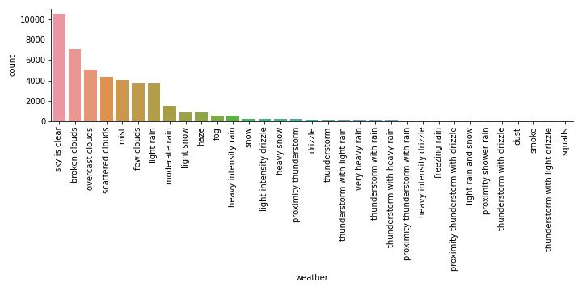
Exploratory data analysis (EDA)
Seven weather types make up most of the data. Other weather types are scarce.

Slide 5
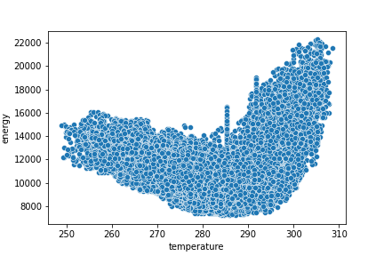
Exploratory data analysis (EDA)
Strong correlation between energy and temperature can be observed.

Slide 6
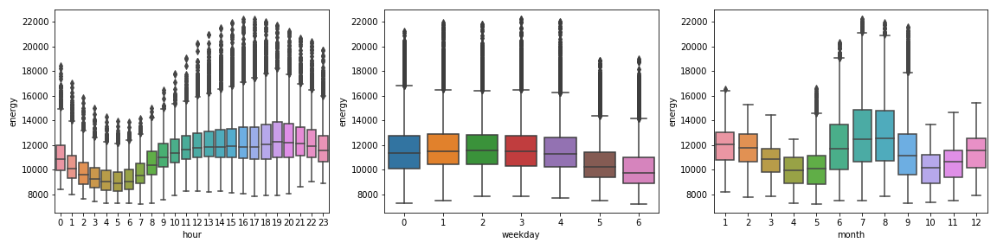
Exploratory data analysis (EDA)
Energy usage varies on an hourly, daily, and monthly basis, likely an indication of human activities and seasons.

Slide 7
Modeling and parameters
Here, modeling techniques that have memory components associated with frameworks were used:
Autoregressive integrated moving average (ARIMA)
p, q, and d are referred as auto regressive, moving average, and difference terms
Long short-term memory (LSTM)
fully connected one LSTM layer with 100 nodes, was optimized based on MSE using Adam optimizer

Slide 8
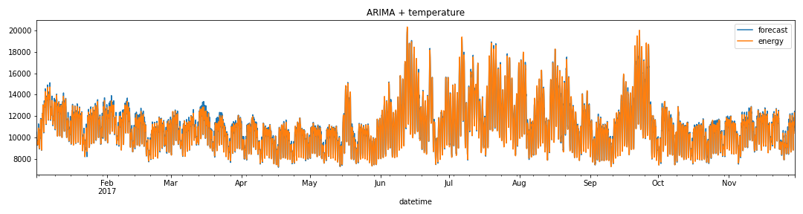
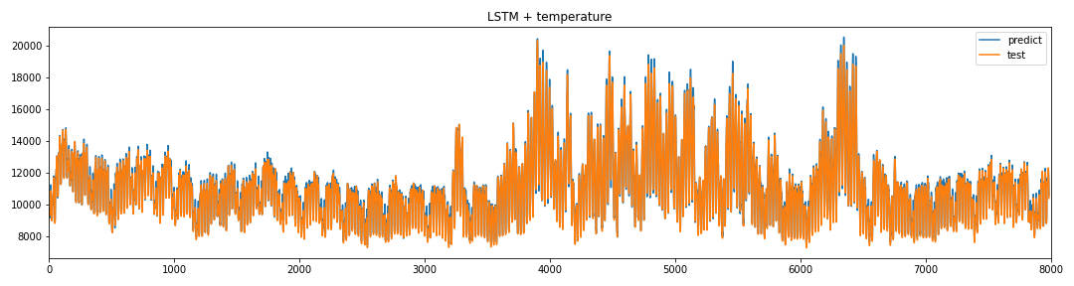
Results
Qualitatively, both models can satisfactorily predict hourly energy demands.

Slide 9
Results
Quantitatively, ARIMA performs better than LSTM. The performance of both models are better with additional features.
Model | RMSE
ARIMA | 188.8
ARIMA + temperature | 184.4
LSTM | 210.9
LSTM + temperature | 202.3

Slide 10
Conclusions and recommendations
Use ARIMA with temperature as exogenous features
Other strategies should be explored to improve these models:
Optimize hyperparameters and network architectures
Include additional weather features such as humidity, pressure, wind speed, wind direction, and weather condition

