Slide 1
PREDICTING THE PROPERTIES OF ORGANIC MOLECULES WITH NEURAL NETWORKS
Capstone presentation

Slide 2

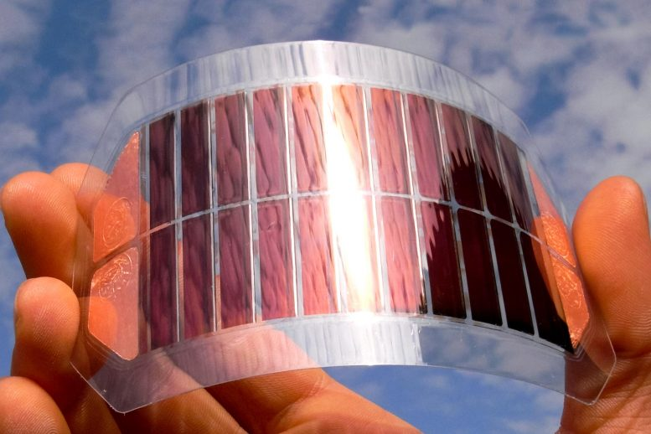
Background
Organic molecules are a promising building block for material because they can be light, transparent, flexible, and scalable.
Light emitting diode
Solar cell
https://www.oled-info.com/lg-display-expand-flexible-oled-production-800-million-investment
https://scitechdaily.com/new-flexible-ultrathin-organic-solar-cell-is-both-highly-efficient-and-durable/

Slide 3
Background
Several aspects of these technologies can be improved by selecting the “right” molecules out of billion molecules.
Using computational chemistry and performing experiment are too expensive and time-consuming.
One solution - machine learning prediction

Slide 4
Dataset
The dataset called QM9 was downloaded from quantum-machine.org.
The dataset contains 134K stable small organic molecules with up to 9 heavy atoms.
Each entry was calculated with density functional theory using the B3LYP/6-31G(2df,p) level of theory.

Slide 5
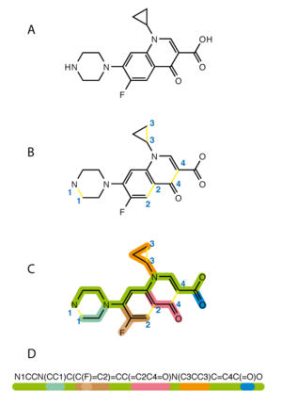
Dataset
Input: SMILES
Outputs:
mu - dipole moment
alpha - isotropic polarizability
homo - the energy of highest occupied molecular orbital
lumo - the energy of lowest occupied molecular orbital
gap - the difference between homo and lumo
r2 - electronic spatial extent
zpve - zero-point vibrational energy
U0 - internal energy at 0 K
U - internal energy at 298.15 K
H - enthalpy at 298.15 K
G - free energy at 298.15 K
Cv - heat capacity at 298.15 K.
https://en.wikipedia.org/wiki/Simplified_molecular-input_line-entry_system

Slide 6
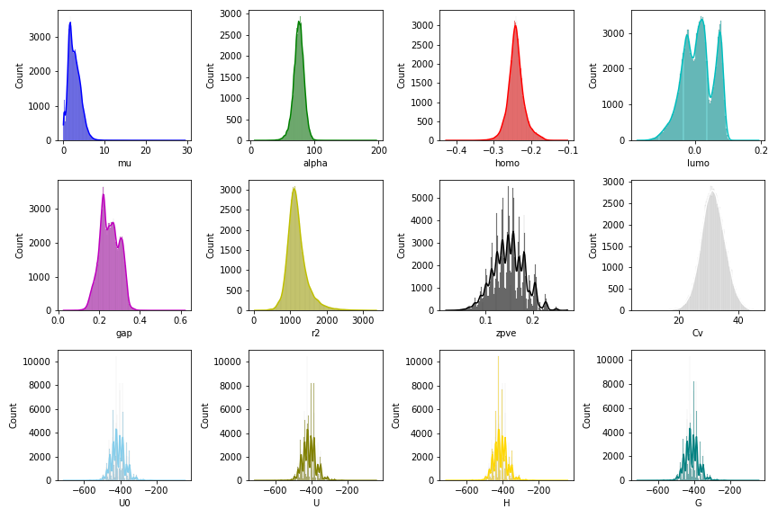
Exploratory data analysis (EDA)
It can be observed that most of these properties contain extreme values and large variation in scales.

Slide 7
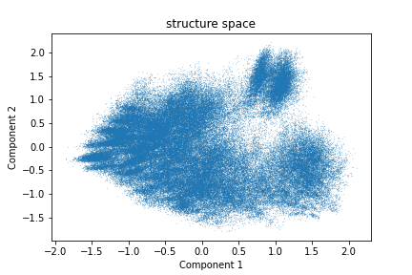
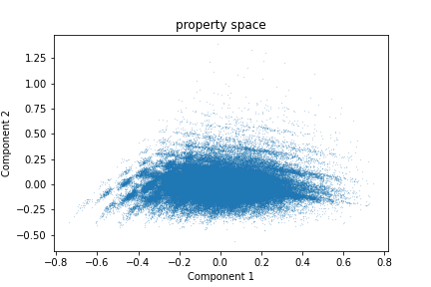
Exploratory data analysis (EDA)
For the structure space, the 133K molecules appear to be nicely distributed.
For property space, a significant amount of data points contain extreme values.

Slide 8
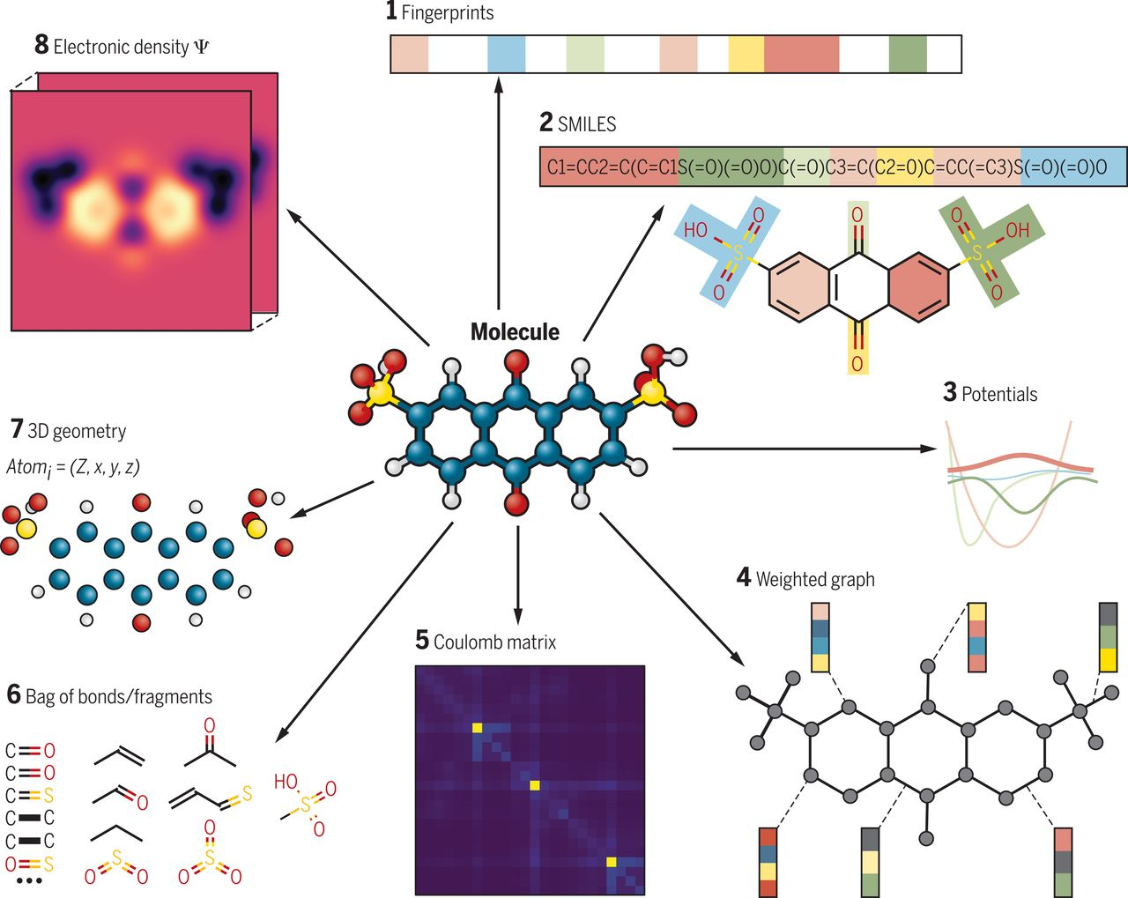
Modeling and parameters
Many ways can be used to represent molecules, resulting in different level of accuracy and generalizability.
Here, graph-based method called Message Passing Neural Networks (MPNN) will be used.
https://www.science.org/doi/10.1126/science.aat2663

Slide 9
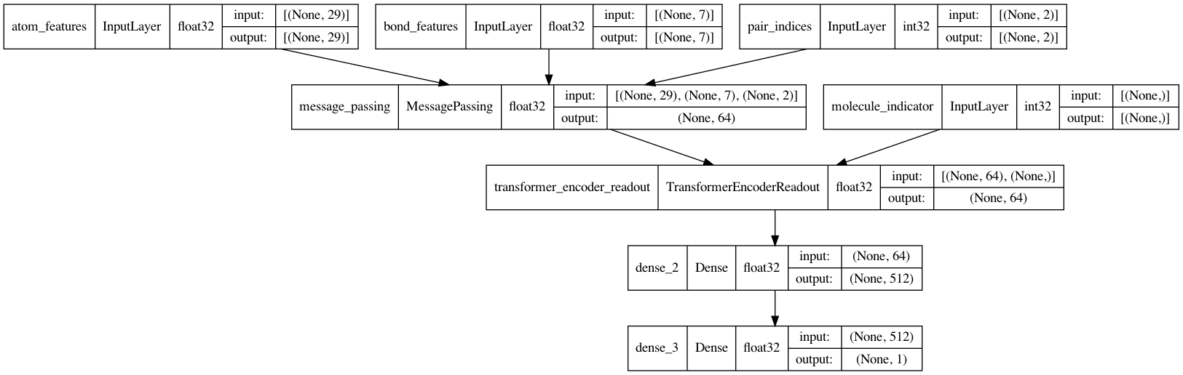
Modeling and parameters
The whole architect include features, message passing unit, encoder readout, and neural networks.

Slide 10
Modeling and parameters
For this dataset, the train/test ratio was 80/20. Within the training set, 20% was used as a validation set.
A total of 50 epochs training, mean squared error loss, and Adam optimizer.
Model | Hidden layers | Nodes per hidden layer
1 | 1 | 512
2 | 1 | 256
3 | 1 | 128
4 | 2 | 512
5 | 2 | 256
6 | 2 | 128

Slide 11
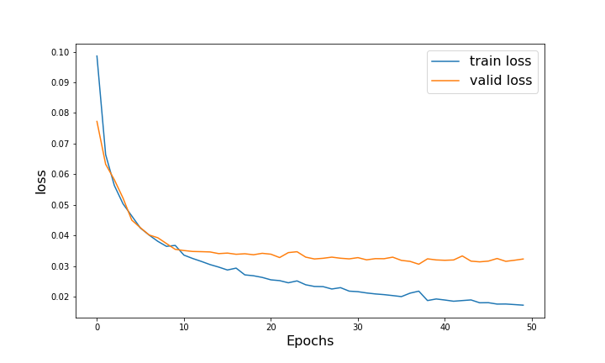
Results
Training with 50 epochs is sufficient for this dataset. The same is true for 100 epochs.

Slide 12
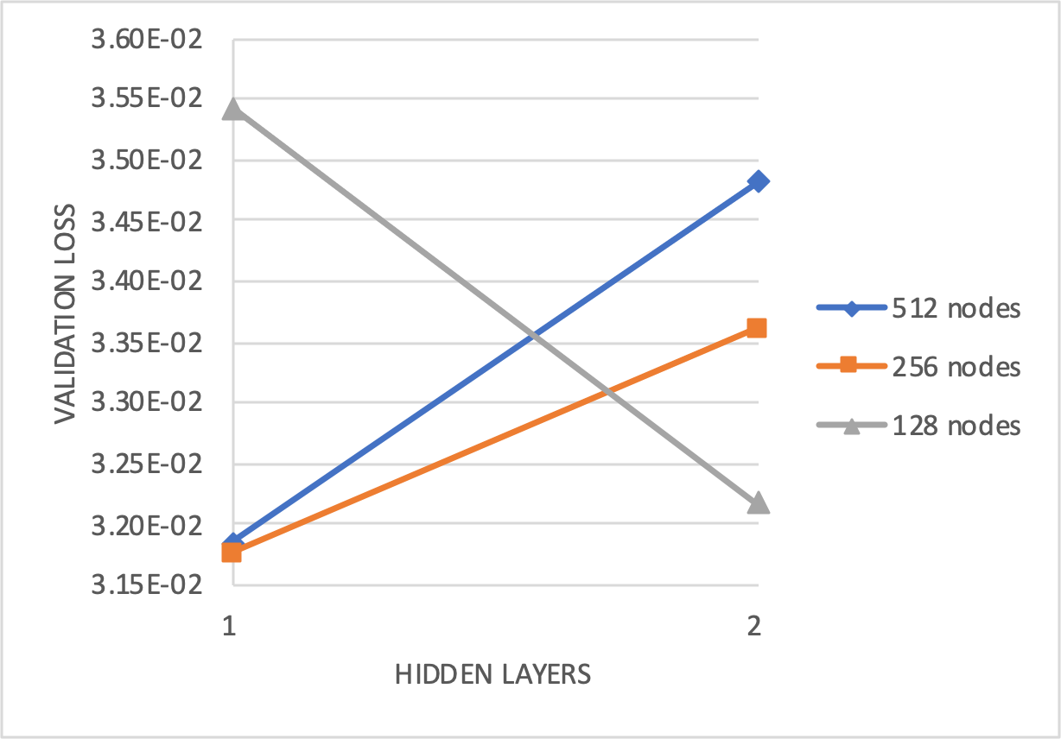
Results
The best architectures are 256 and 512 nodes with one hidden layer.

Slide 13
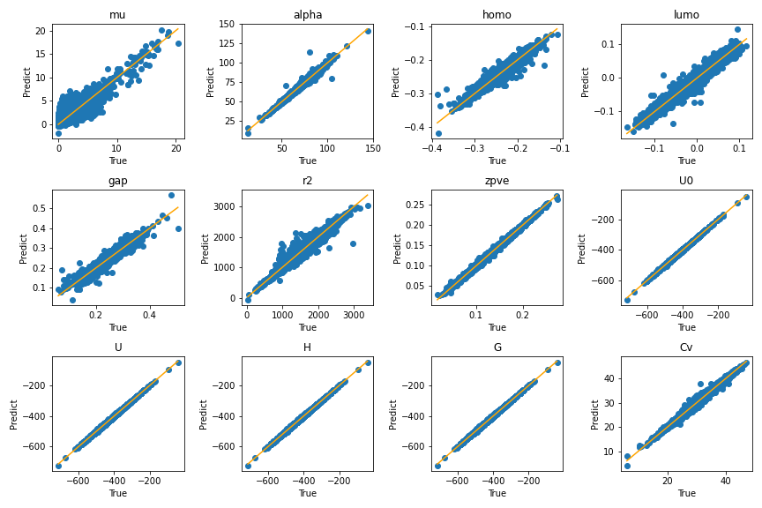
Results
The accuracies are different between properties (r2 between 0.79 and 0.99).

Slide 14
Conclusions and recommendations
The exercise confirms that the MPNN can accurately predict molecular properties.
Best architectures: 256 or 512 nodes with 1 hidden layer
Optimization: features, MPNN, transformer, network architectures, optimizer, and loss functions
Future improvements: more diverse chemical dataset with transfer learning

