Slide 1
World Happiness Report
Analysis for executives

Slide 2
Happiness data
The World Happiness Report is a publication of the United Nations Sustainable Development Solutions Network.
Here, we will be comparing year 2015 versus 2019 based on 158 countries.
Questions we are asking:
What makes them happy?
Are people happier between 2015 and 2019?
Are they going to be happier in the future?

Slide 3
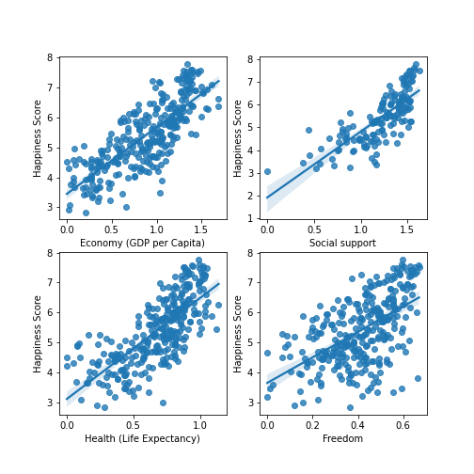
What do correlate with happiness?
Happiness is correlated with:
Economy
Social support
Life expectancy
Freedom

Slide 4
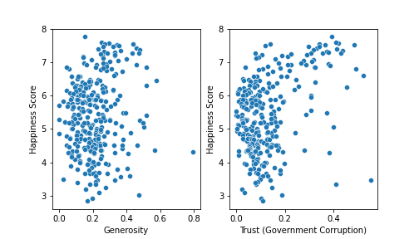
What do not correlate with happiness?
Happiness is uncorrelated with:
Generosity
Trust in their government

Slide 5
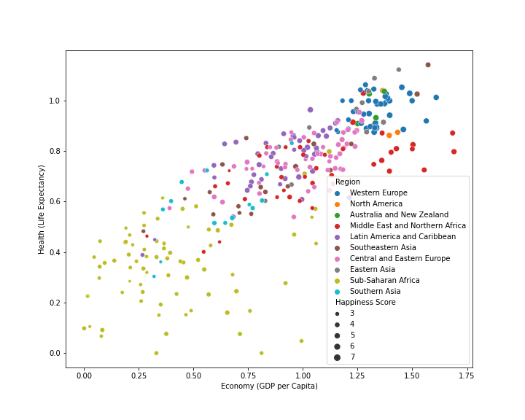
Interrelated factors for happiness
Many factors are related:
Economy and health quality are related.
Better economy/health translates to more happiness.

Slide 6
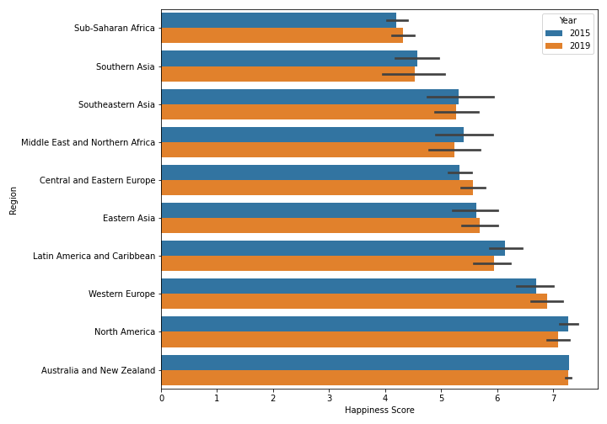
Any improvement between 2015 to 2019?
Between 2015 and 2019:
No major changes in happiness between this period for all regions.

Slide 7
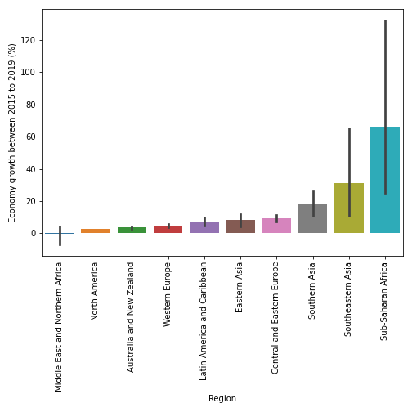
Will people eventually be happier?
Yes! Very likely:
Sub-Saharan Africa, Southeastern Asia, and Southern Asia have the highest economic growth between this period.
It is possible that this will lead to higher happiness.

Slide 8
Summary
To improve happiness, we must emphasize on Economy, Social support, Life expectancy, and Freedom.
Regions in Sub-Saharan Africa, Southeastern Asia, and Southern Asia need assistance in improving Economy and Life expectancy.
Lastly, there is hope. These low-happiness regions have the highest economic growth between 2015 and 2019.

