Slide 1

EditDesk (Client Portal)
-Designed for video editors, freelance creatives, and creative agencies.
-Developed to simplify communication, project tracking, deliverable approvals, and payment management.
Tanishq Mehta | GT Edits

Slide 2
CONTENTS
Problem Statement and Solution
System Architecture
Objective
Future Implementation
Key Features
Conclusion
Workflow

Slide 3


Problem Statement
Client communication is scattered across WhatsApp, emails, and other platforms.
Time consuming project tracking and deadlines from both client side and freelancers
Difficult to keep track of client feedbacks.
Difficult to manage payment records
Not proper client brief , clear vision not understandable.
File sharing and client folder management across platform.

Slide 4

Solution
AI Planner
Centralized portal for both freelancers and clients.
AI Brief Generation from simple text and AI Cost Estimation
Real time project information and work status and organized deliverable reviews and revision tracking.
Automation
Email Updates
Invoice Generator , Google Drive Automation ,
Payment Balance Calculations
Admin : New Request; Deliverable Approve/Revision/Reject
Client : Work Request Approve/Reject ; Deliverable Upload ; Payment Reminder

Slide 5


Objective
Simplify client–editor communication.
Improve project and deadline management.
Automate repetitive administrative tasks.
Make payments and invoices more transparent.
Reduce confusion during revisions and approvals.
Use AI to improve project scoping and planning.

Slide 6


Key
Features
Features that helps both client and freelancer

Slide 7
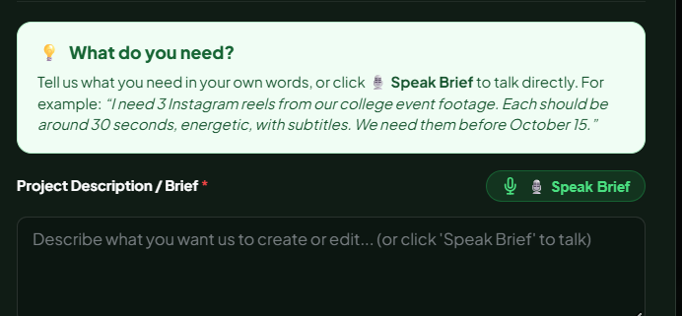
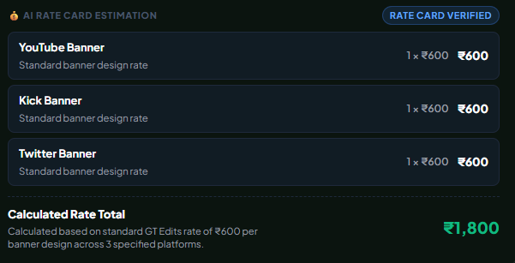
AI Brief Planner and AI Cost Estimation
Innovation
Smart Cost Estimation
Our AI Brief Planner uses Google Gemini API to turn client requirements into a clear project brief. It finds missing details, asks questions, suggests deadlines, and recommends suitable file formats.
Our AI estimates project costs by identifying keywords in client requests and matching them with a predefined rate chart.
Time Efficiency
Customer Focus
It reduces manual work by helping admins prepare project briefs, estimate costs, and plan project timelines faster.
It helps clients share their requirements clearly and understand the expected cost, timeline, and deliverables, making the overall process easier and smoother.

Slide 8
Google Drive Automation
Integrates with Google Drive API v3.
Automatically creates dedicated client folders.
Also has quick deliverable for admin panel.
Reduces manual file organization and repetitive setup work.
Admin: View and manage new work requests.
Admin: Approve, request revisions, or reject deliverables.
Client: Approve or reject work requests and upload deliverables.
Client: Receive payment reminders and track pending payments.
Email Updates

Slide 9
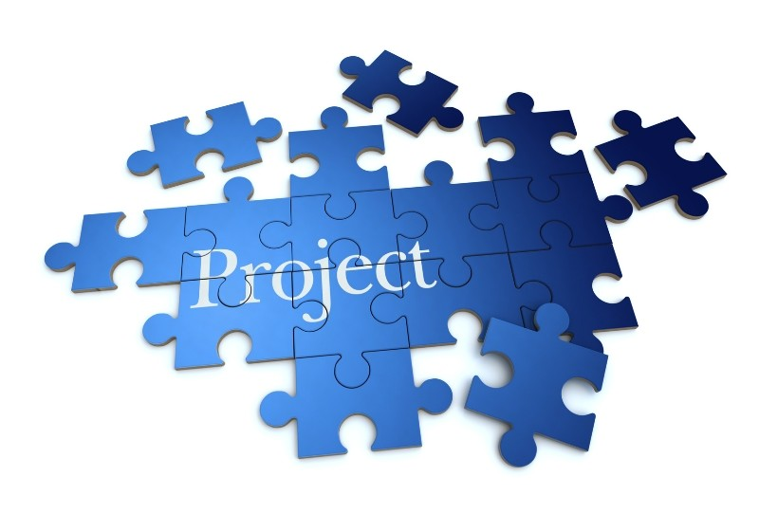
Deliverables, Revisions & Payment Management
Supports video/image uploads and external file links.
Centralizes deliverable reviews, approvals, and revision requests.
Maintains revision history and client feedback for clear communication.
Automatically generates professional PDF invoices.
Tracks advance payments and calculates the remaining balance.

Slide 10
Workflow
Client Work Request
AI Planner
Admin Review
Project Kickoff
Production & Delivery
Client Review
Billing & Payment Remainder

Slide 11

System Architecture
Frontend
AI Service
React provides the user interface for administrators and clients.
Gemini analyzes client briefs and assists with project planning.
Backend
Cloud Integration
Express.js handles API requests and application logic.
Google Drive manages client folders and file organization.
Authentication
Database
Firebase manages user authentication and real-time data synchronization.
MongoDB stores project, deliverable, and work request information.

Slide 12


Future Implementation
Expand EditDesk to support multiple creative teams and agencies.
AI financial analytics and revenue reports.
Automated Payment Reminders: Notify clients about pending payments and upcoming due dates.
Real-Time Chat: Enable direct communication between clients and editors within the portal.
Google Auth Login from client and 2FA.

Slide 13
Conclusion
EditDesk brings project management, client communication, deliverable approvals, and payment tracking together on a single platform. Its AI Brief Planner transforms rough client requirements into structured project briefs, while automation reduces administrative workload and improves workflow efficiency. Overall, EditDesk aims to make creative collaboration more transparent, organized, and professional.

Slide 14
Thank you
Tanishq Mehta – D25IT120

