Slide 1
For the first project, as a BI developer working for a fictional market research firm called Market Minds. The client is a small food and beverage retailer that recently launched six marketing campaigns. They’re still learning about their market and customers, and have provided a sample marketing dataset.
The client wants insights on:
Campaign performance
Product performance
Customer demographics or behaviour
Key factors driving campaign success and buyer decisions
We’ll build a Power BI dashboard using only native visuals—no DAX or coding—yet still aim to deliver powerful, insightful visualizations.

Slide 2
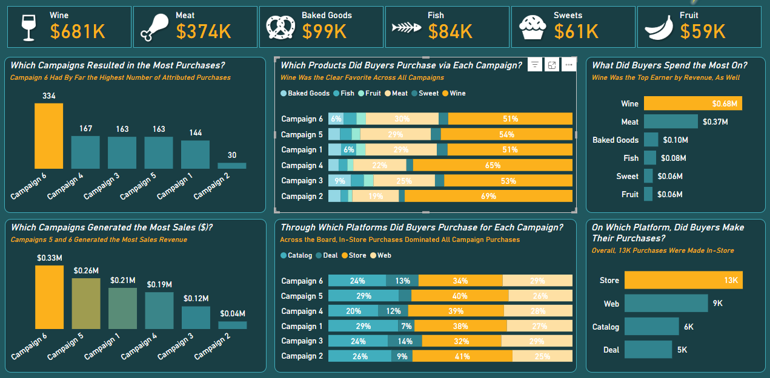

Slide 3
