Slide 1

My Fitness Diary
Gwantea Lee

Slide 2
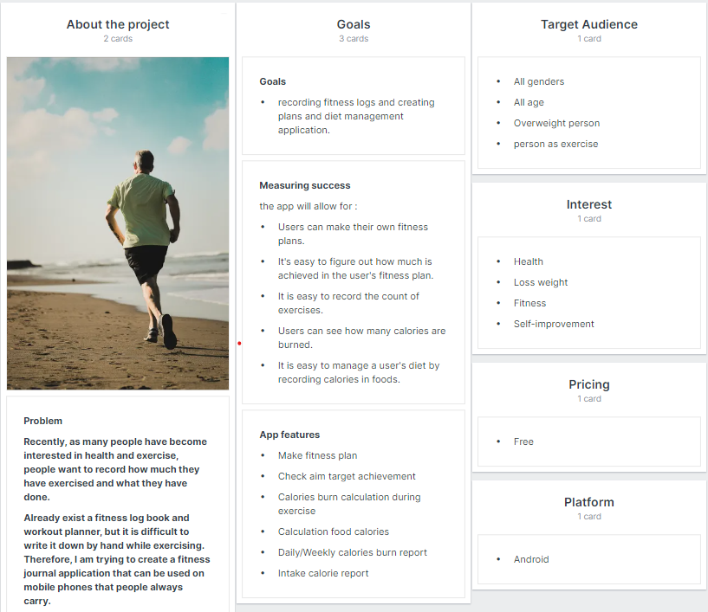
Brief

Slide 3
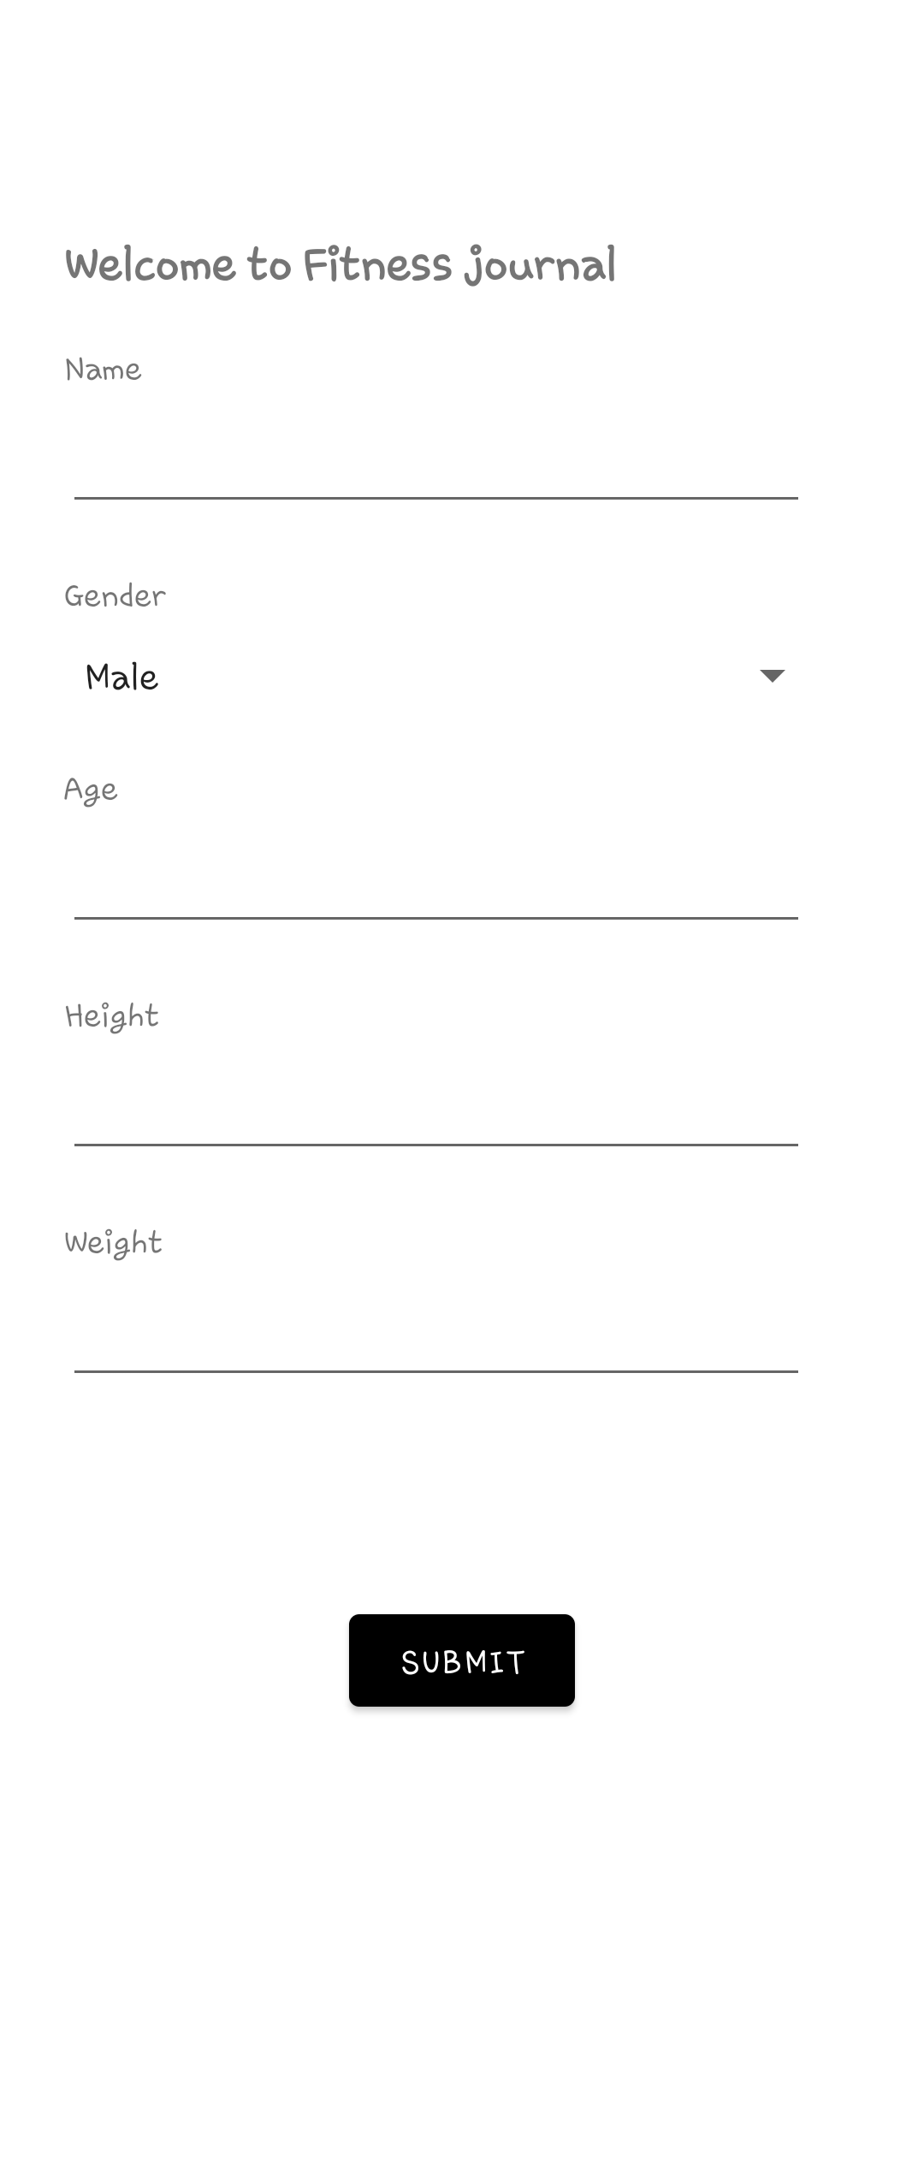
Enter user information screen
We need the user's information (age, gender, height, weight) to calculate user's BMR or calories burned.
This screen shows only once when the user first runs the app.

Slide 4
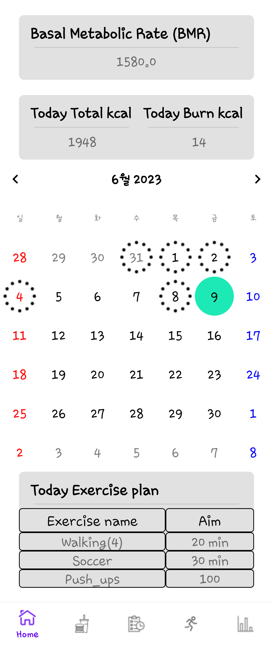
Home screen
The users can see their basic metabolic rate, calories consumed today, calories consumed, and exercise plans.
The user can use a calendar function that allows the user to create an exercise plan for the desired date.

Slide 5
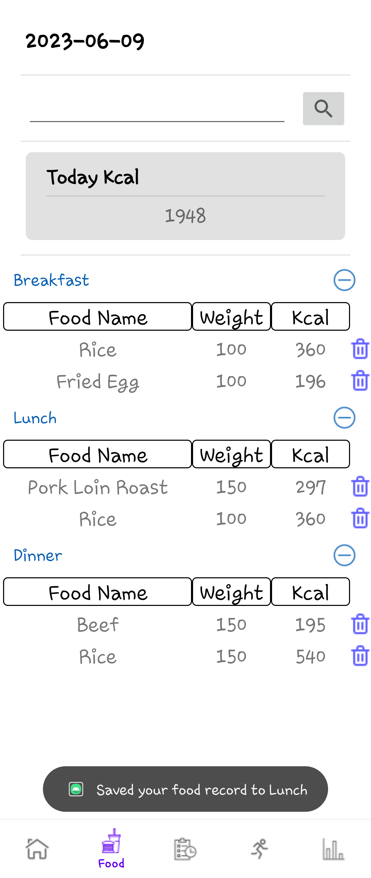
Diet management screen
Users can search for the name of the food they ate, find it, and go to the input window where they write down their weight or calories
Users can see all the calories of the food they ate today.
Users can get a detailed look at the food they recorded, weight, and calories divided by mealtime.
If the user made a mistake, the user can delete the record.

Slide 6
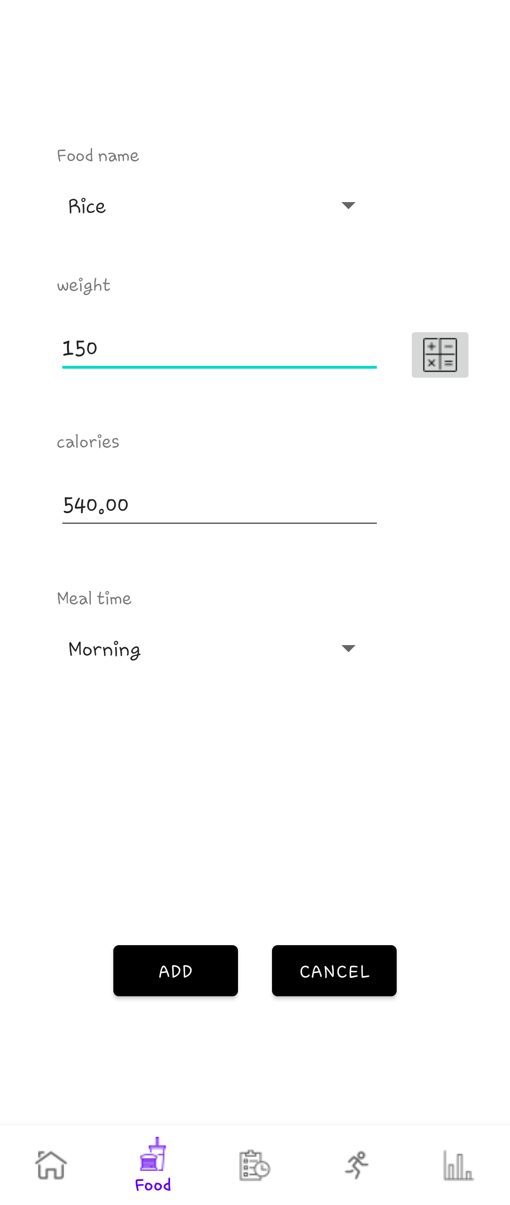
Food details input screen
Users can automatically calculate calories by entering the weight of the food they ate and pressing the calculation button.
Users can select and record mealtimes for effective diet management.

Slide 7
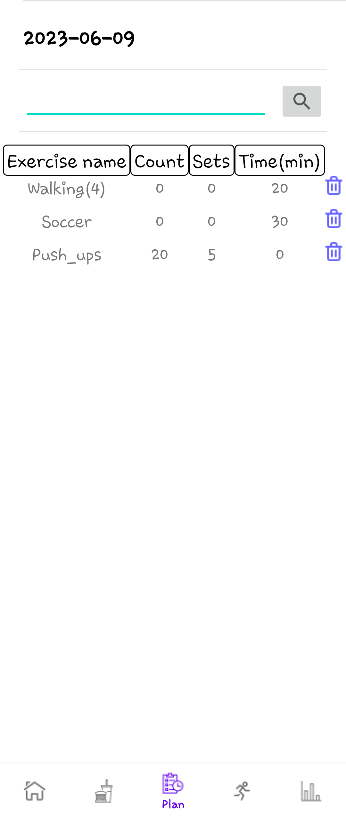
Exercise plan screen
Users can create an exercise plan by searching for the exercise they want.
Users can easily see their exercise plans.
If the user made a mistake, the user can delete the plan.

Slide 8
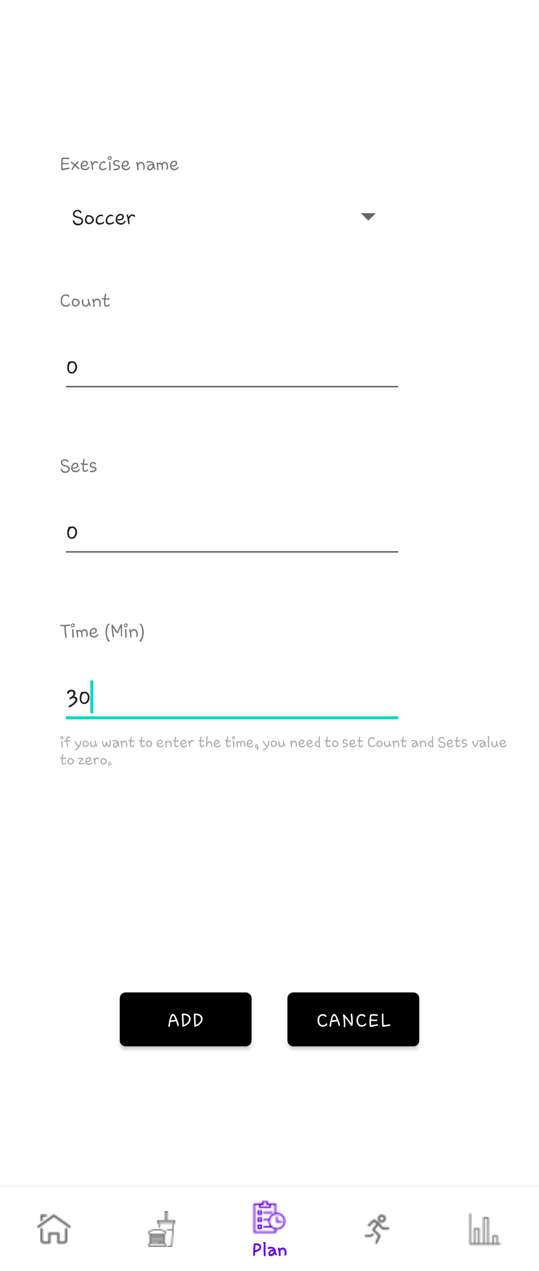
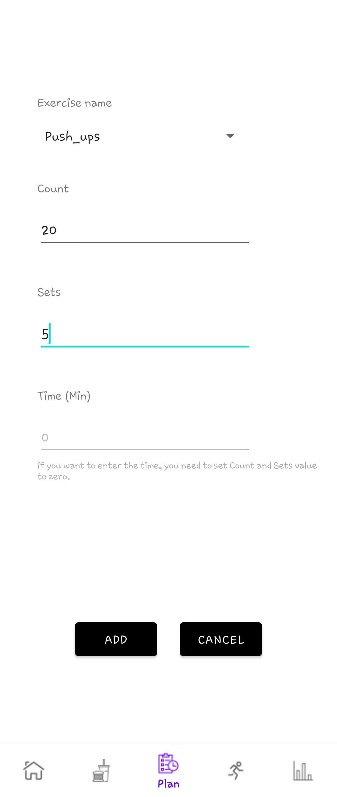
Exercise plan detail screen
Users can enter detailed plans for the exercise they searched for.
Users can set goals by writing down the time or counts of exercise.

Slide 9
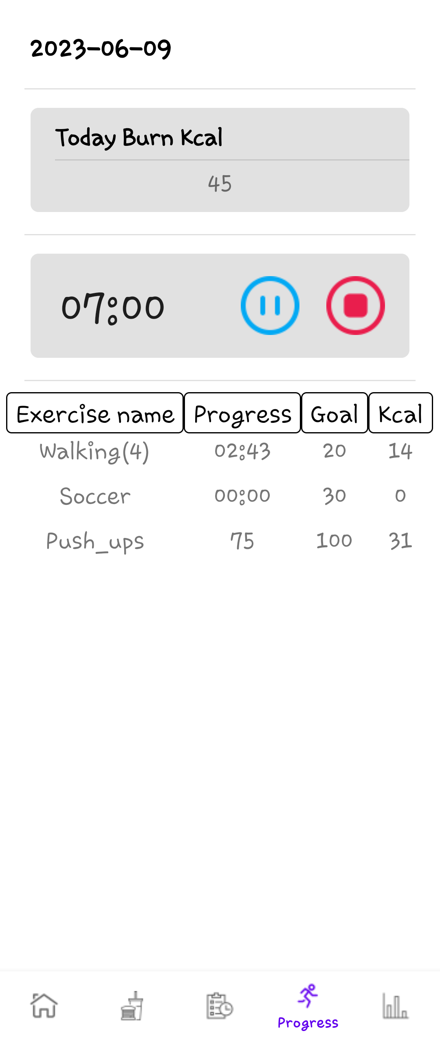
Exercise progress screen
The user can use the timer to know how much exercise he has exercised.
When the user plays in exercises that do not require a timer, the user can manually input their own counts.
The user can see how many calories they burned for each exercise.
The timer will continue to work even if the user uses a different screen or app.

Slide 10
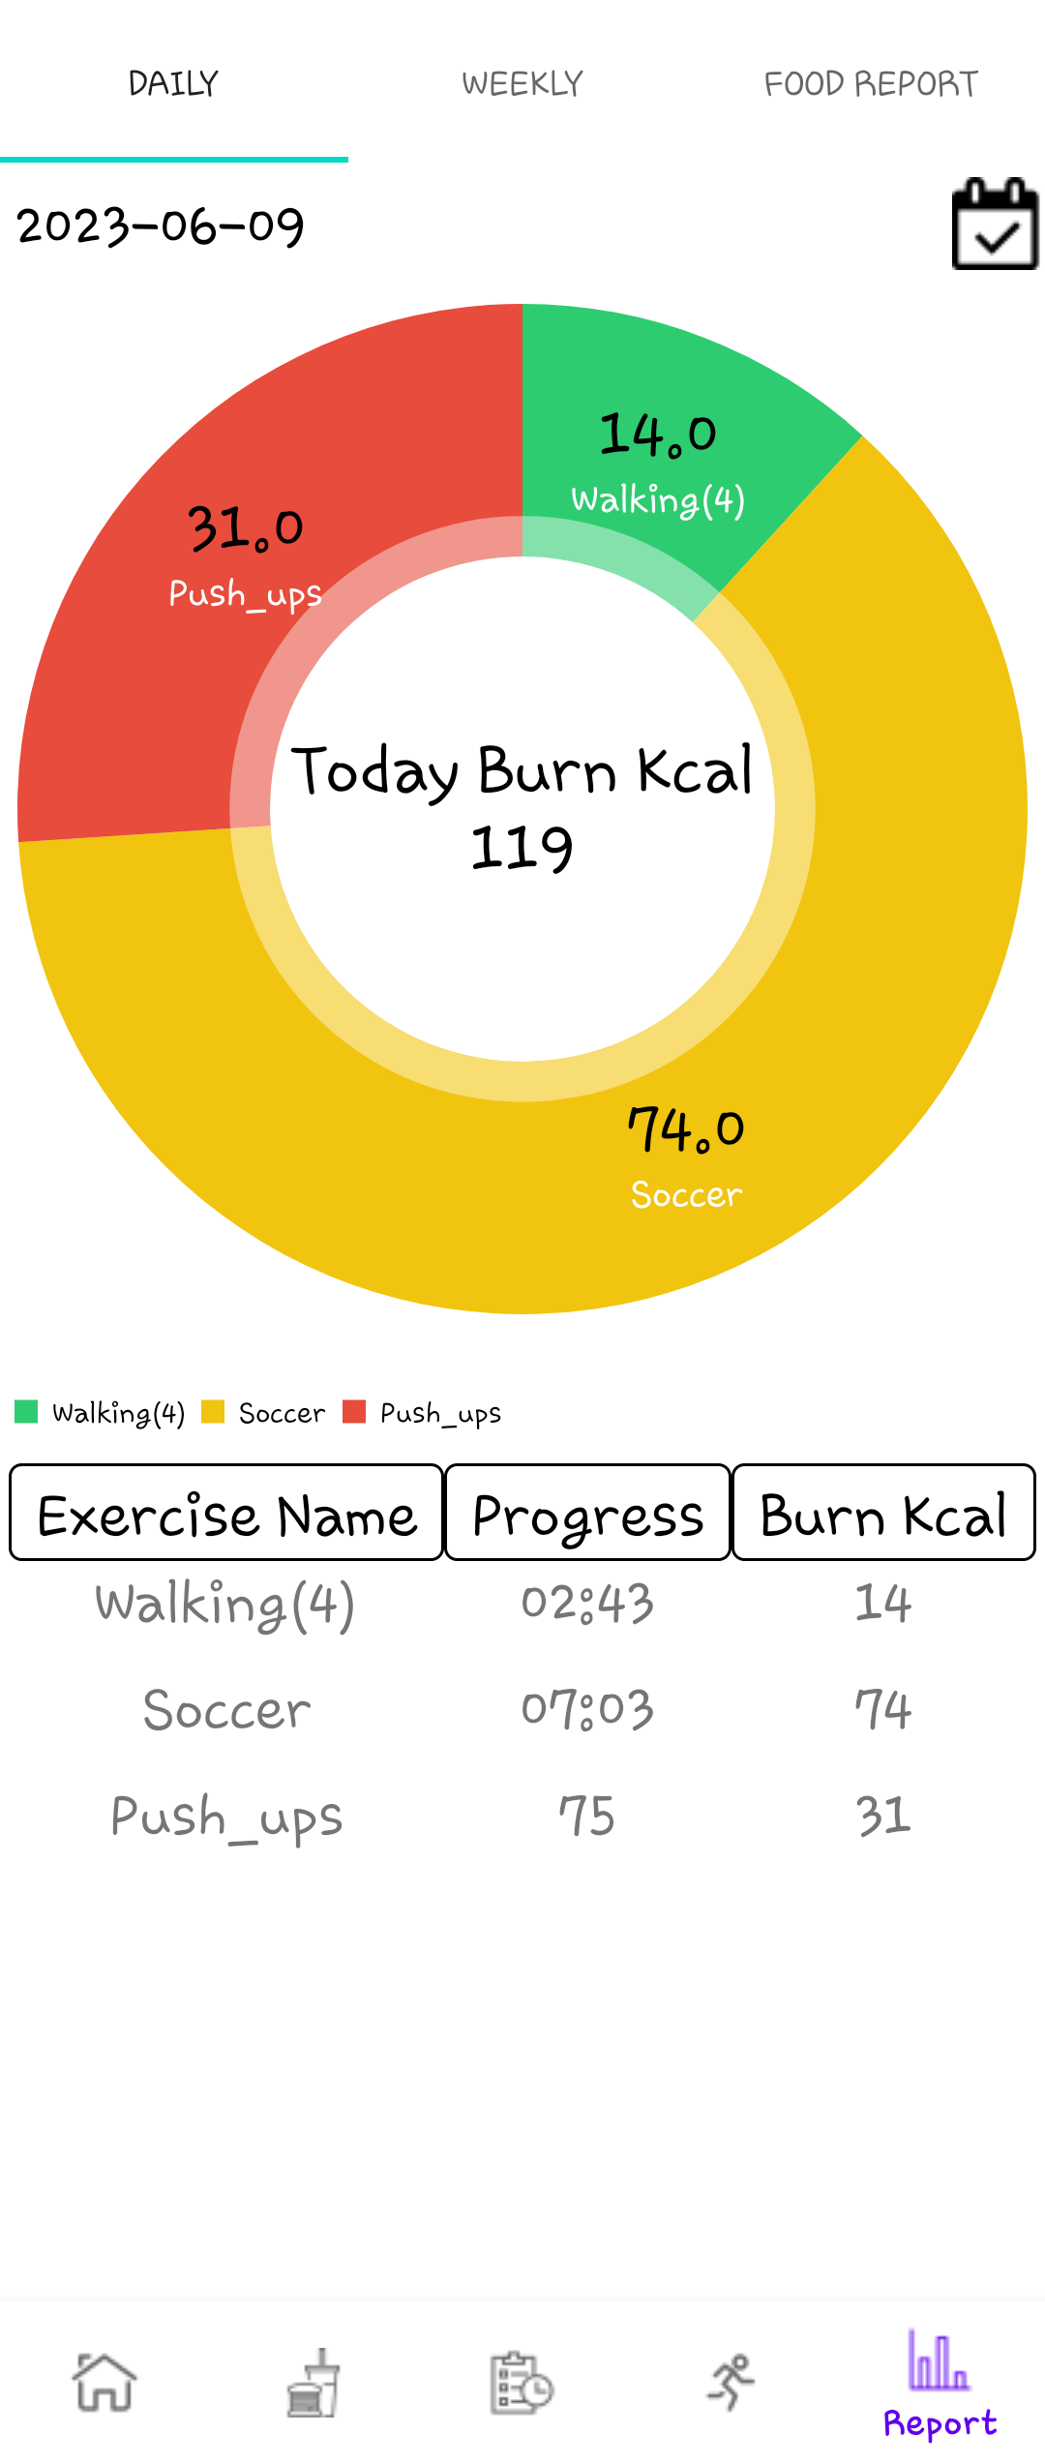
Daily report
Users can view the day's fitness record by selecting the desired date from the calendar.
The user's exercise history can be easily viewed by the user using pie charts and tables.

Slide 11
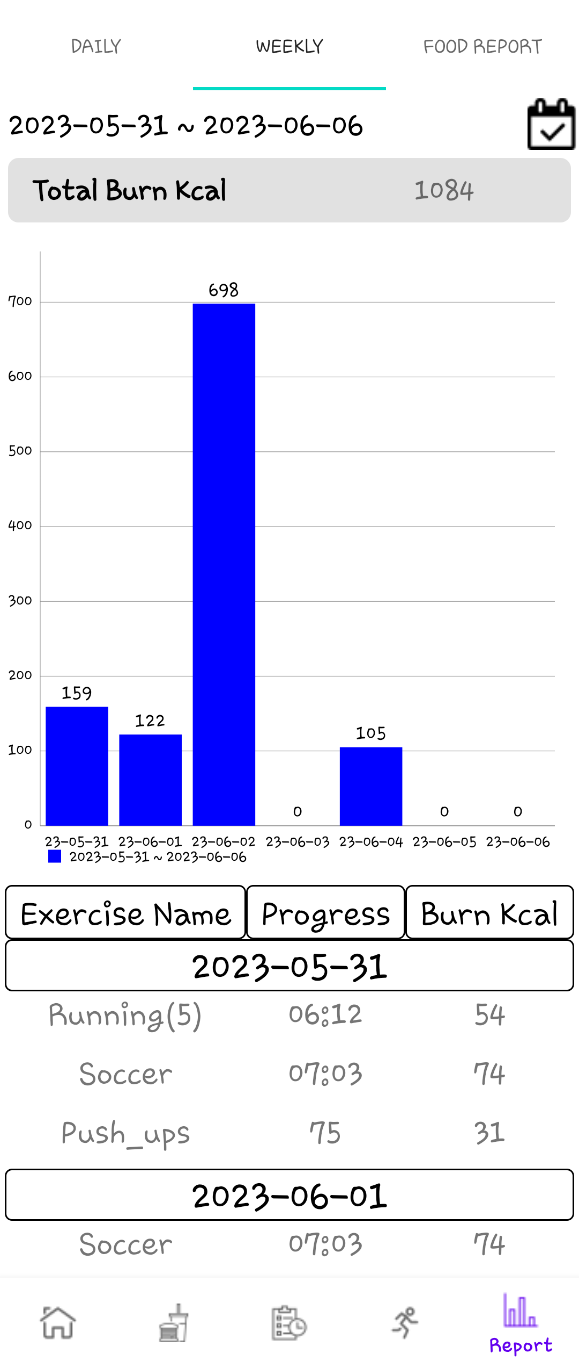
Weekly report
The user can view the exercise history of the selected range date by selecting the desired range of dates in the calendar.
The User can easily view their exercise records through bar graphs and tables.

Slide 12
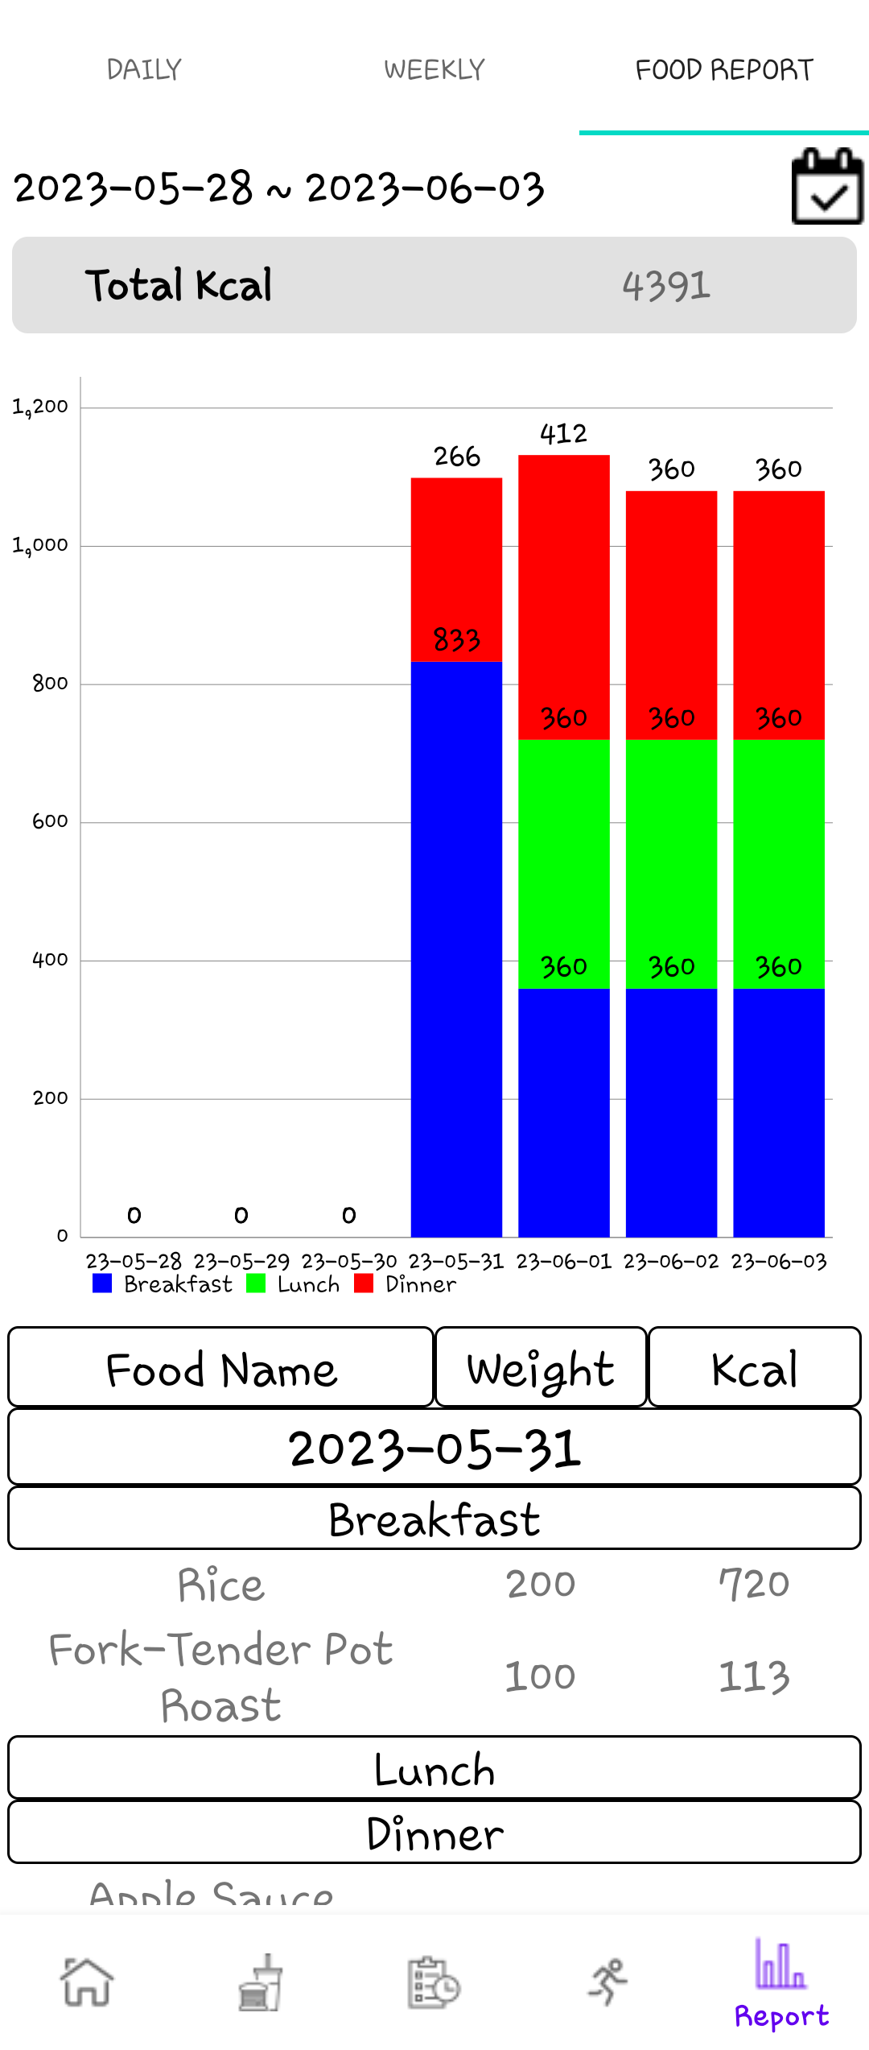
Food report
Users can view the diet records of the selected range date by selecting the desired range of dates in the calendar.
Users can easily view their diet records through stacked bar graphs and tables.

Slide 13
Thank you

