Slide 1

Web Recipe Project UI
Gwantea Lee Geunmok Song

Slide 2
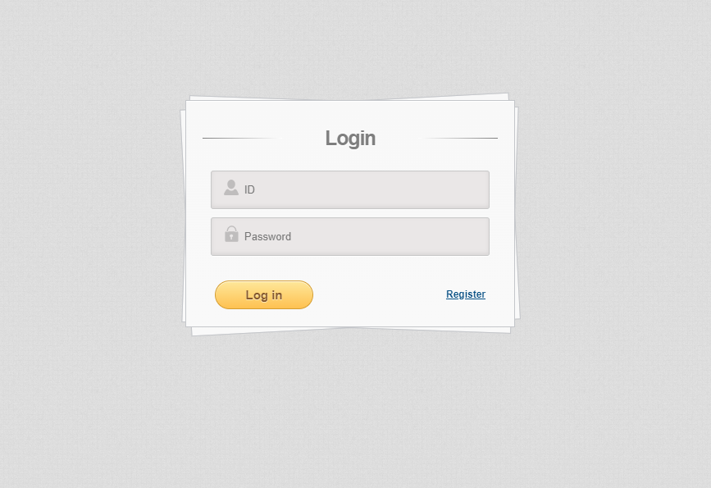
Login UI
Users can log in using their registered information.

Slide 3
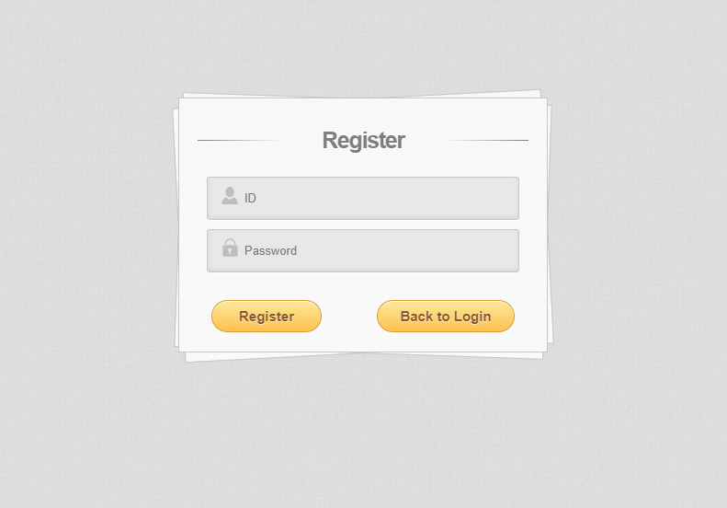
Register UI
Users can register their accounts by entering their information.

Slide 4
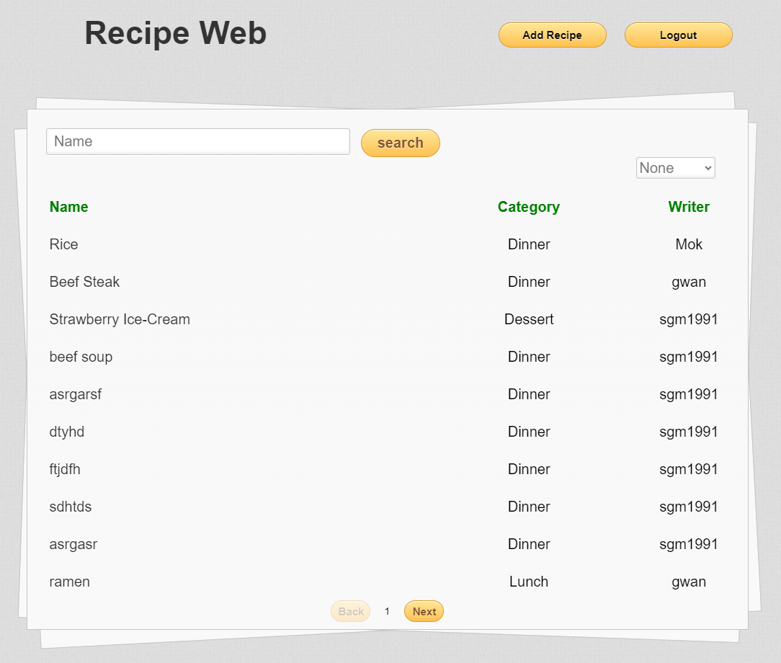
Recipe List
Users can search and explore other people's recipes using various categories or keywords

Slide 5
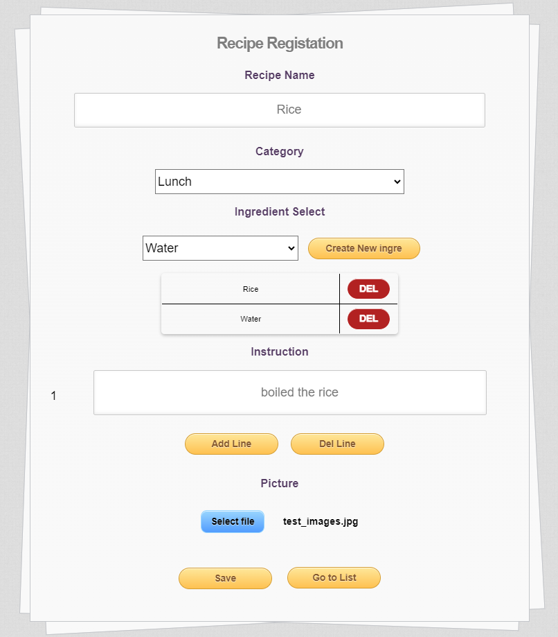
Recipe Add UI
Users can write and upload their own cooking recipes.

Slide 6
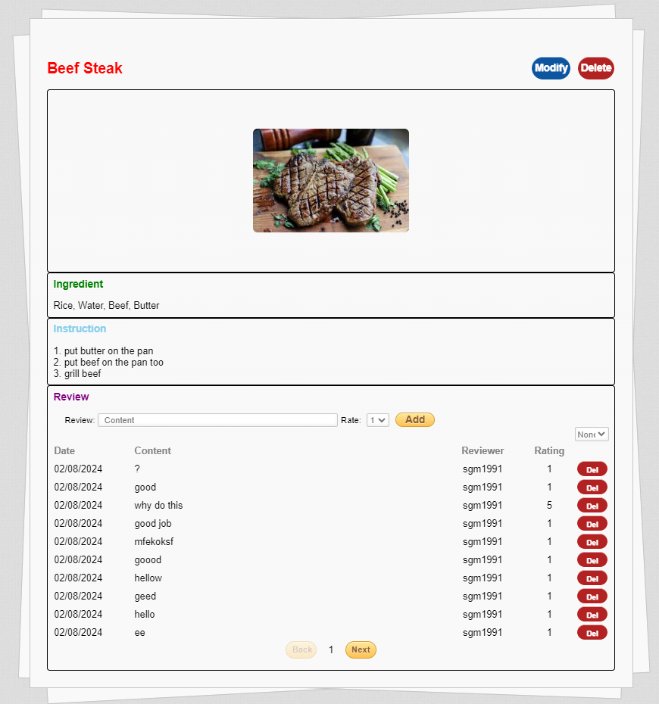
Recipe Detail UI
Users can get details of the ingredients or recipes of food
Users can leave comments on each recipe and rate them with a rating.

Slide 7
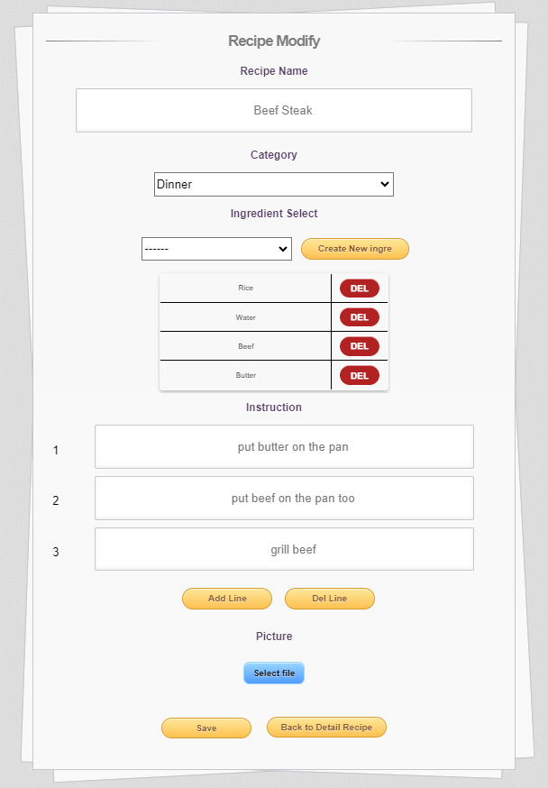
Recipe Modify UI
Users can modify their own cooking recipes.

Slide 8
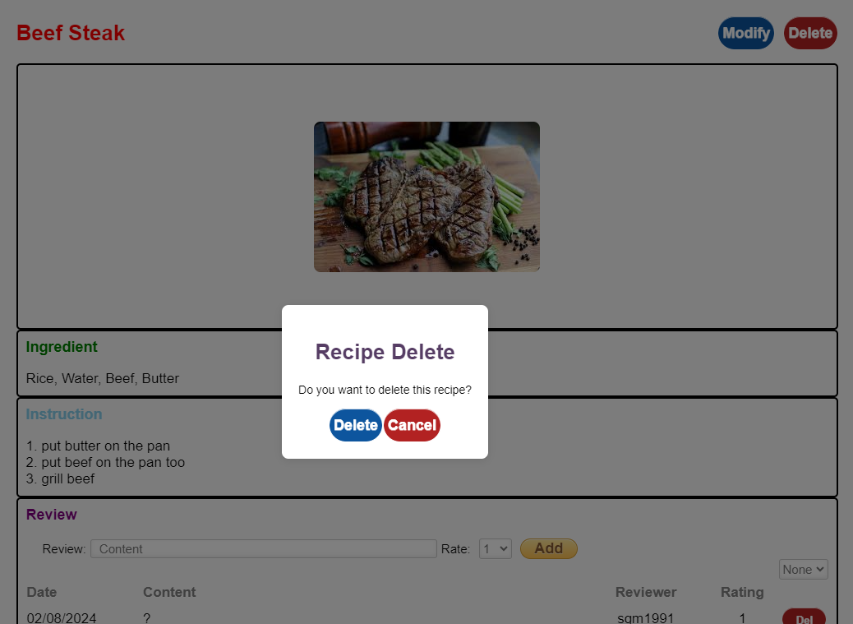
Recipe Delete UI
Users can delete their own cooking recipes.

Slide 9
Thank you

