Slide 1
Tokenization
Meet up 22.03.2024

Slide 2
Agenda:
We need a way to organize who is doing what - ARCI
We need a clear idea of what we are doing and how: SMART
Updates on sub-tokenization

Slide 3
Structure: ARCI
Accountable: Who is accountable for the project, who manages the project and the team
Responsible: Who is responsible for the delivery of the project, who is committed and involved in making the project
Consulting: Who is consulted on the project, gives advice but is not committed or involved to actually making the project deliverables
Informed: Who is informed about the project but is not really part of it

Slide 4
Accountable:
Manages the team
Sets deliverables and who is responsible for it
Set time/deliverable commitment:
biweekly meeting – 1h , 10 min presentation per person
Name: Geoffrey

Slide 5
Responsible:
Makes the project
Set time/deliverable commitment:
Time: biweekly meeting – 1h , 10 min presentation per person,
Deliverable:
Names: Piotr, Murilo, Paschoal, Geoffrey

Slide 6
Consulted:
Gives advice on the project
More needs-based time commitment or set “consulting” time
Needs based / set time:
Names:

Slide 7
Informed:
Is informed that the project is going on but not involved in it:
No set time commitment
Names: Ben Davis, Mark Basham, Dave Ross

Slide 8
Goals: SMART
Specific: What exactly does success look like?
Example: Git-hub repository which most people in the field can use to make a new type of tokenisation of protein sequences based on structure
Measurable: How do we know we achieved our goal?
Example: we have the public repo and publish a paper exploring the new tokenisation method
Actionable: Are there clear actions we can take to achieve our goal?
Examples: build initial sequence to structure code, build code package to
Realistic: is this realistic
Example: Yes!
Time bound: What is our timeline, what are our self-imposed deadlines?
Example: in 4 weeks have POC, in 6 weeks tokenize 1M protein, 12 weeks retrain some model on our tokens and compare change in performance
2 weeks time: how can we sub-tokenize a 2ndary structure

Slide 9
Action points:
What? 3-5 ideas per person
BLOSUM – use to do clustering of subsequnces in 2ndary structure*
Read papers – provide at least 1 reference for whatever strategy you want to propose at the meeting
Who?
When? In 2 weeks

Slide 10
Example:
Who? Piotr
What? prepare a short (8min) presentation on how do we find biologically sensible repeating units in the 2ndary structures that can be used like prefixes/suffixes
give background info
suggest solutions
write code to try to execute 1 solution
When?: next meeting

Slide 11
Report:
What? prepare a short (10min) presentation on how do we find biologically sensible repeating units in the 2ndary structures that can be used like prefixes/suffixes
give background info
suggest solutions
write code to try to execute 1 solution

Slide 12
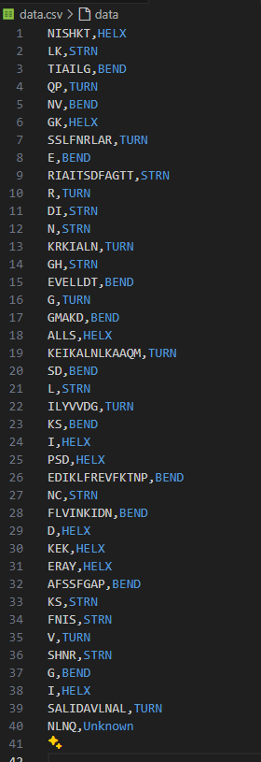
Give background info
Current code function:
UniProt Accesion Code:
"A2BC19"

Slide 13
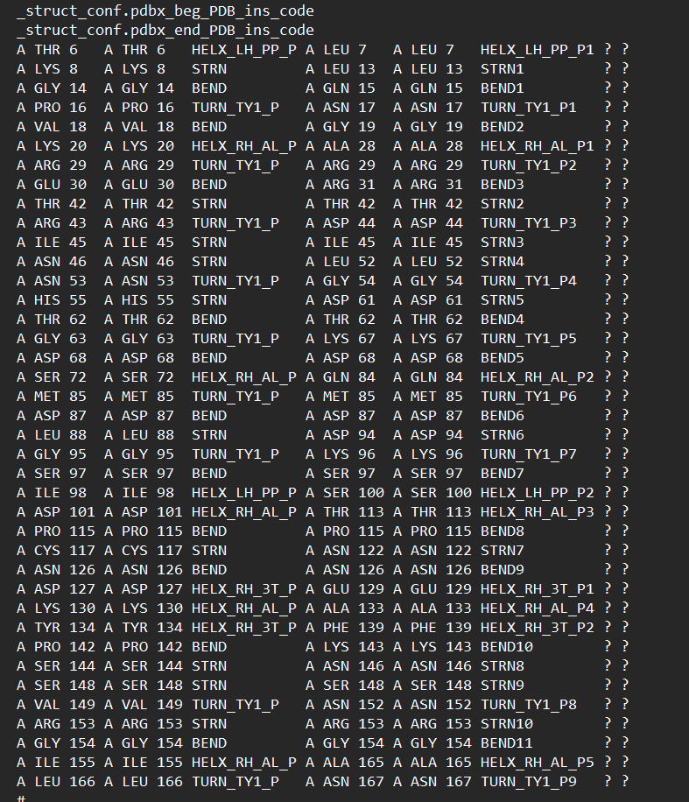
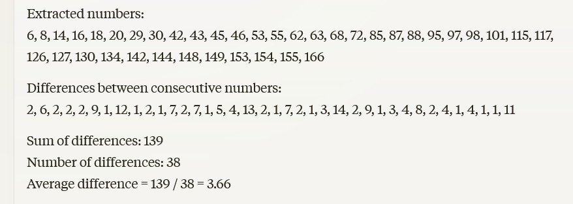
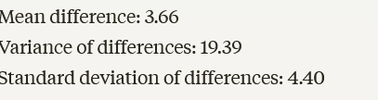

Slide 14
Comments:
The current code is not classifying “unstructured regions”
Either misclassify if at the beginning or in middle
Classify as unknown if at end
The more precise 2ndary structure annotation might actually be as granular as we want
Increasing corpus size perhaps should focus on clustering sequences classified as some specific 2ndary structure

Slide 15
Increasing corpus size
focus on clustering similar sequences classified as some specific 2ndary structure
Ways to cluster similar repeats together:
Substitution matrix closeness
Embed with biochemical+geometric properties and perform some centroid clustering
Embed with amino-acid embeddings from some pre-trained LLM and perform some centroid clustering

Slide 16
Increasing corpus size
Focus on finding the most informative subsequence's
Use some tokenization method on the tokens made via 2ndary structure to find repeating substring

Slide 17
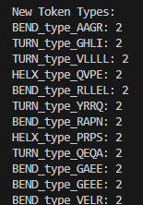
Increasing corpus size
Focus on finding the most informative subsequence's
Use some tokenization method on the tokens made via 2ndary structure to find repeating substring
"A2BC19"

Slide 18
Increasing corpus size
Cap the length of any string making a token?

