Slide 1

MAAS:
Ubuntu’s version of a bare-metal installer
David Collier-Brown
davecb@spamcop.net
Notes:
Yes, some of us do know Jack, but this talk isn't for them
Title stolen from the ACM Queue series of the same name, and addressed to the same audience, such as GTALUG.
They're the target market: intelligent, interested and don't know Little's law

Slide 2
The Nominal Problem
Sometimes, you need to rent out real machines
  VMs have some unpleasant overheads, and
  you don’t find many 128-socket Intel machines.
I actually needed to install OS images in a bunch of racks
  We expected to run containers on the machines, but installing from a lights-out-management board doesn’t scale

Slide 3
Requirements Time!
PXE-boot a machine
Install an OS image, quickly
Then either
  give it to a selected user to sysadmin
  or
  put it into our OpenStack cluster
Later, put a different image on it,
Or maybe reload *!$@^#^!^ Windows.

Slide 4
Non-Requirements
Be able to smash the machine any time
  Especially by accident when doing a different cluster
Be able to interfere with DHCP across the whole company
Have it reject non-Ubuntu images

Slide 5
How it works
Install MAAS manually
Prep the machines for a manual PXE-boot (hmmn, wasn’t that what I was trying to avoid?)
Register them with MAAS
“Commission” them (suck them into MAAS)
“Deploy” them to their sysadmins
“Release” (steal them back) to the pool

Slide 6
Install MAAS manually
Boot and install from the lights-out manager (double hmmn)
Same as a manual Ubuntu install
apt-get install maas
Download some images

Slide 7
Prep the machines for a manual first boot
Get the target machines ready to PXE-boot
Create a non-public network and put it on the bootable interfaces of the targets
  We have Dell R515s so that’s le0 only
  Moved the regular net to le1
Power-cycle and press F12 (the only time)
Watch the MAAS and lights-out manager consoles
Debug it

Slide 8
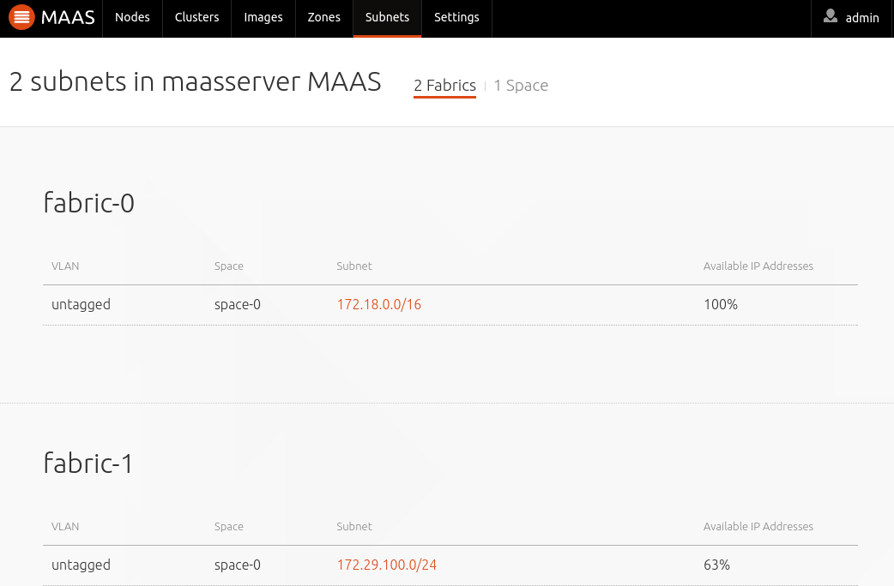
Networks

Slide 9
“Commission” them
Set up their config
Press “Commission”
Wait for them to become “Ready”

Slide 10
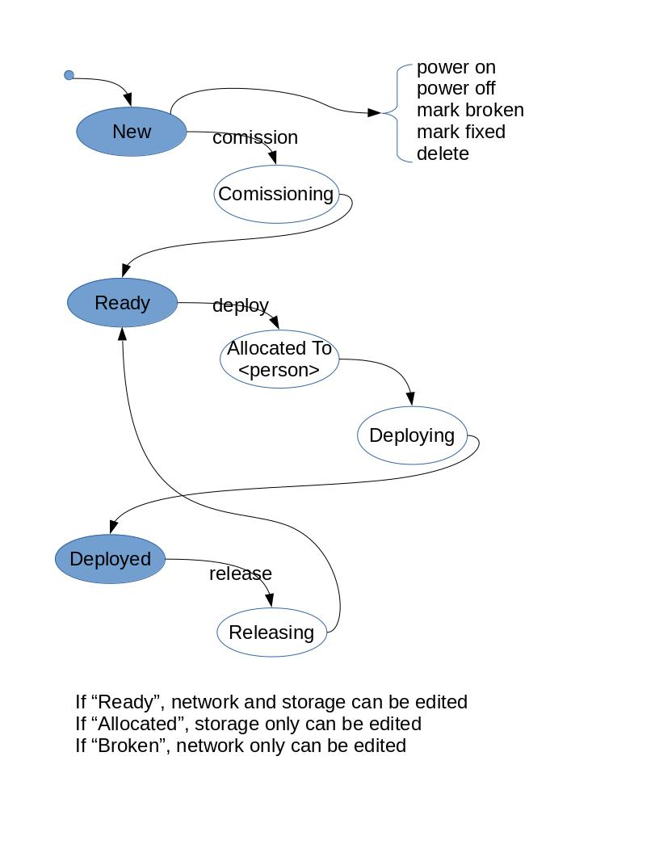
The DFA

Slide 11
“Deploy” them to their sysadmins
Set up ssh keys for yourself and the SA
Optionally change disk, IP settings
Press “Deploy”
Wait for “Deployed”
This is the fast step
Now it belongs to the SA, to ssh ubuntu@IP

Slide 12
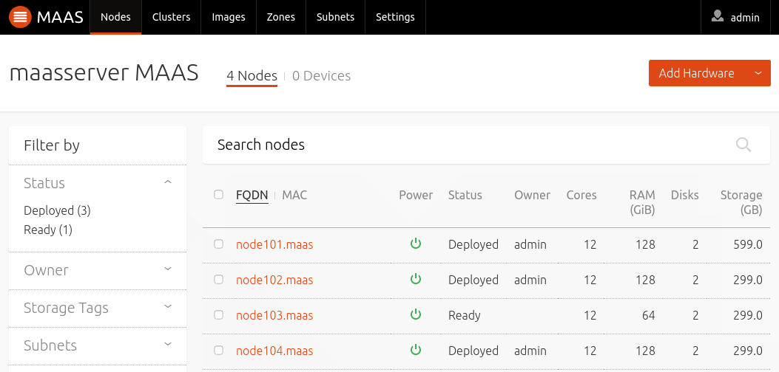
Nodes

Slide 13
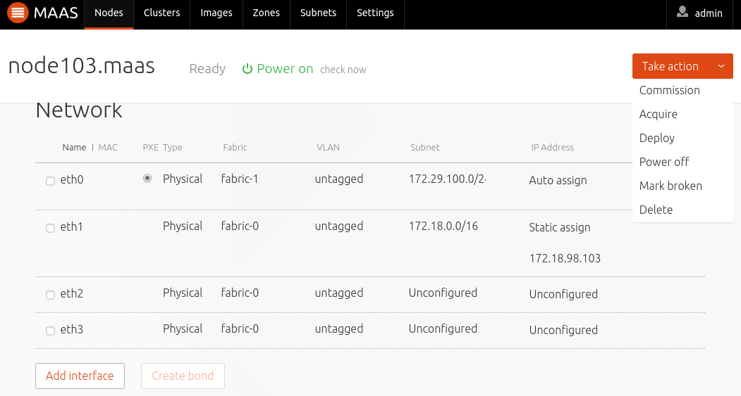
Node 103

Slide 14
A very few bugs
One is hidden on this page
  If you specify “Static Assign” it will suggest and address from the subnet and netmask you specified…
  But the address with be 172.18.0.1, which just so happens to be the router.
We actually used that address
  And wondered why the network would lock up for several minutes. Eventually it would figure out who should win the address conflict and would silently fix itself
I hate fixed-by-god!

Slide 15
A smart SA will then lock you out
Convert it to boot from disk, not DHCP
Remove your keys from the ubuntu account
Create local accounts and continue

Slide 16
If it’s ours for OpenStack
Then we’ll use an installer like juju
Or a tool like Chef
And put a whole bunch of stuff in place for the machine’s new mission.

Slide 17
“Release” (steal them back) to the pool
The MAAS administrator has
  Sudo access to root
  Control over DHCP boot
  And the ability to scrub the machine clean
This is good if we don’t make a misteaque
And handy for re-imaging totally wedged Windows boxes.

Slide 18
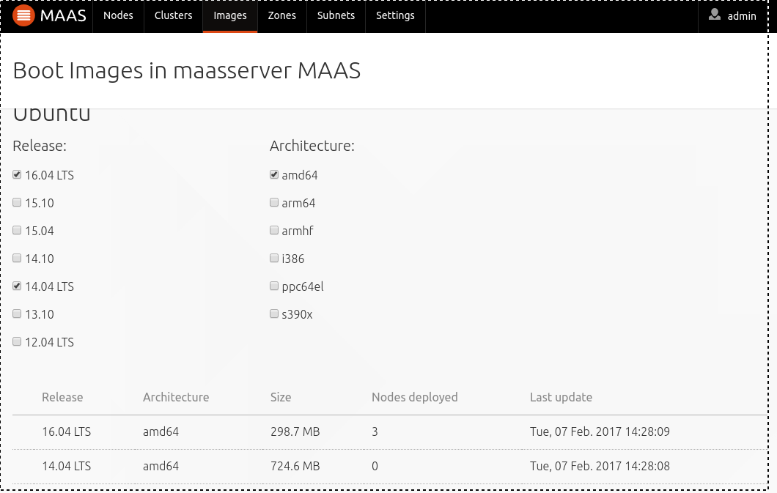
Images

Slide 19
Conclusions
For a single machine, sheer overkill
For lots of reallocation (DISA, for example) then it really is bare metal as a service. Spiffy, profit!
For making sure you have a known starting-point it’s golden.
But the tools stops here, and provisioning the stuff that goes on the machine takes another tool such as Juju, Fuel, Autopilot or a collection of Chef recipes.

