Slide 1

13 Hours of Go:
Learning a new language by writing cool stuff in it
David Collier-Brown
davecb@spamcop.net
Notes:
Yes, some of us do know Jack, but this talk isn't for them
Title stolen from the ACM Queue series of the same name, and addressed to the same audience, such as GTALUG.
They're the target market: intelligent, interested and don't know Little's law

Slide 2
The Supposed Problem
We needed to parse other people’s XML and json at work. Unfortunately,
It constantly changed
It was often <borked \>
Hidden agenda: I wanted a better language than Java or C++
  Java makes me unproductive
  C++ is a trade-off with malloc/free bugs
  Shell and Awk don’t scale that well

Slide 3
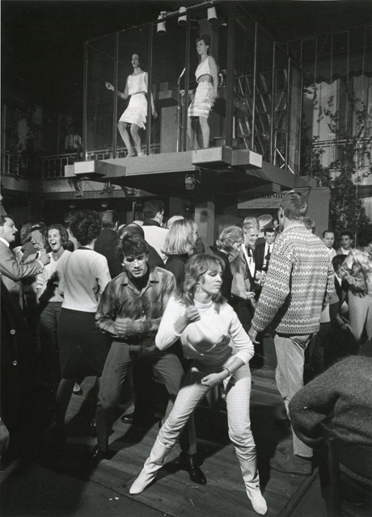
Drew said “go go”
I said “go-go dancers are so 1960s!”
He meant the language

Slide 4
OK, now how do I evaluate a language?
One way is to look for cool or elegant stuff
Another is to rewrite something you know in it
A third is to try writing something that was hard elsewhere in it

Slide 5
Look for cool or elegant stuff
An elegant lexer/parser from Rob Pike
Pipes as a built-in (from the Pike talk)
Elliotte Rusty Harold’s simplification of XML attributes as funny elements
“Explain” what to compile, from model checking

Slide 6
Another is to rewrite something
I’ve written path expressions at least two times before, in Java and C++
It’s lots bigger than “Hello, world”
It looks like
/universe/galaxy[planet=earth]/timelord

Slide 7
A third is to do something that was hard elsewhere
I had the “apptrace” in-context logger,
… which the Java folks promised but didn’t deliver before they were all laid off by Oracle

Slide 8
OK, path expressions in Go
Aimed at validating a business scheme
  We actually invalidated the hypothesis and trashed the project, saving us 6 man-months
Perhaps a test to see if we should adopt another language
  We should, but javascript people cost less, and that’s really really important
The thing I really want to know:
  Does it make me more productive?

Slide 9
Rob’s Elegant Lexer/Parser
Rob Pike has a talks about lexers, parsers and concurrency as a design tool at https://www.youtube.com/watch?v=HxaD_trXwRE
To me concurrency is either pipes (good) or monitors (hard)
To Rob, concurrency is pipes inside the program. “Communicating Sequential Processes” (Tony Hoare, circa 1978 and ignored by the incompetent thereafter)

Slide 10
Cool thing 1: a 3-line lexer
for state := lexTag; state != nil; {
state = state(lex)
}
close(lex.Pipe)
What this says is “the lexing function returns the function to use next in the lexing”
AKA, a 1-character look-ahead tells us what we need to do next

Slide 11
LexTag() lexes out XML tags
We found ‘<’, it’s maybe an xml begin tag
tokenTypeFound = token.BEGIN
// Subject to change, though
if lex.Next() == '/' {
tokenTypeFound = token.END
lex.Ignore()
Nope, it was an xml ‘</’ end tag

Slide 12
And at the end, it decides what’s next
if lex.HasPrefix(">") {
lex.Emit(tokenTypeFound, lex.Current())
lex.Next(); lex.Ignore()
return lexText // we expect text next
}
...
if lex.Next() == eof {
return nil // we expect to stop now

Slide 13
Cool thing 2, pipes
Remember I said close(lex.Pipe) ?
The lexer writes tokens into a pipe to the parser
The parser is
  isolated from the lexer,
  runs in parallel with it and
  yet communicates just like a standalone Unix program does when reading stdin.
No semaphores, no protecteds, no monitors.

Slide 14
The null parser is just a while loop
for {
Tok = ← lex.Pipe
slice = append(slice, tok)
if tok.Typ == token.EOF {
return slice // returns at EOF
}
}
← is a read command

Slide 15
This is “CSP” inside a language
Invented in 1978 by Tony Hoare
Ignored by the “concurrency should be hard” crowd
Good for concurrency, not parallel programming
Loved by Thompson and Richie
A subset in Unix since forever
This is a subset too

Slide 16
Supported by “Goroutines”
Extra-lightweight threads
As many as you’ve memory for
Can all write to a channel, just like a Unix file: writes are atomic
Therefor can do parallelism easily if there aren’t cross-dependencies
Does have shared variable, locks, etc for the hard cases with cross-dependencies (and the hard-cases who like to write them)

Slide 17
Cool thing 3, composing classes
I have two (well, almost three) lexers, which are different enough to not be subclasses of anything
But they use a common bottom-half by including it in the struct that defines them
type jLex struct { type xLex struct {
*lexer.Lexer *lexer.Lexer
} }
I also composed in a tracer, just for fun

Slide 18
Cool thing 4, “explain”
This was originally from the AI world
One asks a model checker to “explain” the steps it took to make the program fail
I ask an interpreter to explain
  The steps it took, and therefore
  What it would generate if it was a compiler

Slide 19
Explain timelords?
$ jxpath -explain /universe/galaxy[world=earth]/timelord <who.xml
explanation:
path := pathExpr.NewPath(lexer.Lex(input));
value := path.FindFirst("universe").FindSuchThat("galaxy", "world", "earth").FindFirst("timelord").TextValue()
Get an input, and optionally save it for fetching multiple values
Then get a single value, text in this case

Slide 20
Easily split into good production code
Can be split into
  Find earth
  subPath := path.FindFirst("universe").FindSuchThat("galaxy", "world", "earth")
  Find timelords and other folks there
  subPath.FindFirst(“timelord”).TextValue()
  subPath.FindFirst(“Ford Prefect”).TextValue()

Slide 21
Recreating things: in-context tracing
We did this in c as part of apptrace(1)
| starting with world:”earth",timelord:"who"...
| | begin lexer.(*Lexer).SkipOver()
| | | skipped whitespace ' '
| | end lexer.(*Lexer).SkipOver
| | begin lexer.(*Lexer).AcceptQstring()
| | | starting with "earth",timelord:"who"...
| | | returning "earth"
| | end lexer.(*Lexer).AcceptQstring
| | begin lexer.(*Lexer).Pop()

Slide 22
This is a class with three members
Begin
Print
Printf
Begin does the begin and end processing
  Via defer, which runs one chunk of code now, and another at the return from the function
  Think of “finally”, but not just for error-handling

Slide 23
Defined by an interface ...
Which allows me to detect writing to /dev/null and “optimize” the code
type FakeTrace struct {}
func (* FakeTrace) Begin(args ...interface{}) func() {
return func() {}
}
func (t FakeTrace) Printf(format string, v ...interface{}) {
}

Slide 24
Live demo
Goes here...

Slide 25
What’s Next?
In-line performance measurement function for servers
Rather simple interface
  request(nBytes)
  response(nBytes)
Returns the full data set from my performance talks
  Latency
  Transfer time
  Think time between requests
  TPS and BPS

Slide 26
But how’s the language, Dave?
“Not half bad”, as the English say
  Not perfect (I dislike closures and captured variables)
Way less academic experimentation
  But some more major capabilities still need to be doped out
More for professionals writing servers
  I’m more productive than in Java or C++
  That’s huge, as I want to do a start-up

