Slide 1

CUSTOMER SEGMENTATION
Conclusion
In closing
Workflow
Content
Problem

Slide 2
Problem Statement
A machine learning model determining the Customer Segmentation or classifying customers in different levels and to Explore the general distribution of the data to get a sense of Male vs. Female customers and how their income, age, and spending scores are similar or different followed by which gender has a higher income and which gender has a higher average spending score.
Conclusion
In closing
Content
Workflow
Problem

Slide 3


Insights
Challenges
Conclusion
Classified Data
UnSupervised method
Predict the clusters of customers.
Finding the optimal number of clusters.
Workflow
Content
In closing
Problem

Slide 4

Content
In closing
Conclusion
Workflow
Problem
PreProcessing
Model Building
Testing
Read data sets
Visualization
Checking NA’s
Splitting column data and factorizing them.
K Means Clustering
Prediction with models

Slide 5
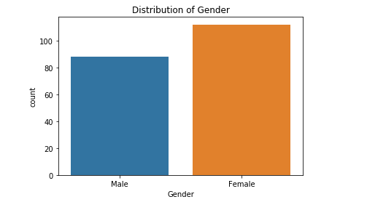
Barplot on Gender:-

Slide 6
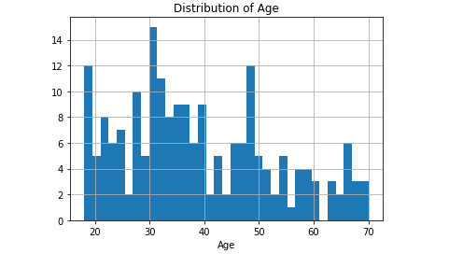
Barplot on Distribution of Age:-

Slide 7
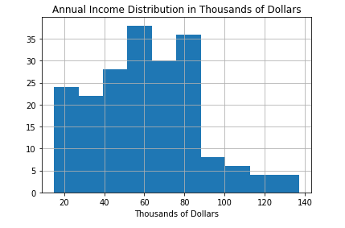
Barplot on Income Distributions

Slide 8
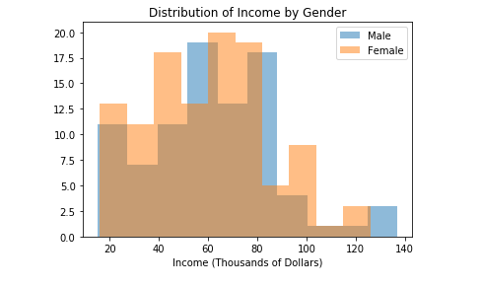
Barplot on Income Distribution by Gender

Slide 9
Conclusion
1. There are 5 rough clusters obtained by the data
Low income, low spending score
Low income, high spending score
Mid income, medium spending score
High income, low spending score
High income, high spending score
2. Based on these data, the following hypotheses could be tested:
Marketing cheaper items to women to see if they purchase more frequently or
more volume.
Marketing more to younger women because their spending score tends to be
higher.
Thinking up new ways to target advertising, pricing, branding, etc. to the older
women (older than early 40s) who have lower spending scores.
Figure out a way to gather more data to build a data set that has more features.
The more features, the better understanding of what determines Spending Score.
Once Spending Score is better understood, we can understand what factors will
lead to increasing Spending Score, thus lead to greater profits.
In closing
Content
Workflow
Conclusion
Problem

Slide 10

Conclusion
In closing
Content
Workflow
Problem

